Slide 1
Control Signals to the Data Path
Exercise 02
R3=|R1-R2|

Slide 2
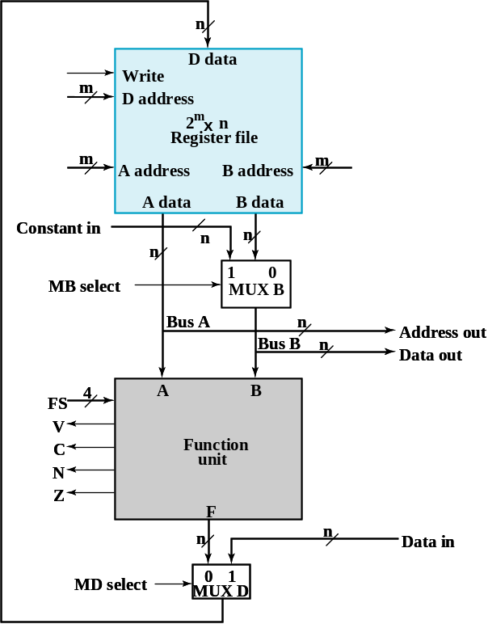
Problem Description
to compute R3=|R1-R2|
Assume: R0=0 at initial
You have to use the CPU data path
control unit
you designed

Slide 3

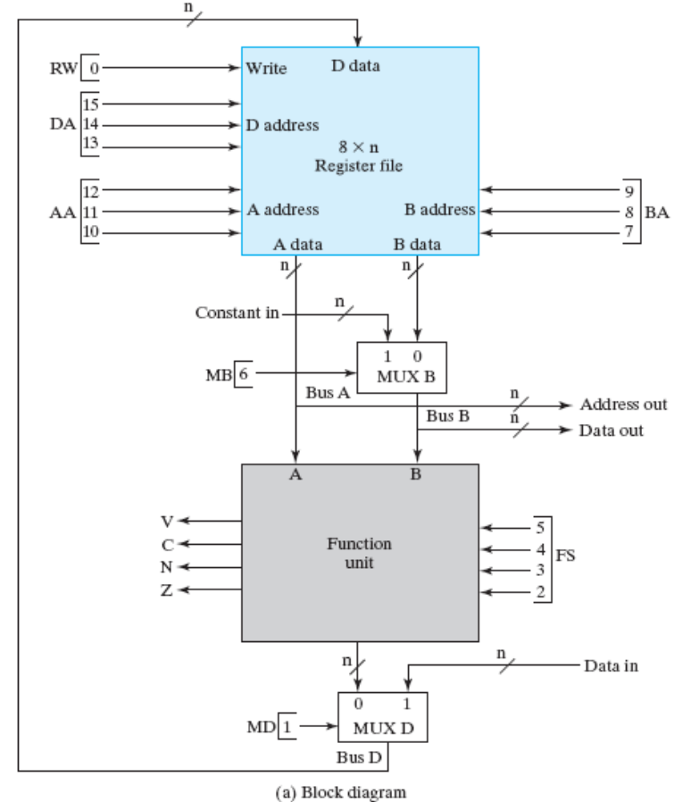

State-diagram of the control
S0
do nothing
start
S1
R3=R1-R2
S2
read R3
N
S3
R3=R0-R3

Slide 4
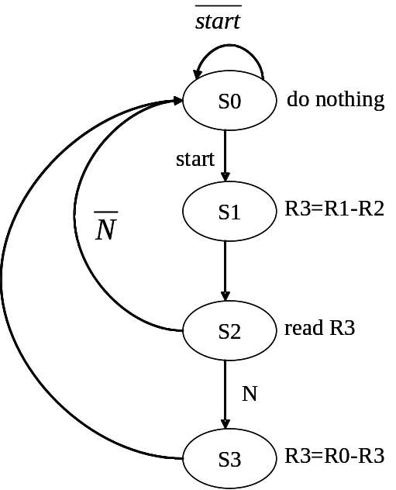

Write-down the control signals for each state
xxx
xxx
xxx
x
xxxx
x
0

Slide 5
Write-down the control signals for each state
011
001
010
0
0101
0
1

Slide 6
Write-down the control signals for each state
xxx
011
xxx
x
0000
x
0

Slide 7
Write-down the control signals for each state
011
000
011
0
0101
0
1

