Slide 1
Processor Data Path Design
Lecture 09

Slide 2
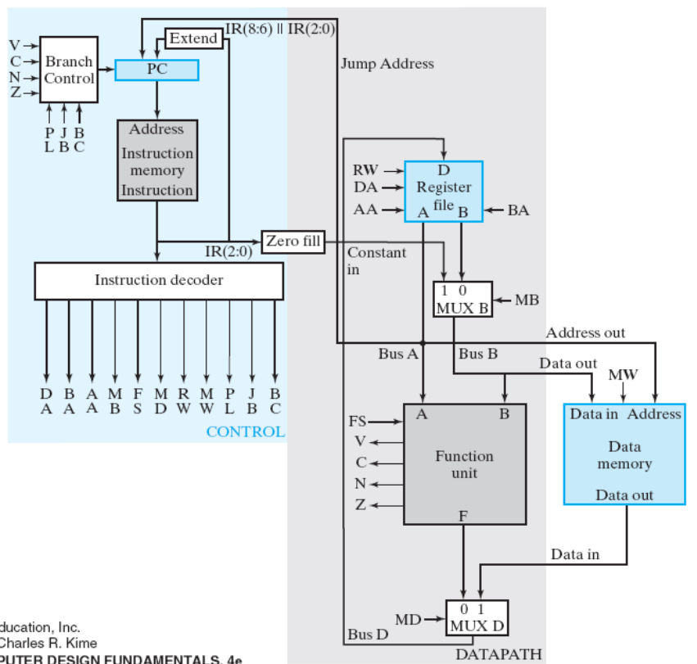
Today’s Goal
guide you to design the data path of a processor
Figure 9-15: single-cycle CPU

Slide 3
Generic CPU data path

Slide 4
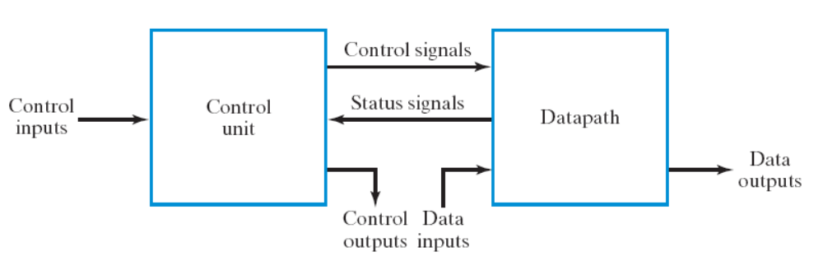
Recall: RTL design also applied for CPU
Step 0: define the “assembly instructions” of the CPU
Step 1: starts from the general framework
Step 2: specify the behavior of each part
  control unit: state-diagram
  data path: micro-operation
Step 3: design circuits from behavior specification
  control unit: state-diagram to circuit (Chapter 5)
  data path: micro-operation to circuit (Sec. 7.3 – 7.6)
Just apply the general
RTL design method!

Slide 5
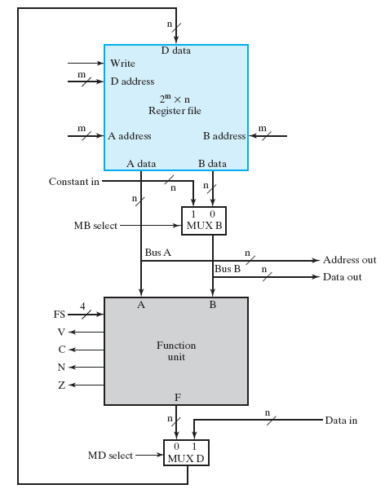
What is a CPU data path for?
a generic hardware to do any arithmetic operations
CPU data path
R=|A-B|+(C-D)
design a
custom control
control
unit
control signals

Slide 6
Generic CPU data path

Slide 7
Generic CPU data path
register file
  the internal storage (memory) within a CPU
  contains a set of registers R0, R1, R2, …
  totally 8 registers in this sample design

Slide 8
Generic CPU data path
function unit
  to perform arithmetic operations
  Example: add, subtraction, logical AND/OR/NOT,etc
  any C/C++ operators
    +, -, *, /, %
    &, |, ~, ^
    <<, >>

Slide 9
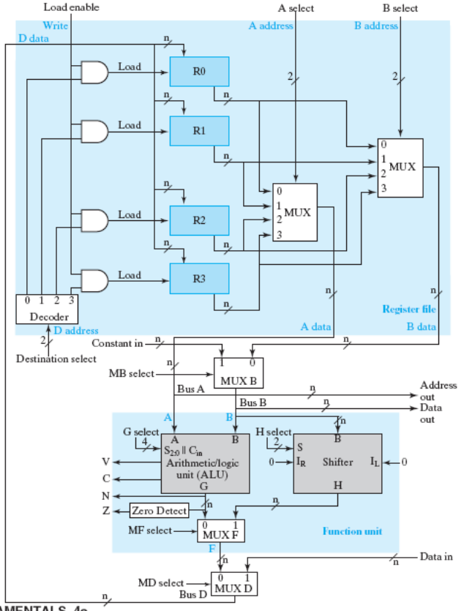
Generic CPU data path
in our CPU design example
Figure 9-1

Slide 10
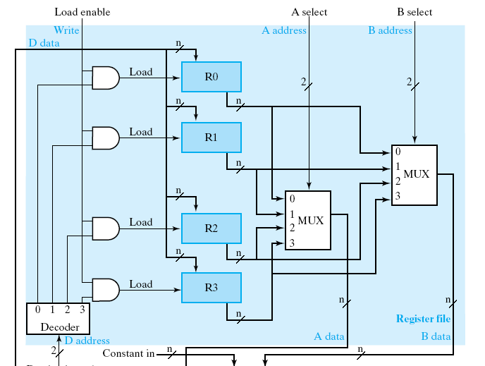
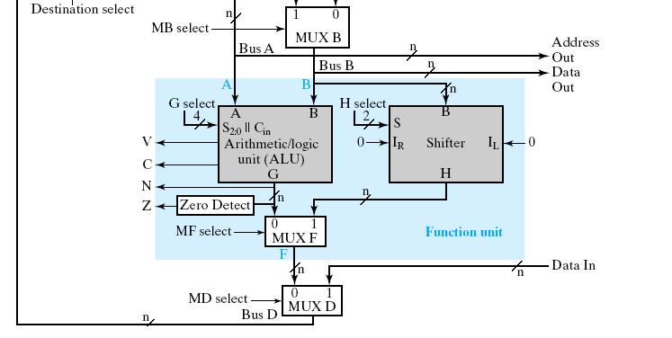
How a CPU works?
from hardware design perspective
the data path:

Slide 11
How a CPU works?
registers to store variables
registers

Slide 12
How a CPU works?
function units to perform computation
function units

Slide 13
How a CPU works?
still follows von Neumann model
A = B+C;
memory
A
B
load R1, B; //R1 = mem[B];
load R2, C; //R2 = mem[C];
add R3, R1, R2; //R3 = R1+R2;
store A, R3; //mem[A] = R3;
C

Slide 14
How a CPU works?
still follows von Neumann model
A = B+C;
memory
A
B
load R1, B; //R1 = mem[B];
load R2, C; //R2 = mem[C];
add R3, R1, R2; //R3 = R1+R2;
store A, R3; //mem[A] = R3;
C

Slide 15
How a CPU works?
still follows von Neumann model
A = B+C;
memory
A
B
load R1, B; //R1 = mem[B];
load R2, C; //R2 = mem[C];
add R3, R1, R2; //R3 = R1+R2;
store A, R3; //mem[A] = R3;
C

Slide 16
How a CPU works?
still follows von Neumann model
A = B+C;
memory
A
B
load R1, B; //R1 = mem[B];
load R2, C; //R2 = mem[C];
add R3, R1, R2; //R3 = R1+R2;
store A, R3; //mem[A] = R3;
C

Slide 17
How a CPU works?
still follows von Neumann model
A = B+C;
memory
A
B
load R1, B; //R1 = mem[B];
load R2, C; //R2 = mem[C];
add R3, R1, R2; //R3 = R1+R2;
store A, R3; //mem[A] = R3;
C

Slide 18
Outline of the detailed design
Part 1: function unit
Part 2: the register file

Slide 19
CPU function unit design
Part A

Slide 20
The design spec
Primary computation data
  two n-bit inputs A and B
  one n-bit output F
  doing operations F = A op B
operation controlled by 4-bit control signal FS
flag output {V,C,N,Z}

Slide 21
The design spec
Primary computation data
  two n-bit inputs A and B
  one n-bit output F
  doing operations F = A op B
operation controlled by 4-bit control signal FS
flag output {V,C,N,Z}

Slide 22
The design spec
Primary computation data
  two n-bit inputs A and B
  one n-bit output F
  doing operations F = A op B
operation controlled by 4-bit control signal FS
flag output {V,C,N,Z}

Slide 23
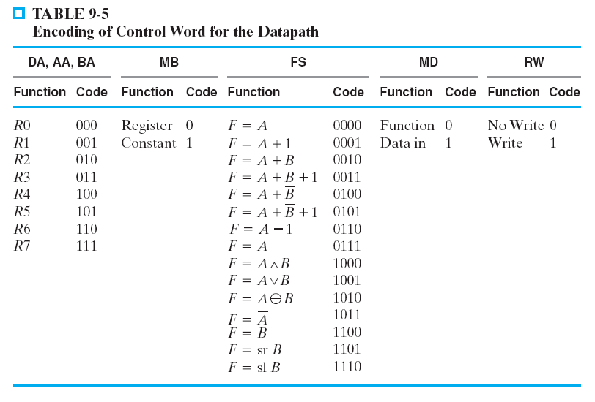
The design spec
operation controlled by 4-bit control signal FS
  to do F= A op B

Slide 24
The design spec
operation controlled by 4-bit control signal FS
  to do F= A op B
0010
F=A+B

Slide 25
The design spec
Primary computation data
  two n-bit inputs A and B
  one n-bit output F
  doing operations F = A op B
operation controlled by 4-bit control signal FS
flag output {V,C,N,Z}

Slide 26
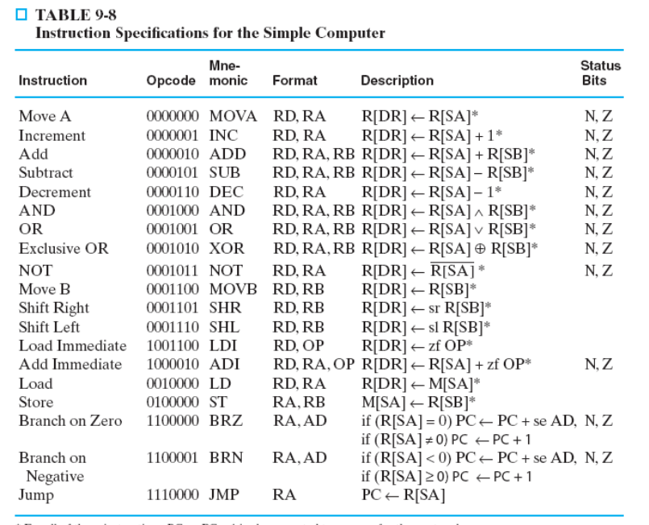
Why these operations
to realize these assembly instructions

Slide 27
Design of the Function Unit

Slide 28
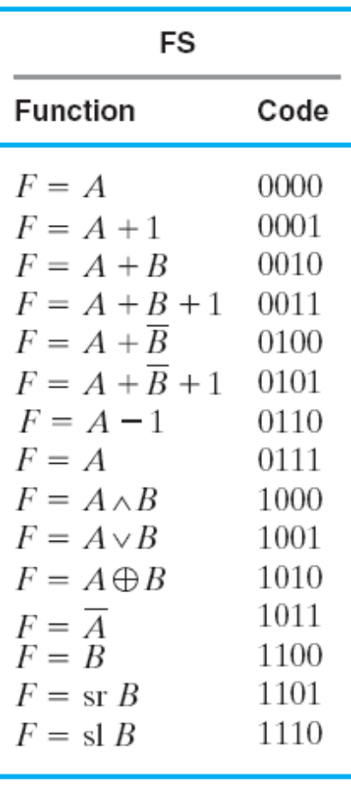
Implementation
Strategy

Slide 29
Implementation
Strategy
The ALU operations I taught you last week

Slide 30
Implementation
Strategy
new
shift 1-bit operations
F=B>>1, F=B<<1

Slide 31
The shifter design of our CPU

Slide 32
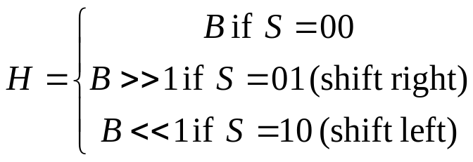
Spec of the shifter
B
n
shifter
S
2
n
H

Slide 33




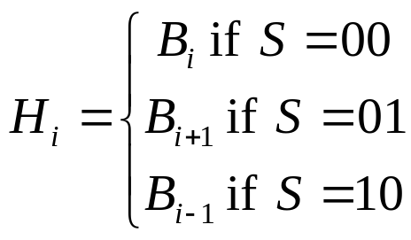
Design of the shifter
MUX
Rules for a bit i

Slide 34
Design of the shifter
MUX
Rules for a bit i

Slide 35
Design of the shifter
MUX
Rules for a bit i

Slide 36
Design of the shifter
MUX
Rules for a bit i

Slide 37
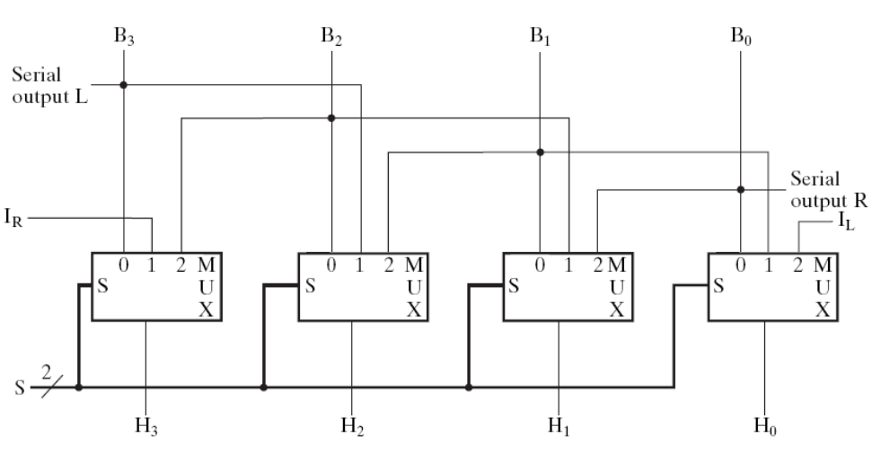
Design of the shifter
the complete circuit
Rules for a bit i
Figure 9-8

Slide 38
Verilog coding for the shifter
always @(*) begin
case (S)
2’b00: H = B;
2’b01: H = {1’b0, B[7:1]};
2’b10: H = {B[6:0], 1’b0};
2’b11: H = 8’hx;
endcase
end

Slide 39
Put it all together
integration of a function unit

Slide 40
Implementation
Strategy

Slide 41
Implementation
Strategy
MUX to select for the outcome

Slide 42
Implementation
Strategy
use ALU

Slide 43
Implementation
Strategy
use the shifter

Slide 44
How to generate the flag signals
still something left to the function unit

Slide 45



Definitions of flags
flag output {V,C,N,Z} determined by ALU output F
  V: overflow
  C: carry out of the adder in ALU
  N: negative
  Z: zero
(check F[n-1])

Slide 46
Why these flags
to realize if-then-else statements in a program

Slide 47
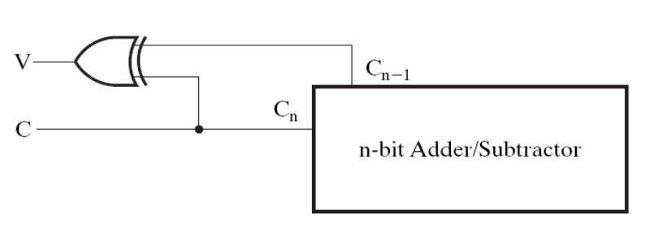
Generating the overflow flag
0
1
1
0
70
0100 0110
-70
1011 1010
+)
80
+)
0101 0000
+)
-80
+)
1011 0000
150
1001 0110
-150
0110 1010

Slide 48
Register File Design
Part B

Slide 49
The Goal
Design the register file of a CPU
function units
Figure 9-1: CPU data path

Slide 50
What is a register file

Slide 51
What is a register file
a set of registers in CPU
  Recall Chap. 7: what is a register for digital system
  Recall Chap. 7: a register with load enable
storage elements to store computing data in a CPU

Slide 52
How a CPU works?
registers to store variables
registers

Slide 53
How a CPU works?
still follows von Neumann model
A = B+C;
memory
A
B
load R1, B; //R1 = mem[B];
load R2, C; //R2 = mem[C];
add R3, R1, R2; //R3 = R1+R2;
store A, R3; //mem[A] = R3;
C

Slide 54
How a CPU works?
still follows von Neumann model
A = B+C;
memory
A
B
load R1, B; //R1 = mem[B];
load R2, C; //R2 = mem[C];
add R3, R1, R2; //R3 = R1+R2;
store A, R3; //mem[A] = R3;
C

Slide 55
How a CPU works?
still follows von Neumann model
A = B+C;
memory
A
B
load R1, B; //R1 = mem[B];
load R2, C; //R2 = mem[C];
add R3, R1, R2; //R3 = R1+R2;
store A, R3; //mem[A] = R3;
C

Slide 56
How a CPU works?
still follows von Neumann model
A = B+C;
memory
A
B
load R1, B; //R1 = mem[B];
load R2, C; //R2 = mem[C];
add R3, R1, R2; //R3 = R1+R2;
store A, R3; //mem[A] = R3;
C

Slide 57
How a CPU works?
still follows von Neumann model
A = B+C;
memory
A
B
load R1, B; //R1 = mem[B];
load R2, C; //R2 = mem[C];
add R3, R1, R2; //R3 = R1+R2;
store A, R3; //mem[A] = R3;
C

Slide 58
Spec of the register file we will design

Slide 59
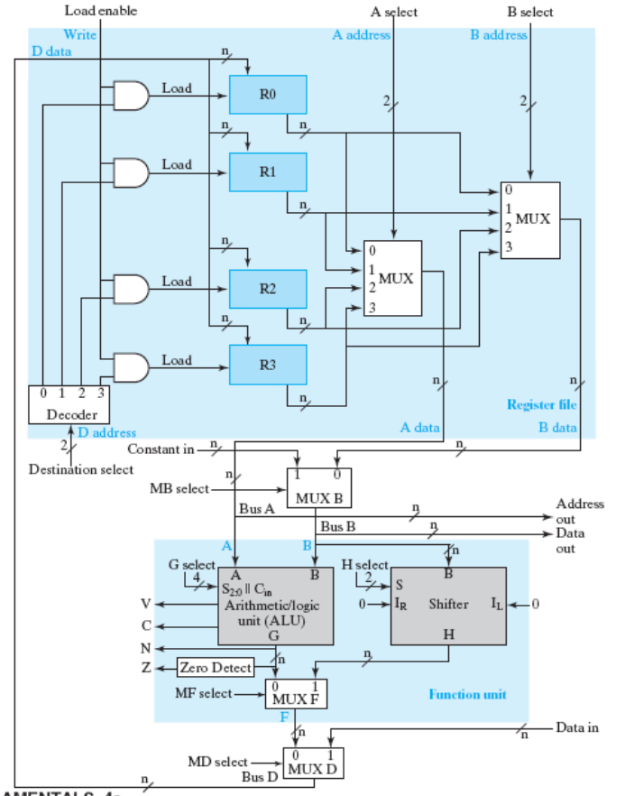
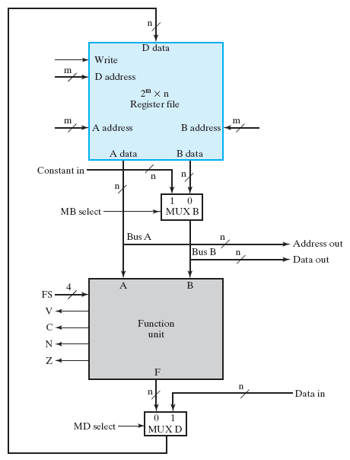
The CPU data path
Figure 9-10: Overview
Figure 9-1: Detailed View

Slide 60
Spec of the register file
read port A
read port B
two read ports A and B
a read port is a set of input/output signals
to read data stored in the register file

Slide 61
Spec of the register file
register ID
to read
a read port (A)
register data
read

Slide 62
Spec of the register file
to read value of register R1
a read port (A)
001
register data
read
value of R1 flows out here

Slide 63
Spec of the register file
to read value of register R2
010
a read port (B)
register data
read
value of R2 flows out here

Slide 64
Spec of the register file
001
010
two reads may be performed in a cycle
R2
R1

Slide 65
Spec of the register file
write port
one write port
a set of input/output signals
to write data to a register

Slide 66
Spec of the register file
write enable
signals of the write port
write occurs only when Write=1

Slide 67
Spec of the register file
data to write to
a register
register ID
to write
specify which register to write
and the data to be written

Slide 68
Spec of the register file
12
1
R3=12
011
Example of a write
I want to write R3
time
clock
Write
1
D address
011 (3)
D data
12
R3
x
12

Slide 69
Design of the register file

Slide 70
Detailed design of register file
registers with load enable
(recall Chap. 7)

Slide 71
Detailed design of register file
MUXs to implement read ports

Slide 72
Detailed design of register file
001 to select R1
read R1 from port A

Slide 73
Detailed design of register file
write port implementation

Slide 74
Detailed design of register file
1 to write enable
to write to R1
001 to write R1

Slide 75
Detailed design of register file
1 to write enable
to write to R1
Q: why other registers won’t be written?
data to all registers
001 to write R1

Slide 76
The complete CPU data path
Part C
put it all together

Slide 77
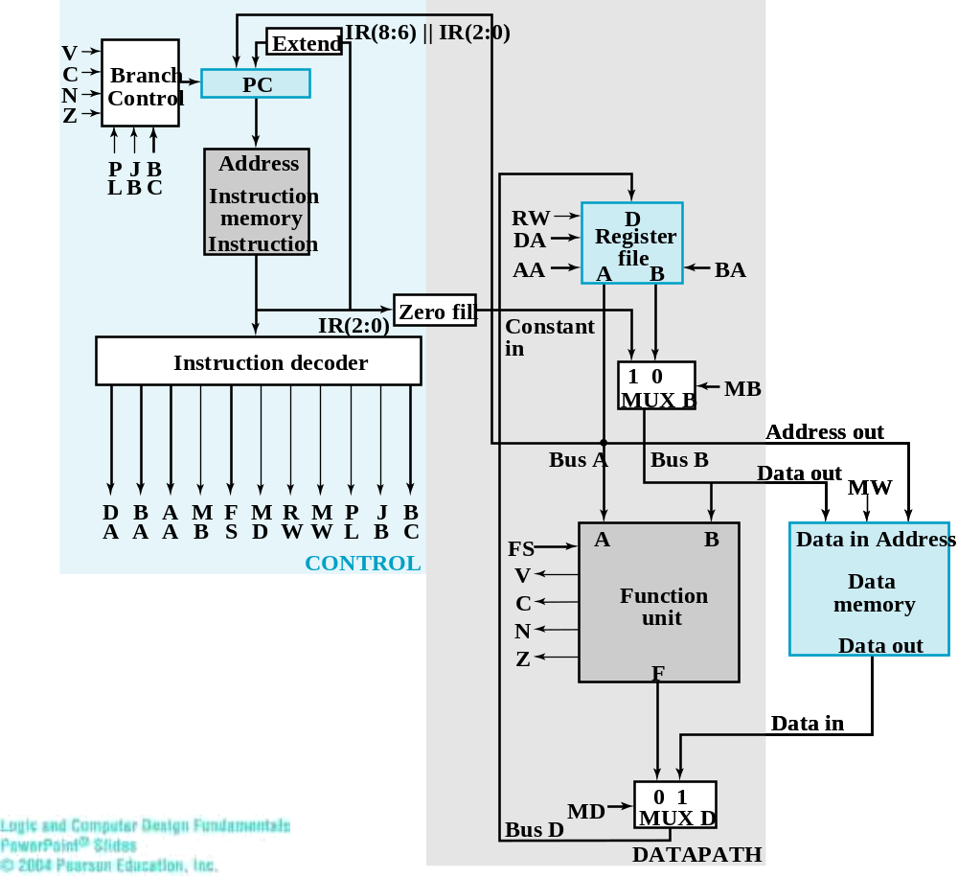
RTL design for the single-cycle CPU
Figure 9-15: the CPU

Slide 78
RTL design for the single-cycle CPU
data path
control unit
Figure 9-15: the CPU

Slide 79
RTL design for the single-cycle CPU
control signals
Figure 9-15: the CPU

Slide 80
RTL design for the single-cycle CPU
control signals
(routed to the data path)
Figure 9-15: the CPU

Slide 81

Extend
IR(8:6) || IR(2:0)
V
C
Branch
PC
N
Control
Z
P
J
B
Address
L
B
C
Instruction
memory
RW
D
instruction
(e.g. ADD R1, R2, R3)
Instruction
DA
Register
AA
A
file
B
BA
IR(2:0)
Zero fill
Constant
Instruction decoder
in
1
0
MB
MUX B
Address out
Bus A
Bus B
Data out
MW
D
B
A
M
F
M
R
M
P
J
B
A
A
A
B
S
D
W
W
L
B
C
FS
A
B
Data in
Address
CONTROL
V
control signals generated
for an instruction
Function
Data
C
unit
memory
N
Data out
Z
F
Data in
MD
0
1
Bus D
MUX D
DATAPATH

Slide 82
Extend
IR(8:6) || IR(2:0)
to instruct the data path to perform
required operations for an instruction
V
C
Branch
PC
N
Control
Z
P
J
B
Address
L
B
C
Instruction
memory
RW
D
instruction
(e.g. ADD R1, R2, R3)
Instruction
DA
Register
AA
A
file
B
BA
IR(2:0)
Zero fill
Constant
Instruction decoder
in
1
0
MB
MUX B
Address out
Bus A
Bus B
Data out
MW
D
B
A
M
F
M
R
M
P
J
B
A
A
A
B
S
D
W
W
L
B
C
FS
A
B
Data in
Address
CONTROL
V
control signals generated
for an instruction
Function
Data
C
unit
memory
N
Data out
Z
F
Data in
MD
0
1
Bus D
MUX D
DATAPATH

Slide 83
RTL design for the single-cycle CPU
status signals sent back to the control unit
(for if-then-else)
Figure 9-15: the CPU

Slide 84
Example: doing R1=R2+R3

Slide 85
How to realize the instruction
ADD R1, R2, R3 //R1=R2+R3
read R1 and R2 from register file
let the function unit do F=A+B (where A=R1 and B=R2)
write the result of function unit to R3 (R3=F)

Slide 86
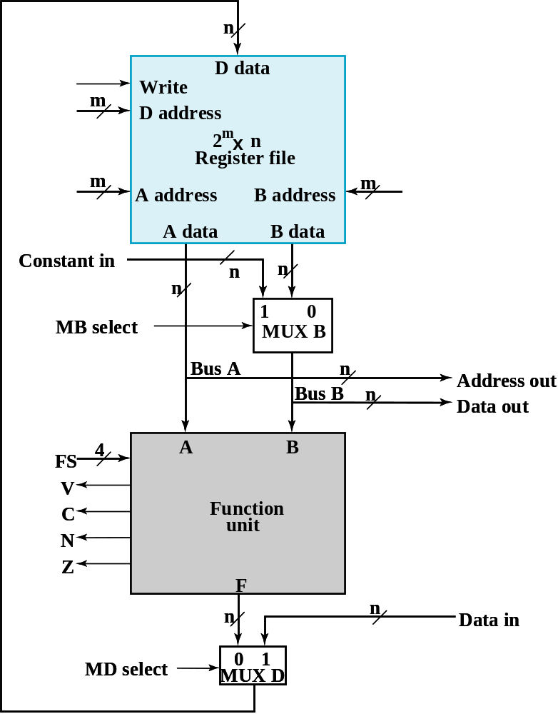
Realizing an instruction
registers R1, R2, and R3 are here
write enable
write R1
R1=R2+R3
select R2
select R3
select B
R3
R2
adder is here
do A+B
do A+B

Slide 87
Read R2 and R3 from the register file
registers R1, R2, and R3 are here
R1=R2+R3
select R2
select R3
select B
R3
R2

Slide 88
Function unit doing F=A+B
R1=R2+R3
R3
R2
adder is here
do A+B
select F

Slide 89
Function unit doing F=A+B
R1=R2+R3
R3
R2
adder is here
0010
do A+B
select F

Slide 90
Write-back: R1=F
registers R1, R2, and R3 are here
write enable
write R1
R1=R2+R3

Slide 91
Remark
registers R1, R2, and R3 are here
write enable
write R1
All these operations are done in one cycle
And the result appears at R1 on the next cycle
select R2
select R3
select B
R3
R2
adder is here
do A+B
do A+B

Slide 92
In-Class Exercise
R3=|R2-R1|

Slide 93
Problem Description
use the CPU data path to do R3=|R2-R1|
  you have to do it with multiple cycles
write down
  finite state machine for control
  value of control signals for each state
control unit
you designed

Slide 94





The finite state machine
STOP
R3 = R2-R1
if (R3<0) R3=~R3+1

Slide 95
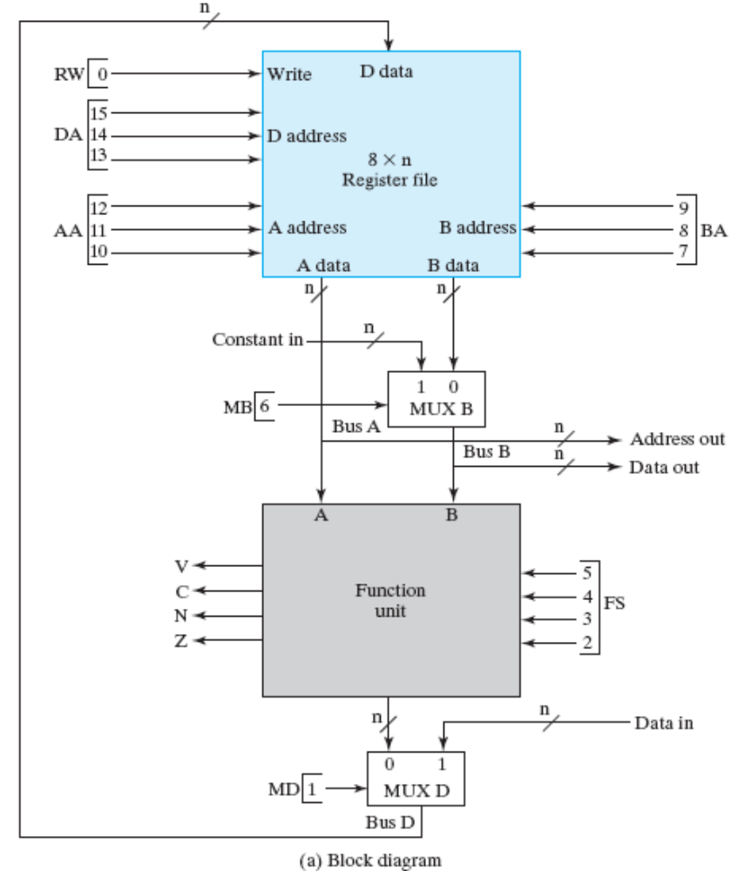
Realizing
Micro-Operations
registers R1, R2, and R3 are here
STOP
R2
R1
do F=R2-R1

Slide 96
Realizing
Micro-Operations
registers R1, R2, and R3 are here
STOP
R2
R1
do F=R2-R1
N(t)=1 if R2(t)-R1(t)<0

Slide 97
Realizing
Micro-Operations
registers R1, R2, and R3 are here
STOP
R2
R1
do F=R2-R1
transition if R2-R1<0
N(t)=1 if R2(t)-R1(t)<0

Slide 98
Realizing
Micro-Operations
registers R1, R2, and R3 are here
transition if R2-R1>=0
STOP
R2
R1
do F=R2-R1
N(t)=1 if R2(t)-R1(t)<0

Slide 99

Control signals
STOP
read R2
read R1
R2
R1
select Bdata
010
001
0

Slide 100
Control signals
STOP
R2
R1
do A-B
select F
010
001
0
0101
0

Slide 101
Control signals
enable
write R3
STOP
R2
R1
011
010
001
0
0101
0
1

Slide 102
Control signals for R3=R2-R1
STOP
011
010
001
0
0101
0
1

Slide 103
Control signals for all states
STOP
XXX
XXX
XXX
X
XXXX
X
0
011
010
001
0
0101
0
1
011
011
XXX
0
1011
0
1
011
011
XXX
0
0001
0
1

