Slide 1
Assembly Programming
Lecture 10
to define the instruction set of our sample CPU

Slide 2
Announce: about the final term
Scope: until processor data path (1/6 content)
  With a little bit of “assembly programming” covered today
  On how to implement an instruction with the data path
Focus:
  General RTL design
  Verilog coding
  Use the processor data path to realize some computation
You will have a complete course, Computer Architecture, to learn processor design at Junior year (大三)

Slide 3
Today’s Goal
What CPU you are going to implement
  the instruction set architecture
  Section 9.7

Slide 4

Extend
IR(8:6) || IR(2:0)
to instruct the data path to perform
required operations for an instruction
V
C
Branch
PC
N
Control
Z
P
J
B
Address
L
B
C
Instruction
memory
RW
D
instruction
(e.g. ADD R1, R2, R3)
Instruction
DA
Register
AA
A
file
B
BA
IR(2:0)
Zero fill
Constant
Instruction decoder
in
1
0
MB
MUX B
Address out
Bus A
Bus B
Data out
MW
D
B
A
M
F
M
R
M
P
J
B
A
A
A
B
S
D
W
W
L
B
C
FS
A
B
Data in
Address
CONTROL
V
control signals generated
for an instruction
Function
Data
C
unit
memory
N
Data out
Z
F
Data in
MD
0
1
Bus D
MUX D
DATAPATH

Slide 5
How a CPU realize a high-level language program?

Slide 6
The Von Neumann Model
memory
D = A+B*C;
E = D+F;
A = A-1;
A
10
CPU
B
20
C
30
D
40
PC: program counter
E
50
F
60

Slide 7
The Von Neumann Model
memory
PC
D = A+B*C;
E = D+F;
A = A-1;
A
10
CPU
B
20
C
30
D
610
PC: program counter
E
50
F
60

Slide 8
The Von Neumann Model
memory
D = A+B*C;
E = D+F;
A = A-1;
PC
A
10
CPU
B
20
C
30
D
610
PC: program counter
E
670
F
60

Slide 9
The Von Neumann Model
memory
D = A+B*C;
E = D+F;
A = A-1;
A
9
PC
CPU
B
20
C
30
D
610
PC: program counter
E
670
F
60

Slide 10
How a CPU works?
follow the von Neumann model
  step by step
  one instruction per step
but decompose operations into primitive and regular ones
assembly program
load R1, A; //R1 = mem[A];
load R2, B; //R2 = mem[B];
load R3, C; //R3 = mem[C];
mult R4, R2, R3; //R4=R2*R3;
add R5, R1, R4; //R5=R1+R4;
store D, R5; //mem[D] = R5;
load R6, F; //R6 = mem[D];
add R7, R5, R6; //R7 = R5+R6;
store E, R7; //mem[E] = R7;
sub R1, R1, 1; //R1 = R1-1;
store A, R1; //mem[A] = R1;
D = A+B*C;
E = D+F;
A = A-1;

Slide 11
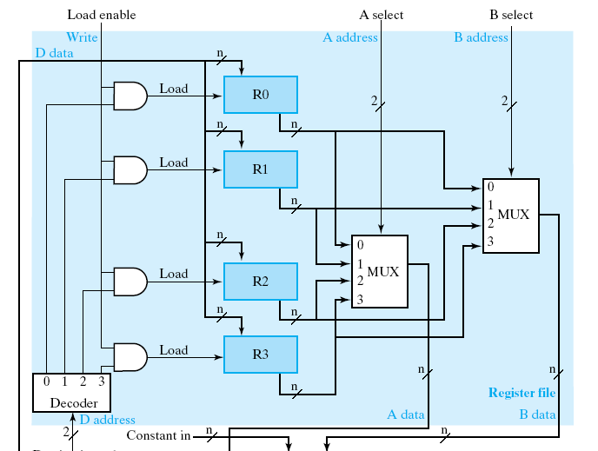
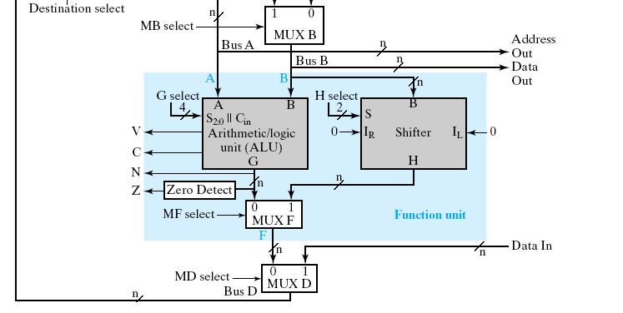
How a CPU works?
from hardware design perspective
the data path:

Slide 12
How a CPU works?
registers to store variables
registers

Slide 13
How a CPU works?
function units to perform computation
function units

Slide 14
How a CPU works?
still follows von Neumann model
A = B+C;
memory
A
B
load R1, B; //R1 = mem[B];
load R2, C; //R2 = mem[C];
add R3, R1, R2; //R3 = R1+R2;
store A, R3; //mem[A] = R3;
C

Slide 15
How a CPU works?
still follows von Neumann model
A = B+C;
memory
A
B
load R1, B; //R1 = mem[B];
load R2, C; //R2 = mem[C];
add R3, R1, R2; //R3 = R1+R2;
store A, R3; //mem[A] = R3;
C

Slide 16
How a CPU works?
still follows von Neumann model
A = B+C;
memory
A
B
load R1, B; //R1 = mem[B];
load R2, C; //R2 = mem[C];
add R3, R1, R2; //R3 = R1+R2;
store A, R3; //mem[A] = R3;
C

Slide 17
How a CPU works?
still follows von Neumann model
A = B+C;
memory
A
B
load R1, B; //R1 = mem[B];
load R2, C; //R2 = mem[C];
add R3, R1, R2; //R3 = R1+R2;
store A, R3; //mem[A] = R3;
C

Slide 18
How a CPU works?
still follows von Neumann model
A = B+C;
memory
A
B
load R1, B; //R1 = mem[B];
load R2, C; //R2 = mem[C];
add R3, R1, R2; //R3 = R1+R2;
store A, R3; //mem[A] = R3;
C

Slide 19
The assembly program to realize a C sample code
assembly program
load R1, A; //R1 = mem[A];
load R2, B; //R2 = mem[B];
load R3, C; //R3 = mem[C];
mult R4, R2, R3; //R4=R2*R3;
add R5, R1, R4; //R5=R1+R4;
store D, R5; //mem[D] = R5;
load R6, F; //R6 = mem[D];
add R7, R5, R6; //R7 = R5+R6;
store E, R7; //mem[E] = R7;
sub R1, R1, 1; //R1 = R1-1;
store A, R1; //mem[A] = R1;
D = A+B*C;
E = D+F;
A = A-1;

Slide 20
The assembly program to realize a C sample code
assembly program
load R1, A; //R1 = mem[A];
load R2, B; //R2 = mem[B];
load R3, C; //R3 = mem[C];
mult R4, R2, R3; //R4=R2*R3;
add R5, R1, R4; //R5=R1+R4;
store D, R5; //mem[D] = R5;
load R6, F; //R6 = mem[D];
add R7, R5, R6; //R7 = R5+R6;
store E, R7; //mem[E] = R7;
sub R1, R1, 1; //R1 = R1-1;
store A, R1; //mem[A] = R1;
D = A+B*C;
E = D+F;
A = A-1;

Slide 21
The assembly program to realize a C sample code
assembly program
load R1, A; //R1 = mem[A];
load R2, B; //R2 = mem[B];
load R3, C; //R3 = mem[C];
mult R4, R2, R3; //R4=R2*R3;
add R5, R1, R4; //R5=R1+R4;
store D, R5; //mem[D] = R5;
load R6, F; //R6 = mem[D];
add R7, R5, R6; //R7 = R5+R6;
store E, R7; //mem[E] = R7;
sub R1, R1, 1; //R1 = R1-1;
store A, R1; //mem[A] = R1;
D = A+B*C;
E = D+F;
A = A-1;

Slide 22
The assembly program to realize a C sample code
assembly program
load R1, A; //R1 = mem[A];
load R2, B; //R2 = mem[B];
load R3, C; //R3 = mem[C];
mult R4, R2, R3; //R4=R2*R3;
add R5, R1, R4; //R5=R1+R4;
store D, R5; //mem[D] = R5;
load R6, F; //R6 = mem[D];
add R7, R5, R6; //R7 = R5+R6;
store E, R7; //mem[E] = R7;
sub R1, R1, 1; //R1 = R1-1;
store A, R1; //mem[A] = R1;
D = A+B*C;
E = D+F;
A = A-1;

Slide 23
Binary code representation of an assembly program
machine code in memory
0100 01 0001011
load R1, B; //R1 = mem[B];
load R2, C; //R2 = mem[C];
add R3, R1, R2; //R3 = R1+R2;
store A, R3; //mem[A] = R3;
0100 10 0000011
0110 01 10 11 000
1100 11 0100110

Slide 24
Instruction Set Architecture
the part that a programmer should know
  registers visible by the programmer
  operations supported (+, -, *, /, etc.)
…(more will be discussed in near future)…

Slide 25
Overview of the instruction set architecture of our CPU
Q: How to realize all C programs?

Slide 26
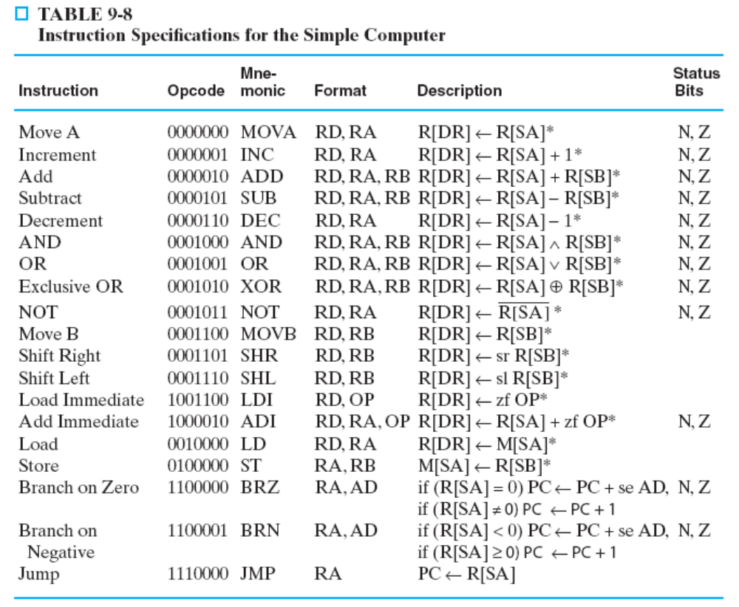
List of assembly instructions

Slide 27
List of assembly instructions
general format of an instruction
RD: destination register
RA,RB: the two source registers
semantics (meaning) of the instruction
Example:
ADD R1, R2,R3
Meaning:
R1 = R2+R3

Slide 28
Classifications on instructions
arithmetic and logic operations
  +, -, *, /, AND, OR, …, etc.
load/store instructions
  to transfer data between CPU registers and memory
control transfer
  how to realize if-then-else, for, while, goto?

Slide 29
Classifications on instructions
arithmetic and logic operations
  +, -, *, /, AND, OR, …, etc.
load/store instructions
  to transfer data between CPU registers and memory
control transfer
  how to realize if-then-else, for, while, goto?

Slide 30
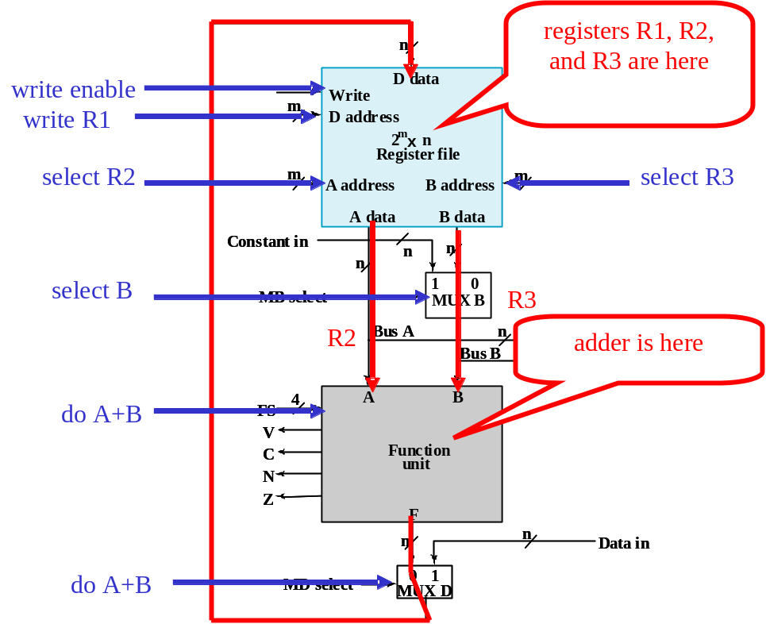
Classifications on instructions
arithmetic and logic operations
  +, -, *, /, AND, OR, …, etc.
load/store instructions
  to transfer data between CPU registers and memory
control transfer
  how to realize if-then-else, for, while, goto?
Example: ADD R1, R2,R3
  R1=R2+R3

Slide 31
Classifications on instructions
arithmetic and logic operations
  +, -, *, /, AND, OR, …, etc.
load/store instructions
  to transfer data between CPU registers and memory
control transfer
  how to realize if-then-else, for, while, goto?

Slide 32
Classifications on instructions
arithmetic and logic operations
  +, -, *, /, AND, OR, …, etc.
load/store instructions
  to transfer data between CPU registers and memory
control transfer
  how to realize if-then-else, for, while, goto?
Example: LD R1, R2
  to load memory data
  R1 = mem[R2]
Memory
0
20
1
30
CPU
…
100
15
R1
101
1000
R2
100
102
300
…
…
address

Slide 33
Classifications on instructions
arithmetic and logic operations
  +, -, *, /, AND, OR, …, etc.
load/store instructions
  to transfer data between CPU registers and memory
control transfer
  how to realize if-then-else, for, while, goto?
Example: LD R1, R2
  to load memory data
  R1 = mem[R2]
Memory
0
20
1
30
CPU
…
100
15
R1
15
101
1000
R2
100
102
300
…
…
address

Slide 34
Classifications on instructions
arithmetic and logic operations
  +, -, *, /, AND, OR, …, etc.
load/store instructions
  to transfer data between CPU registers and memory
control transfer
  how to realize if-then-else, for, while, goto?
Example: LD R1, R2
  to load memory data
  R1 = mem[R2]
Memory
0
20
1
30
CPU
…
100
15
R1
15
101
1000
R2
100
102
300
…
…
address

Slide 35
Classifications on instructions
arithmetic and logic operations
  +, -, *, /, AND, OR, …, etc.
load/store instructions
  to transfer data between CPU registers and memory
control transfer
  how to realize if-then-else, for, while, goto?
Example: ST R2, R1
  to store memory data
  mem[R2] = R1
Memory
0
20
1
30
CPU
…
100
15
R1
40
101
1000
R2
100
102
300
…
…
address

Slide 36
Classifications on instructions
arithmetic and logic operations
  +, -, *, /, AND, OR, …, etc.
load/store instructions
  to transfer data between CPU registers and memory
control transfer
  how to realize if-then-else, for, while, goto?
Example: ST R2, R1
  to store memory data
  mem[R2] = R1
Memory
0
20
1
30
CPU
…
100
40
R1
40
101
1000
R2
100
102
300
…
…
address

Slide 37
Classifications on instructions
arithmetic and logic operations
  +, -, *, /, AND, OR, …, etc.
load/store instructions
  to transfer data between CPU registers and memory
control transfer
  how to realize if-then-else, for, while, goto?

Slide 38
Jump (Branch) instruction
…
Jump my_loc
…
my_loc:
load R1, A;
load R2, B;
add R3, R1, R2;
store C, R3;
…
goto my_loc;
…
my_loc:
C = A+B;

Slide 39
Jump instruction in our CPU
arithmetic and logic operations
  +, -, *, /, AND, OR, …, etc.
load/store instructions
  to transfer data between CPU registers and memory
control transfer
  how to realize if-then-else, for, while, goto?
LDI R1, 100 //R1=100
Jump R1 //goto address pointed by R1
//goto address 100

Slide 40
Realizing if-then-else: Conditional Branch
arithmetic and logic operations
  +, -, *, /, AND, OR, …, etc.
load/store instructions
  to transfer data between CPU registers and memory
control transfer
  how to realize if-then-else, for, while, goto?

Slide 41
Realizing if-then-else
conditional branch (conditional jump)
BRZ: branch on zero
  Example: BRZ R1, label
  if (R1==0) goto label
BRN: branch on negative
  Example: BRN R1, label
  if (R1<0) goto label

Slide 42
Realizing if-then-else
if (a>=b) {
d = e+f;
}
else {
d = e-f;
}
m=m+1;
SUB R0, R1, R2; //R0 = R1-R2; (R0=a-b)
BRN R0, else_part //goto else_part if R0<0
ADD R3, R4, R5; //d=e+f
JUMP out_side;
else_part:
SUB R3, R4, R5; //d=e-f
out_side:
ADD R6, R6, 1 //m=m+1
if (a-b<0) goto else_part;
d = e+f;
goto out_side;
else_part:
d = e-f;
out_side:
m = m+1;

Slide 43
Exercises
Show how the data path realizes the load/store instructions (write down control signal values)
  LD R1, R2 //R1=mem[R2]
  ST R2, R1 //mem[R2] = R1
Write an assembly program to compute R3=|R1-R2|
  translate the following C-code to the assembly of our CPU
R3 = R1-R2;
if (R3<0) goto inverse;
goto exit;
inverse:
R3 = ~R3;
R3 = R3+1;
exit:
….
R3 = R1-R2;
if (R3<0) {
R3 = ~R3;
R3 = R3+1;
}

Slide 44
Realizing memory load instruction
LD R1, R2 //R1=mem[R2]

Slide 45
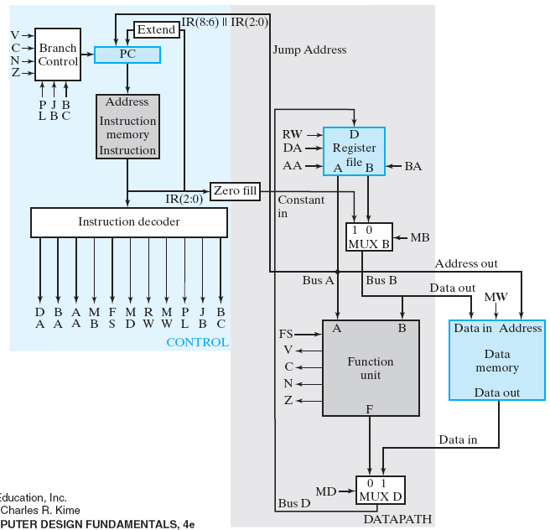
Data path to realize a memory load
address
data memory is here!
data read from memory

Slide 46
What is memory
a chip storing an array
  address: the index to the array
  data: content of elements of the array
0
100
1
20
2
50
MW
…
address
n
50
18
write_data
51
77
n
read_data
52
64
n
…
address
127
0

Slide 47
What is memory
a chip storing an array
  address: the index to the array
  data: content of elements of the array
0
100
to distinguish read/write
1
20
2
50
MW
…
address
n
50
18
write_data
51
77
n
read_data
52
64
n
…
address
127
0

Slide 48
What is memory
Read from memory
  the “load” instruction
0
100
1
20
2
50
0
MW
…
address
51
n
50
18
write_data
51
77
n
read_data
52
64
77
n
…
address
127
0

Slide 49
What is memory
write to memory
  the “store” (ST) instruction
0
100
1
20
2
50
1
MW
…
52
address
n
50
18
write_data
300
51
77
n
52
64
read_data
300
n
…
address
127
0

Slide 50

How to realize LD R1, R2
(R1=mem[R2])
write to R1
001
010
XXX
X
XXXX
1
1
MW=0
R2
data read from memory (mem[R2])

Slide 51
How to realize ST R2, R1
(mem[R2]=R1)
XXX
010
001
0
XXXX
X
0
MW=1
R1
R2

Slide 52
Exercises
Write an assembly program to compute R3=|R1-R2|
  translate the following C-code to the assembly of our CPU
R3 = R1-R2;
if (R3<0) goto inverse;
goto exit;
inverse:
R3 = ~R3;
R3 = R3+1;
exit:
….
XOR R0, R0, R0 //R0=0
SUB R3, R1, R2
BRN R3, 2 //if(R3<0) goto PC+2 (inverse)
BRZ R0, 3 //if(R0==0) goto PC+3(exit)
NOT R3, R3
ADI R3, R3, 1
…
R3 = R1-R2;
if (R3<0) {
R3 = ~R3;
R3 = R3+1;
}

Slide 53
The binary code format

Slide 54
Binary code representation of an assembly program
machine code in memory
0100 01 0001011
load R1, B; //R1 = mem[B];
load R2, C; //R2 = mem[C];
add R3, R1, R2; //R3 = R1+R2;
store A, R3; //mem[A] = R3;
0100 10 0000011
0110 01 10 11 000
1100 11 0100110

Slide 55
The binary code format
15
9
8
6
5
3
2
0
Destination
Source reg-
Source reg-
Opcode
register (DR)
ister A (SA)
ister B (SB)
(a) Register
15
9
8
6
5
3
2
0
Destination
Source reg-
Opcode
register (DR)
ister A (SA)
Operand (OP)
(b) Immediate
15
9
8
6
5
3
2
0
Address (AD)
Source reg-
Address (AD)
Opcode
(Left)
ister A (SA)
(Right)
(c) Jump and Branch

Slide 56
Instruction format 1: all operands are registers
15
9
8
6
5
3
2
0
Destination
Source reg-
Source reg-
Opcode
register (DR)
ister A (SA)
ister B (SB)
(a) Register

Slide 57
Instruction format 1: all operands are registers
15
9
8
6
5
3
2
0
Destination
Source reg-
Source reg-
Opcode
register (DR)
ister A (SA)
ister B (SB)
(a) Register
This format supports instructions represented by:
  R1 ← R2 + R3
  R1 ← sl R2
There are three 3-bit register fields:
  DR - specifies destination register (R1 in the examples)
  SA - specifies the A source register (R2 in the first example)
  SB - specifies the B source register (R3 in the first example and R2 in the second example)

Slide 58
Instruction format 1: all operands are registers
Example: ADD R1, R2,R3
  R1 ← R2 + R3
15
9
8
6
5
3
2
0
0000010
Destination
Source reg-
Source reg-
Opcode
001
010
011
register (DR)
ister A (SA)
ister B (SB)
(opcode of ADD)
(R1)
(R2)
(R3)
(a) Register

Slide 59
Instruction format 2
15
9
8
6
5
3
2
0
Opcode
Destination
Source reg-
Operand (OP)
register (DR)
ister A (SA)
(b) Immediate
This format supports instructions described by: (LDI, ADI)
  R1 ← R2 + 3
The B Source Register field is replaced by an Operand field OP which specifies a constant.
The Operand:
  3-bit constant
  Values from 0 to 7
The constant:
  Zero-fill (on the left of) the Operand to form 16-bit constant
  16-bit representation for values 0 through 7

Slide 60
Instruction Format 2
Example: ADI R1, R2, 3
  R1=R2+3
15
9
8
6
5
3
2
0
1000010
Destination
Source reg-
Opcode
001
010
011
register (DR)
ister A (SA)
Operand (OP)
opcode of ADI
R1
R2
3
(b) Immediate

Slide 61
Instruction format 3
15
9
8
6
5
3
2
0
Address (AD)
Source reg-
Address (AD)
Opcode
(Left)
ister A (SA)
(Right)
(c) Jump and Branch
For BRN, BRZ, JMP instructions
This instruction supports changes in the sequence of instruction execution by adding an extended, 6-bit, signed 2s-complement address offset to the PC value
The 6-bit Address (AD) field replaces the DR and SB fields
  Example: Suppose that a jump is specified by the Opcode and the PC contains 45 (0…0101101) and Address contains – 12 (110100). Then the new PC value will be:
  0…0101101 + (1…110100) = 0…0100001 (45 + (– 12) = 33)
The SA field is retained to permit jumps and branches on N or Z based on the contents of Source register A

Slide 62
Instruction format 3
Example: JUMP R3
  goto the address indicated by register R3
15
9
8
6
5
3
2
0
1110000
Address (AD)
Source reg-
Address (AD)
Opcode
xxx
011
xxx
(Left)
ister A (SA)
(Right)
opcode of Jumo
xxx
R3
xxx
(c) Jump and Branch

Slide 63
Instruction format 3
Example: BRZ R2, 5
  goto current position+5 if R2=0
15
9
8
6
5
3
2
0
1100000
Address (AD)
Source reg-
Address (AD)
Opcode
000
011
101
(Left)
ister A (SA)
(Right)
opcode of BRZ
(c) Jump and Branch
R2
5

Slide 64
Example instructions
Memory Repr
esentation
of Instruc
t
ions and
Data
D
eciimal
Dec
i
mal
Ad
d
r
ess
Mem
o
r
y
C
ontents
Op
cod
e
Other F
elds
i
Op
eration
25
00001
01 001
010
011
5 (Subtract)
DR:1,
SA:2,
SB:3
R1
←
R2
−
R3
35
01000
00 000
100
101
32 (Store
)
S
A:4, SB:5
M[
R4]
←
R5
45
10000
10 010
111
011
66 (Add
DR:
2
, S
A
:
7
, OP
:3
R
2
←
R7
+ 3
Im
mediate)
55
11000
00 101
110
100
96 (Branch
AD:
44, SA:6
If R6 =
0,
on
Z
e
←
−
ro
)
PC
PC
20
70
000
000000110
00000
Data =
1
92. Aft
e
r execution of
instruction in
35,
Data =
8
0
.

Slide 65
Question
Why not embed the whole 16-bit address in the instruction format?
Why separate the address field?

Slide 66
In-Class Exercise (the next meeting)
Problem 1: translate a C program to assembly
  basic arithmetic +, -
  control: for, while if-then-else
Problem 2: transform assembly prgram to machine (binary) code
Problem 3: disassemble machine code to assembly program

Slide 67
Announce
Lab of this week (12/23) begins at 1:00PM
  continue your job on CPU data path

