Slide 1
Final Remarks on CPU Design
Lecture 12

Slide 2
Multi-Cycle CPU
Section 9-9

Slide 3
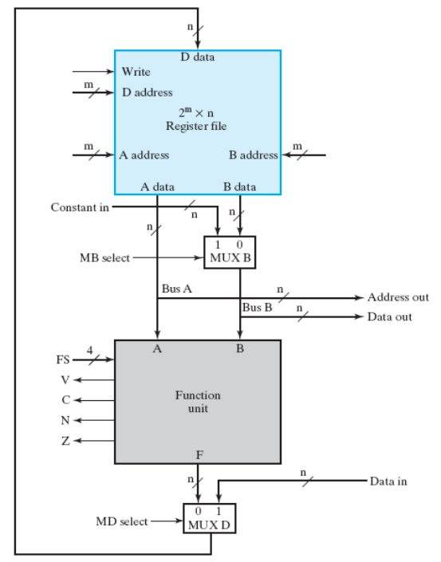
How a single-cycle CPU works
ADD R1, R2, R3 //R1=R2+R3
SUB R4, R5, R1 //R4 = R5-R1
ST R6, R4 //mem[R6] = R4
time
ADD
SUB
ST
R1
100
30
30
R2
10
10
10
R3
20
20
20
R4
0
0
170
R5
200
200
200
R6
1000
1000
1000

Slide 4
How a single-cycle CPU works
ADD R1, R2, R3 //R1=R2+R3
SUB R4, R5, R1 //R4 = R5-R1
ST R6, R4 //mem[R6] = R4
time
ADD
SUB
ST
an instruction spends only one cycle
R1
100
30
30
R2
10
10
10
control signal for ADD
R3
20
20
20
R4
0
0
170
R5
200
200
200
30
R6
1000
1000
1000

Slide 5
The fact
there is no commercial single-cycle CPU
All commercial CPUs are multi-cycle CPUs
  an instruction spends multiple cycles

Slide 6
How a multi-cycle CPU works
an instruction may spend several cycles to complete
Example:
ADD R1, R2, R3 //R1=R2+R3
SUB R4, R5, R1 //R4 = R5-R1
ST R6, R4 //mem[R6] = R4
time
ADD
SUB
ST
several cycles to execute an instruction

Slide 7
Why multi-cycle CPU
run faster
use only one memory port
to implement complex instructions

Slide 8
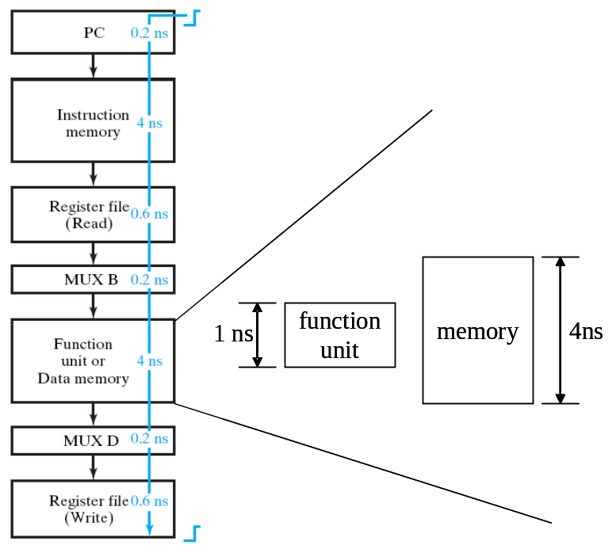
Why multi-cycle CPU
run faster
  the clock period time is too long for a single cycle CPU
  spend too much time on memory access
  not every cycle needs memory access
use only one memory port
to implement complex instructions

Slide 9
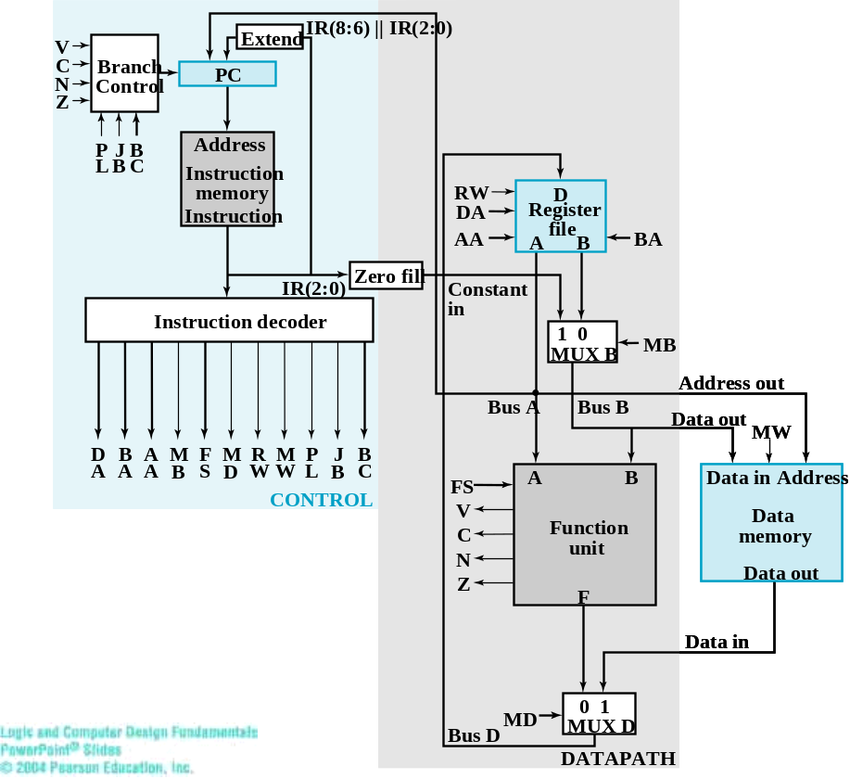
Why multi-cycle CPU
instructions and data come
from different memory
run faster
use only one memory port
  a single-cycle CPU uses two memory ports
  a multi-cycle CPU may use only one memory port
to implement complex instructions

Slide 10
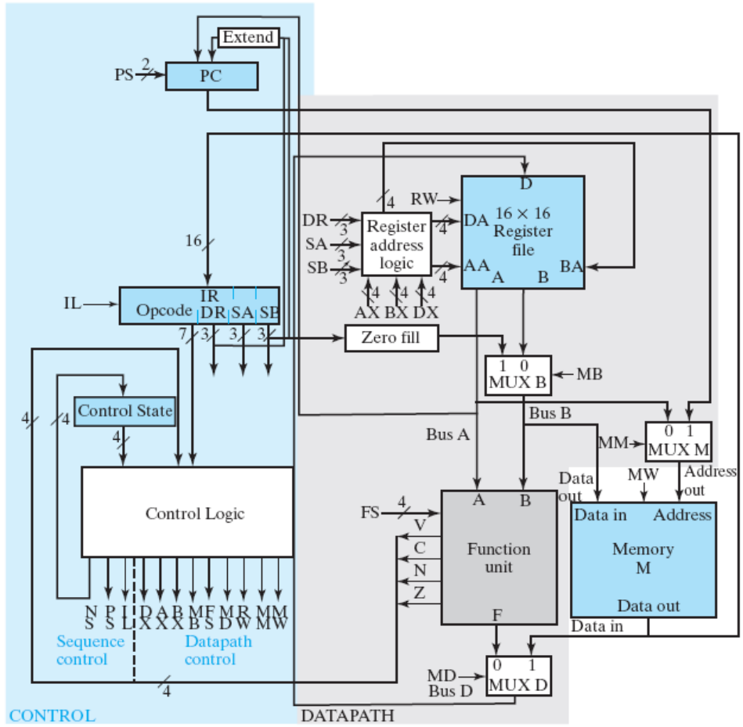
Why multi-cycle CPU
run faster
use only one memory port
  a single-cycle CPU uses two memory ports
  a multi-cycle CPU may use only one memory port
to implement complex instructions
both instructions and data come from here
Figure 9-18: multi-cycle CPU

Slide 11
Why multi-cycle CPU
run faster
use only one memory port
to implement complex instructions
  some arithmetic operations need multiple cycles
    multiplication R0=R1*R2
    division R0=R1/R2

Slide 12
How to design a multi-cycle CPU
detailed in the “Computer Architecture” Course

Slide 13
What you will learn in “Computer Architecture” course
the REAL modern CPU architecture
  e.g. multi-cycle CPU
  in MIPS instruction set
various techniques to make CPU runs faster
  pipeline
  superscalar/VLIW: executes 2+ instructions each cycle
  cache memory

Slide 14
What you will learn in “Computer Architecture” course
the REAL modern CPU architecture
  e.g. multi-cycle CPU
  in MIPS instruction set
various techniques to make CPU runs faster
  pipeline
  superscalar/VLIW: executes 2+ instructions each cycle
  cache memory

Slide 15
Pipelining concepts
process instructions like a pipeline in the factory
instruction
fetch
decode &
fetch operand
execute
write-back
instructions

Slide 16
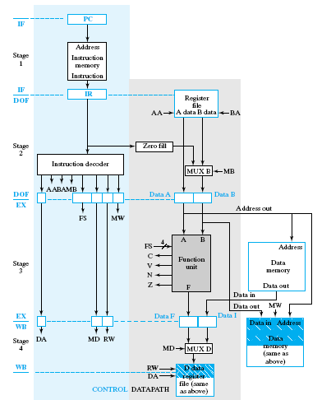
Cycle 1
ADD R1, R2, R3
SUB R4, R5, R6
INC R2
DEC R3
ADD

Slide 17
Cycle 2
ADD R1, R2, R3
SUB R4, R5, R6
INC R2
DEC R3
SUB
ADD

Slide 18
Cycle 3
ADD R1, R2, R3
SUB R4, R5, R6
INC R2
DEC R3
INC
SUB
ADD

Slide 19
Cycle 4
ADD R1, R2, R3
SUB R4, R5, R6
INC R2
DEC R3
DEC
INC
SUB
ADD

Slide 20
What you will learn in “Computer Architecture” course
the REAL modern CPU architecture
  e.g. multi-cycle CPU
  in MIPS instruction set
various techniques to make CPU runs faster
  pipeline
  superscalar/VLIW: executes 2+ instructions each cycle
  cache memory

Slide 21
Suggestions
if you want to go into the field of computer architecture

Slide 22
Suggestions
Study electronics/physics as hard as possible
  the driving force to lead computer architecture research
Hardware is not everything
  knowledge on operating systems, system programming, compiler is a must
establish solid background on mathematics
  lots of optimization problems to be solved
  my PhD dissertation is based on combinatorial optimization

Slide 23
The END

