Slide 1
Multi-Cycle CPU Design
Lecture 12 (Part A)
Section 9-9

Slide 2
Recap: How a single-cycle CPU works

Slide 3
How a single-cycle CPU works
each instruction consumes one cycle
the destination register value changes at the next cycle

Slide 4
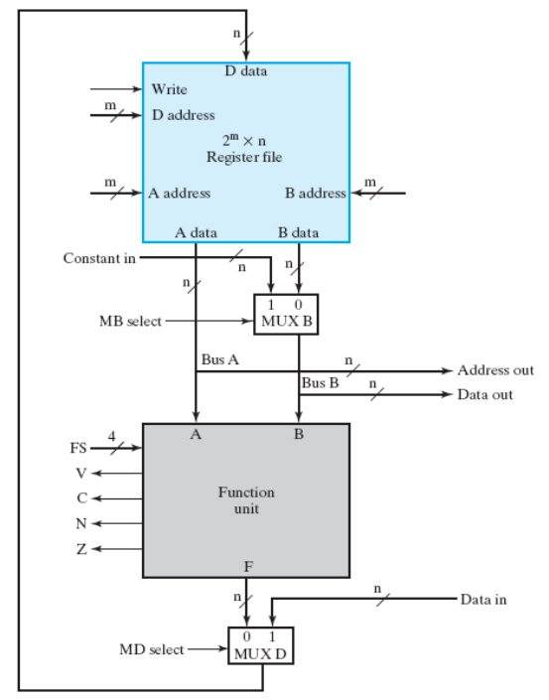
How a single-cycle CPU works
ADD R1, R2, R3 //R1=R2+R3
SUB R4, R5, R1 //R4 = R5-R1
ST R6, R4 //mem[R6] = R4
time
ADD
SUB
ST
R1
100
30
30
R2
10
10
10
R3
20
20
20
R4
0
0
170
R5
200
200
200
R6
1000
1000
1000

Slide 5
How a single-cycle CPU works
ADD R1, R2, R3 //R1=R2+R3
SUB R4, R5, R1 //R4 = R5-R1
ST R6, R4 //mem[R6] = R4
time
ADD
SUB
ST
R1
100
30
30
R2
10
10
10
control signal for ADD
R3
20
20
20
R4
0
0
170
R5
200
200
200
30
R6
1000
1000
1000

Slide 6
How a single-cycle CPU works
ADD R1, R2, R3 //R1=R2+R3
SUB R4, R5, R1 //R4 = R5-R1
ST R6, R4 //mem[R6] = R4
time
ADD
SUB
ST
R1
100
30
30
R2
10
10
10
control signal for ADD
changed at the next cycle
R3
20
20
20
R4
0
0
170
R5
200
200
200
30
R6
1000
1000
1000

Slide 7
How a single-cycle CPU works
ADD R1, R2, R3 //R1=R2+R3
SUB R4, R5, R1 //R4 = R5-R1
ST R6, R4 //mem[R6] = R4
time
ADD
SUB
ST
changed at the next cycle
R1
100
30
30
R2
10
10
10
control signal for SUB
R3
20
20
20
R4
0
0
170
R5
200
200
200
170
R6
1000
1000
1000

Slide 8
The fact
there is no commercial single-cycle CPU
All commercial CPUs are multi-cycle CPUs
  an instruction spends multiple cycles

Slide 9
How a multi-cycle CPU works
an instruction may spend several cycles to complete
Example:
ADD R1, R2, R3 //R1=R2+R3
SUB R4, R5, R1 //R4 = R5-R1
ST R6, R4 //mem[R6] = R4
time
ADD
SUB
ST
several cycles to execute an instruction

Slide 10
Why multi-cycle CPU
run faster
use only one memory port
to implement complex instructions

Slide 11
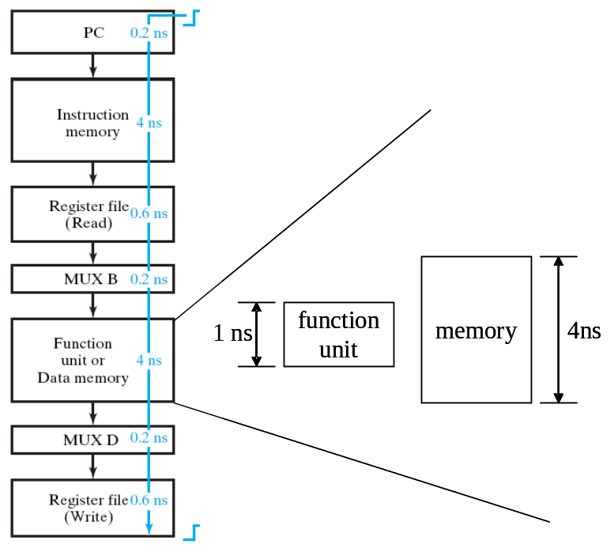
Why multi-cycle CPU
run faster
  the clock period time is too long for a single cycle CPU
  spend too much time on memory access
  not every cycle needs memory access
use only one memory port
to implement complex instructions

Slide 12
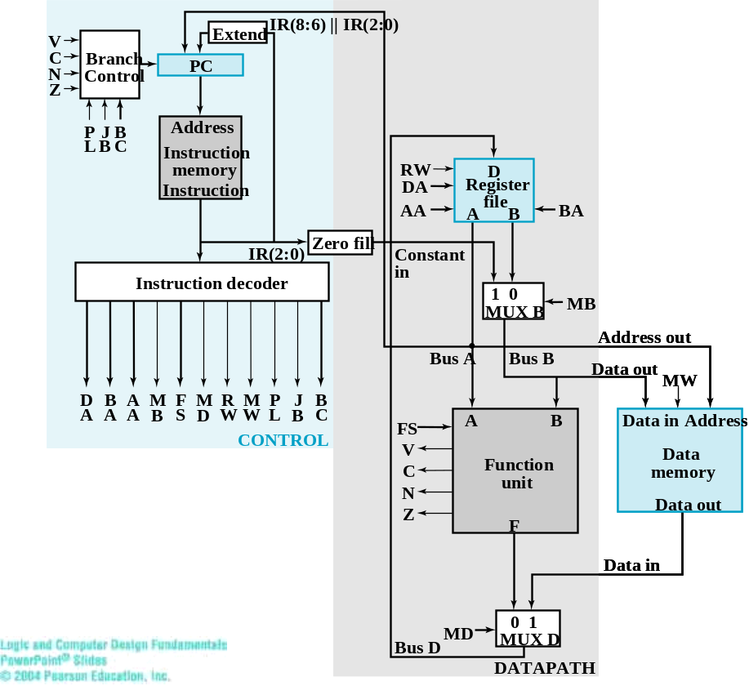
Why multi-cycle CPU
instructions and data come
from different memory
run faster
use only one memory port
  a single-cycle CPU uses two memory ports
  a multi-cycle CPU may use only one memory port
to implement complex instructions

Slide 13
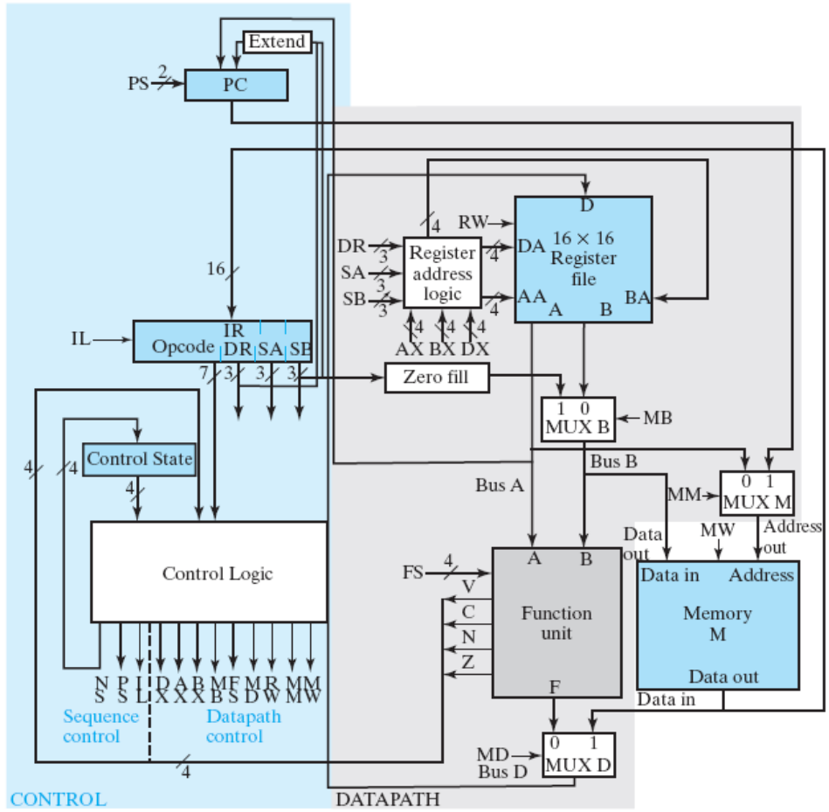
Why multi-cycle CPU
run faster
use only one memory port
  a single-cycle CPU uses two memory ports
  a multi-cycle CPU may use only one memory port
to implement complex instructions
both instructions and data come from here
Figure 9-18: multi-cycle CPU

Slide 14
Why multi-cycle CPU
run faster
use only one memory port
to implement complex instructions
  some arithmetic operations need multiple cycles
    multiplication R0=R1*R2
    division R0=R1/R2

Slide 15
Realization of multi-cycle CPU

Slide 16
Multi-cycle CPU
the differences:
  finite-state machine
  one memory
  larger register file

Slide 17
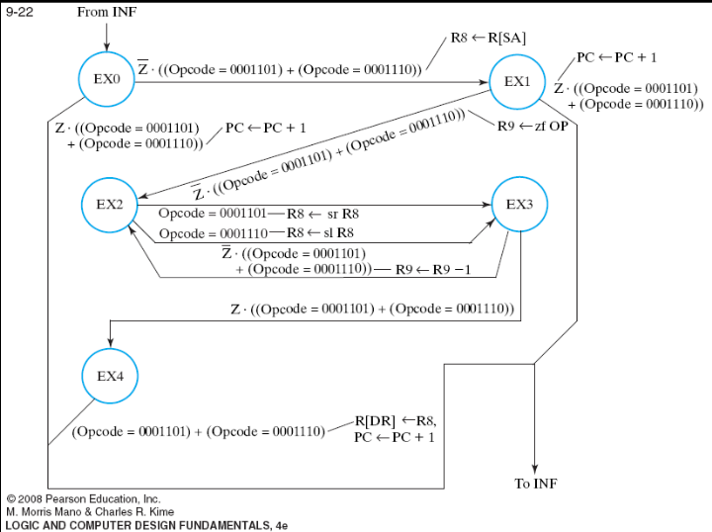
Multi-cycle CPU
the differences:
  finite-state machine
  one memory
  larger register file

Slide 18
Multi-cycle CPU
back to the fetch stage to get the next instruction
General scheme
a cycle to get instruction from memory
instruction
fetch
one or more execution stages (depending on instruciton)
EX1
EX2
…
EXn

Slide 19
Multi-cycle CPU
the differences:
  finite-state machine
  one memory
  larger register file

Slide 20
Multi-cycle CPU
the differences:
  finite-state machine
  one memory
  larger register file

Slide 21
How a multi-cycle CPU works?
Example: R1=R2+R3

Slide 22
How it works
ADD R1, R2, R3 (R1=R2+R3)
the timing diagram and part of the finite-state machine
time
PC
100
100
101
INF
state
INF
EX0
INF
xxx
IR
xxx
ADD
ADD
xxx
control
signals
EX0
A
B
A
R1
10
10
50
R2
20
20
20
R3
30
30
30

Slide 23
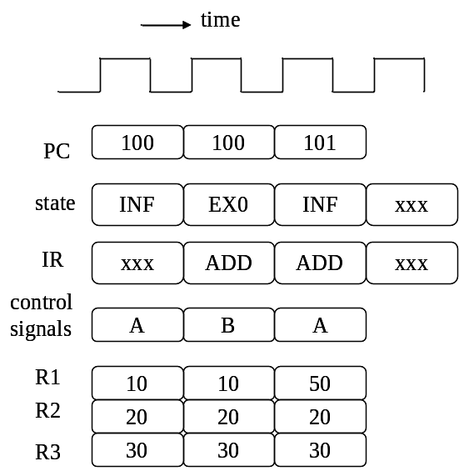
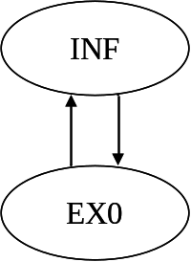
How it works: put it all together
executing
the ADD instruction

Slide 24
How it works: put it all together
instruction fetch

Slide 25
How it works: put it all together
instruction fetch
control signals A
control signals A

Slide 26
How it works: put it all together
instruction fetch
control signals A

Slide 27
How it works: put it all together
the instruction enters IR at the next cycle
instruction fetch
control signals A

Slide 28
How it works: put it all together
execution stage
control signals B
from IR

Slide 29
How it works: put it all together
value changes at the next cycle
R3
R2
execution stage
control signals B
from IR

Slide 30
How it works: put it all together
PC changes at the next cycle
R3
R2
execution stage
control signals B
from IR

Slide 31
How it works: put it all together
fetch the next instruction
execution stage
control signals A

Slide 32
Questions
Why we need only one memory?
Why we need a register for IR?

Slide 33
Realizing complex instruction
the LRI

Slide 34
Semantics of the LRI instruction
LRI: load register indirect
Example: LRI R1, R2
  R1 = mem[mem[R2]]
memory
CPU
R1
30
100
200
R2
100
200
30
address

Slide 35
Semantics of the LRI instruction
LRI: load register indirect
Example: LRI R1, R2
  R1 = mem[mem[R2]]
memory
CPU
R1
30
(1)
100
200
R2
100
200
30
address

Slide 36
Semantics of the LRI instruction
LRI: load register indirect
Example: LRI R1, R2
  R1 = mem[mem[R2]]
memory
CPU
R1
30
(1)
100
200
(2)
R2
100
200
30
address

Slide 37
Semantics of the LRI instruction
LRI: load register indirect
Example: LRI R1, R2
  R1 = mem[mem[R2]]
memory
CPU
R1
30
(1)
100
200
(2)
R2
100
(3)
200
30
address

Slide 38
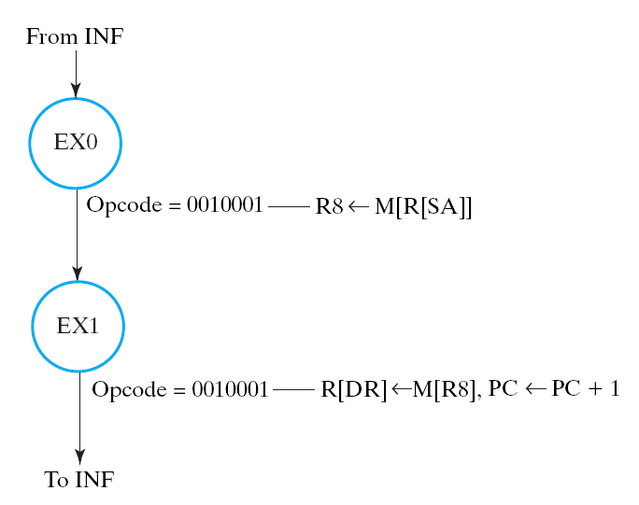
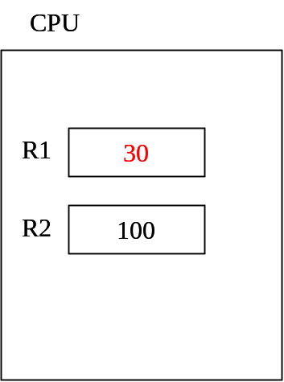
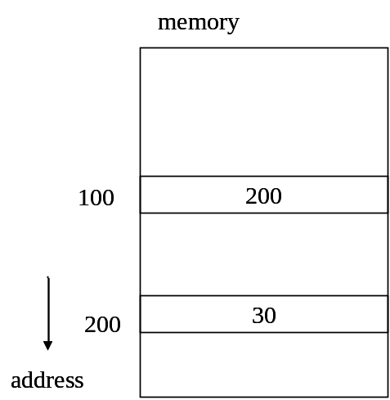
Hardware design strategy: the finite-state machine
LRI R1, R2 //R1 = mem[mem[R2]]

Slide 39
Hardware design strategy: the finite-state machine
LRI R1, R2 //R1 = mem[mem[R2]]
R8
200
R8: an internal register not accessible by programmer

Slide 40
Hardware design strategy: the finite-state machine
LRI R1, R2 //R1 = mem[mem[R2]]
R8
200
R8: an internal register not accessible by programmer

Slide 41
Question: can you put it all together?
timing diagram
control signals, and
data path operation

Slide 42
Question: why larger register file with additional logic?
the differences:
  finite-state machine
  one memory
  larger register file

Slide 43
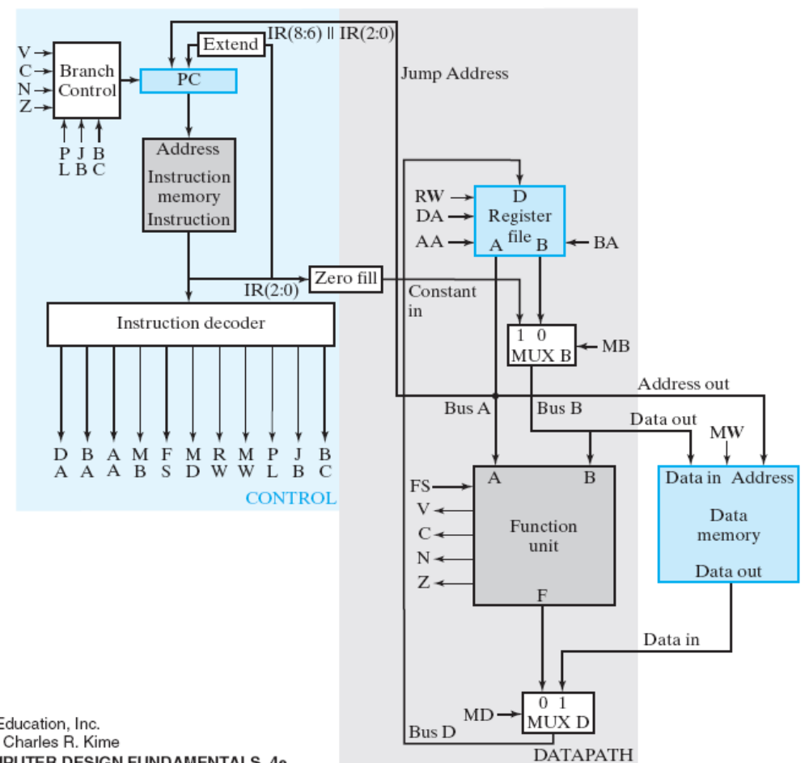
Question: why the single-cycle CPU cannot do LRI instruction?
trace the data path and see what will happen

Slide 44
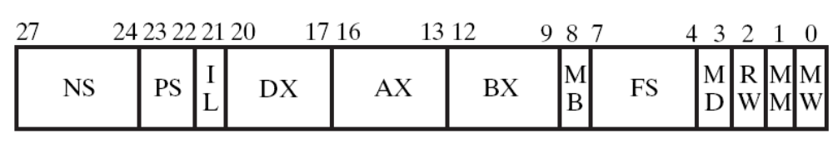
Practice yourself
draw the complete finite state machine
list all control signals
and trace the detailed circuit design

Slide 45
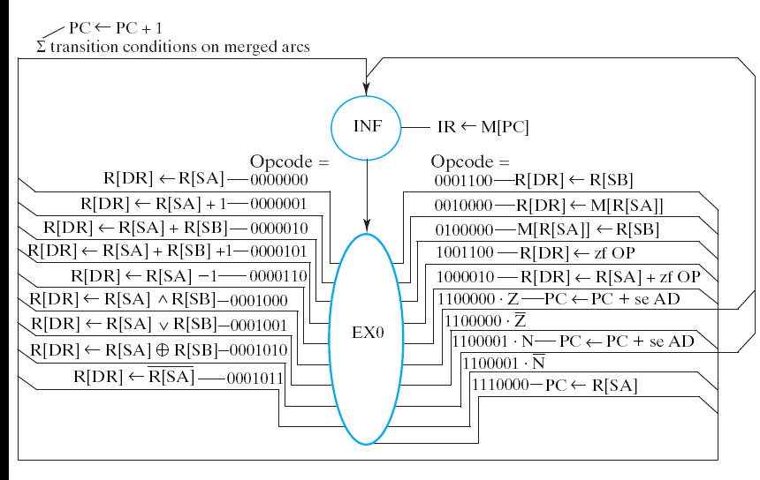
Practice yourself
draw the complete finite state machine
list all control signals
and trace the detailed circuit design

Slide 46
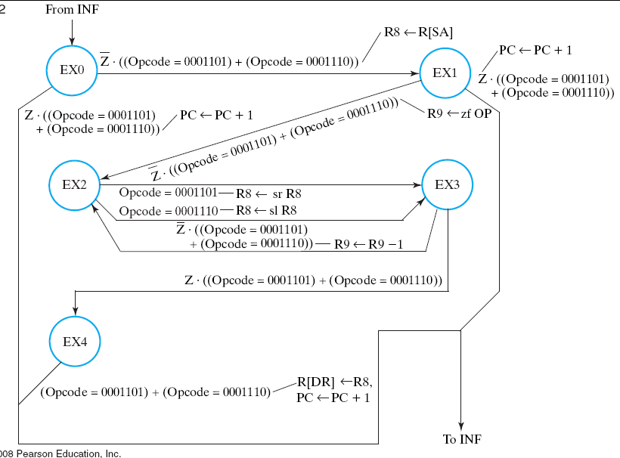
Practice yourself
draw the complete finite state machine
list all control signals
and trace the detailed circuit design

Slide 47
Problem
How to implement shift left/right multiple?
  R1 = R2<<R3
  the shifter in the function unit can only shift one bit at a time
study the textbook pp. 504-507

Slide 48
All circuit designs of this course COMPLETED!

Slide 49
Summary
RTL design makes you doing everything!
  plan the data path
  draw the finite state machine
  imagine the three parts together: timing+circuit+Verilog/VHDL
  distinguish combinational/sequential circuit

Slide 50
Summary
CPU design
  still follows RTL design method
  steps:
    define the instruction set architecture
    make plan: how to execute each instruction cycle-by-cycle
    design the data path and finite-state machine control
    realize in Verilog/VHDL and synthesis the chip

Slide 51
Preview for the computer architecture course
How to design a good CPU
  speed
  chip area
  power consumption
various ways
  better instruction set
  better way to execute instructions
    pipeline
    superscalar/VLIW
  better memory architecture

Slide 52
Next Lecture
a quick view on computer architecture course
  instruction set architecture
  RISC/CISC CPU
your work before the class
  Read Chap. 10-11
  check which part I have taught before

Slide 53
Core Questions
How to make every C program executable by a CPU (Chap. 10)
  the instruction set
  How about float/double data type?
How to make a multi-cycle CPU runs faster?
  pipeline (Chap. 11)

