Slide 1
Final Review

Slide 2
Announce
Final Term Exam: 2013/01/11 (Friday)

Slide 3
All I taught you throughout the semester
(1) general framework of a digital system
(2) combinational vs. sequential circuit
  the timing behavior
(3) RTL design methodology

Slide 4
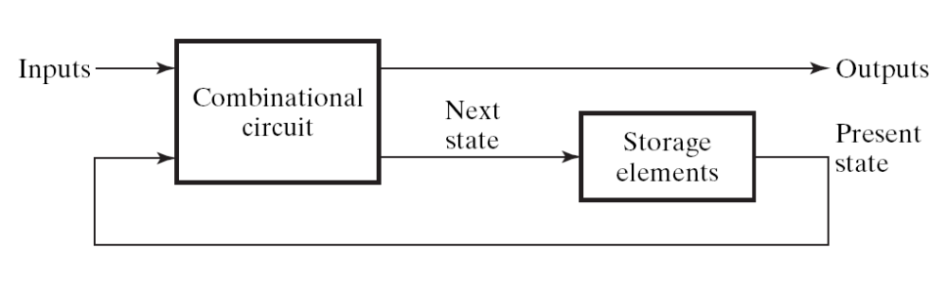
General framework of a digital system
Sequential Circuit:
  a digital circuit with storage element to memorize current state
  Figure 5-1:
the counter part -- Combinational Circuit
  a digital circuit without storage element
clock

Slide 5
All I taught you throughout the semester
(1) general framework of a digital system
(2) combinational vs. sequential circuit
  the timing behavior
(3) RTL design methodology

Slide 6
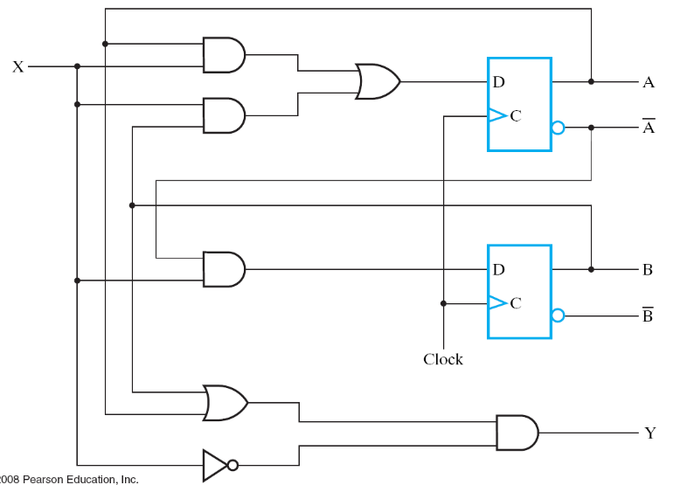




Rule of thumb
a combinational circuit always generates the outputs at the same cycle
combinational circuit
cycle t
time
clock
A
0
0
state
B
0
1
input
X
1
1
0
0
0
0
1
internal
signals
1
1

Slide 7
Rule of thumb
combinational
circuit
D_{A}
A
D
Q
X
D Flip-Flop: A(t+1) = D_{A}(t)
  state changes at the next cycle
clock
Y
time
clock
A
A0
A1=D0
X
X0
D_{A}
D0
Y
Y0

Slide 8
All I taught you throughout the semester
(1) general framework of a digital system
(2) combinational vs. sequential circuit
  the timing behavior
(3) RTL design methodology

Slide 9
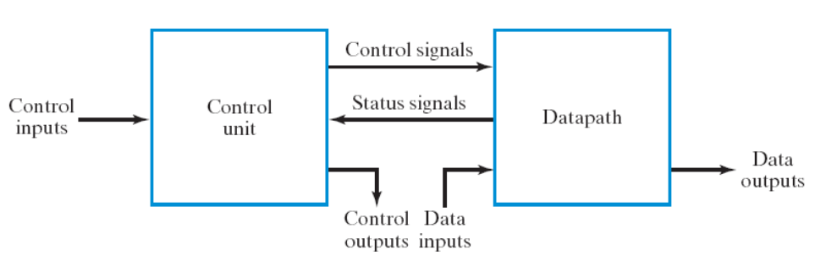
Steps of RTL Design
Step 1: always starts from the general framework
  control signals: the order sent from control unit
  status signals: reports from data path
Step 2: specify the behavior of each part
  control unit: state-diagram
  data path: micro-operation
Step 3: design circuits from behavior specification
  control unit: state-diagram to circuit (Chapter 5)
  data path: micro-operation to circuit (Sec. 7.3 – 7.6)

Slide 10
Problem Set Part 1
simple problems
details may be modified

Slide 11
Problem 1 (20%)
Translate a C program to assembly of the sample CPU
  for (i=0;i<n;i++)
    A[i] = B[i] + C[i]
The program will have array accesses, for/while/if-then-else statements
The program will be changed

Slide 12
Problem 2 (20%)
translate assembly instruction to binary format
  4 instructions covering all three format
Example: ADD R1, R2, R3 //R1=R2+R3
15
9
8
6
5
3
2
0
0000010
Destination
Source reg-
Source reg-
Opcode
001
010
011
register (DR)
ister A (SA)
ister B (SB)
(opcode of ADD)
(R1)
(R2)
(R3)
(a) Register
(the instruction may be changed)

Slide 13
Problem 3 (20%)
Disassemble: translate binary code back to assembly
  four instructions covering three format
15
9
8
6
5
3
2
0
0000010
Destination
Source reg-
Source reg-
Opcode
001
010
011
register (DR)
ister A (SA)
ister B (SB)
(opcode of ADD)
(R1)
(R2)
(R3)
(a) Register
ADD R1, R2, R3
(the instruction may be changed)

Slide 14
Problem 4 (20%)
Write-down control signals value to realize an instruction
  (4 instructions)

Slide 15
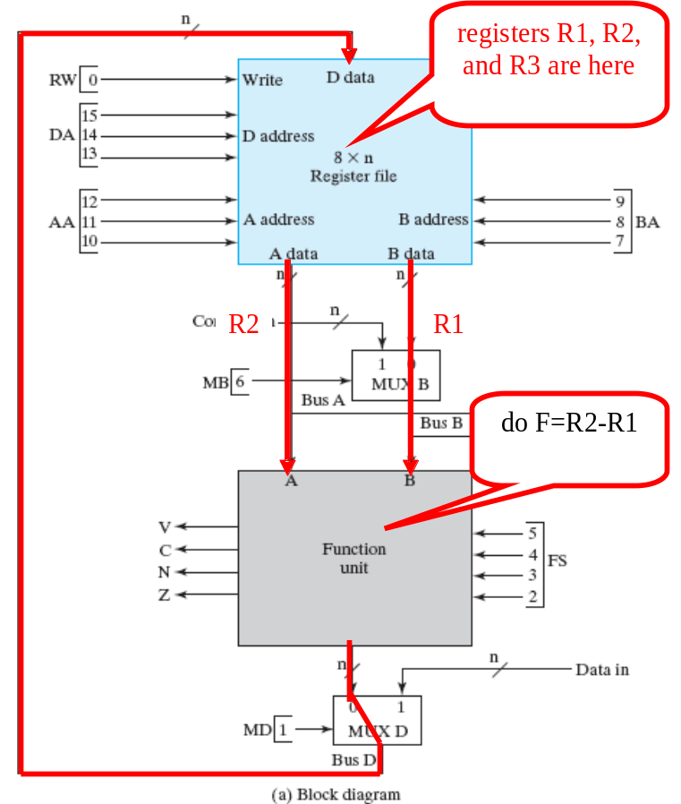

Problem 4 (20%)
Example:
  R3=R2-R1
011
010
001
0
0101
0
1
(The operation may be changed)

Slide 16
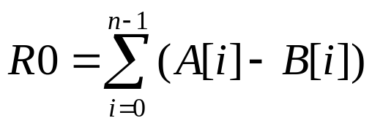
Problem 5 (20%)
use the CPU data path to do
  A[i], B[i] stored in data memory
  n is initially stored in R1
  address of A[0] initially stored in R2
  address of B[0] initially stored in R3
Write down:
  finite state machine of the control unit
  control signals value for each state
Computation may be changed!

Slide 17
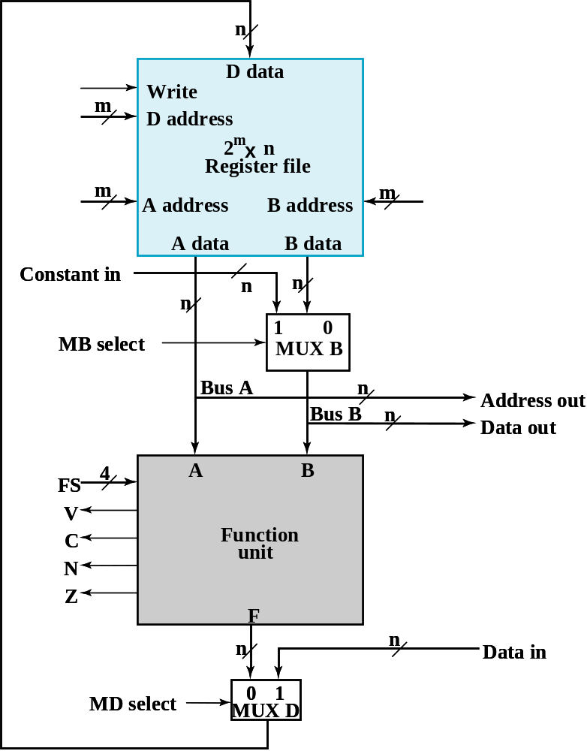
Problem 5 (20%)
Design your own control unit
control unit
you designed

Slide 18
Problem 6 (25%)
You are asked to modify the single-cycle CPU to include a new instruction JAL (Jump and Link) for function calls. The JAL instruction serves as the call to a subroutine: jump to the beginning of a subroutine and store the return address (PC+1) in a register. The instruction has two register operands:
  The first operand specifies the register to store the return address,
  The second operand specifies the destination address to jump to (like the JMP instruction we already have).
For example, the instruction “JAL R1, R2” has the following semantics:
R1 = PC+1 //store the return address at R1
PC = R2 //goto the address stored in R2
Write down your design of the modified CPU. Your answer should address the following issues:
  (1) The binary code format of the new instruction
  (2) The modified data path of the CPU
  (3) The modified control signals
  (4) Value of the control signals to realize “JAL R1, R2”

