Slide 1
Final Review

Slide 2
Announce
Final Term Exam: 2012/01/13 (Friday)

Slide 3
All I taught you throughout the semester
(1) general framework of a digital system
(2) combinational vs. sequential circuit
  the timing behavior
(3) RTL design methodology

Slide 4
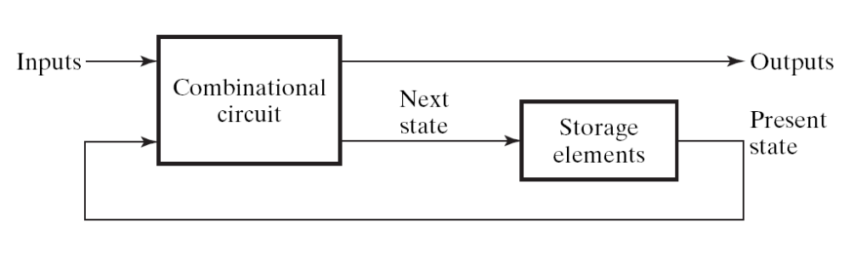
General framework of a digital system
Sequential Circuit:
  a digital circuit with storage element to memorize current state
  Figure 5-1:
the counter part -- Combinational Circuit
  a digital circuit without storage element
clock

Slide 5
All I taught you throughout the semester
(1) general framework of a digital system
(2) combinational vs. sequential circuit
  the timing behavior
(3) RTL design methodology

Slide 6
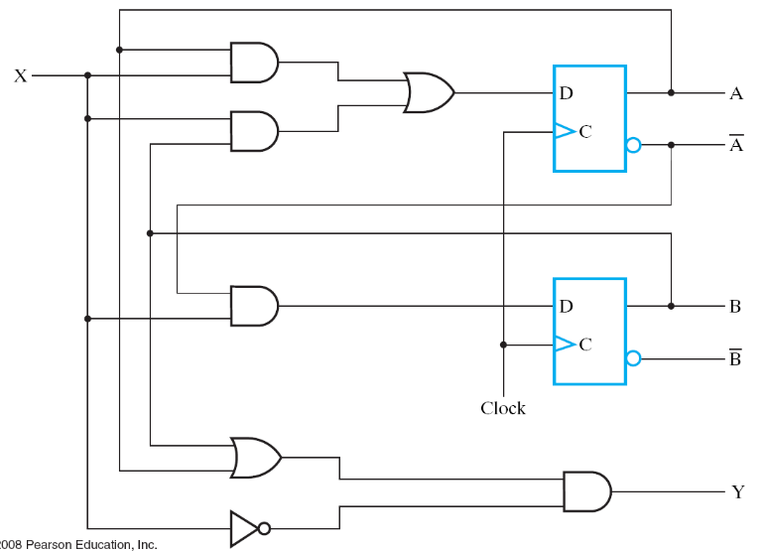




Rule of thumb
a combinational circuit always generates the outputs at the same cycle
combinational circuit
cycle t
time
clock
A
0
0
state
B
0
1
input
X
1
1
0
0
0
0
1
internal
signals
1
1

Slide 7
Rule of thumb
combinational
circuit
D_{A}
A
D
Q
X
D Flip-Flop: A(t+1) = D_{A}(t)
  state changes at the next cycle
clock
Y
time
clock
A
A0
A1=D0
X
X0
D_{A}
D0
Y
Y0

Slide 8
All I taught you throughout the semester
(1) general framework of a digital system
(2) combinational vs. sequential circuit
  the timing behavior
(3) RTL design methodology

Slide 9
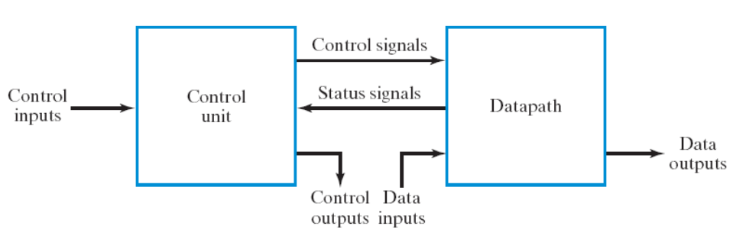
Steps of RTL Design
Step 1: always starts from the general framework
  control signals: the order sent from control unit
  status signals: reports from data path
Step 2: specify the behavior of each part
  control unit: state-diagram
  data path: micro-operation
Step 3: design circuits from behavior specification
  control unit: state-diagram to circuit (Chapter 5)
  data path: micro-operation to circuit (Sec. 7.3 – 7.6)

Slide 10
Problem Set Part 1
simple problems
details may be modified

Slide 11
Problem 1 (20%)
RTL design to do some arithmetic function f(A, B, C, D)
  consists of +, -, and some condition checking
  Example: R=|A-B|+|C-D|
  use only one adder
  specify the control unit (state diagram) and data path
The equation may be changed

Slide 12
Problem 2 (20%)
translate assembly instruction to binary format
  4 instructions covering all three format
Example: ADD R1, R2, R3 //R1=R2+R3
15
9
8
6
5
3
2
0
0000010
Destination
Source reg-
Source reg-
Opcode
001
010
011
register (DR)
ister A (SA)
ister B (SB)
(opcode of ADD)
(R1)
(R2)
(R3)
(a) Register
(the instruction may be changed)

Slide 13
Problem 3 (20%)
Disassemble: translate binary code back to assembly
  four instructions covering three format
15
9
8
6
5
3
2
0
0000010
Destination
Source reg-
Source reg-
Opcode
001
010
011
register (DR)
ister A (SA)
ister B (SB)
(opcode of ADD)
(R1)
(R2)
(R3)
(a) Register
ADD R1, R2, R3
(the instruction may be changed)

Slide 14
Problem 4 (20%)
Write-down control signals value to realize an instruction
  (4 instructions)

Slide 15
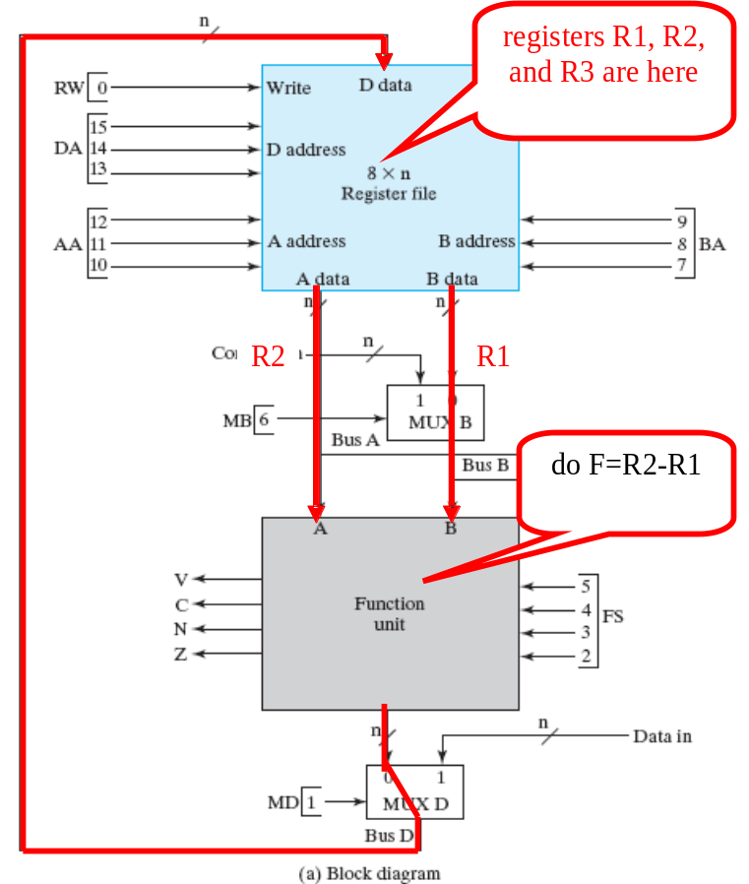

Problem 4 (20%)
Example:
  R3=R2-R1
011
010
001
0
0101
0
1
(The operation may be changed)

Slide 16
Problem Set Part 2
Creative Problem

Slide 17
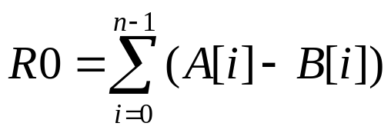
Problem 5 (20%)
use the CPU data path to do
  A[i], B[i] stored in data memory
  n is initially stored in R1
  address of A[0] initially stored in R2
  address of B[0] initially stored in R3
Write down:
  finite state machine of the control unit
  control signals value for each state
Computation may be changed!

Slide 18
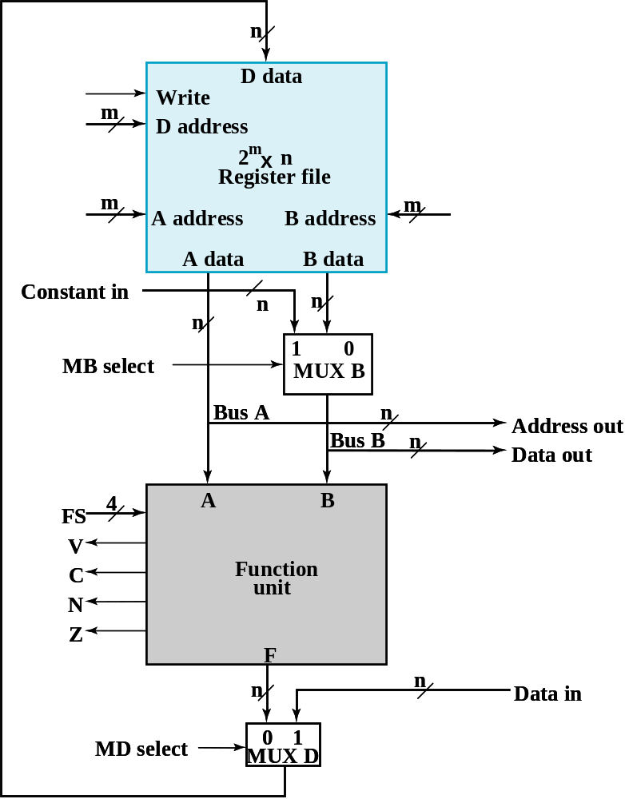
Problem 5 (20%)
Design your own control unit
control unit
you designed

Slide 19
Problem 6 (20%)
instruction enhancement to the single cycle CPU
one of the instruction enhancement in our term project

Slide 20
Instruction Enhancement
SADD R1, R2, R3 (saturated addition)
  tmp=R2+R3
  if (tmp>127) R1=127
  if (tmp <= -128) R1=-128
SSUB R1, R2, R3 (saturated subtraction)
  tmp=R2-R3
  if (tmp>127) R1=127
  if (tmp <= -128) R1=-128
ABS R1, R2 (take absolute value)
  R1=|R2|
BGE R1, 3
  if (R1>=0) goto PC+3

Slide 21
Instruction Enhancement
(5) LDM R1, R2 (load with post modify)
  R1=mem[R2]
  R2=R2+1
(6) STM R1, R2 (store with post modify)
  mem[R1]=R2
  R1=R1+1

