Slide 1
Arithmetic Unit of CPU
Lab 08 (Part A)

Slide 2
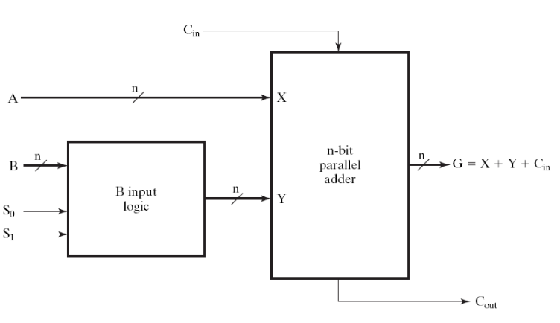
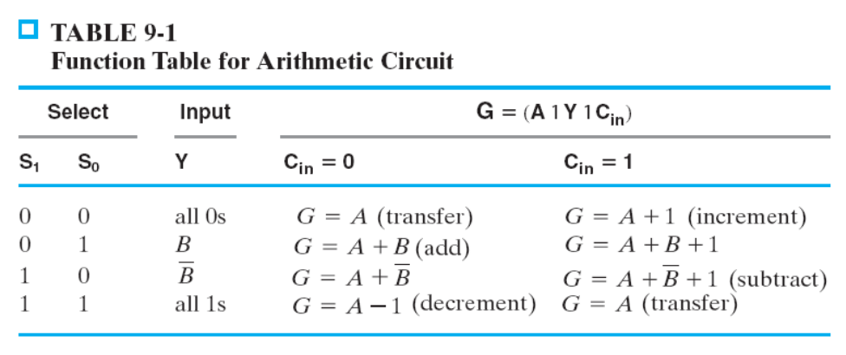
Your Task
Basic (60%): realize the arithmetic unit in Section 9-3
  show simulation waveform of each operation
Realize one of these computation with the arithmetic unit:
  Q=A+B+C+D (70%)
  Q=|A-B| (80%)
  Q=|A-B|+|C-D| (90%)
  where A, B, C, D are 8-bit unsigned integers

Slide 3
Bonus of this lab
use this circuit to do the following computations:
  Q=A+B+C+D
  Q=|A-B|
  Q=|A-B|+|C-D|
data path
control
unit
complementary
part of the datapath
Arithmetic Logic Unit
(Figure 9-3)
practice RTL design
with this circuit

Slide 4
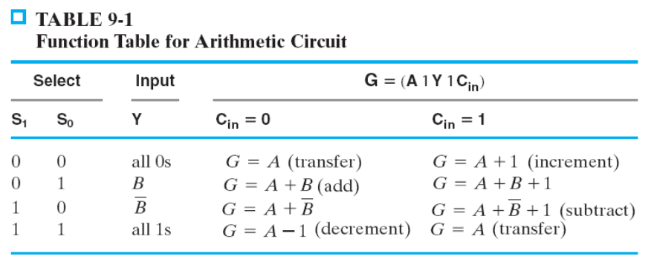
Pre-Lab Report
Q1: How to get circuit delay time and chip area from Quartus II?
Q2: What’s wrong if you write this Verilog code?
always @(*) begin
case (S)
2’b00: G = A+Cin;
2’b01: G = A+B+Cin;
2’b10: G = A+(~B)+Cin;
2’b11: G = A – (~Cin);
endcase
end

Slide 5
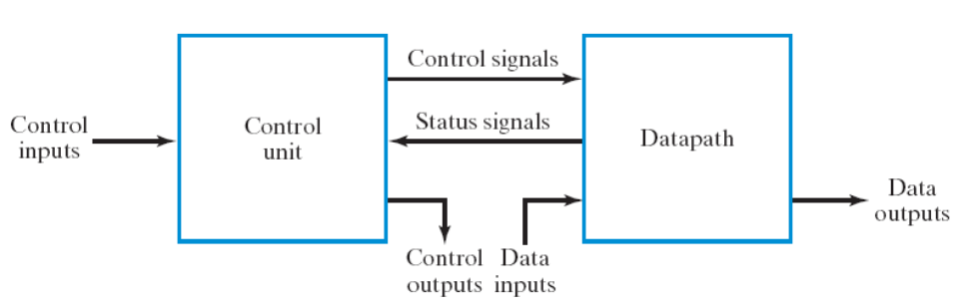
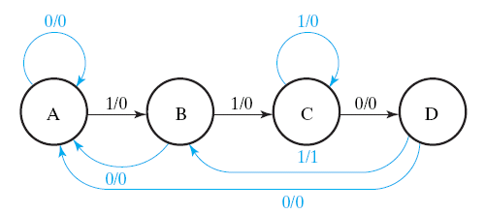
Purpose of this lab
make you feel the power of RTL design with hardware description language
learn the design of general-purpose arithmetic unit in CPU (Chapter 8)
K: A=B+C
(if (K==1) then A=B+C;)

