Slide 1
Arithmetic Unit Design
Lecture 08 (Part A)
Section 8-3

Slide 2
Materials coming from
Section 8-3
Recall: addition, subtraction, and number system
  Section 4-1 ~ 4-4
  your digital circuit textbook: Section 4.5

Slide 3
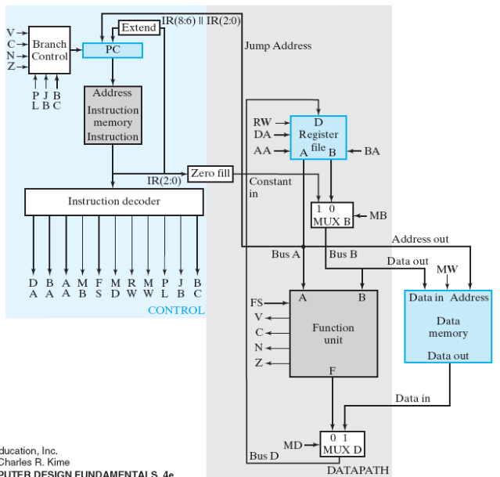
What we are talking about
Figure 9-15: single-cycle CPU

Slide 4
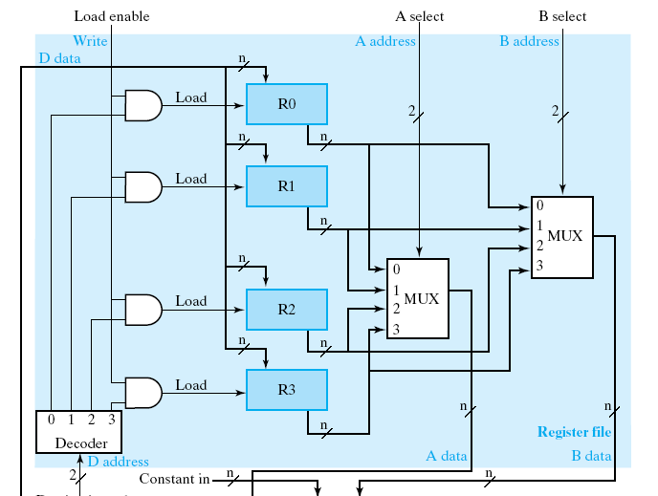
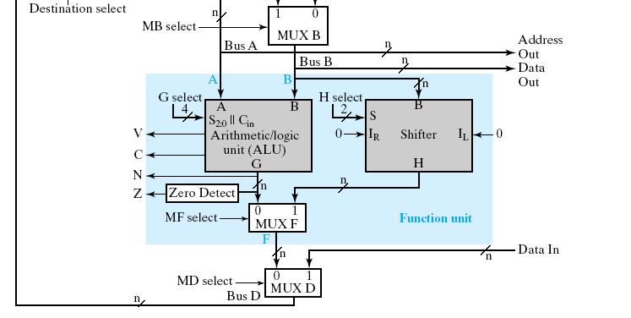
What we are talking about
a generic hardware to all arithmetic operations in a program
  +, -, &, |, ~, >>, <<, etc.
Figure 9-1

Slide 5
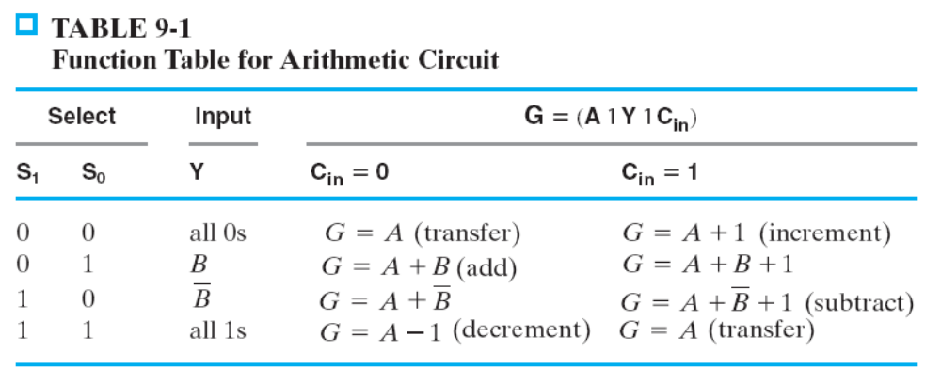
The Goal: design a generic arithmetic unit
Design a hardware with the following functions
B
A
n
n
arithmetic unit
S
Cin
2
n
G

Slide 6
The Goal: design a generic arithmetic unit
Design a hardware with the following functions
B
A
n
n
arithmetic unit
0
01
S
Cin
2
n
G
G=A+B

Slide 7
The Goal: design a generic arithmetic unit
Design a hardware with the following functions
B
A
n
n
arithmetic unit
1
10
S
Cin
2
n
G
G=A-B

Slide 8
Outline
Addition
Signed number representation and subtraction
  2’s complement

Slide 9
Addition

Slide 10
How a computer performs binary addition
0 1 1 0
A
for each bit i=0 to N-1 do {
{C[i+1], S[i]} = A[i]+B[i]+C[i]
}
+)
0 0 1 1
B
S

Slide 11
How a computer performs binary addition
Step 1: addition for bit 0
0 1 1 0
A
for each bit i=0 to N-1 do {
{C[i+1], S[i]} = A[i]+B[i]+C[i]
}
+)
0 0 1 1
B
S

Slide 12
How a computer performs binary addition
Step 1: addition for bit 0
Carry C[1]
0
0 1 1 0
A
for each bit i=0 to N-1 do {
{C[i+1], S[i]} = A[i]+B[i]+C[i]
}
+)
0 0 1 1
B
1
S
Sum S[0]

Slide 13
How a computer performs binary addition
Step 2: addition for bit 1 with carry
0
0 1 1 0
A
for each bit i=0 to N-1 do {
{C[i+1], S[i]} = A[i]+B[i]+C[i]
}
+)
0 0 1 1
B
1
S

Slide 14
How a computer performs binary addition
Step 2: addition for bit 1 with carry
1
0
0 1 1 0
A
for each bit i=0 to N-1 do {
{C[i+1], S[i]} = A[i]+B[i]+C[i]
}
+)
0 0 1 1
B
0
1
S

Slide 15
How a computer performs binary addition
Step 2: addition for bit 1 with carry
Carry C[2]
1
0
0
0 1 1 0
A
for each bit i=0 to N-1 do {
{C[i+1], S[i]} = A[i]+B[i]+C[i]
}
+)
0 0 1 1
B
0
1
S
Sum S[1]

Slide 16
How a computer performs binary addition
repeat the procedure and we get the result
0 1 1 0
A
for each bit i=0 to N-1 do {
{C[i+1], S[i]} = A[i]+B[i]+C[i]
}
+)
0 0 1 1
B
1 0 0 1
S
So, what’s the basic cell for the addition?

Slide 17
Full Adder: the basic component for an adder
a combinational circuit doing the following truth table
to perform addition for a bit i
Y
X
X
Y
Cin
Cout
S
1
0
0
0
0
0
0
0 1 1 0
A
Cin
0
0
1
0
1
+)
0 0 1 1
B
FA
0
1
0
0
1
0
1
1
1
0
0
1
S
1
0
0
0
1
1
0
1
1
0
S
1
1
0
1
0
Cout
1
1
1
1
1

Slide 18
Full Adder: the basic component for an adder
a combinational circuit doing the following truth table
to perform addition for a bit i
1
1
Y
X
X
Y
Cin
Cout
S
1
0
0
0
0
0
0
0 1 1 0
A
Cin
0
0
0
1
0
1
+)
0 0 1 1
B
FA
0
1
0
0
1
0
1
1
1
0
0
1
S
1
0
0
0
1
1
0
1
1
0
S
1
1
0
1
0
Cout
0
1
1
1
1
1
1

Slide 19
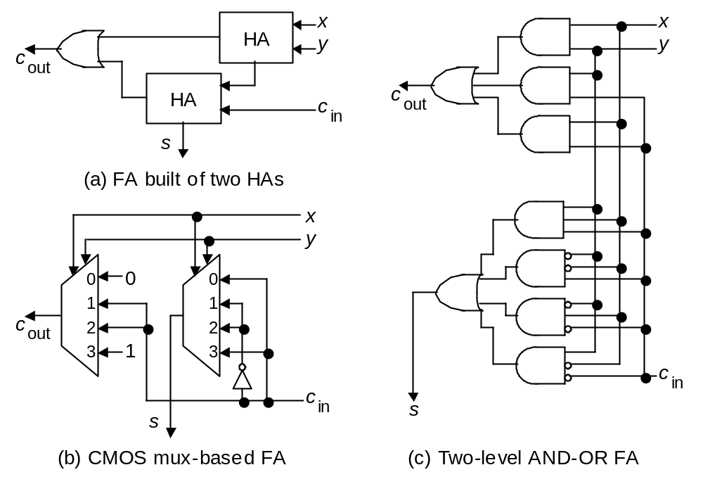
Full-adder implementation

Slide 20
Ripple-Carry Adder
B
A
n
n
always @(*)
{Cout, S} = A+B+Cin;
Cout
Adder
Cin
n
S
B[n-1]
A[n-1]
B[n-2]
A[n-2]
B[2]
A[2]
B[1]
A[1]
B[0]
A[0]
0 1 1 0
A
+)
0 0 1 1
B
Cin
FA
FA
FA
FA
FA
1 0 0 1
S
…
Cout
S[n-1]
S[n-2]
S[2]
S[1]
S[0]

Slide 21
Ripple-Carry Adder
B
A
n
n
always @(*)
{Cout, S} = A+B+Cin;
Cout
Adder
Cin
n
S
B[n-1]
A[n-1]
B[n-2]
A[n-2]
B[2]
A[2]
B[1]
A[1]
B[0]
A[0]
0 1 1 0
A
+)
0 0 1 1
B
Cin
FA
FA
FA
FA
FA
1 0 0 1
S
…
Cout
S[n-1]
S[n-2]
S[2]
S[1]
S[0]

Slide 22
Ripple-Carry Adder
B
A
n
n
always @(*)
{Cout, S} = A+B+Cin;
Cout
Adder
Cin
n
S
B[n-1]
A[n-1]
B[n-2]
A[n-2]
B[2]
A[2]
B[1]
A[1]
B[0]
A[0]
0 1 1 0
A
+)
0 0 1 1
B
Cin
FA
FA
FA
FA
FA
1 0 0 1
S
…
Cout
S[n-1]
S[n-2]
S[2]
S[1]
S[0]

Slide 23
Signed number and subtraction

Slide 24
Signed number representation (2’s complement)
the general format
  4-bit signed number
  representing -8 ~ 7
sign bit

Slide 25
Signed number representation (2’s complement)
Example: representing positive number +5
positive number
0
1
0
1
sign bit

Slide 26


Signed number representation (2’s complement)
Example: representing negative number -5
Rule:
A=+5
0
1
0
1
negative number
1
0
1
0
1
0
1
1
1
0
1
1
sign bit

Slide 27

Signed number representation (2’s complement)
Property:
A=-5
1
0
1
1
0
1
0
0
+5
0
1
0
1
0
1
0
1
sign bit

Slide 28
How to do subtraction
use adder with 2’s complement encoding

Slide 29
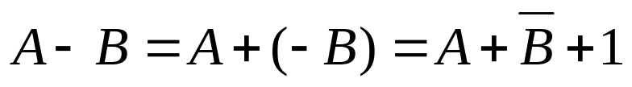


Method to do subtraction
Rule:
Example: A=5, B=3
A=5
0
0
1
1
0
1
0
1
B=3
-B=-3
+)
1
1
0
1
1
1
0
0
1
0
0
1
0
1
1
0
1
A-B=2

Slide 30
Method to do subtraction
Rule:
Example: A=3, B=5
A=3
0
1
0
1
0
0
1
1
B=5
-B=-5
+)
1
0
1
1
1
0
1
0
0
1
1
1
0
1
0
1
1
A-B=-2

Slide 31
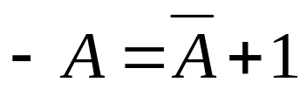
Rule of thumb
Key Properties:
Apply whenever positive or negative
Why?
  lots of mathematics
  I will talk about this more in “computer arithmetic” course

Slide 32
In-Class Exercise
to help you learn the above concept

Slide 33
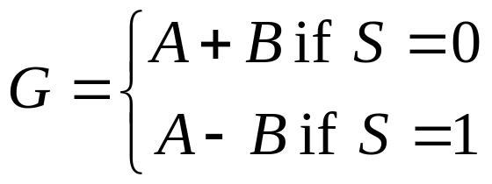
In-Class Exercise
(open book, may discuss with others)
Q1: write a C-code to calculate |A-B|
  you cannot use the following operators: -, >, <, >=, <=
  only add(+) and bit-wise logical operators available
Q2: design hardware for both addition and subtraction
B
A
n
n
adder/subtractor
S
n
G

Slide 34
Method to take absolute value
|A-B| in C

Slide 35
Problem
write a C-code to calculate |A-B|
  you cannot use the following operators: -, >, <, >=, <=
  only add(+) and bit-wise logical operators available

Slide 36
The Solution
write a C-code to calculate Q=|A-B|
  you cannot use the following operators: -, >, <, >=, <=
  only add(+) and bit-wise logical operators available
R = A+(~B)+1;
Q = (R & 0x80000000)? (~R)+1: R;

Slide 37
The Solution
write a C-code to calculate Q=|A-B|
  you cannot use the following operators: -, >, <, >=, <=
  only add(+) and bit-wise logical operators available
R = A-B;
if (R<0)
Q = -R;
else
Q = R;
R = A+(~B)+1;
Q = (R & 0x80000000)? (~R)+1: R;

Slide 38

The Solution
write a C-code to calculate Q=|A-B|
  you cannot use the following operators: -, >, <, >=, <=
  only add(+) and bit-wise logical operators available
R = A+(~B)+1;
Q = (R & 0x80000000)? (~R)+1: R;

Slide 39
The Solution
write a C-code to calculate Q=|A-B|
  you cannot use the following operators: -, >, <, >=, <=
  only add(+) and bit-wise logical operators available
R = A+(~B)+1;
Q = (R & 0x80000000)? (~R)+1: R;
check if R₃₁=1 or 0

Slide 40

The Solution
write a C-code to calculate Q=|A-B|
  you cannot use the following operators: -, >, <, >=, <=
  only add(+) and bit-wise logical operators available
R = A+(~B)+1;
Q = (R & 0x80000000)? (~R)+1: R;

Slide 41
Adder/Subtractor Design

Slide 42
Goal
Design hardware for both addition and subtraction
B
A
n
n
adder/subtractor
S
n
G

Slide 43
The Design
B
A
n
n
~B
n
S
MUX
n
adder
Cin
S
n
G

Slide 44
Recall: the adder design
B
A
n
n
Carry-in
always @(*)
{Cout, S} = A+B+Cin;
Cout
Adder
Cin
n
S
B[n-1]
A[n-1]
B[n-2]
A[n-2]
B[2]
A[2]
B[1]
A[1]
B[0]
A[0]
0 1 1 0
A
+)
0 0 1 1
B
Cin
FA
FA
FA
FA
FA
Carry-in
1 0 0 1
S
…
Cout
S[n-1]
S[n-2]
S[2]
S[1]
S[0]

Slide 45
The Design
B
A
n
n
~B
n
0
S
MUX
n
adder
Cin
S
0
n
G
G=A+B+0

Slide 46

The Design
B
A
n
n
~B
n
1
S
MUX
n
adder
Cin
S
1
n
G
G=A+(~B)+1

Slide 47
Summary until now
Most important properties of 2’s complement encoding:
sign bit
we now back to the arithmetic unit design in a CPU

Slide 48
Arithmetic unit design for a CPU

Slide 49
Recall The Goal: a generic arithmetic unit
Design a hardware with the following functions
B
A
n
n
arithmetic unit
S
Cin
2
n
G

Slide 50
Recall The Goal: a generic arithmetic unit
Design a hardware with the following functions
B
A
n
n
arithmetic unit
0
01
S
Cin
2
n
G
G=A+B

Slide 51
Recall The Goal: a generic arithmetic unit
Design a hardware with the following functions
B
A
n
n
arithmetic unit
1
10
S
Cin
2
n
G
G=A-B

Slide 52
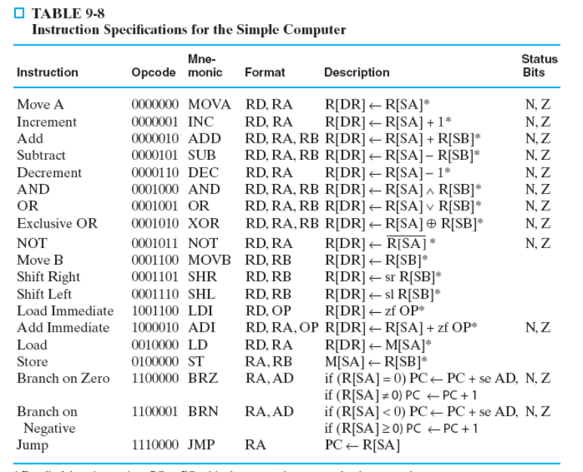
Why this spec
Preview on the CPU instruction set
these assembly instructions are to be executed in the hardware
(A+0, A+B, A-B, A+1, A-1, …)

Slide 53
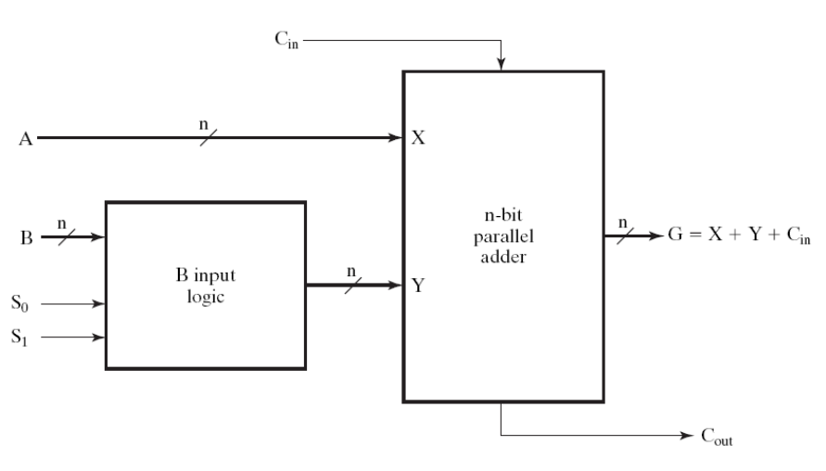
Overview of the circuit diagram
Figure 9-3

Slide 54
Overview of the circuit diagram
All are doing G=A+something
the adder we talked about before
Figure 9-3
A
G=A+something

Slide 55
Overview of the circuit diagram
All are doing G=A+something
Figure 9-3
“Something” controlled by the circuit

Slide 56
Control an input to the adder
Figure 9-3
B
0
(111…11)₂
~B
MUX
S
Y

Slide 57
Control an input to the adder
Figure 9-3
B
0
(111…11)₂
~B
MUX
S
Y
Y=B

Slide 58
Control an input to the adder
Figure 9-3
B
0
(111…11)₂
~B
MUX
S
Y
Y=~B

Slide 59
Realizing A+B
Figure 9-3
B
0
0
(111…11)₂
~B
G=A+B+0
MUX
01
S
01
Y=B
Y
Y=B

Slide 60
Realizing A-B
Figure 9-3
B
0
1
(111…11)₂
~B
G=A+(~B)+1
MUX
10
S
10
Y=~B
Y
Y=~B

Slide 61
Q: How to realize A-1?
Figure 9-3
B
0
(111…11)₂
~B
MUX
S
Y

Slide 62
Summary and Remarks

Slide 63
Summary: we finished the hardware for part of the CPU instructions
these assembly instructions are to be executed in the hardware
(A+0, A+B, A-B, A+1, A-1, …)
Figure 9-3

Slide 64
Lab of this week
use this circuit to do the following computations:
  Q=A+B+C+D
  Q=|A-B|
  Q=|A-B|+|C-D|
Figure 9-3

Slide 65
Lab of this week
use this circuit to do the following computations:
  Q=A+B+C+D
  Q=|A-B|
  Q=|A-B|+|C-D|
data path
control
unit
complementary
part of the datapath
Arithmetic Unit
(Figure 9-3)
practice RTL design
with this circuit

Slide 66
Question
What will happen if you write this Verilog code?
always @(*) begin
case (S)
2’b00: G = A+Cin;
2’b01: G = A+B+Cin;
2’b10: G = A+(~B)+Cin;
2’b11: G = A – (~Cin);
endcase
end

