Slide 1
CPU Design Overview
Lecture 08 (Appendix)
a quick overview on Chap. 8

Slide 2
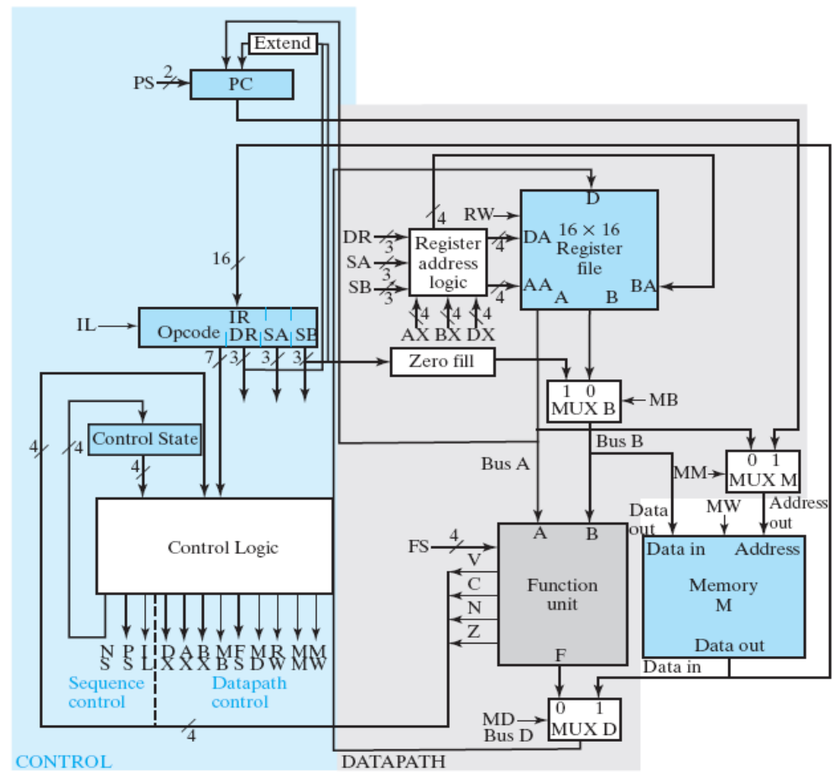
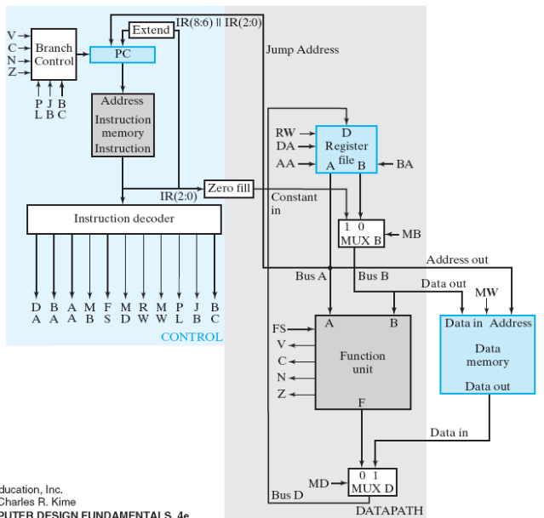
Goal of Chapter 8
Implement a CPU
two designs presented
Figure 8-18: multi-cycle CPU
Figure 8-15: single-cycle CPU

Slide 3
Lectures to present CPU design
Figure 8-18: multi-cycle CPU
Figure 8-15: single-cycle CPU
(Sec. 8-2)
(Sec. 8-3, 8-4)

Slide 4
Lectures to present CPU design
Figure 8-18: multi-cycle CPU
Figure 8-15: single-cycle CPU
(Sec. 8-5, Sec. 8-6)

Slide 5
Lectures to present CPU design
(Sec. 8-9)
Figure 8-18: multi-cycle CPU
Figure 8-15: single-cycle CPU
(Sec. 8-7~8-8)

Slide 6
How a CPU realize a high-level language program?

Slide 7
The Von Neumann Model
memory
D = A+B*C;
E = D+F;
A = A-1;
A
10
CPU
B
20
C
30
D
40
PC: program counter
E
50
F
60

Slide 8
The Von Neumann Model
memory
PC
D = A+B*C;
E = D+F;
A = A-1;
A
10
CPU
B
20
C
30
D
610
PC: program counter
E
50
F
60

Slide 9
The Von Neumann Model
memory
D = A+B*C;
E = D+F;
A = A-1;
PC
A
10
CPU
B
20
C
30
D
610
PC: program counter
E
670
F
60

Slide 10
The Von Neumann Model
memory
D = A+B*C;
E = D+F;
A = A-1;
A
9
PC
CPU
B
20
C
30
D
610
PC: program counter
E
670
F
60

Slide 11
How a CPU works?
follow the von Neumann model
  step by step
  one instruction per step
but decompose operations into primitive and regular ones
assembly program
load R1, A; //R1 = mem[A];
load R2, B; //R2 = mem[B];
load R3, C; //R3 = mem[C];
mult R4, R2, R3; //R4=R2*R3;
add R5, R1, R4; //R5=R1+R4;
store D, R5; //mem[D] = R5;
load R6, F; //R6 = mem[D];
add R7, R5, R6; //R7 = R5+R6;
store E, R7; //mem[E] = R7;
sub R1, R1, 1; //R1 = R1-1;
store A, R1; //mem[A] = R1;
D = A+B*C;
E = D+F;
A = A-1;

Slide 12
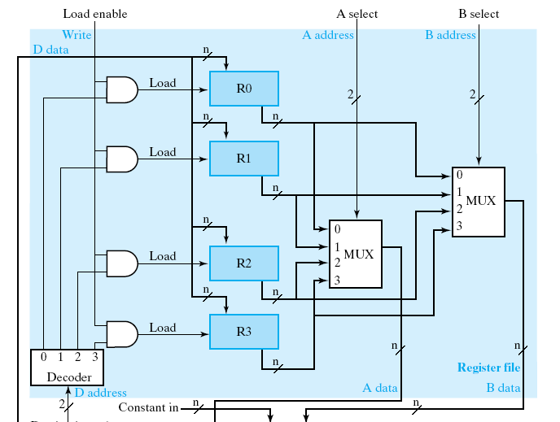
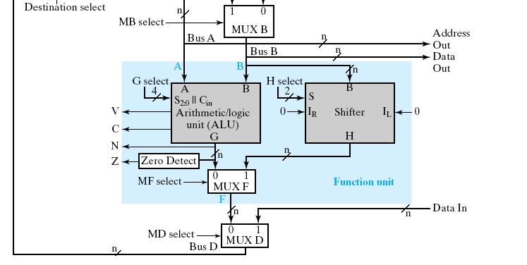
How a CPU works?
from hardware design perspective
the data path:

Slide 13
How a CPU works?
registers to store variables
registers

Slide 14
How a CPU works?
function units to perform arithmetic operations (+, -, &, |, ~, ^, <<, >>)
function units

Slide 15
How a CPU works?
still follows von Neumann model
A = B+C;
memory
A
B
load R1, B; //R1 = mem[B];
load R2, C; //R2 = mem[C];
add R3, R1, R2; //R3 = R1+R2;
store A, R3; //mem[A] = R3;
C

Slide 16
How a CPU works?
still follows von Neumann model
A = B+C;
memory
A
B
load R1, B; //R1 = mem[B];
load R2, C; //R2 = mem[C];
add R3, R1, R2; //R3 = R1+R2;
store A, R3; //mem[A] = R3;
C

Slide 17
How a CPU works?
still follows von Neumann model
A = B+C;
memory
A
B
load R1, B; //R1 = mem[B];
load R2, C; //R2 = mem[C];
add R3, R1, R2; //R3 = R1+R2;
store A, R3; //mem[A] = R3;
C

Slide 18
How a CPU works?
still follows von Neumann model
A = B+C;
memory
A
B
load R1, B; //R1 = mem[B];
load R2, C; //R2 = mem[C];
add R3, R1, R2; //R3 = R1+R2;
store A, R3; //mem[A] = R3;
C

Slide 19
How a CPU works?
still follows von Neumann model
A = B+C;
memory
A
B
load R1, B; //R1 = mem[B];
load R2, C; //R2 = mem[C];
add R3, R1, R2; //R3 = R1+R2;
store A, R3; //mem[A] = R3;
C

Slide 20
The assembly program to realize a C sample code
assembly program
load R1, A; //R1 = mem[A];
load R2, B; //R2 = mem[B];
load R3, C; //R3 = mem[C];
mult R4, R2, R3; //R4=R2*R3;
add R5, R1, R4; //R5=R1+R4;
store D, R5; //mem[D] = R5;
load R6, F; //R6 = mem[D];
add R7, R5, R6; //R7 = R5+R6;
store E, R7; //mem[E] = R7;
sub R1, R1, 1; //R1 = R1-1;
store A, R1; //mem[A] = R1;
D = A+B*C;
E = D+F;
A = A-1;

Slide 21
The assembly program to realize a C sample code
assembly program
load R1, A; //R1 = mem[A];
load R2, B; //R2 = mem[B];
load R3, C; //R3 = mem[C];
mult R4, R2, R3; //R4=R2*R3;
add R5, R1, R4; //R5=R1+R4;
store D, R5; //mem[D] = R5;
load R6, F; //R6 = mem[D];
add R7, R5, R6; //R7 = R5+R6;
store E, R7; //mem[E] = R7;
sub R1, R1, 1; //R1 = R1-1;
store A, R1; //mem[A] = R1;
D = A+B*C;
E = D+F;
A = A-1;

Slide 22
The assembly program to realize a C sample code
assembly program
load R1, A; //R1 = mem[A];
load R2, B; //R2 = mem[B];
load R3, C; //R3 = mem[C];
mult R4, R2, R3; //R4=R2*R3;
add R5, R1, R4; //R5=R1+R4;
store D, R5; //mem[D] = R5;
load R6, F; //R6 = mem[D];
add R7, R5, R6; //R7 = R5+R6;
store E, R7; //mem[E] = R7;
sub R1, R1, 1; //R1 = R1-1;
store A, R1; //mem[A] = R1;
D = A+B*C;
E = D+F;
A = A-1;

Slide 23
The assembly program to realize a C sample code
assembly program
load R1, A; //R1 = mem[A];
load R2, B; //R2 = mem[B];
load R3, C; //R3 = mem[C];
mult R4, R2, R3; //R4=R2*R3;
add R5, R1, R4; //R5=R1+R4;
store D, R5; //mem[D] = R5;
load R6, F; //R6 = mem[D];
add R7, R5, R6; //R7 = R5+R6;
store E, R7; //mem[E] = R7;
sub R1, R1, 1; //R1 = R1-1;
store A, R1; //mem[A] = R1;
D = A+B*C;
E = D+F;
A = A-1;

Slide 24
Binary code representation of an assembly program
machine code in memory
0100 01 0001011
load R1, B; //R1 = mem[B];
load R2, C; //R2 = mem[C];
add R3, R1, R2; //R3 = R1+R2;
store A, R3; //mem[A] = R3;
0100 10 0000011
0110 01 10 11 000
1100 11 0100110

Slide 25
Instruction Set Architecture
the part that a programmer should know
  registers visible by the programmer
  operations supported (+, -, *, /, etc.)
…(more will be discussed in near future)…

Slide 26
Relate RTL Design Methodology to CPU Design

Slide 27
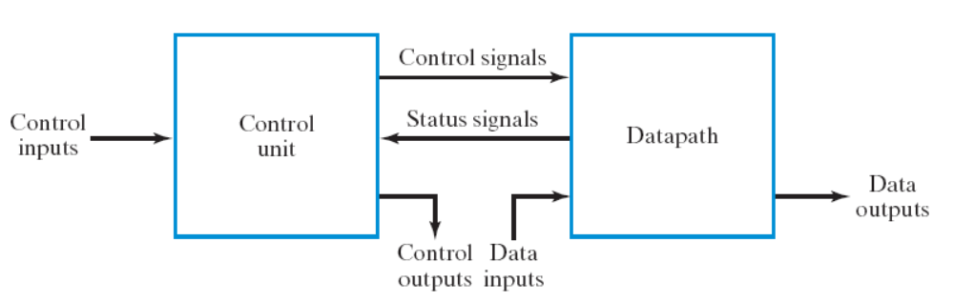
How to design a CPU
Step 0: define the “assembly instructions” of the CPU
Step 1: starts from the general framework
Step 2: specify the behavior of each part
  control unit: state-diagram
  data path: micro-operation
Step 3: design circuits from behavior specification
  control unit: state-diagram to circuit (Chapter 5)
  data path: micro-operation to circuit (Sec. 7.3 – 7.6)
Just apply the general
RTL design method!

Slide 28
RTL design for CPU
data path: a generic arithmetic unit
Figure 9-18: multi-cycle CPU

Slide 29
RTL design for CPU
control unit: send required control
signals to realize an instruction
instruction
address
memory
instruction
control signals
Figure 9-18: multi-cycle CPU

