Slide 1
Instruction Set Architecture and Assembly Programming
Exercise

Slide 2
Problem 1
assembly programming

Slide 3
Q1: assembly programming
for (i=0;i<N;i++)
  A[i] = B[i]+C[i];
translate the C-code to assembly

Slide 4
Step 1: a coding style with simpler implementation
for (i=0;i<N;i++)
A[i] = B[i]+C[i];
int *p, *q, *r;
p = &(A[0]);
q = &(B[0]);
r = &(C[0]);
for (i=0;i<N;i++) {
t1 = *q; //t1=B[i]
q++;
t2 = *r; //t2=C[i]
r++;
t3 = t1+t2; //t3=B[i]+C[i]
*p = t3; //A[i] = t3
p++;
}
address
A[0]
A[1]
A[2]
…
p
B[0]
B[1]
B[2]
…
q
C[0]
C[1]
C[2]
…
r

Slide 5
Step 1: a coding style with simpler implementation
for (i=0;i<N;i++)
A[i] = B[i]+C[i];
int *p, *q, *r;
p = &(A[0]);
q = &(B[0]);
r = &(C[0]);
for (i=0;i<N;i++) {
t1 = *q; //t1=B[i]
q++;
t2 = *r; //t2=C[i]
r++;
t3 = t1+t2; //t3=B[i]+C[i]
*p = t3; //A[i] = t3
p++;
}
Load B[i] and increment
the pointor
address
A[0]
A[1]
A[2]
…
p
B[0]
B[1]
B[2]
…
q
C[0]
C[1]
C[2]
…
r

Slide 6
Step 2: Deal with loop control
for (i=0;i<N;i++) {
t1 = *q; //t1=B[i]
q++;
t2 = *r; //t2=C[i]
r++;
t3 = t1+t2; //t3=B[i]+C[i]
*p = t3; //A[i] = t3
p++;
}
i=0;
Loop_Start:
t1 = *q; //t1=B[i]
q++;
t2 = *r; //t2=C[i]
r++;
t3 = t1+t2; //t3=B[i]+C[i]
*p = t3; //A[i] = t3
p++;
i=i+1;
C = i-N;
if (C<0) goto Loop_Start; //use BRN instruction

Slide 7
Step 3: Register Allocation
i=0;
Loop_Start:
t1 = *q; //t1=B[i]
q++;
t2 = *r; //t2=C[i]
r++;
t3 = t1+t2; //t3=B[i]+C[i]
*p = t3; //A[i] = t3
p++;
i=i+1;
C = i-N;
if (C<0) goto Loop_Start; //use BRN instruction
i
R0
t1
R1
t2
R2
t3
R3
p
R4
q
R5
r
R6
N
R7
C
??
Oh No! Out of Register!

Slide 8
Step 3: Register Allocation
i=0;
Loop_Start:
t1 = *q; //t1=B[i]
q++;
t2 = *r; //t2=C[i]
r++;
t3 = t1+t2; //t3=B[i]+C[i]
*p = t3; //A[i] = t3
p++;
i=i+1;
C = i-N;
if (C<0) goto Loop_Start; //use BRN instruction
i
R0
t1
R1
t2
R2
t3
R3
p
R4
q
R5
r
R6
N
R7
C
R3
Re-use a register with value no longer been used again!

Slide 9
Step 3: Translate to assembly code
i=0;
Loop_Start:
t1 = *q; //t1=B[i]
q++;
t2 = *r; //t2=C[i]
r++;
t3 = t1+t2; //t3=B[i]+C[i]
*p = t3; //A[i] = t3
p++;
i=i+1;
C = i-N;
if (C<0) goto Loop_Start;
i
R0
XOR R0, R0; //i=0
Loop_Start:
LD R1, R5 //R1=mem[R5]
ADI R5, R5, 4 //R5=R5+4;
LD R2, R6 //R2=mem[R6]
ADI R6, R6, 4 //R6=R6+4
ADD R3, R1, R2 //R3=R1+R2
ST R4, R3 //mem[R4]=R3
ADI R4, R4, 4 //R4=R4+4
ADI R0, R0, 1 //R0=R0+1
SUB R3, R3, R7 //R3=R3-R7
BRN R3, -9 //if (R3<0) PC=PC-9
t1
R1
t2
R2
t3
R3
p
R4
q
R5
r
R6
N
R7
C
R3

Slide 10
Step 3: Translate to assembly code
a trick to clear a register/variable content
i=0;
Loop_Start:
t1 = *q; //t1=B[i]
q++;
t2 = *r; //t2=C[i]
r++;
t3 = t1+t2; //t3=B[i]+C[i]
*p = t3; //A[i] = t3
p++;
i=i+1;
C = i-N;
if (C<0) goto Loop_Start;
i
R0
XOR R0, R0, R0; //i=0
Loop_Start:
LD R1, R5 //R1=mem[R5]
ADI R5, R5, 4 //R5=R5+4;
LD R2, R6 //R2=mem[R6]
ADI R6, R6, 4 //R6=R6+4
ADD R3, R1, R2 //R3=R1+R2
ST R4, R3 //mem[R4]=R3
ADI R4, R4, 4 //R4=R4+4
ADI R0, R0, 1 //R0=R0+1
SUB R3, R3, R7 //R3=R3-R7
BRN R3, -9 //if (R3<0) PC=PC-9
t1
R1
t2
R2
t3
R3
p
R4
q
R5
r
R6
N
R7
C
R3

Slide 11
Step 3: Translate to assembly code
i=0;
Loop_Start:
t1 = *q; //t1=B[i]
q++;
t2 = *r; //t2=C[i]
r++;
t3 = t1+t2; //t3=B[i]+C[i]
*p = t3; //A[i] = t3
p++;
i=i+1;
C = i-N;
if (C<0) goto Loop_Start;
i
R0
XOR R0, R0, R0; //i=0
Loop_Start:
LD R1, R5 //R1=mem[R5]
ADI R5, R5, 4 //R5=R5+4;
LD R2, R6 //R2=mem[R6]
ADI R6, R6, 4 //R6=R6+4
ADD R3, R1, R2 //R3=R1+R2
ST R4, R3 //mem[R4]=R3
ADI R4, R4, 4 //R4=R4+4
ADI R0, R0, 1 //R0=R0+1
SUB R3, R3, R7 //R3=R3-R7
BRN R3, -9 //if (R3<0) PC=PC-9
load memory content with a pointor
t1
R1
t2
R2
t3
R3
p
R4
q
R5
r
R6
N
R7
C
R3

Slide 12
Step 3: Translate to assembly code
i=0;
Loop_Start:
t1 = *q; //t1=B[i]
q++;
t2 = *r; //t2=C[i]
r++;
t3 = t1+t2; //t3=B[i]+C[i]
*p = t3; //A[i] = t3
p++;
i=i+1;
C = i-N;
if (C<0) goto Loop_Start;
i
R0
XOR R0, R0, R0; //i=0
Loop_Start:
LD R1, R5 //R1=mem[R5]
ADI R5, R5, 4 //R5=R5+4;
LD R2, R6 //R2=mem[R6]
ADI R6, R6, 4 //R6=R6+4
ADD R3, R1, R2 //R3=R1+R2
ST R4, R3 //mem[R4]=R3
ADI R4, R4, 4 //R4=R4+4
ADI R0, R0, 1 //R0=R0+1
SUB R3, R3, R7 //R3=R3-R7
BRN R3, -9 //if (R3<0) PC=PC-9
t1
R1
t2
R2
add with constant should use another instruction
t3
R3
p
R4
(assume sizeof(int)=4)
q
R5
r
R6
N
R7
C
R3

Slide 13
Step 3: Translate to assembly code
i=0;
Loop_Start:
t1 = *q; //t1=B[i]
q++;
t2 = *r; //t2=C[i]
r++;
t3 = t1+t2; //t3=B[i]+C[i]
*p = t3; //A[i] = t3
p++;
i=i+1;
C = i-N;
if (C<0) goto Loop_Start;
i
R0
XOR R0, R0, R0; //i=0
Loop_Start:
LD R1, R5 //R1=mem[R5]
ADI R5, R5, 4 //R5=R5+4;
LD R2, R6 //R2=mem[R6]
ADI R6, R6, 4 //R6=R6+4
ADD R3, R1, R2 //R3=R1+R2
ST R4, R3 //mem[R4]=R3
ADI R4, R4, 4 //R4=R4+4
ADI R0, R0, 1 //R0=R0+1
SUB R3, R3, R7 //R3=R3-R7
BRN R3, -9 //if (R3<0) PC=PC-9
t1
R1
t2
R2
t3
R3
p
R4
q
R5
r
R6
conditional branch
N
R7
C
R3

Slide 14
Problem 2
assembly to binary machine code translation

Slide 15
Problem Description
write-down the machine code encoding for the following assembly instructions
  (1) LD R1, R5 //R1 = mem[R5]
  (2) ADI R5, R3, 4 //R5=R3+4
  (3) SUB R3, R2, R7 //R3=R2-R7
  (4) BRN R3, -9 //if (R3<0) goto PC-9

Slide 16
Solution
LD R1, R5 //R1=mem[R5]
use format 1
15
9
8
6
5
3
2
0
0010000
Destination
Source reg-
Source reg-
Opcode
001
101
000
register (DR)
ister A (SA)
ister B (SB)
(opcode of LD)
(R1)
(R5)
(xxx)
(a) Register

Slide 17
Solution
ADI R5, R3, 4 //R5=R3+4
use format 2
15
9
8
6
5
3
2
0
1000010
Destination
Source reg-
Opcode
101
011
100
register (DR)
ister A (SA)
Operand (OP)
opcode of ADI
R5
R3
4
(b) Immediate

Slide 18
Solution
SUB R3, R2, R7 //R3=R2-R7
use format 1
15
9
8
6
5
3
2
0
0000101
Destination
Source reg-
Source reg-
Opcode
011
010
111
register (DR)
ister A (SA)
ister B (SB)
(opcode of sub)
(R3)
(R2)
(R7)
(a) Register

Slide 19
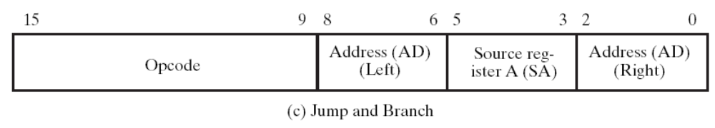
Solution
BRN R3, -9
110
3 (011)
111
opcode of BRN: 1100001
-9 = 110111

Slide 20
Problem 3
Disassemble

Slide 21
Answers
0000101 011 101 110 =>SUB R3, R5, R6
  R3 = R5-R6
1100001 010 011 011 =>BRN R3, 19
  if (R3<0) PC=PC+19
0100000 000 010 110 =>ST R2, R6
  Mem[R2] = R6

Slide 22
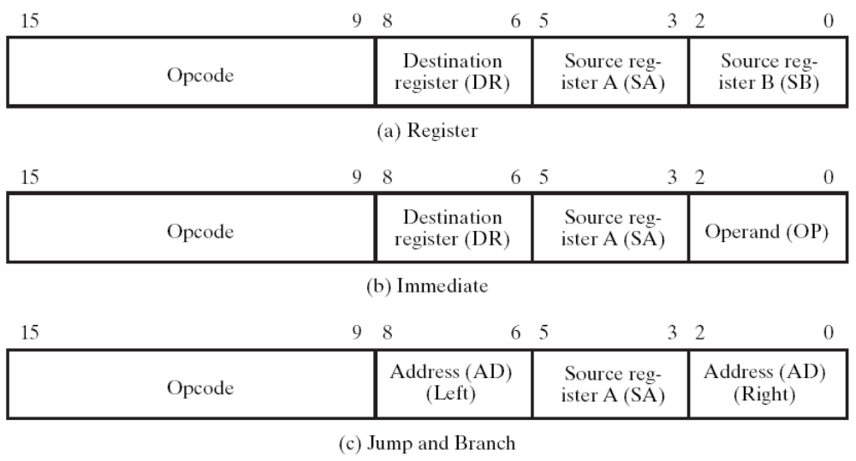
Answer to Problem 3(c)
machine code: 0100000 000 010 110
which format?

Slide 23
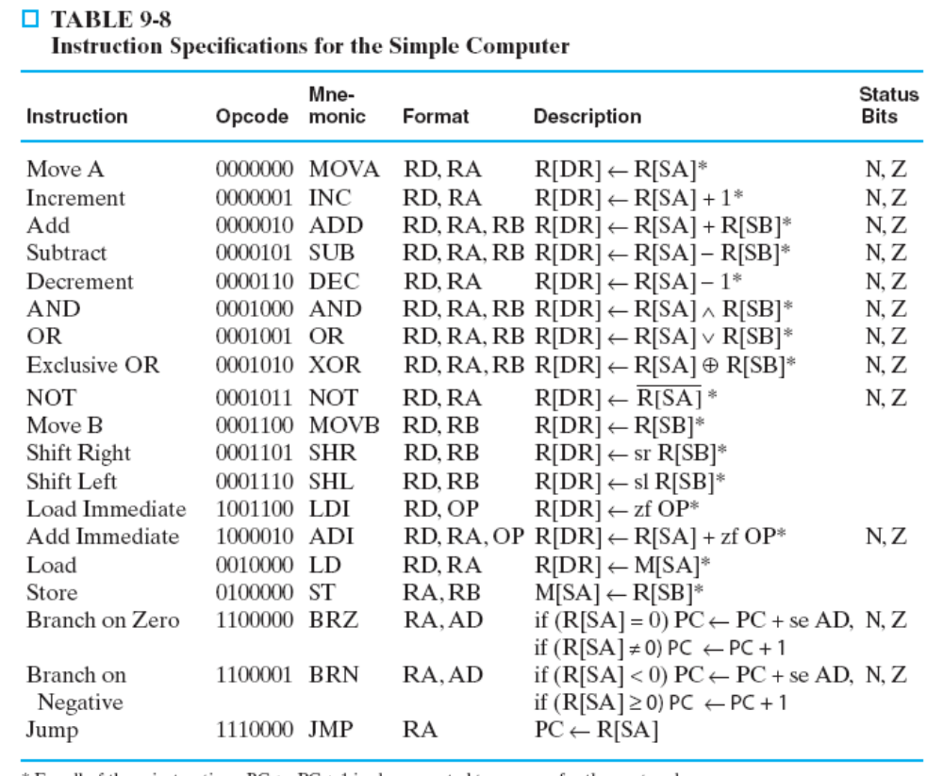
Answer to Problem 2(c)
machine code: 0100000 000 010 110
Step 1: check for the opcode table
  => the store (ST) instruction

Slide 24
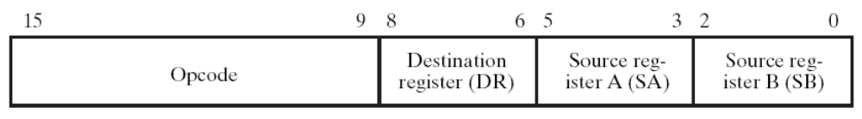
Answer to Problem 2(c)
machine code: 0100000 000 010 110
Step 1: check for the opcode table
  => the store (ST) instruction
Step 2: match with the binary code format
  ST, R2, R6
R2
R6
opcode of store (ST)
0100000
000
010
110

Slide 25
Problem 4
realization of assembly instructions

Slide 26
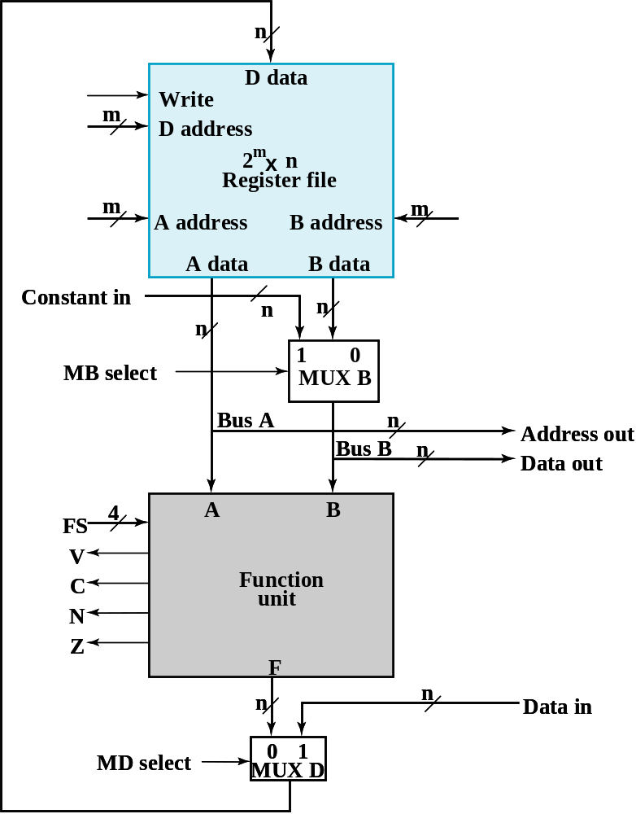
Answer to Problem 4(a)
registers R1, R2, and R5 are here
1
write enable
SUB R1, R2, R5
  R1=R2-R5
001
write R1
010
select R2
select R5
101
0
select B
R5
R2
adder is here
0101
do A+(~B)+1
0
select function unit

Slide 27
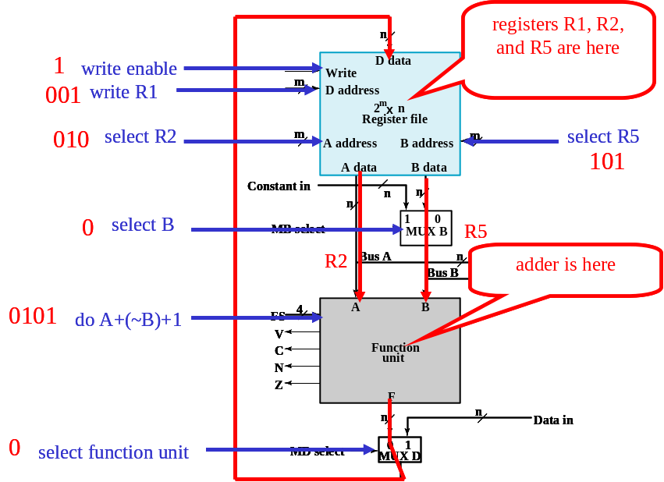
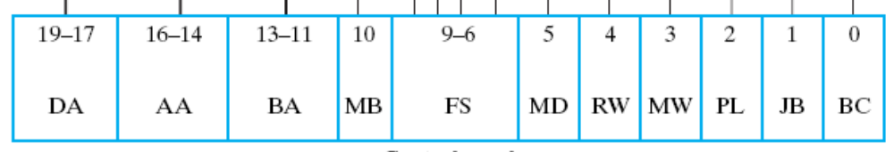
Answer to Problem 4(a)
SUB R1, R2, R5
  R1=R2-R5
001
010
101
0
0101
0
1
0
0
X
X

Slide 28
Answer to Problem 4(a)
registers R1, R2, and R5 are here
SUB R1, R2, R5
  R1=R2-R5
adder is here

Slide 29
Answer to Problem 4(a)
registers R1, R2, and R5 are here
SUB R1, R2, R5
  R1=R2-R5
010
select R2
select R5
101
0
select B
R5
R2
adder is here

Slide 30
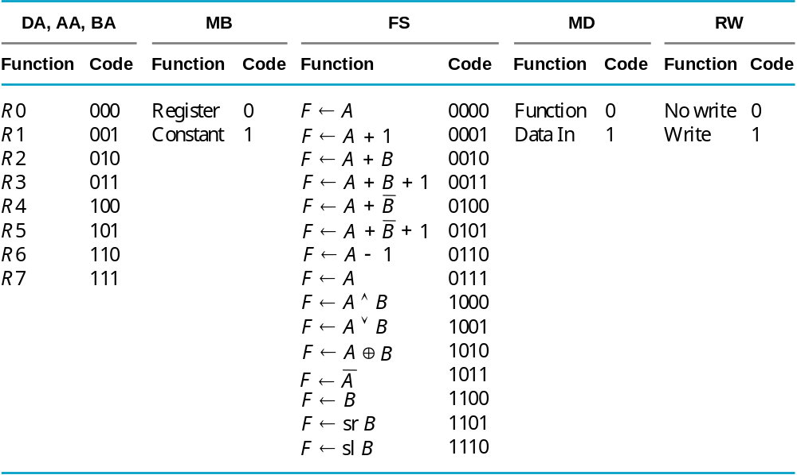
Answer to Problem 4(a)

Slide 31
Answer to Problem 4(a)
SUB R1, R2, R5
  R1=R2-R5
R5
R2
adder is here
0101
do A+(~B)+1

Slide 32
Answer to Problem 4(a)
1
write enable
SUB R1, R2, R5
  R1=R2-R5
001
write R1
R2-R5
0
select function unit

Slide 33
Answer to Problem 4(a)
SUB R1, R2, R5
  R1=R2-R5
001
010
101
0
0101
0
1
0
0
X
X

Slide 34
Answer to Problem 4(b)
registers R1 and R2 are here
1
write enable
LD R1, R2
  R1=mem[R2]
001
write R1
010
select R2
don’t care
XXX
X
don’t care
R2
XXXX
don’t care
not used
1
select memory data
memory data

Slide 35
Problem 4(c)
XXX
XXX
XXX
X
0000
X
0
0
1
0
1
BRN R1, 5
  if (R1<0) PC=PC+5

Slide 36
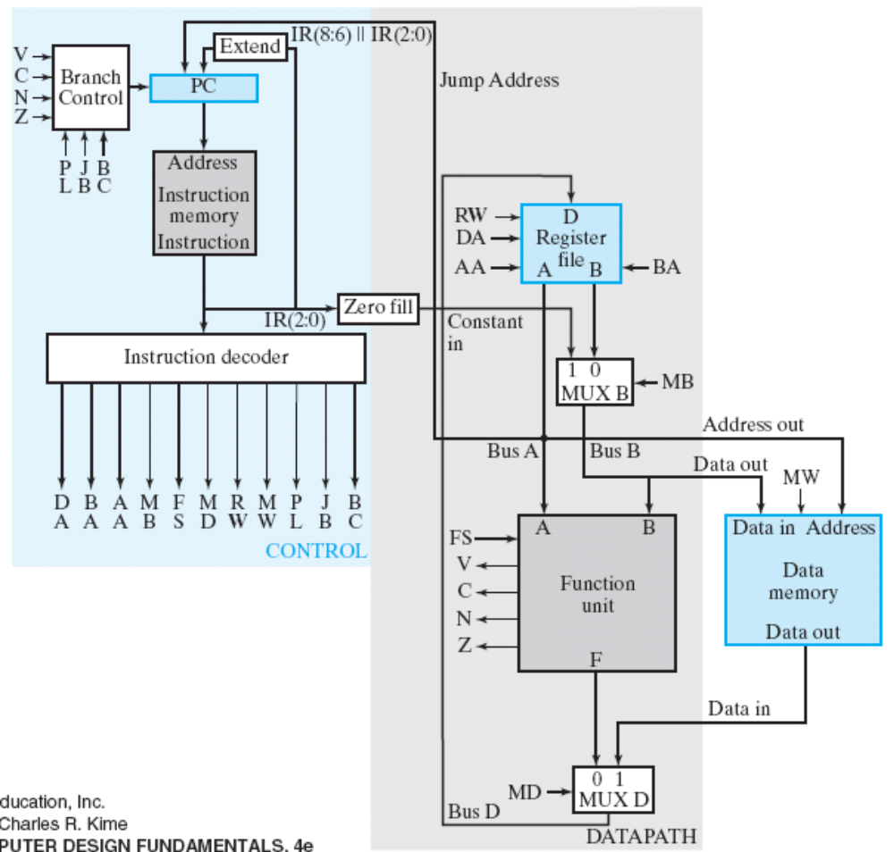
Answer to Problem 4(c)
0
do not write
1
0
1
select R1
001
0
do not write
R1
F=A
000
BRN R1, 5
  if (R1<0) PC=PC+5

Slide 37
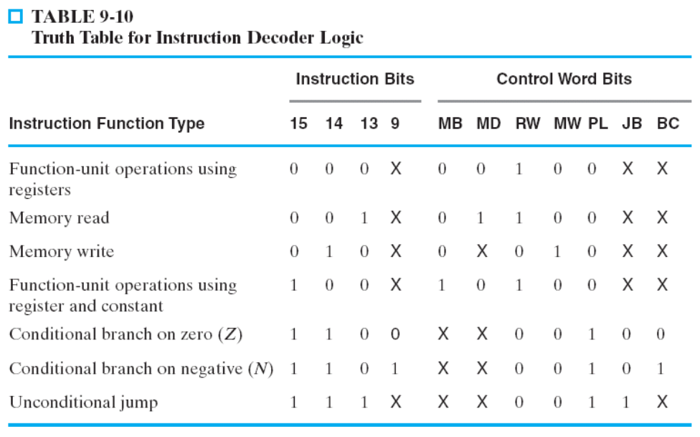
Answer to Problem 4(c)
0
do not write
1
0
1
select R1
001
0
control signals to determine next PC
do not write
R1
F=A
000
BRN R1, 5
  if (R1<0) PC=PC+5

Slide 38
Answer to Problem 4(c)
1
0
1
select R1
001
R1
F=A
0000
BRN R1, 5
  if (R1<0) PC=PC+5

Slide 39
Answer to Problem 4(c)
0
do not write
0
do not write
BRN R1, 5
  if (R1<0) PC=PC+5

Slide 40
Problem 4(c)
XXX
XXX
XXX
X
0000
X
0
0
1
0
1
BRN R1, 5
  if (R1<0) PC=PC+5

