Slide 1
Control Unit of a single-cycle CPU
Lecture 11

Slide 2
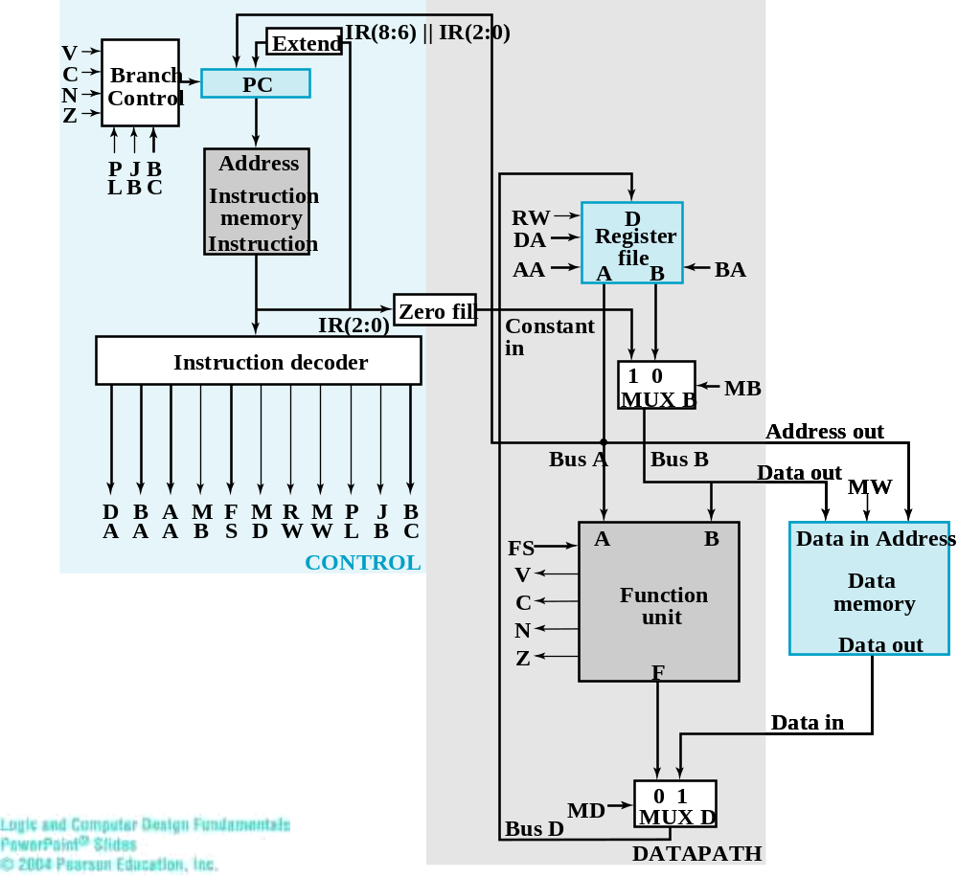
RTL design for the single-cycle CPU

Slide 3
A view on CPU
a hardware with
  generic control unit, and
  generic data path

Slide 4
Generic control unit
assembly program as a finite state machine
0
ADD R1, R2, R3
LDI R5, 7
1
SUB R4, R1, R5
PC=10
2
BRN R4, 8
branch taken
3
LDI R5, 0
PC=0
PC=1
PC=2
…
branch non-taken
PC=3
ADD R1, R2, R3
SUB R4, R1, R5
BRN R4, 8
10
LDI R5, 7
LDI R5, 0
address

Slide 5
How to realize a “generic” control unit
Key Idea: store operations in RAM
The Design:
  use PC (program counter) as the state of FSM
  retrieve operations (assembly instruction) for each state from memory
  decode and send-out control signals

Slide 6
RTL design for the single-cycle CPU
PC: Program Counter
(the register to keep the state of FSM)
use PC (program counter) as the state of FSM
retrieve operations (assembly instruction) for each state from memory
decode and send-out control signals

Slide 7
The finite-state machine
PC=10
branch taken
PC=0
PC=1
PC=2
branch non-taken
PC=3
memory
decode logic
(combinational circuit)
control signals
instruction

Slide 8

Extend
IR(8:6) || IR(2:0)
V
C
Branch
PC
N
Control
address
Z
P
J
B
Address
L
B
C
Instruction
memory
RW
D
Instruction
DA
Register
0
AA
A
file
B
BA
ADD R1, R2, R3
IR(2:0)
Zero fill
Constant
1
SUB R4, R1, R5
Instruction decoder
in
1
0
MB
BRN R4, 8
2
MUX B
Address out
LDI R5, 0
3
Bus A
Bus B
Data out
MW
D
B
A
M
F
M
R
M
P
J
B
…
A
A
A
B
S
D
W
W
L
B
C
FS
A
B
Data in
Address
CONTROL
V
Function
Data
C
LDI R5, 7
memory
10
unit
N
Data out
Z
F
address
Data in
MD
0
1
Bus D
MUX D
DATAPATH

Slide 9
Extend
IR(8:6) || IR(2:0)
V
C
Branch
PC
N
Control
Z
P
J
B
Address
L
B
C
Instruction
memory
RW
D
Instruction
DA
Register
instruction
(e.g. ADD R1, R2, R3)
file
memory data output
AA
A
B
BA
IR(2:0)
Zero fill
Constant
Instruction decoder
in
1
0
MB
MUX B
Address out
Bus A
Bus B
Data out
MW
D
B
A
M
F
M
R
M
P
J
B
A
A
A
B
S
D
W
W
L
B
C
FS
A
B
Data in
Address
CONTROL
V
Function
Data
C
unit
memory
N
Data out
Z
F
Data in
MD
0
1
Bus D
MUX D
DATAPATH

Slide 10
Extend
IR(8:6) || IR(2:0)
V
C
Branch
PC
N
Control
Z
P
J
B
Address
L
B
C
Instruction
memory
RW
D
Instruction
DA
Register
instruction
(e.g. ADD R1, R2, R3)
file
AA
A
B
BA
IR(2:0)
Zero fill
Constant
Instruction decoder
in
1
0
MB
MUX B
Address out
Bus A
Bus B
Data out
MW
D
B
A
M
F
M
R
M
P
J
B
A
A
A
B
S
D
W
W
L
B
C
FS
A
B
Data in
Address
CONTROL
V
control signals to data path
Function
Data
C
unit
memory
N
Data out
Z
F
Data in
MD
0
1
Bus D
MUX D
DATAPATH

Slide 11
Instruction Decoder Design

Slide 12
General scheme to design the decoder
the general scheme of designing a combinational circuit
instruction
opcode
dest.
register
source reg.
A
source reg.
B
combinational circuit
…
DA
BA
AA
Please draw a 2¹⁶*20 truth table ?!

Slide 13
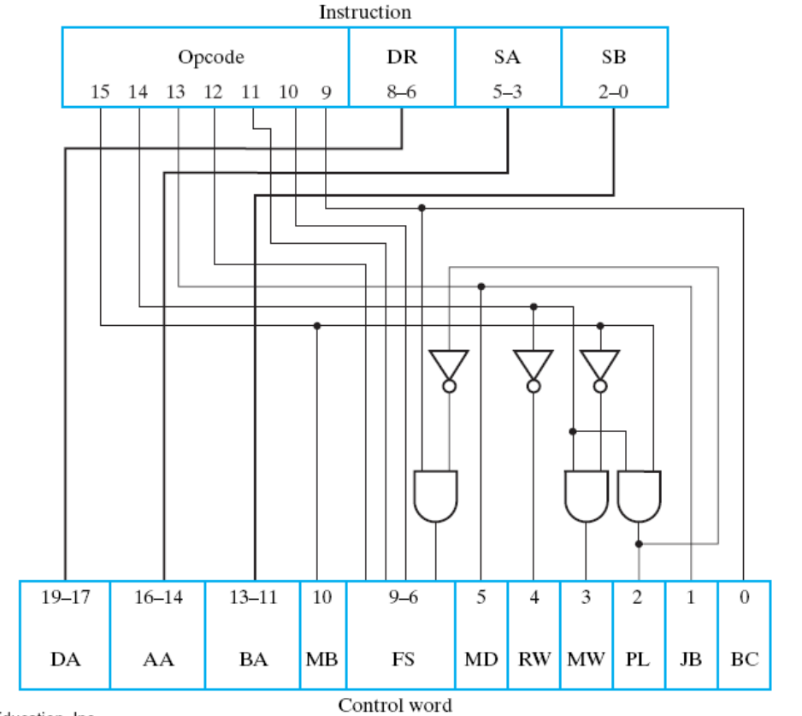
The complete decoder circuit
Why it’s so simple?

Slide 14
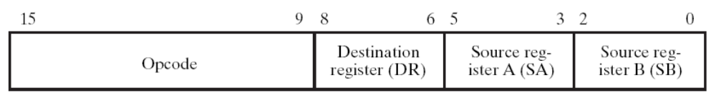
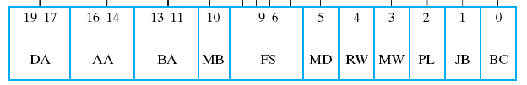
Decoding an arithmetic instruction with register operands
e.g. Add R1, R2, R3
direct wiring
0
0
1

Slide 15
Decoding an arithmetic instruction with register operands
always @(*) begin
//for function unit to perform add
if (opcode==ADD) FS = 4’b0010;
//for function unit to perform sub
else if (opcode==SUB) FS = 4’b0101;
…
end
e.g. Add R1, R2, R3
combinational circuit

Slide 16
The complete decoder circuit
Why it’s so simple?

Slide 17
The complete decoder circuit
please observe from the opcode encoding
Why it’s so simple?

Slide 18
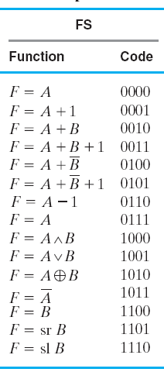
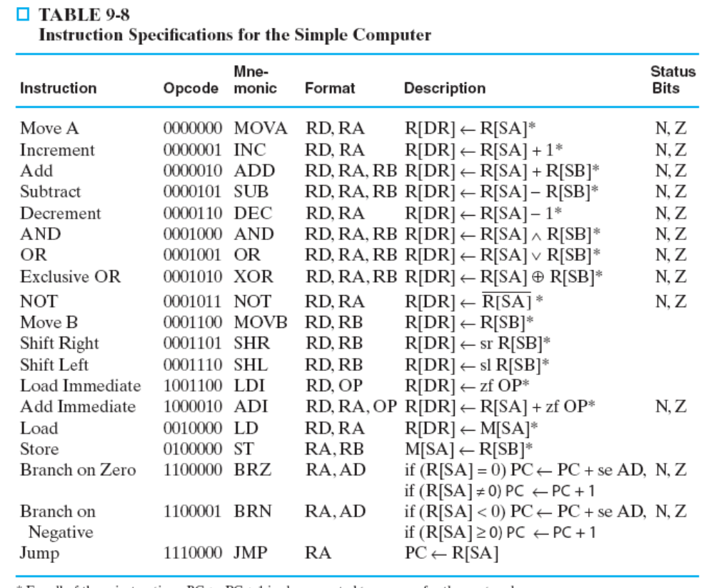
Opcode vs. control signals FS

Slide 19
Instruction Decoder Design
(These fields all decoded from opcode)
combinational circuit

Slide 20
Extend
IR(8:6) || IR(2:0)
V
C
Branch
PC
N
Control
Z
P
J
B
Address
L
B
C
Instruction
memory
RW
D
Instruction
DA
Register
AA
A
file
B
BA
IR(2:0)
Zero fill
Constant
Instruction decoder
in
1
0
MB
MUX B
Address out
Bus A
Bus B
Data out
MW
D
B
A
M
F
M
R
M
P
J
B
A
A
A
B
S
D
W
W
L
B
C
FS
A
B
Data in
Address
CONTROL
V
Function
Data
C
unit
memory
MB=1 only if OPCODE=LDI or ADI
N
Data out
Z
F
Data in
MD
0
1
Bus D
MUX D
DATAPATH

Slide 21
The complete decoder circuit
check the opcode table:
How to classify a constant
Why it’s so simple?

Slide 22
The complete decoder circuit
check the opcode table:
How to tell a load/store instruction
Why it’s so simple?

Slide 23
General scheme to simplify the decoder
The Trick: make opcode and instruction format regular
fixed for various types of instructions
opcode
dest reg.
source reg.
A
source reg.
B
instruction
type
mode
operation
function

Slide 24
What’s left
control signals for branch/jump instructions

Slide 25

Detailed design of branch control
control signals for branch

Slide 26
Detailed design of branch control
PL=1 if executing one of JMP, BRN, BRZ

Slide 27
Detailed design of branch control
JB =1 if executing one of unconditional jump (JMP)

Slide 28
Detailed design of branch control
BC=0 for BRZ
BC=1 for BRN

Slide 29
The Solution
1
constant
PL
logic
JB
MUX
0
1
BC
sel_1
N
Z
adder
Bus_A
sel_2
MUX
PC

Slide 30
Executing BRN R1, 3
(if (R1<0) goto PC+3)
3
R1
control signals for branch

Slide 31
Executing BRN R1, 3
(if (R1<0) goto PC+3)
3
1
constant
PL
logic
JB
MUX
0
1
BC
sel_1
N
Z
adder
Bus_A
sel_2
MUX
PC

Slide 32
Executing JMP R1
(goto R1) (PC=R1)
R1
control signals for branch

Slide 33
Executing JMP R1
(goto R1) (PC=R1)
1
constant
PL
logic
JB
MUX
0
1
BC
sel_1
N
R1
Z
adder
Bus_A
sel_2
MUX
PC

