Slide 1
Control Signals of Data Path
Exercise 01
max. even number not exceeding
(R1-R2+R3)

Slide 2
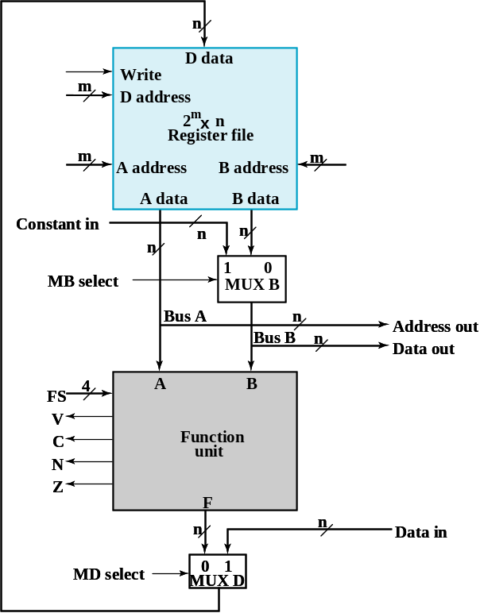
Problem Description
to compute R4=(max. even number not exceeding (R1-R2)+R3)
Assume: R7=(11111110)₂ at initial
You have to use the CPU data path
control unit
you designed

Slide 3

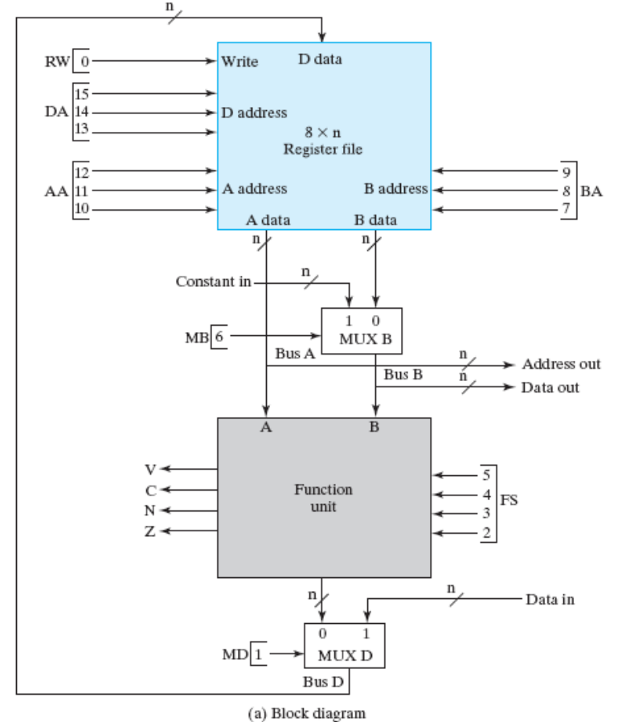

State diagram of the control
write-down the control signal for each state
S0
do nothing
start
S1
R5=R1-R2
S2
R6=R5+R3
S3
R4=R6&R7

Slide 4
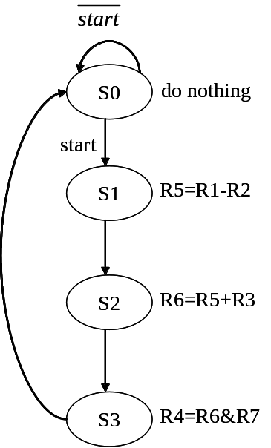
State diagram of the control
xxx
xxx
xxx
x
xxxx
x
0

Slide 5
State diagram of the control
101
001
010
0
0101
0
1

Slide 6
State diagram of the control
110
101
011
0
0010
0
1

Slide 7
State diagram of the control
100
110
111
0
1000
0
1

