Slide 1
Design Exercise for Sequential Circuit
Lecture 02A

Slide 2
Outline: the three exercises
a simple finite state machine
the sequence recognizer with different state assignment
  one flip-flop per state
a digit lock

Slide 3
Recall: steps to realize a state diagram

Slide 4
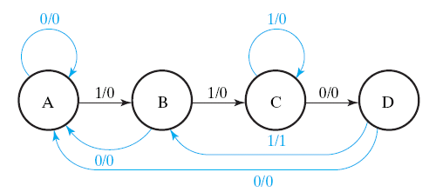
Design Example
realize the finite automata
S0
S1
S2
S3
time
state of
flip flops
S0
S0
S1
S2
input X
0
1
1
0

Slide 5
Design Steps
Step 1: draw the state diagram and state table
Step 2: assign state values and flip flops
Step 3: draw the spec of the combinational part
  draw the truth table
Step 4: realize the combinational part
  logic simplification if necessary

Slide 6
Design Steps
00
01
11
10
Step 1: draw the state diagram and state table
Step 2: assign state values and flip flops
Step 3: draw the spec of the combinational part
  draw the truth table
Step 4: realize the combinational part
  logic simplification if necessary
combinational
circuit
A
D
B
X
D
Y

Slide 7
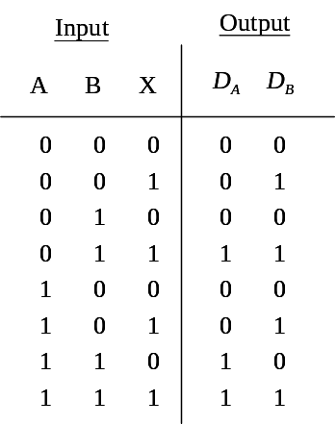
Design Steps
00
01
11
10
Step 1: draw the state diagram and state table
Step 2: assign state values and flip flops
Step 3: draw the spec of the combinational part
  draw the truth table
Step 4: realize the combinational part
  logic simplification if necessary
combinational
circuit
A
D
B
X
D
Y

Slide 8
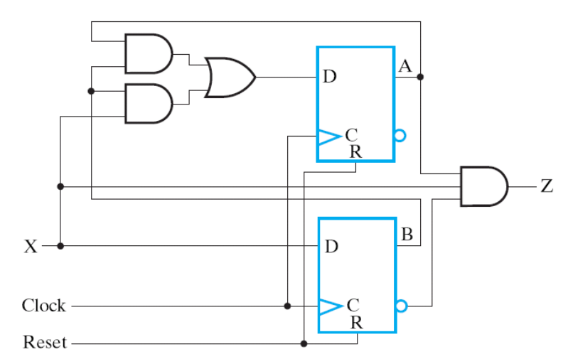
Design Steps
00
01
11
10
Step 1: draw the state diagram and state table
Step 2: assign state values and flip flops
Step 3: draw the spec of the combinational part
  draw the truth table
Step 4: realize the combinational part
  logic simplification if necessary

Slide 9
Outline: the three exercises
a simple finite state machine
the sequence recognizer with different state assignment
  one flip-flop per state
a digit lock

Slide 10
Design Exercise 01
realizing a state diagram

Slide 11
The Problem
realize the state diagram
  4 states with one input signal X
draw the framework (block diagram) with key signals named
  write down the Boolean equation for each key signal
X=0
X=1
X=0
X=1
X=0
X=1
00
01
10
11
X=1
X=0

Slide 12




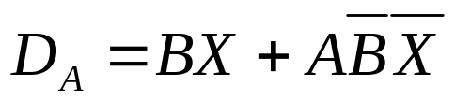
The Solution
X=0
X=1
X=0
X=1
X=0
X=1
00
01
10
11
X=1
X=0
combinational
circuit
A
D
Input
Output
A
B
X
B
X
D
0
0
0
0
0
0
0
1
0
1
0
1
0
0
1
0
1
1
1
0
1
0
0
1
1
1
0
1
0
0
1
1
0
0
0
1
1
1
1
1

Slide 13
Design Exercise 02
sequential circuit design from given state diagram

Slide 14
The Problem
Realize the state diagram
  with 4 flip flops
1000
0100
0010
0001

Slide 15
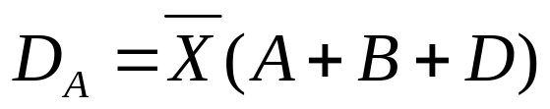
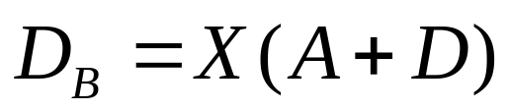
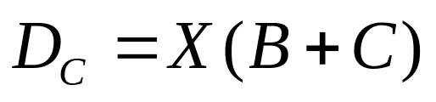

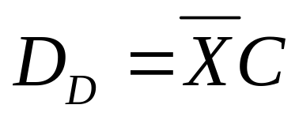

The
Solution
1000
0100
0010
0001
combinational
circuit
A
D
B
D
C
D
X
D
D

Slide 16
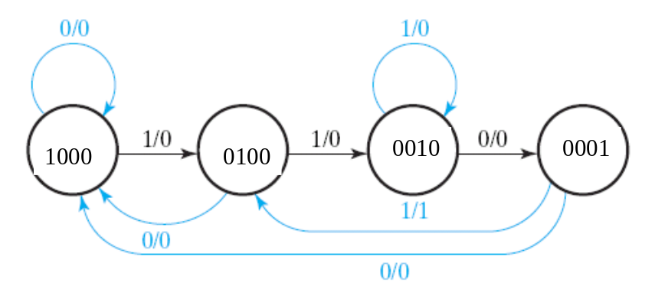
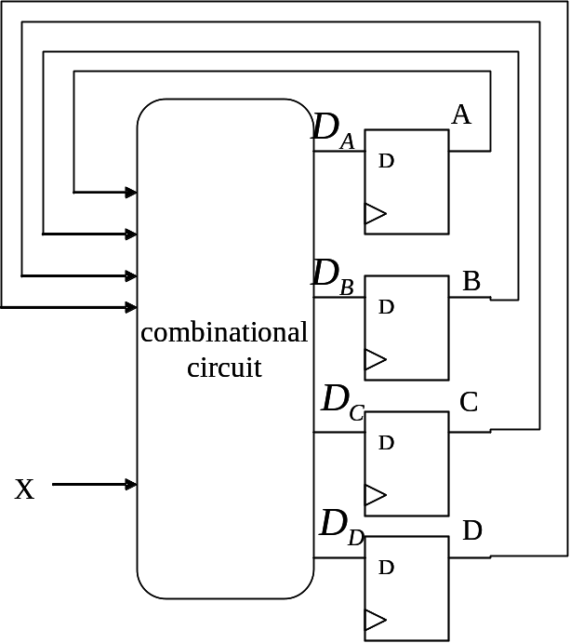
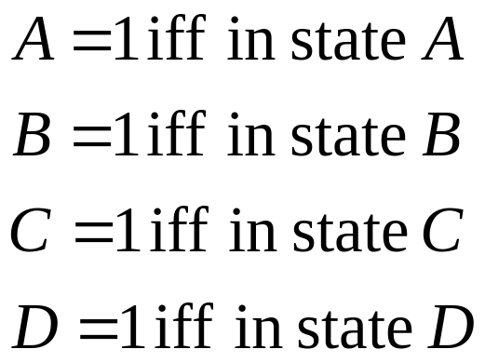
How to observe the answer
meaning of each D flip-flop
B
D
A
C

Slide 17
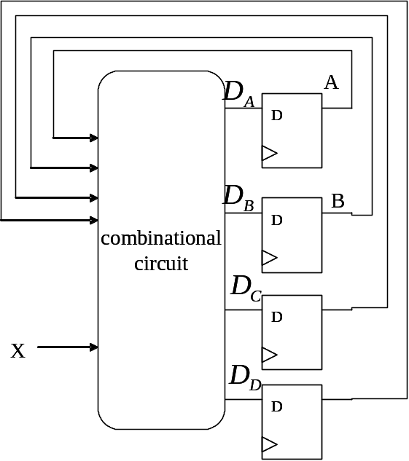


How to observe the answer directly
B
D
A
C
A
B
C
D
X
…
0
0
1
0
0
1
1
only the two entries set D_{C}=1
…
0
0
0
1
0
1
1

Slide 18
How to observe the answer directly
B
D
A
C

Slide 19
Remark
there will be many many don’t-care states if you draw the state table
good K-map simplification also yields the same result

Slide 20
Exercise 03: Digit Lock

Slide 21
The Problem
Want to Design: a digital lock
  initial: in Lock state
  turn to Unlock state if a key sequence matched the pass-word
  at Lock state: turn-back to Unlock state if any key pressed
  the passwd is: 1103
0
Lock
1
2
Unlock
3
back to lock after the key pressed
1
0
1
1
1
0
3
1
2
…
passwd matched, Unlock

Slide 22
The design spec
generate an one cycle pulse X_{i} for each hit of button i
X0
0
state
controller
L
Lock
X1
1
X2
2
U
Unlock
X3
3
clock

Slide 23

The Solution
state diagram
Y+X0+X2+X3
Y
Y+X1
Y
Y
X1
X1
X0
X3
init
A0
A1
A2
A3
A4
X0+X2+X3
X1
X2+X3
Y=1 if no button pressed

Slide 24
The Solution
Trick: setup the meaning for each state
sequence “110” received
a ‘1’ received
Y+X0+X2+X3
Y
Y+X1
Y
Y
X1
X1
X0
X3
init
A0
A1
A2
A3
A4
X0+X2+X3
X1
initial state
at least two consecutive 1s received
sequence “1103” received
X2+X3
Y=1 if no button pressed

Slide 25
The Solution
state diagram
Y+X0+X2+X3
Y
Y+X1
Y
Y
X1
1
X1
1
X0
0
X3
3
init
A0
A1
A2
A3
A4
X0+X2+X3
X1
X2+X3
Y=1 if no button pressed

Slide 26
The Solution
a false trial: 112
Y+X0+X2+X3
Y
Y+X1
Y
Y
X1
1
X1
1
X0
X3
init
A0
A1
A2
A3
A4
X0+X2+X3
2
X1
X2+X3
Y=1 if no button pressed

Slide 27
The Solution
trial: 11111103
1111…
Y+X0+X2+X3
Y
Y+X1
Y
Y
X1
1
X1
1
X0
0
X3
3
init
A0
A1
A2
A3
A4
X0+X2+X3
2
X1
at least two consecutive 1s received
X2+X3
Y=1 if no button pressed

Slide 28
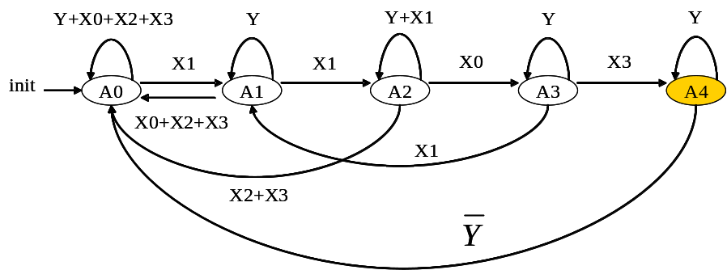
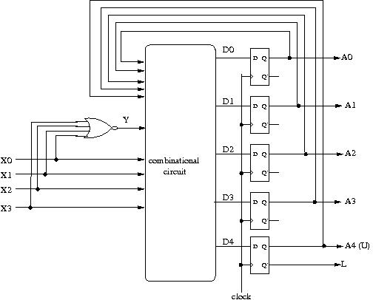
The Solution
framework of the hardware
The trick: Y=1 iff no button pressed

Slide 29



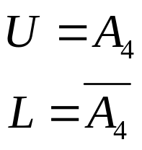

The Solution
Boolean equations:

Slide 30
The Solution
Boolean equations:

Slide 31
Bonus Question
Find a bug of my design for digit lock
  you may hack the lock without the password!

Slide 32
And we finished Chap. 5

Slide 33
Coming Up
We will go into Chap. 7
Lecture 05: registers design
  Section 7.1: register with parallel load
  Section 7.6: shift registers
Lecture 06: counters design and their applications
  Section 7.6
  with your digital clock lab
Lecture 07: RTL design
  RTL: register-transfer level design
  go through whole Chap. 7
  with dash-watch example

Slide 34
How about Chap. 6?
Chap. 6: “Selected Design Topics”
  a quick review on your “electronics” course
  the implementation aspects of VLSI design
We will go back to Chap. 6 before your start your CPU term project
  Recall: implement CPU with UMC 90nm process!

