Slide 1
Sequential Circuit Design
Lecture 02
Section 4-5

Slide 2
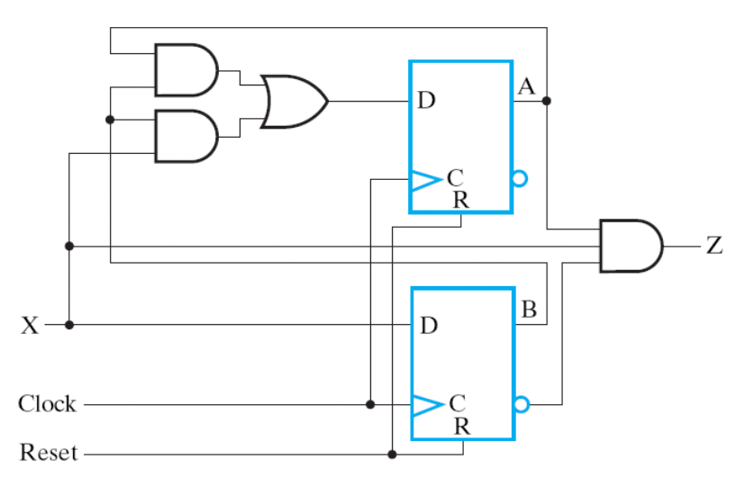
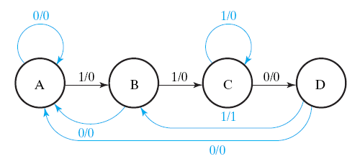
Core Problem Today
Given: expected behavior of a sequential circuit
  Represented as a state diagram
Want to Design: the digital circuit that behaves as the state diagram

Slide 3
Recap 1: state-diagram
(Section 5-4)

Slide 4
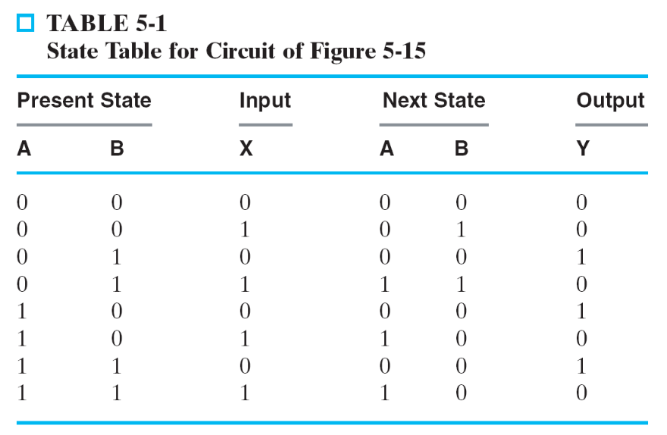
What is the state diagram?
a graphical way to represent the state table
X=0
00
X=1
X=0
X=0
01
10
X=1
X=0
X=1
X=1
11

Slide 5
What is the state diagram?
node (state): content of the D-FFs
edge: state transition upon receiving input signal value
X=0
00
X=1
X=0
X=0
01
10
X=1
X=0
X=1
X=1
11

Slide 6
What is the state diagram?
node (state): content of the D-FFs
edge: state transition upon receiving input signal value
X=0
00
X=1
X=0
present state
X=0
01
10
X=1
X=0
X=1
X=1
11
next state

Slide 7
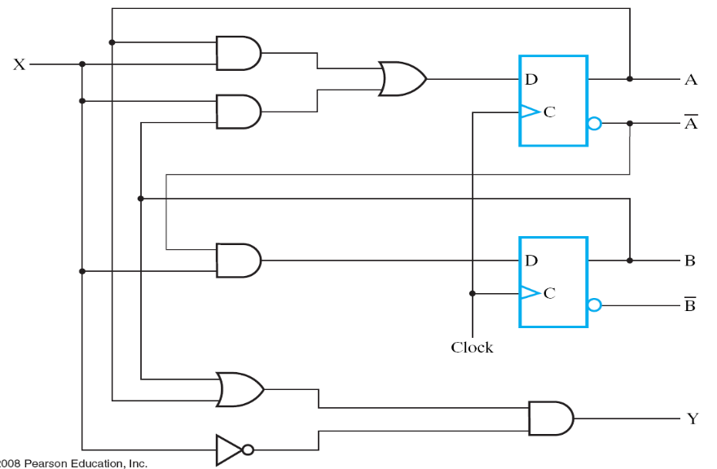


Draw timing waveform from state-diagram
X=0
time
00
X=1
X=0
clock
X=0
01
10
X=1
A
0
0
1
0
0
state
X=0
B
0
1
1
0
0
X=1
X=1
11
input
X
1
1
0
0
0

Slide 8
Draw timing waveform from state-diagram
X=0
present state
time
00
X=1
X=0
clock
present state
X=0
01
10
X=1
A
0
0
state
X=0
B
0
1
next state
X=1
X=1
11
input
X
1
input signal

Slide 9
Recap 2: Timing analysis of a sequential circuit

Slide 10
General rule
combinational
circuit
D_{A}
A
D
Q
X
draw the timing waveform cycle-by-cycle
Step 1: remove D-FFs and derive Boolean equations for the combinational circuit
  state A is an input to the combinational circuit
Step 2: derive outputs of the combinational circuit at the same cycle
  inputs to D-FFs are outputs of the combinational circuit
  the combinational circuit generates output at the same cycle
Step 3: derive the next state of D-FFs
  A(t+1)=D_{A}(t)
clock
Y
time
clock
A
A0
A1
X
X0
D_{A}
D0
Y
Y0

Slide 11
General rule
combinational
circuit
D_{A}
A
D
Q
X
draw the timing waveform cycle-by-cycle
Step 1: remove D-FFs and derive Boolean equations for the combinational circuit
  state A is an input to the combinational circuit
Step 2: derive outputs of the combinational circuit at the same cycle
  inputs to D-FFs are outputs of the combinational circuit
  the combinational circuit generates output at the same cycle
Step 3: derive the next state of D-FFs
  A(t+1)=D_{A}(t)
clock
Y
time
clock
A
A0
A1
X
X0
D_{A}
D0
Y
Y0

Slide 12
General rule
combinational
circuit
D_{A}
A
D
Q
X
draw the timing waveform cycle-by-cycle
Step 1: remove D-FFs and derive Boolean equations for the combinational circuit
  state A is an input to the combinational circuit
Step 2: derive outputs of the combinational circuit at the same cycle
  inputs to D-FFs are outputs of the combinational circuit
  the combinational circuit generates output at the same cycle
Step 3: derive the next state of D-FFs
  A(t+1)=D_{A}(t)
clock
Y
time
clock
A
A0
A1
X
X0
D0=BoolFunc (A0, X0)
D_{A}
D0
Y0=BoolFunc(A0, X0)
Y
Y0

Slide 13
General rule
combinational
circuit
D_{A}
A
D
Q
X
draw the timing waveform cycle-by-cycle
Step 1: remove D-FFs and derive Boolean equations for the combinational circuit
  state A is an input to the combinational circuit
Step 2: derive outputs of the combinational circuit at the same cycle
  inputs to D-FFs are outputs of the combinational circuit
  the combinational circuit generates output at the same cycle
Step 3: derive the next state of D-FFs
  A(t+1)=D_{A}(t)
clock
Y
time
clock
A
A0
A1=D0
X
X0
D_{A}
D0
Y
Y0

Slide 14
Rule of Thumb
Combinational Circuit: generate outputs at the same cycle to inputs
D Flip-Flop: A(t+1) = D_{A}(t)
  state changes at the next cycle

Slide 15

Example
?
time
clock
A
0
?
0
1
0
0
state
B
0
1
1
0
0
input
X
1
1
0
0
0
?
0
1
0
0
0
internal
signals
1
1
0
0
0

Slide 16


Example
?
combinational circuit
time
clock
A
0
?
0
1
0
0
state
B
0
1
1
0
0
input
X
1
1
0
0
0
?
0
1
0
0
0
internal
signals
1
1
0
0
0

Slide 17
Example
combinational circuit
time
clock
A
0
state
B
0
input
X
1
1
0
0
0
0
internal
signals
1

Slide 18
Example
combinational circuit
time
clock
A
0
0
state
B
0
1
input
X
1
1
0
0
0
0
internal
signals
1

Slide 19
Example
combinational circuit
time
clock
A
0
0
state
B
0
1
input
X
1
1
0
0
0
0
1
internal
signals
1
1

Slide 20
Example
combinational circuit
time
clock
A
0
0
1
state
B
0
1
1
input
X
1
1
0
0
0
0
1
internal
signals
1
1

Slide 21
Example
time
clock
A
0
0
1
0
0
state
B
0
1
1
0
0
input
X
1
1
0
0
0
Complete by yourself!
0
1
0
0
0
internal
signals
1
1
0
0
0

Slide 22
Core Problem Today
Given: expected behavior of a sequential circuit
  Represented as a state diagram
Want to Design: the digital circuit that behaves as the state diagram

Slide 23
Scenario of the design example
a sequence recognizer in a communication system

Slide 24
Example: a communication system
bit string flows: “00100101100111010110…”
shared media (air, Ethernet bus, etc.)
station 0
station 1
station i
station M-1
…
…
message started with 1101 is for me
sequence
recognizer
receiver
“011010…”
Z

Slide 25
Spec of the sequence recognizer to be designed
sequence
recognizer
“011010…”
X
Z
clock
reset
recognize the sequence “1101” by sending out Z
time
clock
input X
0
1
1
1
0
1
1
output Z
0
1
0

Slide 26
Overview of the design steps

Slide 27
Design Steps
Step 1: draw the state diagram and state table
Step 2: assign state values and flip flops
Step 3: draw the spec of the combinational part
  draw the truth table
Step 4: realize the combinational part
  logic simplification if necessary

Slide 28
Draw the state diagram from application specification

Slide 29
Design Steps
Step 1: draw the state diagram and state table
Step 2: assign state values and flip flops
Step 3: draw the spec of the combinational part
  draw the truth table
Step 4: realize the combinational part
  logic simplification if necessary

Slide 30
Imagination on finite automata
a tape storing the input string
tape
…
0
1
1
1
0
1
1
…
state transition: input/output
pointor to tape
a state

Slide 31
Imagination on finite automata
at each step, we determine the next state from
  current state
  input character
tape
…
0
1
1
1
0
1
1
…

Slide 32
Imagination on finite automata
Step 1
tape
…
0
1
1
1
0
1
1
…
0
next state
current state

Slide 33
Imagination on finite automata
Step 2
tape
…
0
1
1
1
0
1
1
…
next state
1
current state

Slide 34
Imagination on finite automata
a sequence of state transitions
tape
…
0
1
1
1
0
1
1
…
1
1
0
1
send output 1 at this transition

Slide 35
Let’s describe the design problem again

Slide 36
Problem
Design a sequential circuit that works as the state diagram
S0
S1
S2
S3
time
state of
flip flops
S0
S0
S1
S2
input X
0
1
1
0

Slide 37
Problem
Design a sequential circuit that works as the state diagram
0
S0
S1
S2
S3
current state
time
state of
flip flops
S0
S0
input X
0

Slide 38
Problem
Design a sequential circuit that works as the state diagram
1
S0
S1
S2
S3
current state
next state
time
state of
flip flops
S0
S0
S1
input X
0
1

Slide 39
State assignment

Slide 40
Design Steps
Step 1: draw the state diagram and state table
Step 2: assign state values and flip flops
Step 3: draw the spec of the combinational part
  draw the truth table
Step 4: realize the combinational part
  logic simplification if necessary

Slide 41
Problem
realize the finite automata
S0
S1
S2
S3

Slide 42
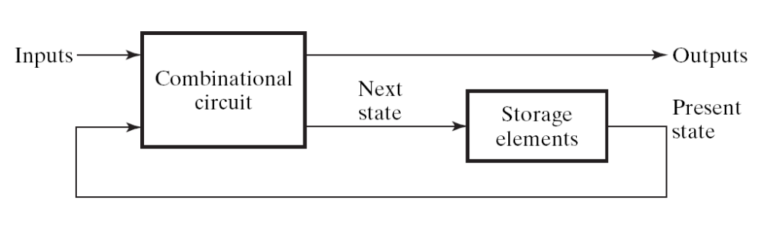
General structure of a sequential circuit
Sequential Circuit:
  a digital circuit with storage element to memorize current state
  Figure 5-1:
to setup this part

Slide 43
Question
How many D flip flops required to realize the state diagram?
  each of the four states needs a distinct representation
S0
S1
S2
S3

Slide 44
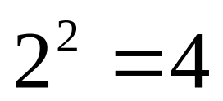
Question
How many D flip flops required to memorize 4 possible states?
  Ans: 2 flip flops
S0
S1
S2
S3

Slide 45
Re-describe the design problem again
realize the following state-diagram with the hardware framework
combinational
circuit
A
D
00
01
11
10
B
X
D
Y

Slide 46
Re-describe the design problem again
realize the following state-diagram with the hardware framework
A=0, B=0
A=1, B=1
combinational
circuit
A
D
00
01
11
10
B
X
D
A=0, B=1
A=1, B=0
Y

Slide 47
Remark
state assignment is not unique
the assignment may affect the chip area to realize the circuit
an alternative state assignment
combinational
circuit
A
D
10
01
00
11
B
X
D
Y

Slide 48
Draw the spec of the combinational part

Slide 49
Design Steps
Step 1: draw the state diagram and state table
Step 2: assign state values and flip flops
Step 3: draw the spec of the combinational part
  draw the truth table
Step 4: realize the combinational part
  logic simplification if necessary

Slide 50
Re-describe the design problem again
realize the following state-diagram with the hardware framework
to design this part
A=0, B=0
A=1, B=1
combinational
circuit
A
D
00
01
11
10
B
X
D
A=0, B=1
A=1, B=0
Y

Slide 51
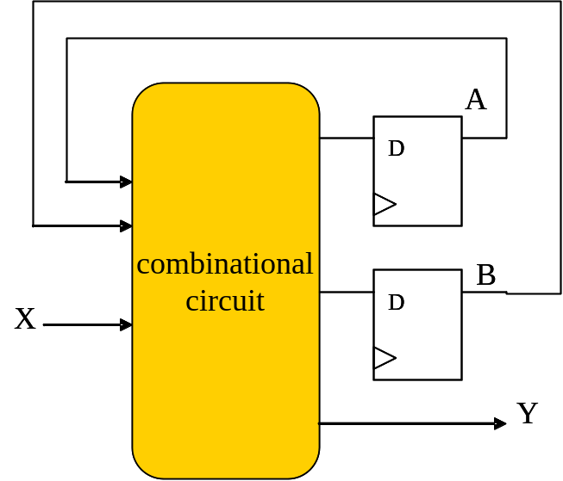


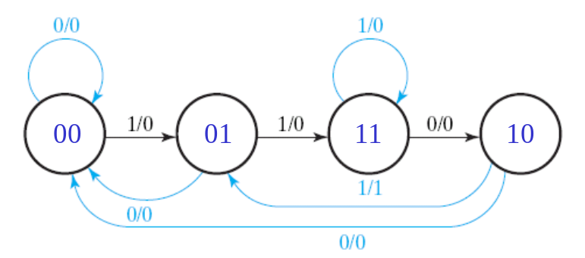
How to realize a combinational circuit?
draw the truth table
derive the Boolean equation (do logic simplification if necessary)
draw the circuit from the Boolean equation
Input
Output
A
B
X
0
0
0
0
?
0
0
0
1
0
1
0
1
0
0
0
0
1
1
1
1
1
0
0
0
0
1
0
1
0
1
1
1
0
1
0
1
1
1
1
1

Slide 52
Deriving the truth table
Input
Output
A
B
X
0
0
0
0
0
1
0
1
0
1
0
0
1
1
next state
1
0
0
1
0
1
1
1
0
1
1
1
1
current state
time
clock
A
0
0
B
0
1
X
1
0
1

Slide 53
Deriving the truth table
Input
Output
A
B
X
0
0
0
0
0
1
0
1
0
0
1
1
1
0
0
0
0
next state
1
0
1
1
1
0
1
1
1
current state
0
time
clock
A
1
0
B
0
0
X
0
0
0

Slide 54
In-Class Exercise: complete the truth table
Input
Output
A
B
X
0
0
0
0
0
1
0
1
0
0
1
1
1
0
0
1
0
1
1
1
0
1
1
1
time
clock
A
0
B
0
X
1

Slide 55
Logic simplification and draw the complete circuit diagram

Slide 56
Design Steps
Step 1: draw the state diagram and state table
Step 2: assign state values and flip flops
Step 3: draw the spec of the combinational part
  draw the truth table
Step 4: realize the combinational part
  logic simplification if necessary

Slide 57
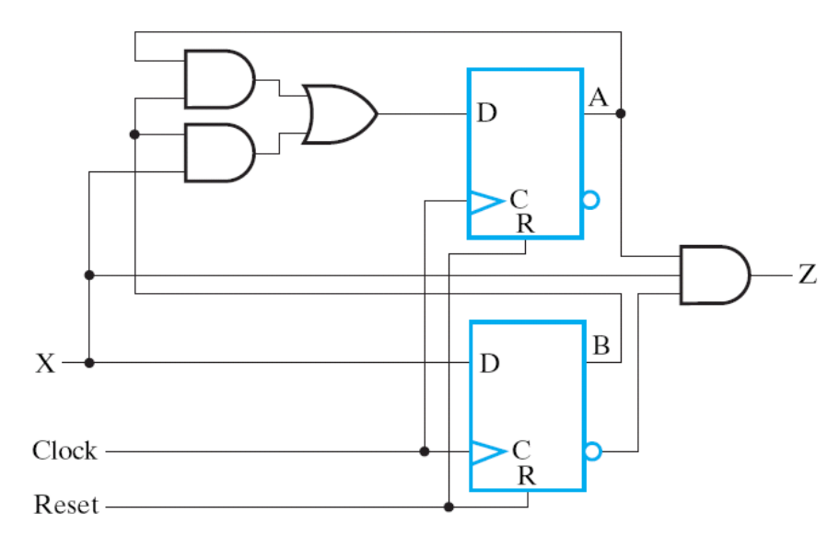
Derive the final design
Input
Output
A
B
X
0
0
0
0
0
0
0
1
0
1
0
1
0
0
0
0
1
1
1
1
1
0
0
0
0
1
0
1
0
1
1
1
0
1
0
combinational circuit
from K-map simplification
1
1
1
1
1

Slide 58
The circuit we want
sequence
recognizer
“011010…”
X
Z
clock
reset
recognize the sequence “1101” by sending out Z
time
clock
input X
0
1
1
1
0
1
1
output Z
0
1
0
Question: How to derive signal Z?

Slide 59
Design Exercise 01
realizing a state diagram

Slide 60
The Problem
realize the state diagram
  4 states with one input signal X
draw the framework (block diagram) with key signals named
  write down the Boolean equation for each key signal
X=0
X=1
X=0
X=1
X=0
X=1
00
01
10
11
X=1
X=0

Slide 61



The Solution
X=0
X=1
X=0
X=1
X=0
X=1
00
01
10
11
X=1
X=0
combinational
circuit
A
D
Output
Input
A
B
X
B
X
D
0
0
0
0
0
0
0
1
0
1
0
1
0
0
1
0
1
1
1
0
1
0
0
1
1
1
0
1
0
0
1
1
0
0
0
1
1
1
1
1

Slide 62
Design Exercise 02
sequential circuit design from given state diagram

Slide 63
The Problem
Realize the state diagram
  with 4 flip flops
1000
0100
0010
0001

Slide 64
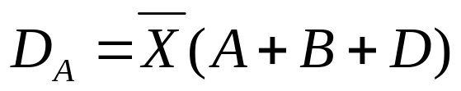
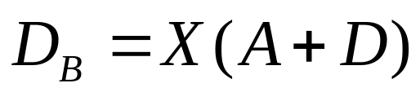
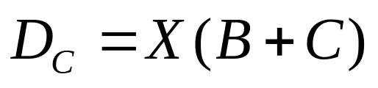

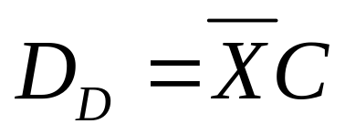

The
Solution
1000
0100
0010
0001
combinational
circuit
A
D
B
D
C
D
X
D
D

Slide 65
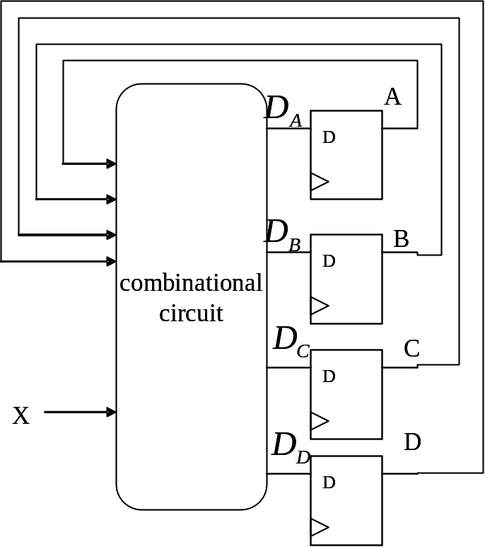
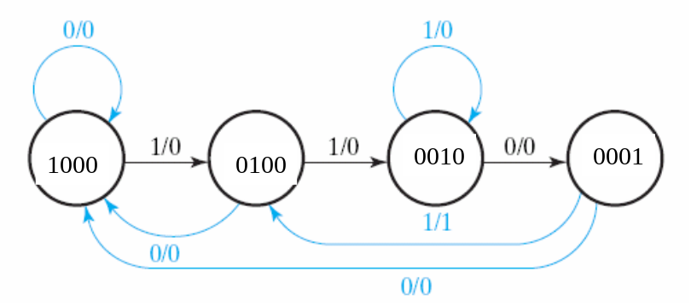

How to observe the answer directly
one flip-flop stands for a state

Slide 66
Remark
there will be many many don’t-care states if you draw the state table
good K-map simplification also yields the same result

Slide 67
Design Exercise 03

Slide 68
Quiz at the next meeting
Want to Design: a digital lock
  initial: in Lock state
  turn to Unlock state if a key sequence matched the pass-word
  at Lock state: turn-back to Unlock state if any key pressed
  Example: the passwd is: 1132
0
Lock
1
2
Unlock
3
back to lock after the key pressed
1
0
1
1
1
3
2
1
2
…
passwd matched, Unlock
the password will be
announced at the quiz

Slide 69
The design spec
generate an one cycle pulse X_{i} for each hit of button i
X0
0
state
controller
L
Lock
X1
1
X2
2
U
Unlock
X3
3
clock

