Slide 1
Synthesizable Verilog Coding
Lecture 07
for RTL design

Slide 2
Course Material
[Thomas] Thomas &Moorby, The Verilog Hardware Description Language, 5/e, Kluware Academic, 2008
[Uyemura] J. P. Uyemura, Introduction to VLSI Circuits and Systems, John Wiley & Sons, 2002
Chap. 5 of your textbook [Mano]
Find your favorite Verilog book and read by yourself!

Slide 3
Course package of this lecture
power point slides:
  lec07-verilog.ppt: concepts of Verilog coding
  lab07-verilog.ppt: exercises for this lab
  lec07a-abs_diff: RTL design example R=|A-B|
Verilog source code:
  sub-dir components: for Ex01
  sub-dir abs_diff: the demo code of R=|A-B|
  sub-dir synthesis_demo: a demo code to show you Verilog->HW synthesis

Slide 4
Let’s start from RTL design

Slide 5
What is RTL design
RTL: Register Transfer Level (Language)
a standard method to design any digital IC
Feature:
  designer specify rules to transfer data from one register to another register
  EDA (electronic design automation) tool synthesis RTL code to real hardware
B
C
Verilog code
+
reg [3:0] A, B, C;
always @(posedge clk) begin
A <= B+C;
end
clk
register
A

Slide 6
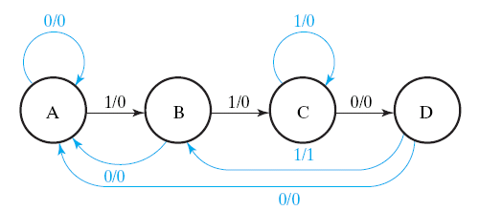
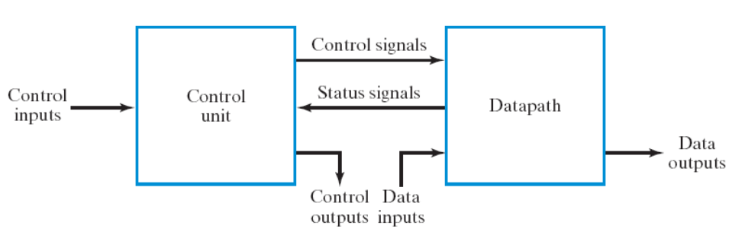
Goal of this lecture
let you do RTL design using Verilog
Step 1: always starts from the general framework
  control signals: the order sent from control unit
  status signals: reports from data path
Step 2: specify the behavior of each part
  control unit: state-diagram
  data path: micro-operation
Step 3: design circuits from behavior specification
  control unit: state-diagram to circuit (Chapter 5)
  data path: micro-operation to circuit (Sec. 7.3 – 7.6)
by EDA tool
K: A=B+C
(if (K==1) then A=B+C;)

Slide 7
How to make a (digital) chip

Slide 8
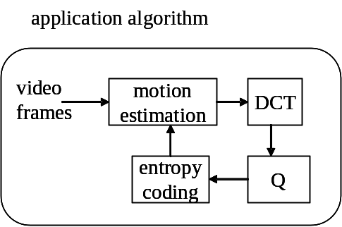
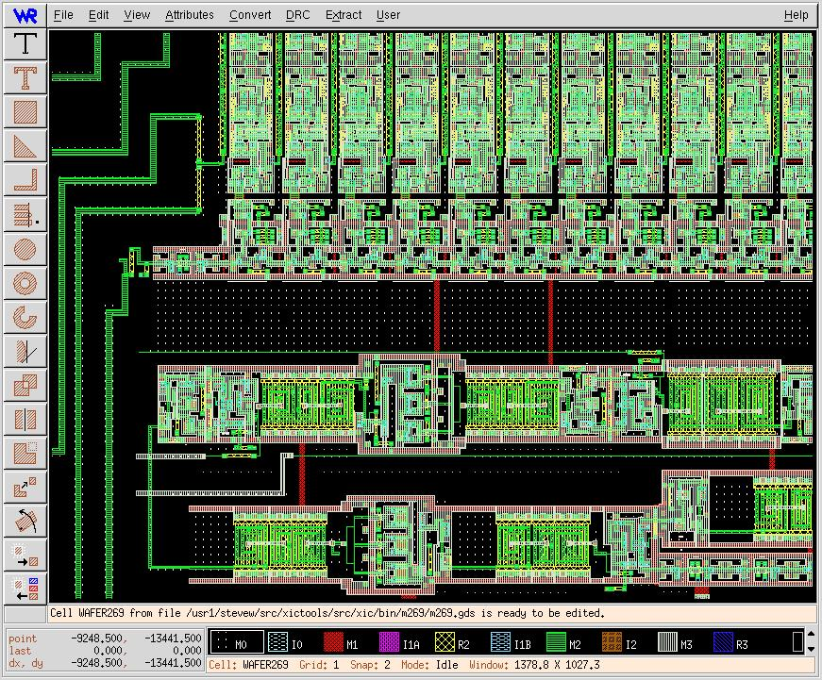
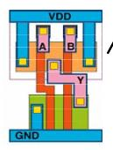
VLSI Design Flow in SoC Era
ESL design
(Electronic System Level)
RTL design
(Register Transfer Level)
gate-level design
circuit-level design
(transistor-level)
physical layout

Slide 9
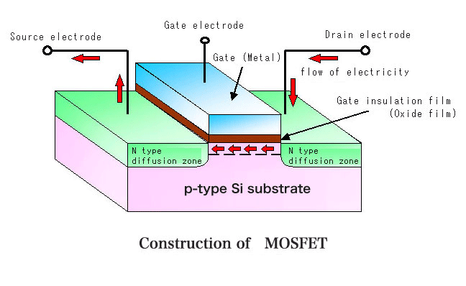
The basic device to build a chip:
MOS transistor
ESL design
(Electronic System Level)
RTL design
(Register Transfer Level)
gate-level design
circuit-level design
(transistor-level)
D
G
physical layout
X
X=0
X=1
S

Slide 10
Physical Layout
ESL design
(Electronic System Level)
RTL design
(Register Transfer Level)
gate-level design
circuit-level design
(transistor-level)
physical layout

Slide 11
Physical layout of a chip
The image you find in fully-custom design

Slide 12

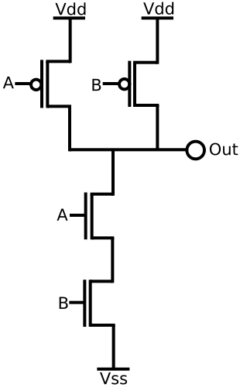
Gate-level to Circuit-level Transform
ESL design
(Electronic System Level)
RTL design
(Register Transfer Level)
gate-level design
circuit-level design
(transistor-level)
physical layout

Slide 13
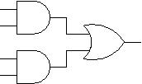
RTL to Gate-level transform
reg A, B, C, D, E;
always @(*)
E = A&B | C&D;
ESL design
(Electronic System Level)
RTL design
(Register Transfer Level)
gate-level design
circuit-level design
(transistor-level)
physical layout

Slide 14
State-of-art chip design
always @(posedge clk)
A <= B+C;
RTL design
(Register Transfer Level)
gate-level design
circuit-level design
(transistor-level)
automatically
processed by EDA
tools
physical layout

Slide 15
Still some comments before we begin

Slide 16
Common error of beginners
non-synthesizable coding style
  a wrong code may result in correct simulation wave-form/FPGA outcome
synthesizable but without concrete imagine on hardware generated
  long path delay
  extremely large chip area

Slide 17
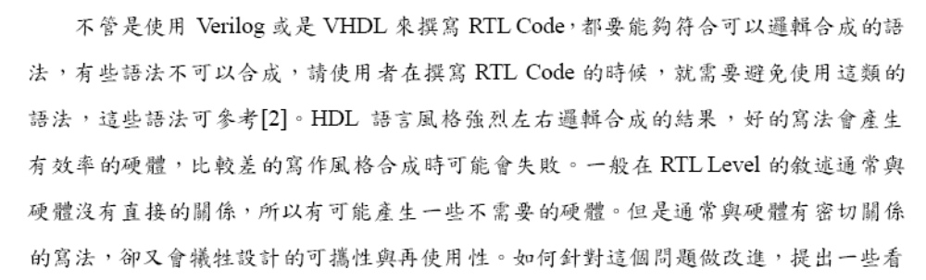
Caution
(adopted from CIC technical report)

Slide 18
Correct method of doing RTL coding
Step 1: draw the block diagram of your hardware
  be aware of combinational and sequential circuit
Step 2: translate each block into Verilog/VHDL code
  follow fixed coding style
always have a hardware block diagram in your minds!

Slide 19
Suggestion to beginners
do “synthesis” for each small piece of your code
  synthesis means: translate a higher level design to a lower level design (e.g. RTL=> gate-level)
use “Tools->Net List Viewer -> RTL view” of Quartus II

Slide 20
Now we begin to talk about Verilog coding

Slide 21
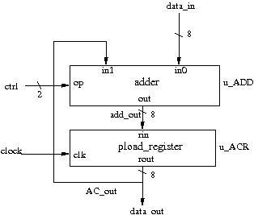
Verilog coding
structural description
  describe the hardware directly
behavior description
  the “register transfer” rules
  most of beginners error
input A [3:0];
input B [3:0];
input clock;
reg S [3:0];
always @(posedge clock)
S <= #1 A+B;

Slide 22
Structural description (1)
describing a hardware with block diagram in minds

Slide 23
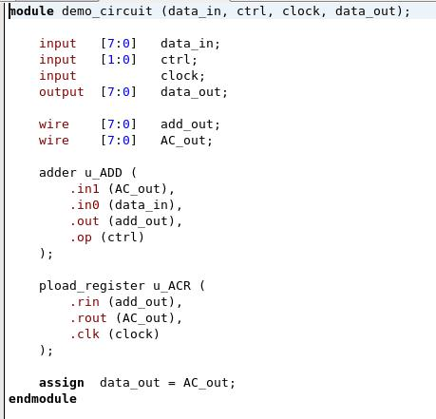
What is structural description
describing a hardware with detailed block diagram in minds

Slide 24
A “module”
the basic unit for Verilog hardware design is a “module”
  the hardware you designed is a module
  you may have sub-modules in your design
structural description to describe the hardware architecture of a module:
  Step 1: module declaration with input/output specifications
  Step 2: instance sub-modules
  Step 3: declare wires and make connections

Slide 25
Example of structural description

Slide 26
Example of structural description
module declaration
the module you designed

Slide 27
Example of structural description
input/output specification

Slide 28
Example of structural description

Slide 29
Example of structural description

Slide 30
A “module”
the basic unit for Verilog hardware design is a “module”
  the hardware you designed is a module
  you may have sub-modules in your design
structural description to describe the hardware architecture of a module:
  Step 1: module declaration with input/output specifications
  Step 2: instance sub-modules
  Step 3: declare wires and make connections

Slide 31
Instance Sub-Modules

Slide 32
Instance Sub-Modules
type of this sub-module

Slide 33
Instance Sub-Modules
name of this block
(you can give any name as you want)

Slide 34
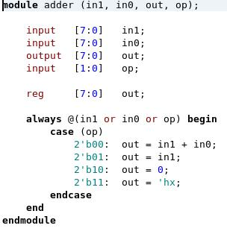
A sub-module with detailed design

Slide 35
A “module”
the basic unit for Verilog hardware design is a “module”
  the hardware you designed is a module
  you may have sub-modules in your design
structural description to describe the hardware architecture of a module:
  Step 1: module declaration with input/output specifications
  Step 2: instance sub-modules
  Step 3: declare wires and make connections

Slide 36
Declare wires

Slide 37
Connecting ports of modules

Slide 38
Lab Exercise
Write a Verilog module for this accumulator circuit
provided that the following sub-modules are given
  adder
  MUX
  register with load enable
A
8
8
adder
in1
in0
0
MUX
S
8
Register R
L
Load
D
Q
8

Slide 39
Caution
always use “wire” to declare signals in structural description
no “always @(…)” in structural description

Slide 40
Structural Description (2)
describe the hardware with Boolean/arithmetic equations

Slide 41
The “assign” statement
the “assign” a wire as driven by some combinational circuit
Example 1: the Boolean equation
Example 2: the arithmetic equation
Example 3: the multiplexer (MUX)

Slide 42

The “assign” statement
the “assign” a wire as driven by some combinational circuit
Example 1: the Boolean equation
Example 2: the arithmetic equation
Example 3: the multiplexer (MUX)
module my_circuit (A, B, C, E);
input A;
input B;
input C;
output E;
wire D;
assign D = A&B;
assign E = C | D;
endmodule
E
the same operators to C/C++

Slide 43
The “assign” statement
the “assign” a wire as driven by some combinational circuit
Example 1: the Boolean equation
Example 2: the arithmetic equation
Example 3: the multiplexer (MUX)
module my_circuit (A, B, C, E);
input A;
input B;
input C;
output E;
assign E = (A&B)|C;
endmodule
E
you may write a longer equation

Slide 44
The “assign” statement
the “assign” a wire as driven by some combinational circuit
Example 1: the Boolean equation
Example 2: the arithmetic equation
Example 3: the multiplexer (MUX)
A
B
module my_circuit (A, B, C);
input [7:0] A;
input [7:0] B;
output [7:0] C;
assign C = A+B;
endmodule
8
8
adder
8
arithmetic equation in C
C

Slide 45
The “assign” statement
the “assign” a wire as driven by some combinational circuit
Example 1: the Boolean equation
Example 2: the arithmetic equation
Example 3: the multiplexer (MUX)
C
A
B
8
8
module my_circuit (A, B, C, E);
input [7:0] A;
input [7:0] B;
input [7:0] C;
output [7:0] E;
wire [7:0] D;
assign D = A+B;
assign E = C+D;
endmodule
8
adder
8
D
adder
8
E

Slide 46
The “assign” statement
the “assign” a wire as driven by some combinational circuit
Example 1: the Boolean equation
Example 2: the arithmetic equation
Example 3: the multiplexer (MUX)
C
A
B
8
8
module my_circuit (A, B, C, E);
input [7:0] A;
input [7:0] B;
input [7:0] C;
output [7:0] E;
wire [7:0] D;
assign E = C+D;
assign D = A+B;
endmodule
8
adder
8
D
adder
8
re-order yields the same result
E

Slide 47
The “assign” statement
the “assign” a wire as driven by some combinational circuit
Example 1: the Boolean equation
Example 2: the arithmetic equation
Example 3: the multiplexer (MUX)
C
A
B
8
8
module my_circuit (A, B, C, E);
input [7:0] A;
input [7:0] B;
input [7:0] C;
output [7:0] E;
assign E = A+B+C;
endmodule
8
adder
8
D
adder
8
E

Slide 48
The “assign” statement
the “assign” a wire as driven by some combinational circuit
Example 1: the Boolean equation
Example 2: the arithmetic equation
Example 3: the multiplexer (MUX)
A
B
module MUX (A, B, S, C);
input [7:0] A;
input [7:0] B;
input S;
output [7:0] C;
assign C = (S)? A: B;
endmodule
8
8
S
MUX
8
C
C-style expression

Slide 49

Rule of thumb to use “assign”
describe a combinational circuit with Boolean or arithmetic equations
  an equation from inputs to outputs
  the same operators/expressions to C/C++
A
B
C
…
combinational
circuit
D

Slide 50
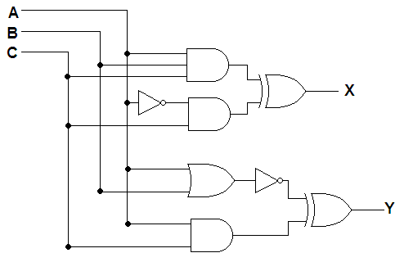
Lab Exercise
Design the circuit with “assign” statements
  write the Boolean equations

Slide 51
Behavior description

Slide 52
General Semantics of Behavior Description
specify the rules for event-driven simulation
Remark: Verilog is originally for hardware simulation, not for hardware synthesis
reg D, E; //declare variables but
//not necessary synthesis registers
always @(event_list) begin
…
// C code to compute D and E from A, B, C
…
end
A
B
C
hardware to be
simulated
D
E

Slide 53
Inferring combinational circuit with behavior description

Slide 54
Inferring combinational circuit
general coding style:
  always @(all signal list)
  always @(*)
  use blocking assignment “=“
    do not use “<= “
  you have to enumerate all cases to determine the output value

Slide 55
Example: a combinational circuit
semantics from event-driven simulation
time
module demo_circuit (A, B, C, E);
input A, B, C;
output E;
reg E;
always @(A or B or C) begin
E = (A&B)|C;
end
endmodule
clock
A
0
1
B
1
C
0
E
0
1

Slide 56
Example: a combinational circuit
semantics from event-driven simulation
time
module demo_circuit (A, B, C, E);
input A, B, C;
output E;
reg E;
always @(A or B or C) begin
E = (A&B)|C;
end
endmodule
clock
events to trigger the simulation
A
0
1
B
1
C
0
E
0
1

Slide 57
Example: a combinational circuit
semantics from event-driven simulation
time
module demo_circuit (A, B, C, E);
input A, B, C;
output E;
reg E;
always @(A or B or C) begin
E = (A&B)|C;
end
endmodule
clock
A
0
1
B
1
C
0
C-like statements to simulate
E
0
1

Slide 58
Example: a combinational circuit
semantics from event-driven simulation
time
signal change causes the simulation
module demo_circuit (A, B, C, E);
input A, B, C;
output E;
reg E;
always @(A or B or C) begin
E = (A&B)|C;
end
endmodule
clock
A
0
1
B
1
the simulated output value
C
0
E
0
1

Slide 59
Example: a combinational circuit
semantics from event-driven simulation
time
module demo_circuit (A, B, C, E);
input A, B, C;
output E;
reg E;
always @(A or B or C) begin
E = (A&B)|C;
end
endmodule
clock
A
0
1
B
1
C
0
E
0
1
signal change not waiting for a clock

Slide 60
Example: a combinational circuit
the synthesized circuit
module demo_circuit (A, B, C, E);
input A, B, C;
output E;
reg E;
always @(A or B or C) begin
E = (A&B)|C;
end
endmodule
E

Slide 61
Example: a combinational circuit
the synthesized circuit
declared as a register but not register synthesized
module demo_circuit (A, B, C, E);
input A, B, C;
output E;
reg E;
always @(A or B or C) begin
E = (A&B)|C;
end
endmodule
E

Slide 62
More Examples of inferring combinational circuits
design by specifying the Boolean equations
design by specifying the truth table
inferring a data path with case statement
inferring a data path with if-then-else

Slide 63
Example 1 (a)
design by specifying Boolean equations
module demo_circuit (A, B, C, E);
input A, B, C;
output E;
reg E;
always @(A or B or C) begin
E = (A&B)|C;
end
endmodule
E

Slide 64
Example 1 (b)
design by specifying Boolean equations
module demo_circuit (A, B, C, E);
input A, B, C;
output E;
reg E;
always @(*) begin
E = (A&B)|C;
end
endmodule
simulation triggered by any change on input signals
E

Slide 65
Example 1 (c)
design by specifying Boolean equations
module demo_circuit (A, B, C, E);
input A, B, C;
output E;
reg D;
reg E;
always @(*) begin
D = A&B;
end
always @(*) begin
E = D|C;
end
endmodule
E

Slide 66
Example 1 (d)
design by specifying Boolean equations
module demo_circuit (A, B, C, E);
input A, B, C;
output E;
reg D;
reg E;
always @(*) begin
E = D|C;
end
always @(*) begin
D = A&B;
end
endmodule
E
exchange yields the same result

Slide 67
More Examples of inferring combinational circuits
design by specifying the Boolean equations
design by specifying the truth table
inferring a data path with case statement
inferring a data path with if-then-else

Slide 68
Example 2
module demo_circuit (A, B, C, E);
input A, B, C;
output E;
reg E;
always @(*) begin
case ({A, B, C})
3’b000: E = 1’b0;
3’b001: E = 1’b1;
3’b010: E = 1’b0;
3’b011: E = 1’b1;
3’b100: E = 1’b0;
3’b101: E = 1’b1;
3’b110: E = 1’b1;
3’b111: E = 1’b1;
endcase
end
endmodule
inferring combinational circuit by specifying the truth table
E

Slide 69
Example 2
module demo_circuit (A, B, C, E);
input A, B, C;
output E;
reg E;
always @(*) begin
case ({A, B, C})
3’b000: E = 1’b0;
3’b001: E = 1’b1;
3’b010: E = 1’b0;
3’b011: E = 1’b1;
3’b100: E = 1’b0;
3’b101: E = 1’b1;
3’b110: E = 1’b1;
3’b111: E = 1’b1;
endcase
end
endmodule
inferring combinational circuit by specifying the truth table
the truth table
E

Slide 70
Constant Representation
binary number:
  [width]’bnumber
  Example 1: ‘b101
  Example 2: 3’b101
hexdecimal number
  [width]’hnumber
  Example 1: ‘h09a2
  Example 2: 16’h09a2
decimal:
  Example: 1234
  Example: ‘d1234
  Example: 32’d1234

Slide 71
Example 2
module demo_circuit (A, B, C, E);
input A, B, C;
output E;
reg E;
always @(*) begin
case ({A, B, C})
3’b000: E = 1’b0;
3’b001: E = 1’b1;
3’b010: E = 1’b0;
3’b011: E = 1’b1;
3’b100: E = 1’b0;
3’b101: E = 1’b1;
3’b110: E = 1’b1;
3’b111: E = 1’b1;
endcase
end
endmodule
inferring combinational circuit by specifying the truth table
E = 1 if {A,B,C}==001
E

Slide 72
More Examples of inferring combinational circuits
design by specifying the Boolean equations
design by specifying the truth table
inferring a data path with case statement
inferring a data path with if-then-else

Slide 73
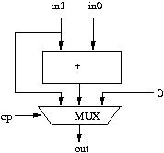
Example: combinational circuit

Slide 74
Example: combinational circuit
register is not a register!

Slide 75
Example: combinational circuit
C-like code to compute output from inputs

Slide 76
Example: combinational circuit
specify a don’t-care

Slide 77
More Examples of inferring combinational circuits
design by specifying the Boolean equations
design by specifying the truth table
inferring a data path with case statement
inferring a data path with if-then-else

Slide 78
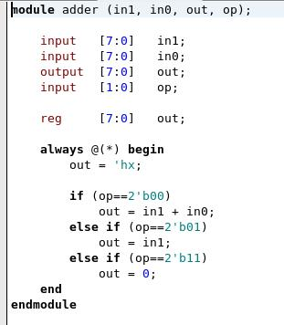
Example: combinational circuit
if-then-else rules also work!

Slide 79
Example: combinational circuit
This line is necessary to enforce
a combinational circuit

Slide 80
Example: combinational circuit
Verilog 2001 standard:
depends on all input signals

Slide 81
Inferring sequential circuit with behavior description

Slide 82
The general scheme
for sequential circuit
  only simulate when clock triggered
A
B
C
always @(posedge clk) begin
…
// C code to compute D and E
…
end
hardware to be
simulated
clk
D
E

Slide 83
Inferring sequential circuit
coding style:
  always @(posedge clk)
  use non-blocking assignment “<=“

Slide 84
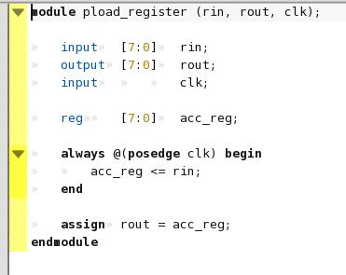
Example 1:
parallel D-FFs triggered by clock
time
rin
1010
0110
acc_reg
1010
0110
rin
acc_reg
clock

Slide 85
Example 1
parallel D-FFs triggered by clock
time
rin
1010
0110
acc_reg
1010
0110
simulation triggered by clock
rin
acc_reg
clock

Slide 86
Example 1
parallel D-FFs triggered by clock
time
rin
1010
0110
acc_reg
1010
0110
Caution: You have to use non-blocking assignment
to generate registers!
rin
acc_reg
clock

Slide 87
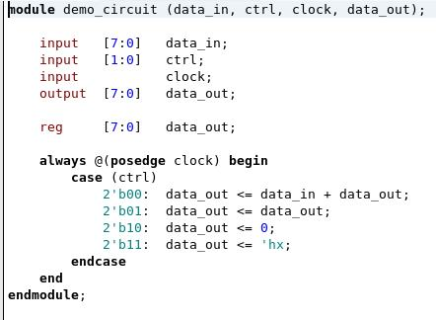
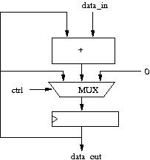
Example 2: sequential circuit
with combinational circuit for computation

Slide 88
Example 3: realizing finite-state machine
realize the finite-state machine with behavior description
reg S;
always @(posedge clock) begin
case (S)
1’b0:
begin
if (X==0)
S <= 1’b0;
else
S <= 1’b1;
end
1’b1: S <= (T)? 1’b1: 1’b0;
endcase
end
X=0
T=1
X=1
0
1
T=0

Slide 89
I believe that most of you are confused with
  combinational circuit vs.
  sequential circuit

Slide 90
Example: the adder
combinational vs. sequential circuit

Slide 91
What’s the difference?
reg [3:0] A, B, C;
always @(*) begin
A = B+C;
end
reg [3:0] A, B, C;
always @(posedge clk) begin
A <= B+C;
end

Slide 92
What’s the difference?
reg [3:0] A, B, C;
always @(*) begin
A = B+C;
end
reg [3:0] A, B, C;
always @(posedge clk) begin
A <= B+C;
end
B
C
B
C
+
+
clk
register
A
A

Slide 93
What’s the difference?
reg [3:0] A, B, C;
always @(*) begin
A = B+C;
end
reg [3:0] A, B, C;
always @(posedge clk) begin
A <= B+C;
end
clk
clk
B
10
1
5
B
10
1
5
5
2
7
C
5
2
7
C
A
15
3
12
A
15
3
12

Slide 94
Caution on behavior description
Be aware of which part is combinational circuit and which part is sequential circuit
use fixed coding style for
  combinational circuit
  sequential circuit
Do not try other coding styles!

Slide 95
Rule of thumb
declaration on “variables”
  structural description: wire
  behavior description: reg

Slide 96
Rule of thumb for behavior description
for combinational circuit:
  always @(all signals used)
  always @(*)
  use “=“ (blocking assignment)
for sequential circuit
  always @(posedge clock)
  use “<=“ (non-blocking assignment)

Slide 97
Final Remarks
find a Verilog book for details
  we don’t have time to talk about Verilog coding in detail
If you don’t like Verilog, you can still keep on drawing block diagrams
  Verilog is not a must in this course

Slide 98
The next lecture
we will go into Chap. 9
  “Computer Design Basics”
Recall “digital circuit” before the class
  adder design
  2’s complement
  how to do add/subtract

