Slide 1
Computing R=|A-B| with one adder
Lecture 07A (Appendix)
Example of RTL design with Verilog

Slide 2
What is RTL design
RTL: Register Transfer Level (Language)
a standard method to design any digital IC
Feature:
  designer specify rules to transfer data from one register to another register
  EDA (electronic design automation) tool synthesis RTL code to real hardware
B
C
Verilog code
+
reg [3:0] A, B, C;
always @(posedge clk) begin
A <= B+C;
end
clk
register
A

Slide 3
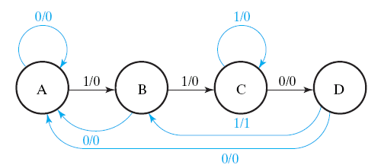
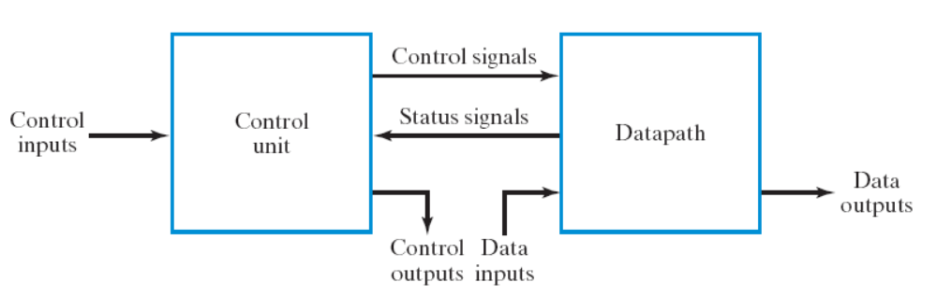
Goal of this lecture
let you do RTL design using Verilog
Step 1: always starts from the general framework
  control signals: the order sent from control unit
  status signals: reports from data path
Step 2: specify the behavior of each part
  control unit: state-diagram
  data path: micro-operation
Step 3: design circuits from behavior specification
  control unit: state-diagram to circuit (Chapter 5)
  data path: micro-operation to circuit (Sec. 7.3 – 7.6)
by EDA tool
K: A=B+C
(if (K==1) then A=B+C;)

Slide 4
Begin of our design example
R=|A-B|

Slide 5
Problem
Design a hardware to compute R=|A-B| using only one adder
A
B
n
n
start
R=|A-B|
clock
n
R

Slide 6
Steps of RTL Design
Step 0: write-down the “step-by-step” flow-chart for the task
Step 1: starts from the general framework
Step 2: design the data path
  micro-operations
  the circuit data path
Step 3: design the control unit
  finite state machine
  sequential circuit realization

Slide 7






Algorithm to compute R=|A-B|
S0
R = A+(~B)+1;
if (R[n-1]==1)
R = (~R)+1;
start
S1
S2
S3

Slide 8
Algorithm to compute R=|A-B|
no operation, keep value of R
S0
R = A+(~B)+1;
if (R[n-1]==1)
R = (~R)+1;
start
S1
S2
S3

Slide 9
Algorithm to compute R=|A-B|
S0
R=A-B
R = A+(~B)+1;
if (R[n-1]==1)
R = (~R)+1;
start
S1
S2
S3

Slide 10
Algorithm to compute R=|A-B|
S0
R = A+(~B)+1;
if (R[n-1]==1)
R = (~R)+1;
start
S1
check if R<0 or not
R>=0
S2
R<0
S3

Slide 11
Algorithm to compute R=|A-B|
S0
R = A+(~B)+1;
if (R[n-1]==1)
R = (~R)+1;
start
S1
S2
R=-R
S3

Slide 12
The data path to compute
R=|A-B|

Slide 13
Steps of RTL Design
Step 0: write-down the “step-by-step” flow-chart for the task
Step 1: starts from the general framework
Step 2: design the data path
  micro-operations
  the circuit data path
Step 3: design the control unit
  finite state machine
  sequential circuit realization

Slide 14
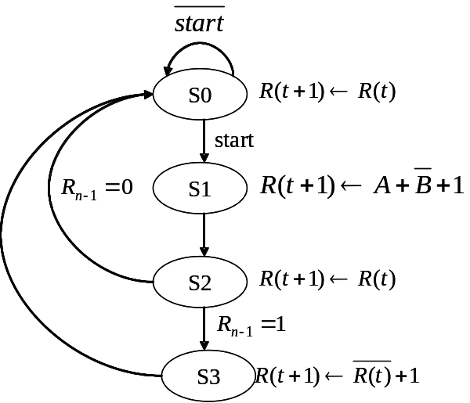
The data path
make sure that all micro-operations can be realized!
A
0
B
R
S1
MUX
MUX
S0
NOT
adder
Cin
1
load
L
register R

Slide 15
Questions
write down the control signal value to realize each of the micro-operations
  R(t+1)=A+(~B)+1
  R(t+1)=(~R(t))+1
  R(t+1)=(~R(t))
you may give your own MUX encoding as you like
A
0
B
R
S1
MUX
MUX
S0
NOT
adder
Cin
1
load
L
register R

Slide 16

Control Signal
1
0
MUX
Realize R(t+1)=~R(t)+1
A
0
B
R
0
S1
MUX
MUX
S0
0
NOT
adder
Cin
1
1
load
Enable
L
register R

Slide 17

Control Signal
1
0
MUX
Realize R(t+1)=A+(~B)+1
A
0
B
R
1
S1
MUX
MUX
S0
1
NOT
adder
Cin
1
1
load
Enable
L
register R

Slide 18

Control Signal
1
0
MUX
Realize R(t+1)=R(t)
outcome of this part is don’t-care
A
0
B
R
MUX
MUX
S0
X
X
S1
NOT
adder
Cin
1
0
load
L
register R
not loading the input

Slide 19
The control unit

Slide 20

What’s the control unit for
hardware to send out control signals
to ask the data path to perform required micro-operations for each cycle
A
0
B
R
S1
MUX
MUX
S0
NOT
R[n-1]
adder
Cin
1
load
L
register R

Slide 21



Behavior specification of the control unit
write down the control signals for each state
  to perform required operations
S0
start
S1
S2
S3

Slide 22
Behavior specification of the circuit
Check the match between control signals and data path
A
0
B
R
S1
MUX
MUX
S0
S0
NOT
start
S1
adder
Cin
1
S2
load
L
register R
S3

Slide 23
The timing diagram
Can you image how the circuit works?

Slide 24
Problem (Practice by yourself)
Draw the timing diagram until the outcome R finished
A
3
B
8
start
1
0
state
S0
???
(L, S1, S0)
???
R[n-1]
???
R
???

Slide 25
Rule of Thumb
Combinational Circuit: generate outputs at the same cycle to inputs
D Flip-Flop: A(t+1) = D_{A}(t)
  state changes at the next cycle

Slide 26
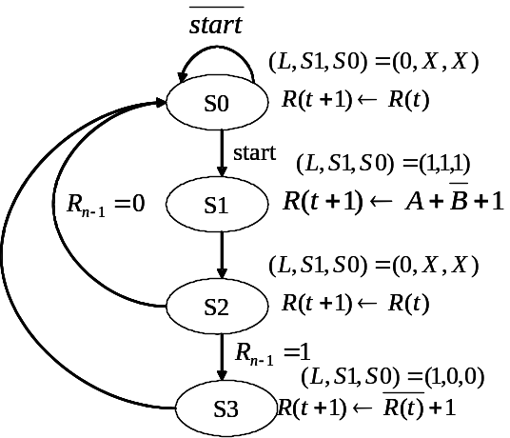
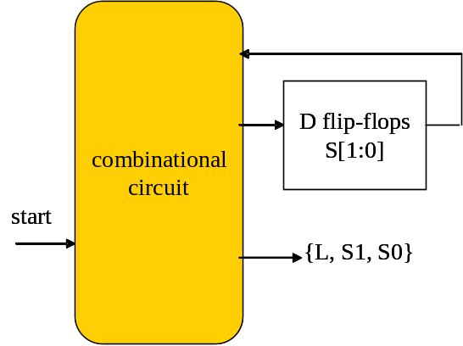
Timing of the control unit
control unit appears at the same cycle to the state
time
clock
state
S1
(L,S1,S0)
(1,1,1)
the same cycle
by combinational circuit

Slide 27
Timing of the control unit
state changes at the next cycle
time
clock
state
S1
S2
(L,S1,S0)
(1,1,1)

Slide 28
Timing of the data path
Computation at cycle t follows the control signals sent at cycle t
But the result appears on the register at cycle t+1
A
0
B
R
time
S1
MUX
MUX
S0
clock
NOT
state
S1
S2
(L,S1,S0)
(1,1,1)
adder
Cin
1
X
A+~B+1
X
load
L
register R
register R
x
A+~B+1

Slide 29
Timing of the data path
Computation at cycle t follows the control signals sent at cycle t
But the result appears on the register at cycle t+1
A
0
B
R
combinational circuit
time
S1
MUX
MUX
S0
clock
1
1
NOT
state
S1
S2
(L,S1,S0)
(1,1,1)
follows the
control signal
adder
Cin
1
X
A+~B+1
X
load
L
register R
register R
x
A+~B+1

Slide 30
Timing of the data path
Computation at cycle t follows the control signals sent at cycle t
But the result appears on the register at cycle t+1
A
0
B
R
time
S1
MUX
MUX
S0
clock
NOT
state
S1
S2
(L,S1,S0)
(1,1,1)
adder
Cin
1
A+~B+1
stored at the
next cycle
X
X
1
load
L
register R
register R
x
A+~B+1

Slide 31
Timing of the whole circuit
realize the hardware algorithm:
  do the required computation at each cycle
  and store the result at the next cycle
time
S0
clock
start
state
S1
S2
S1
(L,S1,S0)
(1,1,1)
S2
X
A+~B+1
register R
x
A+~B+1
S3

Slide 32
Timing of the whole circuit
realize the hardware algorithm:
  do the required computation at each cycle
  and store the result at the next cycle
time
S0
clock
start
state
S1
S2
S1
(L,S1,S0)
(1,1,1)
S2
X
A+~B+1
register R
x
A+~B+1
S3

Slide 33
Timing of the whole circuit
realize the hardware algorithm:
  do the required computation at each cycle
  and store the result at the next cycle
time
S0
clock
start
state
S1
S2
S1
(L,S1,S0)
(1,1,1)
S2
X
A+~B+1
register R
x
A+~B+1
S3

Slide 34
Timing of the whole circuit
state transition following the state diagram
time
S0
clock
start
state
S1
S2
S1
(L,S1,S0)
(1,1,1)
S2
X
A+~B+1
register R
x
A+~B+1
S3

Slide 35

Timing diagram of an working example
You just have to look at the hardware algorithm
A
3
B
8
start
1
0
state
S0
S1
S2
S3
S0
(L, S1, S0)
(0,X,X)
(1,1,1)
(0,X,X)
(1,0,0)
(0,X,X)
R[n-1]
x
x
1
1
0
R
x
x
-5
-5
5

Slide 36
Verilog coding to realize the RTL design

Slide 37
Guidelines to efficient and correct Verilog coding
Follow the RTL design method means:
  you have to get this!
A
0
B
R
S1
MUX
MUX
S0
S0
NOT
start
S1
adder
Cin
1
S2
load
L
register R
S3

Slide 38
Guidelines to efficient and correct Verilog coding
(1) Follow the RTL design method to get
  data path in block diagram
  control unit in finite-state machine
(2) Translate your circuit in mind to Verilog with standard coding style
  block-by-block
  be aware of combinational and sequential circuit

Slide 39
Coding the data path
A
0
B
R
S
MUX
MUX
S
wire [7:0] X = (S)? A: 7'h0;
wire [7:0] Y = (S)? B: R;
wire [7:0] D = X + (~Y) + 1'b1;
reg [7:0] R;
always @(posedge clk) begin
if (reset)
R <= 7'h0;
else
R <= (L)? D: R;
end
Y
X
NOT
adder
Cin
1
D
load
L
register R

Slide 40
Coding the data path
A
0
B
R
S
MUX
MUX
S
wire [7:0] X = (S)? A: 7'h0;
wire [7:0] Y = (S)? B: R;
wire [7:0] D = X + (~Y) + 1'b1;
reg [7:0] R;
always @(posedge clk) begin
if (reset)
R <= 7'h0;
else
R <= (L)? D: R;
end
Y
X
NOT
adder
Cin
1
D
load
L
register R

Slide 41
Coding the data path
A
0
B
R
S
MUX
MUX
S
wire [7:0] X = (S)? A: 7'h0;
wire [7:0] Y = (S)? B: R;
wire [7:0] D = X + (~Y) + 1'b1;
reg [7:0] R;
always @(posedge clk) begin
if (reset)
R <= 7'h0;
else
R <= (L)? D: R;
end
Y
X
NOT
adder
Cin
1
D
load
L
register R

Slide 42
Coding the data path
A
0
B
R
S
MUX
MUX
S
wire [7:0] X = (S)? A: 7'h0;
wire [7:0] Y = (S)? B: R;
wire [7:0] D = X + (~Y) + 1'b1;
reg [7:0] R;
always @(posedge clk) begin
if (reset)
R <= 7'h0;
else
R <= (L)? D: R;
end
Y
X
NOT
adder
Cin
1
D
load
L
register R

Slide 43
Coding the data path
A
0
B
R
S
MUX
MUX
S
wire [7:0] X = (S)? A: 7'h0;
wire [7:0] Y = (S)? B: R;
wire [7:0] D = X + (~Y) + 1'b1;
reg [7:0] R;
always @(posedge clk) begin
if (reset)
R <= 7'h0;
else
R <= (L)? D: R;
end
Y
X
NOT
adder
Cin
1
D
load
L
register R

Slide 44
Coding the control unit
the circuit framework from finite-state machine
combinational
circuit
S0
start
D flip-flops
state [1:0]
S1
start
S2
{L, S1, S0}
S3

Slide 45
Coding the control unit
decomposition for better coding style
S0
combinational
circuit
start
D flip-flops
state [1:0]
S1
combinational
circuit
S2
{L, S1, S0}
start
S3

Slide 46

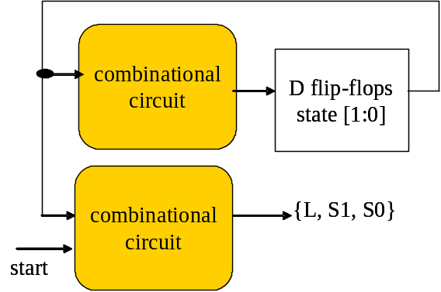
Coding the control unit
//the state transition
always @(posedge clk) begin
if (reset)
state <= `S0;
else begin
case (state)
`S0: state <= (start)? `S1: `S0;
`S1: state <= `S2;
`S2: state <= (R7)? `S3: `S0;
`S3: state <= `S0;
endcase
end
end //the state transition
//generate control signals output
always @(*) begin
case (state)
`S0: {L, S} = 2'b0x;
`S1: {L, S} = 2'b11;
`S2: {L, S} = 2'b0x;
`S3: {L, S} = 2'b10;
endcase
end

Slide 47
Coding the control unit
//the state transition
always @(posedge clk) begin
if (reset)
state <= `S0;
else begin
case (state)
`S0: state <= (start)? `S1: `S0;
`S1: state <= `S2;
`S2: state <= (R7)? `S3: `S0;
`S3: state <= `S0;
endcase
end
end //the state transition
//generate control signals output
always @(*) begin
case (state)
`S0: {L, S} = 2'b0x;
`S1: {L, S} = 2'b11;
`S2: {L, S} = 2'b0x;
`S3: {L, S} = 2'b10;
endcase
end
describe the state-transition rules case-by-case
standard coding style of
sequential circuit

Slide 48
Coding the control unit
//the state transition
always @(posedge clk) begin
if (reset)
state <= `S0;
else begin
case (state)
`S0: state <= (start)? `S1: `S0;
`S1: state <= `S2;
`S2: state <= (R7)? `S3: `S0;
`S3: state <= `S0;
endcase
end
end //the state transition
//generate control signals output
always @(*) begin
case (state)
`S0: {L, S} = 2'b0x;
`S1: {L, S} = 2'b11;
`S2: {L, S} = 2'b0x;
`S3: {L, S} = 2'b10;
endcase
end
standard coding style of
combinational circuit
describe the rules the send-out control signals for each state

Slide 49
The top-level of the hardware
connecting the control unit and the data path
using standard structural description
control_unit u_control (
.start (start),
.R7 (R[7]),
.L (L),
.S (S),
.reset (reset),
.clk (clk)
);
data_path u_data_path (
.A (A),
.B (B),
.L (L),
.S (S),
.R (R),
.reset (reset),
.clk (clk)
);
R[n-1]

Slide 50
Still feel difficult to realize the circuit?
some suggestions

Slide 51
Suggestion 1
Follow the RTL design methodology
Systematical analysis saves lots of your time!

Slide 52
Suggestion 2
Modular Design
  make each of your sub-module as small as possible!
  isolated testing/debugging with each of your sub-module
  Do not try to debug a large design at a time!

Slide 53
Suggestion 3
check timing waveform, don’t stare on your circuit/code
  trace the signal value alone your data path

