Slide 1
Usage of FPGA Experiment Board
Lab 01

Slide 2
Today’s Goals
Let you know how to work with our FPGA board
  FPGA: Field Programmable Gate Array
  a special hardware architecture to simulate digital circuit design
Establish your imagination on timing analysis

Slide 3
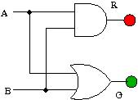
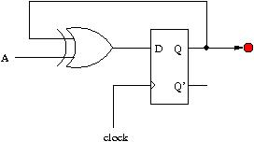
Task 1
Draw the two circuits and demo how it works on FPGA
  Connects buttons, LEDs, and clock signal with FPGA pins
Answer the question in your report:
  Explain why the sequential circuit seems not reliable

Slide 4
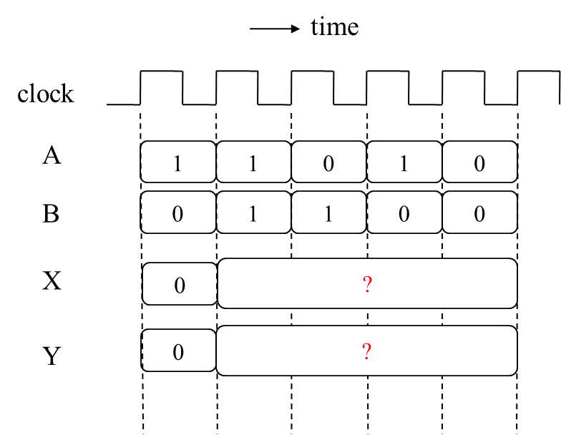
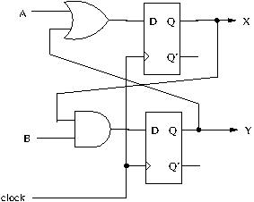
Task 2
Draw the circuit and demo the timing waveform of the simulation to TA
Answer the question in your report:
  What is the maximum clock frequency that the circuit can work correctly?

