Slide 1
Basic Concepts of Sequential Circuits
Lecture 01
Section 5.1-5.3

Slide 2
Definitions of Sequential Circuit
(Section 5-1)

Slide 3
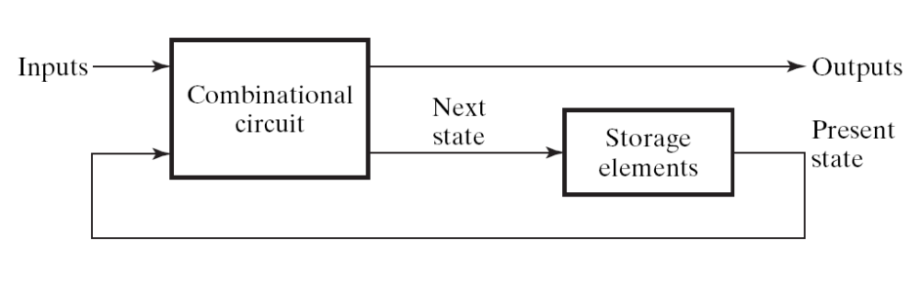
What is a sequential circuit
Sequential Circuit:
  a digital circuit with storage element to memorize current state
  Figure 5-1:
the counter part -- Combinational Circuit
  a digital circuit without storage element

Slide 4
Example 1: combinational circuit
A
combinational
circuit
R
B
G
turn-on the RED LED when both of the two buttons pressed
turn-on the Green LED when only one the two buttons pressed
turn-off the two LEDs when no buttons pressed

Slide 5
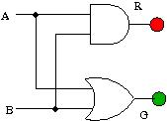
Example 1: combinational circuit
turn-on the RED light when one of the two buttons pressed
turn-on the Green light when both the two buttons pressed
none of the LED ON when you release the buttons
there is no memory in this circuit

Slide 6
Example 2: sequential circuit
sequential
circuit
A
R
turn ON/OFF the LED by press button A
  1st hit: ON
  2nd hit: OFF
  3rd hit: ON
  4th hit: OFF
  ...

Slide 7
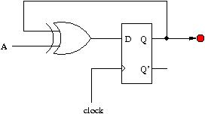
Example 2: sequential circuit
the LED may keep ON after you release the button

Slide 8
Example 2: sequential circuit
storage element (D flip-flop) to memorize the state: ON/OFF
the LED may keep ON after you release the button

Slide 9
Example 2: sequential circuit
to memorize state ON/OFF with one D flip-flop
hit the button A to control which LED on
  1st hit: turn on R
  2nd hit: turn off R
  3rd hit: turn on R again
  ...

Slide 10
How to distinguish combinational and sequential circuit?

Slide 11
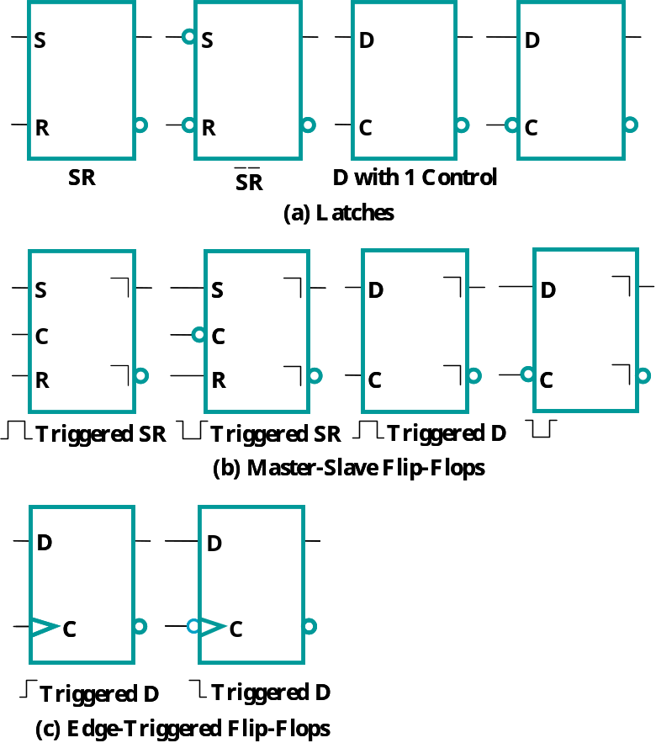
Storage elements
SR latches and D-latches
edge-triggered D flip-flops

Slide 12
Storage elements
a circuit contains one of these symbols is a sequential circuit
otherwise it is a combinational circuit

Slide 13
Example 1: combinational circuit
turn-on the RED light when one of the two buttons pressed
turn-on the Green light when both the two buttons pressed
none of the LED ON when you release the buttons
there is no memory in this circuit

Slide 14
Example 2: sequential circuit
the LED may keep ON after you release the button

Slide 15
Storage Element
the D flip-flop

Slide 16
Recall: What is a sequential circuit
Sequential Circuit:
  a digital circuit with storage element to memorize current state
  Figure 5-1:
Q1: When the storage element will memorize the input?
Q2: How long the storage element will keep its memory?

Slide 17
The D Flip-Flop
in
D
Q
out
clk
Imagine that a D flip-flop is a box of 1-bit memory
When the D flip-flop memorize the input?
  at (positive) edge trigger of the clock (clk) signal
  like a snapshot of a camera!

Slide 18
Timing Waveform of the D Flip-Flop
in
D
Q
out
clk
time
clk
in
0
1
content
xxxxxxx
0
1
Q
xxxxxxx

Slide 19
The D Flip-Flop
in
D
Q
out
clk
Imagine that a D flip-flop is a box of 1-bit memory
When the D flip-flop memorize the input?
  at (positive) edge trigger of the clock (clk) signal
  like a snapshot of a camera!
  unstable input signal between two clock triggers will be ignored!

Slide 20
Timing Waveform of the D Flip-Flop
in
D
Q
out
clk
time
clk
in
content
Q

Slide 21
Timing Waveform of the D Flip-Flop
in
D
Q
out
only the last 0 before clock trigger been memorized
clk
time
clk
0
in
content
0
Q

Slide 22
Timing Waveform of the D Flip-Flop
in
D
Q
out
the unstable input signals ignored
only the last 0 before clock trigger been memorized
clk
time
clk
0
in
content
0
Q

Slide 23
Timing Waveform of the D Flip-Flop
in
D
Q
out
only the last 1 before clock trigger been memorized
clk
time
clk
in
1
content
1
Q

Slide 24
Timing Waveform of the D Flip-Flop
in
D
Q
out
clk
time
clk
in
v0
v1
v2
v3
content
v0
v1
v2
v3
Q
v0
v1
v2
v3

Slide 25
The D Flip-Flop
in
D
Q
X
Q’
Y
clk
the inverse of the memory content can also be retrieved

Slide 26
Timing Waveform of the D Flip-Flop
in
D
Q
X
Q’
Y
clk
time
clk
in
X
xxxxxxx
Y
xxxxxxx

Slide 27
Timing Waveform of the D Flip-Flop
in
D
Q
X
Q’
Y
clk
time
clk
in
X
0
1
1
0
1
0
xxxxxxx
Y
xxxxxxx
1
0
0
1
0
1

Slide 28
Timing Waveform of the D Flip-Flop
in
D
Q
X
Q’
Y
clk
time
at any time, Y is always the inverse of X
clk
in
X
0
1
1
0
1
0
xxxxxxx
Y
xxxxxxx
1
0
0
1
0
1

Slide 29
Summary

Slide 30
Answer these questions briefly
Q1: What is a sequential circuit?
Q2: What’s the clock signal for?
Q3: When a D flip flop will memorize it’s input?
Q4: How long a D flip flop will keep it’s memory?

Slide 31
Skipped Part
latches
J-K flip flop
T flip-flop
Remark: only D flip-flop is available in modern IC design!

Slide 32
Next Lecture
sequential circuit analysis
  to draw the timing waveform from a circuit diagram
Please study Section 5.4 before the class!

