Slide 1
Sequential Circuit Analysis
Lecture 01 (A)
Draw the timing diagram from the circuit
Section 5.4

Slide 2
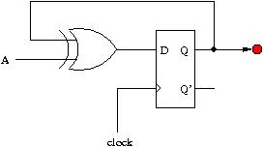
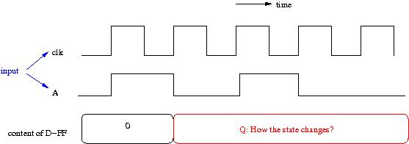
Today’s Goal
establish the ability to imagine how a circuit works
  draw the timing waveform from a circuit diagram

Slide 3
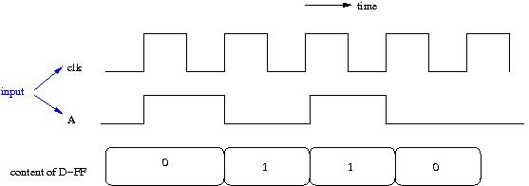
Today’s Goal
establish the ability to imagine how a circuit works
  draw the timing waveform from a circuit diagram

Slide 4
Today’s Goal
That’s why we call it sequential circuit
sequence of state changes

Slide 5
Materials coming from
Section 5.4

Slide 6
Preliminary: timing of logic elements (1)
storage element: the D flip-flop

Slide 7
The D Flip-Flop
in
D
Q
out
clk
Imagine that a D flip-flop is a box of 1-bit memory
When the D flip-flop memorize the input?
  at (positive) edge trigger of the clock (clk) signal
  like a snapshot of a camera!

Slide 8
Timing Waveform of the D Flip-Flop
in
D
Q
out
the unstable input signals ignored
only the last 0 before clock trigger been memorized
clk
time
clk
0
in
content
0
Q

Slide 9
Timing Waveform of the D Flip-Flop
in
D
Q
out
clk
time
clk
in
0
1
content
xxxxxxx
0
1
Q
xxxxxxx

Slide 10
Preliminary: timing of logic elements (2)
elements for combinational circuit

Slide 11

Timing of combinational circuit
signal value changes immediately without waiting for the clock trigger
time
clock
A
B
(logic 0)
C
X

Slide 12
Timing of combinational circuit
signal value changes immediately without waiting for the clock trigger
time
clock
A
changes on C causes the signal value changes on X
B
(logic 0)
C
X

Slide 13
Timing of combinational circuit
signal value changes immediately without waiting for the clock trigger
time
clock
A
B
(logic 0)
the delay will be ignored through-out this course
C
X

Slide 14
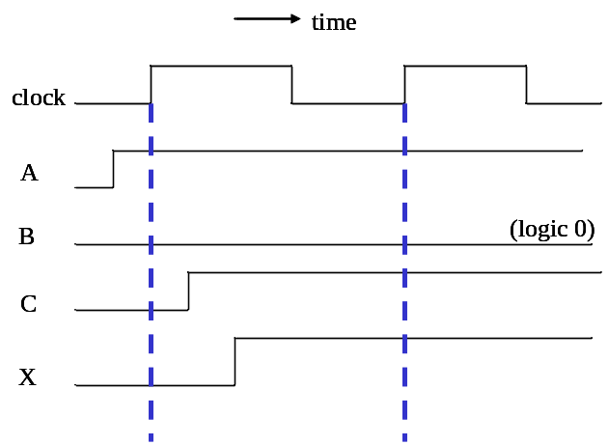
Timing of combinational circuit
we simply express the timing waveform cycle by cycle
time
clock
A
1
1
B
0
1
C
1
1
X
1
1

Slide 15
Timing of combinational circuit
we simply express the timing waveform cycle by cycle
time
clock
A
1
1
the signal value of C is stable at 1 at the end of this cycle
B
0
1
C
1
1
X
1
1

Slide 16
Timing of combinational circuit
combinational circuit always gets the output at the same cycle!
time
clock
A
1
1
B
0
0
C
1
1
X
1
1

Slide 17
Now we begin
to draw the timing diagram from a sequential circuit

Slide 18
Recall your goal
establish the ability to imagine how a circuit works
  draw the timing waveform from a circuit diagram

Slide 19
Method to analyze a sequential circuit
Step 1: derive input equations to D flip-flops
Step 2: derive the state table
Step 3: draw the state-diagram
Then you can draw the timing waveform from a state-diagram

Slide 20
Input equations to storage elements
for D flip-flops only

Slide 21
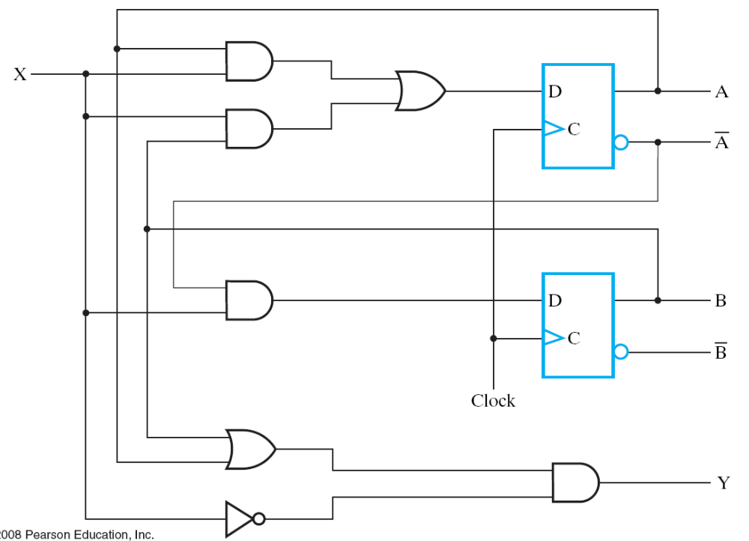
Example Circuit
Figure 5-15 at page 241

Slide 22




Input equation to D-FFs
Boolean function to
  determine the input to D-FFs
  from current state (cycle t) and input signals

Slide 23


How to derive the input equations?
ignore the D-FFs and consider the combinational circuit only
simply write-down the Boolean equation of the combinational circuit
combinational circuit

Slide 24
How to derive the input equations?
ignore the D-FFs and consider the combinational circuit only
simply write-down the Boolean equation of the combinational circuit
combinational circuit
the input equation we want

Slide 25
Meaning of the input equations to D-FFs

Slide 26
Meaning of the input equations
the signal value at the end of the current cycle t
combinational circuit
time
clock
A
0
0
1
0
0
state
B
0
1
1
0
0
input
X
1
1
0
0
0
0
1
0
0
0
internal
signals
1
1
0
0
0

Slide 27
Meaning of the input equations
the signal value at the end of the current cycle t
combinational circuit
time
clock
A
0
0
1
0
0
state
B
0
1
1
0
0
input
X
1
1
0
0
0
Q: How to derive these signal values?
0
1
0
0
0
internal
signals
1
1
0
0
0

Slide 28
Meaning of the input equations
the signal value at the end of the current cycle t
combinational circuit
time
clock
A
0
Q: How to derive these states?
0
1
0
0
state
B
0
1
1
0
0
input
X
1
1
0
0
0
Q: How to derive these signal values?
0
1
0
0
0
internal
signals
1
1
0
0
0

Slide 29

Meaning of the input equations
the signal value at the end of the current cycle t
combinational circuit
cycle t
time
clock
A
0
state
B
0
input
X
1
1
0
0
0
0
internal
signals

Slide 30

Meaning of the input equations
the signal value at the end of the current cycle t
combinational circuit
cycle t
time
clock
A
0
state
B
0
input
X
1
1
0
0
0
0
internal
signals
1

Slide 31
Meaning of the input equations
the signal value at the end of the current cycle t
combinational circuit
cycle t
time
clock
A
0
0
state
B
0
1
input
X
1
1
0
0
0
0
internal
signals
1

Slide 32

Meaning of the input equations
the signal value at the end of the current cycle t
combinational circuit
cycle t
time
clock
A
0
0
state
B
0
1
input
X
1
1
0
0
0
0
1
internal
signals
1

Slide 33
Meaning of the input equations
the signal value at the end of the current cycle t
combinational circuit
cycle t
time
clock
A
0
0
state
B
0
1
input
X
1
1
0
0
0
0
1
internal
signals
1
1

Slide 34
Meaning of the input equations
the signal value at the end of the current cycle t
combinational circuit
Derive remaining part by yourself!
time
clock
A
0
0
1
0
0
state
B
0
1
1
0
0
input
X
1
1
0
0
0
0
1
0
0
0
internal
signals
1
1
0
0
0

Slide 35
Rule of thumb
a combinational circuit always generates the outputs at the same cycle
combinational circuit
cycle t
time
clock
A
0
0
state
B
0
1
input
X
1
1
0
0
0
0
1
internal
signals
1
1

Slide 36
State table of a sequential circuit

Slide 37
Method to analyze a sequential circuit
Step 1: derive input equations to D flip-flops
Step 2: derive the state table
Step 3: draw the state-diagram
Then you can draw the timing waveform from a state-diagram

Slide 38
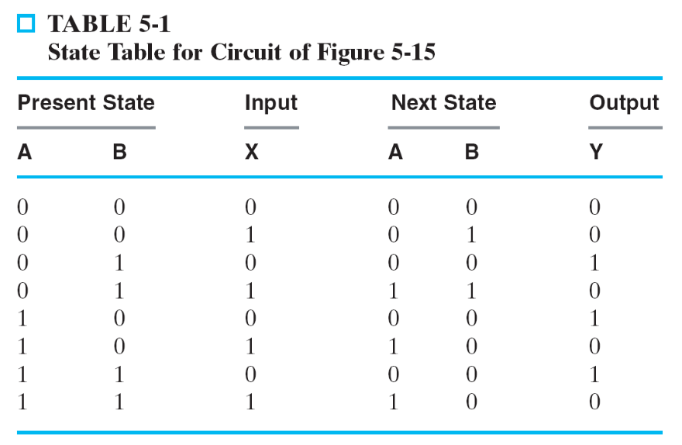
What is a state table?
like a truth table
rules to determine the state at cycle t+1 from
  state at cycle t, and
  input signals at cycle t
state: content of D-FFs

Slide 39
What is a state table?
like a truth table
rules to determine the state at cycle t+1 from
  state at cycle t, and
  input signals at cycle t
state: content of D-FFs
enumerate all
possible conditions

Slide 40
What is a state table?
like a truth table
rules to determine the state at cycle t+1 from
  state at cycle t, and
  input signals at cycle t
state: content of D-FFs
state at cycle t
state at cycle t+1
enumerate all
possible conditions

Slide 41
Meaning of a state-table
timing waveform can be drawn from the state table
time
clock
A
0
0
?
1
0
0
state
B
0
1
1
0
0
X
1
1
0
0
0
input

Slide 42
Meaning of a state-table
timing waveform can be drawn from the state table
time
clock
A
0
0
1
0
0
state
B
0
1
1
0
0
X
1
1
0
0
0
input

Slide 43
Meaning of a state-table
rules to determine the state at cycle t+1 from
  state at cycle t, and
  input signals at cycle t
time
clock
A
0
cycle t
cycle t+1
state
B
0
X
1
input
cycle t
cycle t+1

Slide 44
Meaning of a state-table
rules to determine the state at cycle t+1 from
  state at cycle t, and
  input signals at cycle t
time
clock
A
0
0
cycle t
cycle t+1
state
B
0
1
X
1
input
cycle t
cycle t+1

Slide 45
Meaning of a state-table
rules to determine the state at cycle t+1 from
  state at cycle t, and
  input signals at cycle t
time
clock
A
0
0
cycle t
cycle t+1
state
B
0
1
X
1
1
input
cycle t
cycle t+1

Slide 46
Meaning of a state-table
rules to determine the state at cycle t+1 from
  state at cycle t, and
  input signals at cycle t
time
clock
A
0
0
1
cycle t
cycle t+1
state
B
0
1
1
X
1
1
input
cycle t
cycle t+1

Slide 47
Meaning of a state-table
timing waveform can be drawn from the state table
complete the timing waveform
by yourself!
time
clock
A
0
0
1
0
0
state
B
0
1
1
0
0
X
1
1
0
0
0
input

Slide 48
How to derive the state table

Slide 49
Method to analyze a sequential circuit
Step 1: derive input equations to D flip-flops
Step 2: derive the state table
Step 3: draw the state-diagram
Then you can draw the timing waveform from a state-diagram

Slide 50

How to derive the state-table
Rule of thumb:
  the input to a D-FF at cycle t equals the state of D-FF at cycle t+1
combinational circuit

Slide 51



Timing Waveform of the D Flip-Flop
combinational
circuit
in
D
Q
out
time
clk
clk
in
v0
v1
v2
v3
content
v0
v1
v2
v3
Q
v0
v1
v2
v3

Slide 52
How to derive the state-table
D_{A}(t)=0
check the rules and the state-table
D_{B}(t)=1
state at cycle t
state at cycle t+1

Slide 53
Put it all together
derive the state table and the timing waveform

Slide 54
General rule
combinational
circuit
D_{A}
A
D
Q
X
draw the timing waveform cycle-by-cycle
Step 1: remove D-FFs and derive Boolean equations for the combinational circuit
  state A is an input to the combinational circuit
Step 2: derive outputs of the combinational circuit at the same cycle
  inputs to D-FFs are outputs of the combinational circuit
  the combinational circuit generates output at the same cycle
Step 3: derive the next state of D-FFs
  A(t+1)=D_{A}(t)
clock
Y
time
clock
A
A0
A1
X
X0
D_{A}
D0
Y
Y0

Slide 55
General rule
combinational
circuit
D_{A}
A
D
Q
X
draw the timing waveform cycle-by-cycle
Step 1: remove D-FFs and derive Boolean equations for the combinational circuit
  state A is an input to the combinational circuit
Step 2: derive outputs of the combinational circuit at the same cycle
  inputs to D-FFs are outputs of the combinational circuit
  the combinational circuit generates output at the same cycle
Step 3: derive the next state of D-FFs
  A(t+1)=D_{A}(t)
clock
Y
time
clock
A
A0
A1
X
X0
D_{A}
D0
Y
Y0

Slide 56
General rule
combinational
circuit
D_{A}
A
D
Q
X
draw the timing waveform cycle-by-cycle
Step 1: remove D-FFs and derive Boolean equations for the combinational circuit
  state A is an input to the combinational circuit
Step 2: derive outputs of the combinational circuit at the same cycle
  inputs to D-FFs are outputs of the combinational circuit
  the combinational circuit generates output at the same cycle
Step 3: derive the next state of D-FFs
  A(t+1)=D_{A}(t)
clock
Y
time
clock
A
A0
A1
X
X0
D0=BoolFunc (A0, X0)
D_{A}
D0
Y0=BoolFunc(A0, X0)
Y
Y0

Slide 57
General rule
combinational
circuit
D_{A}
A
D
Q
X
draw the timing waveform cycle-by-cycle
Step 1: remove D-FFs and derive Boolean equations for the combinational circuit
  state A is an input to the combinational circuit
Step 2: derive outputs of the combinational circuit at the same cycle
  inputs to D-FFs are outputs of the combinational circuit
  the combinational circuit generates output at the same cycle
Step 3: derive the next state of D-FFs
  A(t+1)=D_{A}(t)
clock
Y
time
clock
A
A0
A1=D0
X
X0
D_{A}
D0
Y
Y0

Slide 58
Rule of Thumb
Combinational Circuit: generate outputs at the same cycle to inputs
D Flip-Flop: A(t+1) = D_{A}(t)
  state changes at the next cycle

Slide 59
Example
?
time
clock
A
0
?
0
1
0
0
state
B
0
1
1
0
0
input
X
1
1
0
0
0
?
0
1
0
0
0
internal
signals
1
1
0
0
0

Slide 60
Example
?
combinational circuit
time
clock
A
0
?
0
1
0
0
state
B
0
1
1
0
0
input
X
1
1
0
0
0
?
0
1
0
0
0
internal
signals
1
1
0
0
0

Slide 61
Example
combinational circuit
time
clock
A
0
state
B
0
input
X
1
1
0
0
0
0
internal
signals
1

Slide 62
Example
combinational circuit
time
clock
A
0
0
state
B
0
1
input
X
1
1
0
0
0
0
internal
signals
1

Slide 63
Example
combinational circuit
time
clock
A
0
0
state
B
0
1
input
X
1
1
0
0
0
0
1
internal
signals
1
1

Slide 64
Example
combinational circuit
time
clock
A
0
0
1
state
B
0
1
1
input
X
1
1
0
0
0
0
1
internal
signals
1
1

Slide 65
Example
time
clock
A
0
0
1
0
0
state
B
0
1
1
0
0
input
X
1
1
0
0
0
Complete by yourself!
0
1
0
0
0
internal
signals
1
1
0
0
0

Slide 66
Example
time
clock
A
0
0
1
0
0
state
B
0
1
1
0
0
input
X
1
1
0
0
0
Q: How about output Y?
0
1
0
0
0
internal
signals
1
1
0
0
0
output
Y
?

Slide 67
State diagram
finite-state machine model for digital circuit

Slide 68
Method to analyze a sequential circuit
Step 1: derive input equations to D flip-flops
Step 2: derive the state table
Step 3: draw the state-diagram
Then you can draw the timing waveform from a state-diagram

Slide 69
What is the state diagram?
a graphical way to represent the state table
X=0
00
X=1
X=0
X=0
01
10
X=1
X=0
X=1
X=1
11

Slide 70
What is the state diagram?
node (state): content of the D-FFs
edge: state transition upon receiving input signal value
X=0
00
X=1
X=0
X=0
01
10
X=1
X=0
X=1
X=1
11

Slide 71
What is the state diagram?
node (state): content of the D-FFs
edge: state transition upon receiving input signal value
X=0
00
X=1
X=0
present state
X=0
01
10
X=1
X=0
X=1
X=1
11
next state

Slide 72
Draw timing waveform from state-diagram
X=0
time
00
X=1
X=0
clock
X=0
01
10
X=1
A
0
0
1
0
0
state
X=0
B
0
1
1
0
0
X=1
X=1
11
input
X
1
1
0
0
0

Slide 73
Draw timing waveform from state-diagram
X=0
present state
time
00
X=1
X=0
clock
present state
X=0
01
10
X=1
A
0
0
state
X=0
B
0
1
next state
X=1
X=1
11
input
X
1
input signal

