Slide 1
Timing Analysis of Sequential Circuit
Lecture 01B

Slide 2
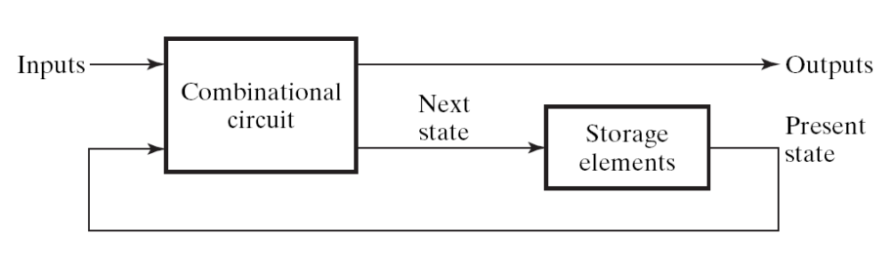
What is a sequential circuit
Sequential Circuit:
  a digital circuit with storage element to memorize current state
  Figure 5-1:
the counter part -- Combinational Circuit
  a digital circuit without storage element

Slide 3
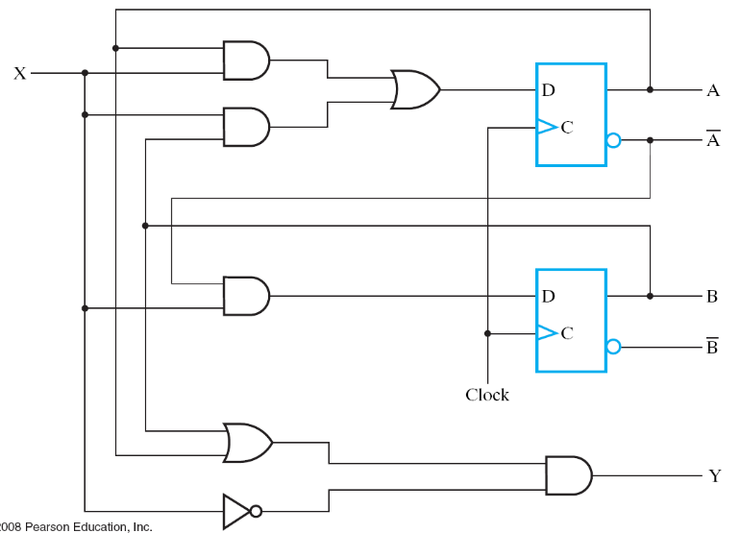
The key to design hardware
imagine how a circuit works
time
clock
A
0
0
1
0
0
state
B
0
1
1
0
0
input
X
1
1
0
0
0

Slide 4
Note: we are talking about Synchronous Clocked Circuit
All flip flops receive the same clock signal
time
clock
A
0
0
1
0
0
state
B
0
1
1
0
0
input
X
1
1
0
0
0

Slide 5

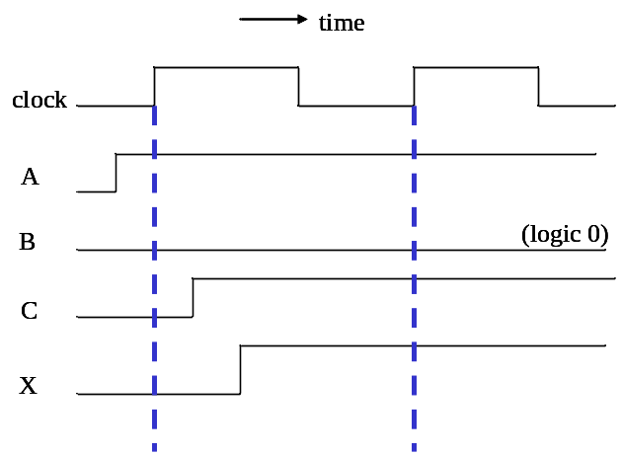
Cycle-based vs. Actual Timing
time
clock
A
1
1
B
0
1
C
1
1
X
1
1
Actual Timing
Cycle-based reasosning

Slide 6
Analysis for actual timing
minimum clock period time

Slide 7

Core Question
What’s the minimum clock period time to make the circuit works correctly?
clock
time
clock

Slide 8
What’s the clock for?
Answer: to make the circuit doing step-by-step computation
  clock signal is fed to all flip flops of the circuit
  to let a sequential circuit performs its task in step-by-step manner
  forms a sequence of state change on flip flops
    imagine the flip flops as variables for programming
sequence of state change
time
clock
A
0
0
1
0
0
state
B
0
1
1
0
0
input
X
1
1
0
0
0

Slide 9

Core Question
What’s the maximum one-step computation time?
A
B
clock
the combinational circuit is to perform one-step computation

Slide 10
Core Question
What’s the maximum one-step computation time?
A
B
clock
the one-step computation time

Slide 11
Recall: property of D flip-flop
in
D
Q
out
the unstable input signals ignored
only the last 0 before clock trigger been memorized
clk
time
clk
0
in
content
0
Q

Slide 12

Core Question
What’s the maximum one-step computation time?
A
B
clock
time
clock
A
stable
B
stable

Slide 13
Analysis Example

Slide 14
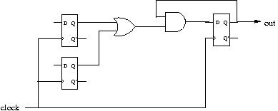
Problem Description
find the maximum clock frequency (minimum clock period time) of the circuit
delay of AND-gate: 3 ns
delay of OR-gate: 4 ns
setup time of D-FF: 2 ns
clock-to-output time of D-FF: 1 ns

Slide 15
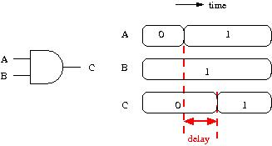
Delay of a gate

Slide 16
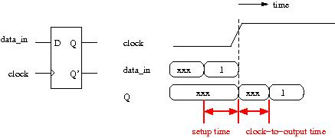
Delay for a flip-flop

Slide 17
Problem Description
find the maximum clock frequency (minimum clock period time) of the circuit
delay of AND-gate: 3 ns
delay of OR-gate: 4 ns
setup time of D-FF: 2 ns
clock-to-output time of D-FF: 1 ns

Slide 18
Analysis method
start from the outputs of D-FFs
mark critical points in the circuit
find-out signal stable time for each point
A
B
E
D
C

Slide 19
Timing analysis
delay of AND-gate: 3 ns
delay of OR-gate: 4 ns
setup time of D-FF: 2 ns
clock-to-output time of D-FF: 1 ns
A
1ns
1ns
B
E
D
C
1ns

Slide 20
Timing analysis
delay of AND-gate: 3 ns
delay of OR-gate: 4 ns
setup time of D-FF: 2 ns
clock-to-output time of D-FF: 1 ns
A
1ns
B
5ns
E
D
4ns delay
C
1ns

Slide 21
Timing analysis
delay of AND-gate: 3 ns
delay of OR-gate: 4 ns
setup time of D-FF: 2 ns
clock-to-output time of D-FF: 1 ns
1ns
A
B
E
D
8ns
5ns
C
3ns delay

Slide 22
Timing analysis
delay of AND-gate: 3 ns
delay of OR-gate: 4 ns
setup time of D-FF: 2 ns
clock-to-output time of D-FF: 1 ns
A
B
10 ns
E
D
8ns
C

Slide 23
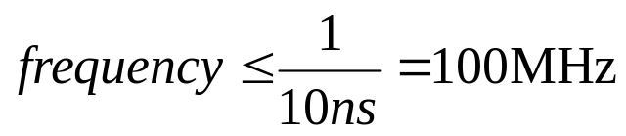
Clock period time and frequency
A
B
10 ns
E
D
C
≥10 ns
time
clock

Slide 24
The next lecture

Slide 25
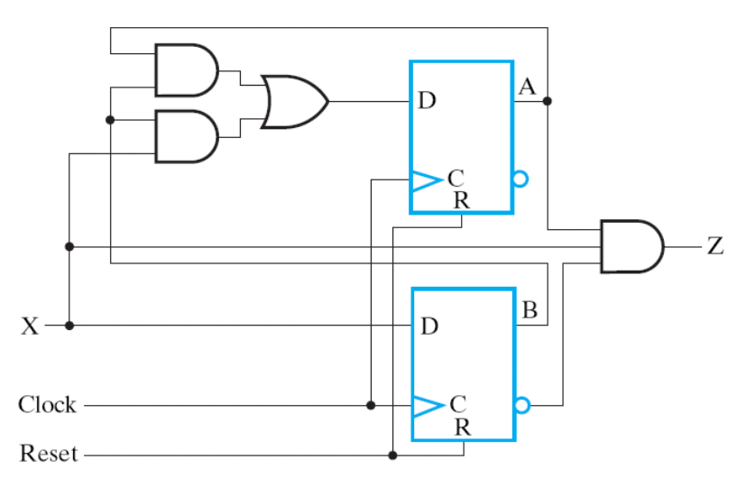
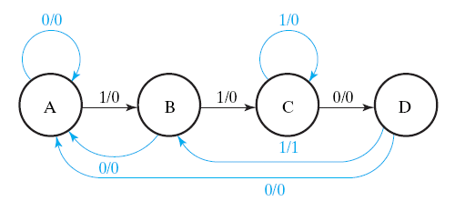
Next Lecture
circuit design to realize a state-diagram
  Section 5-5

Slide 26
Your work before the next meeting
Preview the textbook: Section 5-5
Review “digital circuit”: combinational circuit design from the truth table
  Chap. 2: Boolean algebra
  Chap. 3: K-map simplification
Review “discrete mathematics”: finite automata
  also named finite-state machine

