Slide 1
RTL Design Methodology
Lecture 05
Sec 6.2-6.5

Slide 2
What is RTL design?
a quick overview

Slide 3
What is a register
a variable in a chip
an n-bit storage device
  triggered by clock
  D flip-flop is an 1-bit register
may with various control signals (load, shift, counting, etc.)
in
D
Q
out
D
Q
4
4
clk
clock

Slide 4
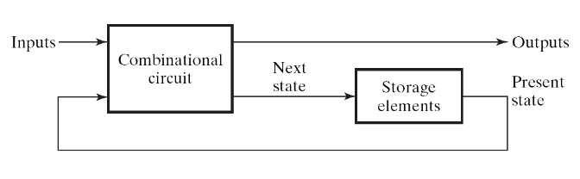
What is RTL design (1)
(What’s the clock for?)
Answer: to make the circuit doing step-by-step computation
  clock signal is fed to all registers of the circuit
  to let a sequential circuit performs its task in step-by-step manner
    one step: a micro-operation (Section 6-3)
  forms a sequence of state change on flip flops
    imagine the flip flops as variables for programming
sequence of state change
time
registers A, B, C, …
clock
A
0010
0111
1001
1111
1100
registers
B
0101
1000
1010
0000
0011
A=B+C
clock
input
X
1
1
0
0
0
Figure 5-1

Slide 5
What is RTL design
RTL: Register Transfer Level (Language)
a standard method to design any digital IC
Feature:
  designer specify rules to transfer data from one register to another register
  EDA (electronic design automation) tool synthesis RTL code to real hardware
B
C
Verilog code
+
reg [3:0] A, B, C;
always @(posedge clk) begin
A <= B+C;
end
clk
register
A

Slide 6
RTL Design Methodology
an overview

Slide 7
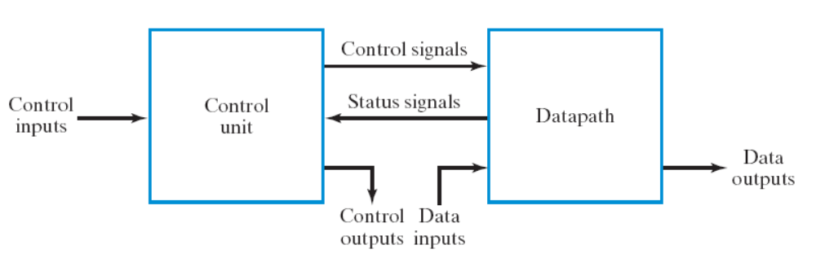
Steps of RTL Design
Step 1: always starts from the general framework
  control signals: the order sent from control unit
  status signals: reports from data path
Step 2: specify the behavior of each part
  control unit: state-diagram
  data path: micro-operation
Step 3: design circuits from behavior specification
  control unit: state-diagram to circuit (Chapter 5)
  data path: micro-operation to circuit (Sec. 7.3 – 7.6)

Slide 8
Steps of RTL Design
Step 1: always starts from the general framework
  control signals: the order sent from control unit
  status signals: reports from data path
Step 2: specify the behavior of each part
  control unit: state-diagram
  data path: micro-operation
Step 3: design circuits from behavior specification
  control unit: state-diagram to circuit (Chapter 5)
  data path: micro-operation to circuit (Sec. 7.3 – 7.6)
Hey you, do A=B+C
A=B+C, where A, B, C are registers

Slide 9
Steps of RTL Design
Step 1: always starts from the general framework
  control signals: the order sent from control unit
  status signals: reports from data path
Step 2: specify the behavior of each part
  control unit: state-diagram
  data path: micro-operation
Step 3: design circuits from behavior specification
  control unit: state-diagram to circuit (Chapter 5)
  data path: micro-operation to circuit (Sec. 7.3 – 7.6)
I got overflow from A=B+C, sir

Slide 10
Steps of RTL Design
Step 1: always starts from the general framework
  control signals: the order sent from control unit
  status signals: reports from data path
Step 2: specify the behavior of each part
  control unit: state-diagram
  data path: micro-operation
Step 3: design circuits from behavior specification
  control unit: state-diagram to circuit (Chapter 5)
  data path: micro-operation to circuit (Sec. 7.3 – 7.6)

Slide 11
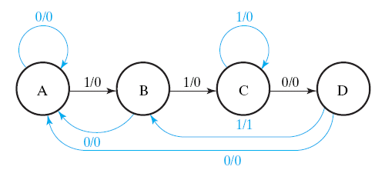
Steps of RTL Design
Step 1: always starts from the general framework
  control signals: the order sent from control unit
  status signals: reports from data path
Step 2: specify the behavior of each part
  control unit: state-diagram
  data path: micro-operation
Step 3: design circuits from behavior specification
  control unit: state-diagram to circuit (Chapter 5)
  data path: micro-operation to circuit (Sec. 7.3 – 7.6)

Slide 12
Steps of RTL Design
Step 1: always starts from the general framework
  control signals: the order sent from control unit
  status signals: reports from data path
Step 2: specify the behavior of each part
  control unit: state-diagram
  data path: micro-operation
Step 3: design circuits from behavior specification
  control unit: state-diagram to circuit (Chapter 5)
  data path: micro-operation to circuit (Sec. 7.3 – 7.6)
K
K: A=B+C
(if (K==1) then A=B+C;)

Slide 13
Steps of RTL Design
Step 1: always starts from the general framework
  control signals: the order sent from control unit
  status signals: reports from data path
Step 2: specify the behavior of each part
  control unit: state-diagram
  data path: micro-operation
Step 3: design circuits from behavior specification
  control unit: state-diagram to circuit (Chapter 5)
  data path: micro-operation to circuit (Sec. 7.3 – 7.6)

Slide 14
Steps of RTL Design
Step 1: always starts from the general framework
  control signals: the order sent from control unit
  status signals: reports from data path
Step 2: specify the behavior of each part
  control unit: state-diagram
  data path: micro-operation
Step 3: design circuits from behavior specification
  control unit: state-diagram to circuit (Chapter 5)
  data path: micro-operation to circuit (Sec. 7.3 – 7.6)
K
K: A=B+C
(if (K==1) then A=B+C;)

Slide 15
Micro Operations

Slide 16
What is RTL design (1)
(What’s the clock for?)
Answer: to make the circuit doing step-by-step computation
  clock signal is fed to all registers of the circuit
  to let a sequential circuit performs its task in step-by-step manner
    one step: a micro-operation (Section 7-3)
  forms a sequence of state change on flip flops
    imagine the flip flops as variables for programming
time
registers A, B, C, …
clock
A
0010
0111
1001
1111
1100
registers
B
0101
1000
1010
0000
0011
A=B+C
clock
input
X
1
1
0
0
0
Figure 5-1

Slide 17



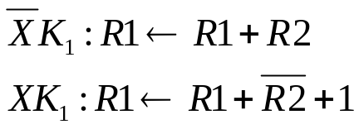
Examples
a simple transfer
conditional transfer
a simple arithmetic
conditional arithmetic

Slide 18
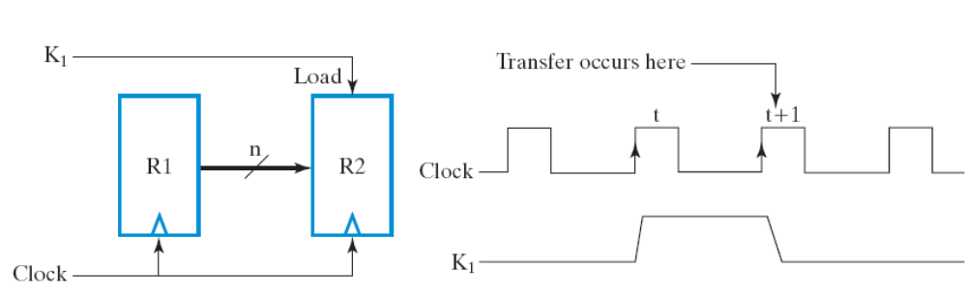
Example 1
time
clock
R1
0010
0111
1001
1111
1100
registers
R2
x
0010
0111
1001
1111

Slide 19

Example 2
register with load enable (Figure 7-2)
time
clock
R1
0010
0111
1001
registers
R2
x
0010
0010
K1
1
0
0

Slide 20
Example 3
R1
R2
an adder
(Chap. 4)
+
R0
time
clock
R1
10
2
8
registers
R2
5
7
2
R0
X
15
9

Slide 21
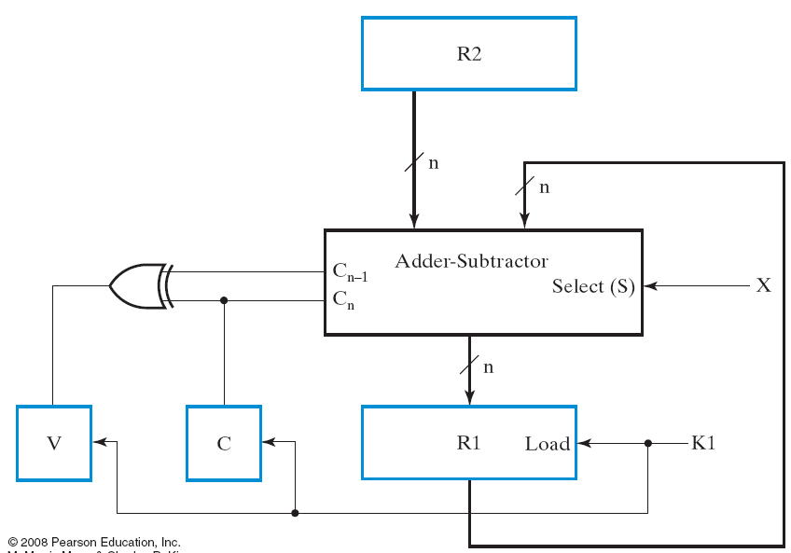
Example 4

Slide 22
RTL Design Example
Q=A+B+C+D with only one adder

Slide 23
The Problem
use only one adder to compute Q=A+B+C+D
  start computing when “START” button pressed
  hold the result in Q and inform by LED “FINISH”
n
Accumulator
A
n
B
n
Q
C
n
n
D
FINISH
START

Slide 24
Steps of RTL Design
Step 0: write-down the “step-by-step” flow-chart for the task
Step 1: starts from the general framework
Step 2: specify the behavior of each part
  control unit: state-diagram
  data path: micro-operation
Step 3: design circuits from behavior specification
  control unit: state-diagram to circuit (Chapter 5)
  data path: micro-operation to circuit (Sec. 7.3 – 7.6)

Slide 25
The hardware algorithm

Slide 26






Steps to do Q=A+B+C+D
Notes:
  each state holds for one cycle
  one step performs a micro-operation with combinational circuit
STOP
Step 0
Step 1
Step 2
the four steps to
compute Q=A+B+C+D
Step 3

Slide 27
Behavior spec of the datapath

Slide 28
Steps of RTL Design
Step 0: write-down the “step-by-step” flow-chart for the task
Step 1: starts from the general framework
Step 2: specify the behavior of each part
  control unit: state-diagram
  data path: micro-operation
Step 3: design circuits from behavior specification
  control unit: state-diagram to circuit (Chapter 5)
  data path: micro-operation to circuit (Sec. 7.3 – 7.6)

Slide 29





Behavior of the data path
S[2:0]
STOP
0
X
X
1
0
0
Step 0
1
0
1
1
1
0
1
1
1
Step 1
Step 2
Step 3
Q

Slide 30
Behavior of the data path
all micro-operations in the algorithm
S[2:0]
STOP
0
X
X
1
0
0
Step 0
1
0
1
1
1
0
1
1
1
Step 1
Step 2
Step 3
Q

Slide 31
Behavior of the data path
3-bit signal for the command
S[2:0]
STOP
0
X
X
1
0
0
Step 0
1
0
1
1
1
0
1
1
1
Step 1
S
Step 2
Step 3
Q

Slide 32
Behavior spec of the control unit
the state diagram

Slide 33
Steps of RTL Design
Step 0: write-down the “step-by-step” flow-chart for the task
Step 1: starts from the general framework
Step 2: specify the behavior of each part
  control unit: state-diagram
  data path: micro-operation
Step 3: design circuits from behavior specification
  control unit: state-diagram to circuit (Chapter 5)
  data path: micro-operation to circuit (Sec. 7.3 – 7.6)

Slide 34
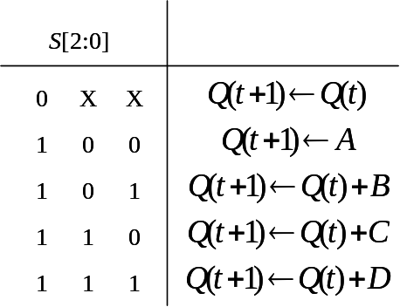
Behavior of the control unit
just send corresponding signals for required operation
STOP
STOP
S=000
Step 0
Step 0
S=100
Step 1
Step 1
S=101
Step 2
Step 2
S=110
Step 3
Step 3
S=111

Slide 35
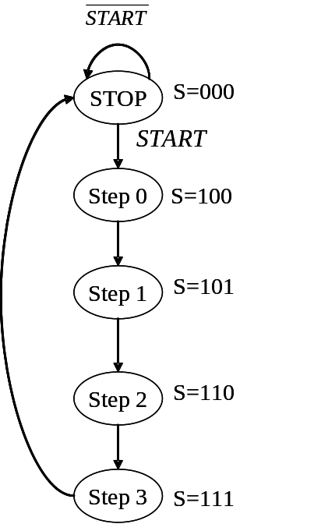
Behavior spec
S[2:0]
0
X
X
1
0
0
1
0
1
1
1
0
1
1
1
S[2:0]
Q

Slide 36
Circuit of the data path

Slide 37
Steps of RTL Design
Step 0: write-down the “step-by-step” flow-chart for the task
Step 1: starts from the general framework
Step 2: specify the behavior of each part
  control unit: state-diagram
  data path: micro-operation
Step 3: design circuits from behavior specification
  control unit: state-diagram to circuit (Chapter 5)
  data path: micro-operation to circuit (Sec. 7.3 – 7.6)

Slide 38
Circuit of the data path
0
A
B
C
D
S[2:0]
0
X
X
S[1]
OR
MUX
S[1:0]
MUX
S[0]
1
0
0
1
0
1
Adder
1
1
0
1
1
1
S[2]
register Q
Load

Slide 39
Circuit of the data path
0
A
B
C
D
S[2:0]
0
X
X
S[1]
OR
MUX
S[1:0]
MUX
S[0]
1
0
0
1
0
1
Adder
1
1
0
1
1
1
0
register Q
S[2]
Load
holds the original value

Slide 40
Circuit of the data path
0
A
B
C
D
S[2:0]
0
X
X
S[1]
OR
MUX
S[1:0]
MUX
S[0]
1
0
0
1
0
1
Adder
1
1
0
1
1
1
1
register Q
S[2]
Load
loads input from the adder

Slide 41
Circuit of the data path
0
A
B
C
D
S[2:0]
0
0
X
X
S[1]
OR
00
MUX
S[1:0]
MUX
S[0]
0
1
0
0
0
1
0
1
Adder
1
1
0
1
1
1
S[2]
1
register Q
Load

Slide 42
Circuit of the data path
0
A
B
C
D
S[2:0]
0
0
X
X
S[1]
OR
01
MUX
S[1:0]
MUX
S[0]
1
1
0
0
1
1
0
1
Adder
1
1
0
1
1
1
S[2]
1
register Q
Load

Slide 43
Timing diagram of the data path
time
A
1000
B
0100
C
0010
D
0001
S
100
101
110
111
000
Q
xxxx
1000
1100
1110
1111

Slide 44

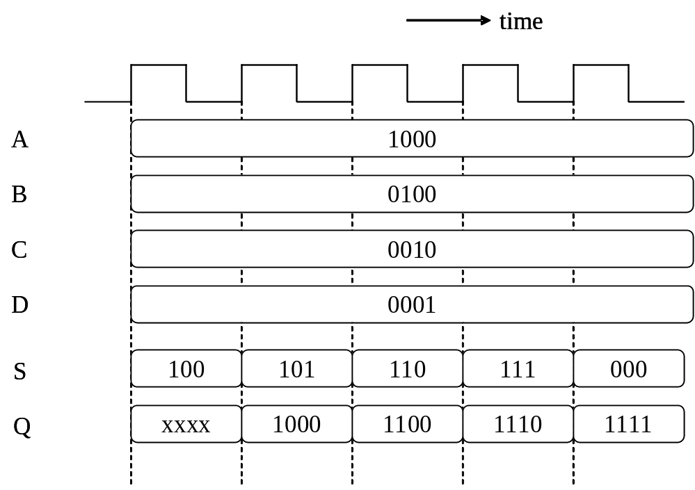
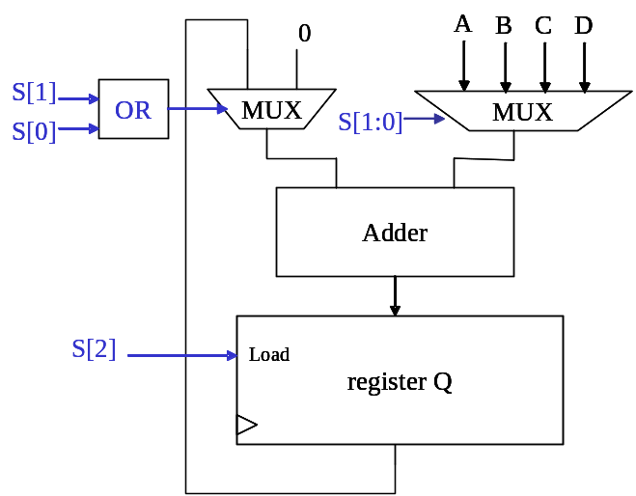
Put it all together: How the data path works

Slide 45
Put it all together: How the datap ath works
00
00
1

Slide 46
Put it all together: How the datap ath works
01
01
1

Slide 47
Circuit of the control unit

Slide 48
Steps of RTL Design
Step 0: write-down the “step-by-step” flow-chart for the task
Step 1: starts from the general framework
Step 2: specify the behavior of each part
  control unit: state-diagram
  data path: micro-operation
Step 3: design circuits from behavior specification
  control unit: state-diagram to circuit (Chapter 5)
  data path: micro-operation to circuit (Sec. 7.3 – 7.6)

Slide 49
State assignment
3 D flip-flops
the state value equals the control!
STOP
S=000
000
S=000
Step 0
100
S=100
S=100
Step 1
S=101
101
S=101
Step 2
S=110
110
S=110
Step 3
111
S=111
S=111

Slide 50
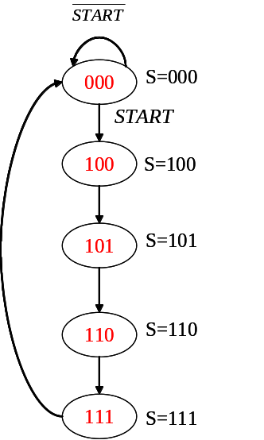
Standard method to realize a state diagram
combinational
circuit
D flip-flops
S[2:0]
D[2:0]
START
S[2:0]
START
D[2:0]
0XX
0
000
0XX
1
100
100
X
101
101
X
110
110
X
111
111
X
000

Slide 51
Some tricks to implement the control unit
use a counter for S[1:0]
  be careful for the logic to set S[2]
use a counter for the whole state diagram
  be careful on the count-enable control
011
S=011
100
S=100
101
S=101
110
S=110
111
S=111

Slide 52
Timing diagram of the control unit
time
A
1000
B
0100
C
0010
D
0001
state
Step 0
Step 1
Step 2
Step 3
Stop
S
100
101
110
111
000

Slide 53
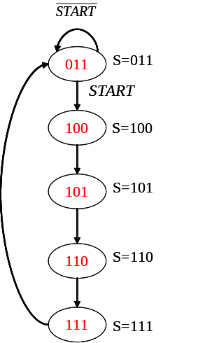
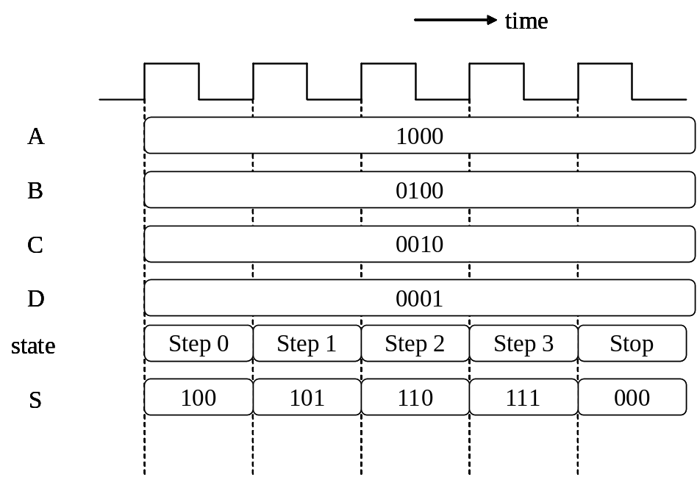
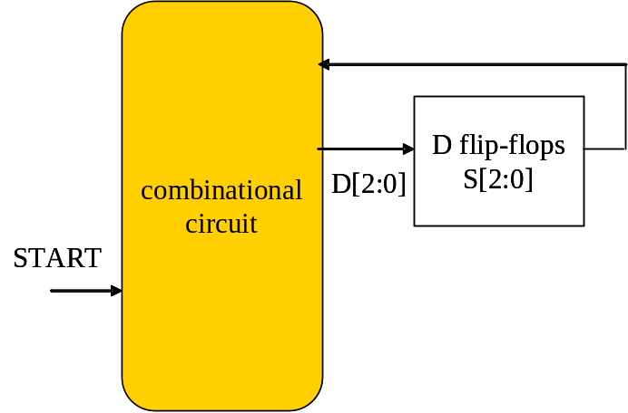
Timing diagram of the control unit

Slide 54
How the hardware Q=A+B+C+D works
put it all together

Slide 55

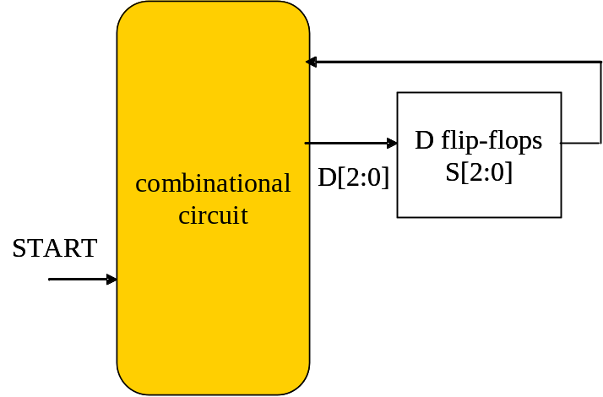
The whole circuit

Slide 56
Timing diagram of the circuit
time
A
1000
B
0100
C
0010
D
0001
state
Step 0
Step 1
Step 2
Step 3
Stop
S
100
101
110
111
000
Q
xxxx
1000
1100
1110
1111

Slide 57
Timing diagram of the circuit
time
A
1000
state sequence of the control unit
B
0100
C
0010
D
0001
state
Step 0
Step 1
Step 2
Step 3
Stop
S
100
101
110
111
000
Q
xxxx
1000
1100
1110
1111

Slide 58
Timing diagram of the circuit
time
A
1000
B
0100
operations of the data path
C
0010
D
0001
state
Step 0
Step 1
Step 2
Step 3
Stop
S
100
101
110
111
000
Q
xxxx
1000
1100
1110
1111
control signal affects the content of Q at the next cycle

Slide 59
Exercise
R=|A-B| with only one adder

Slide 60
Problem Description
Design a hardware to compute R=|A-B| using only one adder
Write down the following:
  State transition diagram with micro-operations annotated
  Circuit of the data path
  Circuit of the control unit (specifying the truth-table of combinatorial part only)
A
B
n
n
start
R=|A-B|
clock
n
R

Slide 61
Steps of RTL Design
Step 0: write-down the “step-by-step” flow-chart for the task
Step 1: starts from the general framework
Step 2: design the data path
  micro-operations
  the circuit data path
Step 3: design the control unit
  finite state machine
  sequential circuit realization

Slide 62






Algorithm to compute R=|A-B|
S0
R = A+(~B)+1;
if (R[n-1]==1)
R = (~R)+1;
start
S1
S2
S3

Slide 63
Algorithm to compute R=|A-B|
no operation, keep value of R
S0
R = A+(~B)+1;
if (R[n-1]==1)
R = (~R)+1;
start
S1
S2
S3

Slide 64
Algorithm to compute R=|A-B|
S0
R=A-B
R = A+(~B)+1;
if (R[n-1]==1)
R = (~R)+1;
start
S1
S2
S3

Slide 65
Algorithm to compute R=|A-B|
S0
R = A+(~B)+1;
if (R[n-1]==1)
R = (~R)+1;
start
S1
check if R<0 or not
R>=0
S2
R<0
S3

Slide 66
Algorithm to compute R=|A-B|
S0
R = A+(~B)+1;
if (R[n-1]==1)
R = (~R)+1;
start
S1
S2
R=-R
S3

Slide 67
The data path to compute
R=|A-B|

Slide 68
Steps of RTL Design
Step 0: write-down the “step-by-step” flow-chart for the task
Step 1: starts from the general framework
Step 2: design the data path
  micro-operations
  the circuit data path
Step 3: design the control unit
  finite state machine
  sequential circuit realization

Slide 69
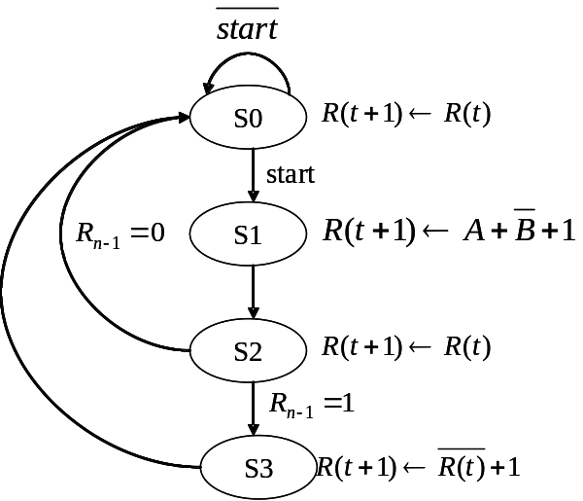
The data path
make sure that all micro-operations can be realized!
A
0
B
R
S1
MUX
MUX
S0
NOT
adder
Cin
1
load
L
register R

Slide 70
Exercise 1
write down the control signal value to realize each of the micro-operations
  R(t+1)=A+(~B)+1
  R(t+1)=(~R(t))+1
  R(t+1)=(~R(t))
you may give your own MUX encoding as you like
A
0
B
R
S1
MUX
MUX
S0
NOT
adder
Cin
1
load
L
register R

Slide 71

Control Signal
1
0
MUX
Realize R(t+1)=~R(t)+1
A
0
B
R
0
S1
MUX
MUX
S0
0
NOT
adder
Cin
1
1
load
Enable
L
register R

Slide 72

Control Signal
1
0
MUX
Realize R(t+1)=A+(~B)+1
A
0
B
R
1
S1
MUX
MUX
S0
1
NOT
adder
Cin
1
1
load
Enable
L
register R

Slide 73

Control Signal
1
0
MUX
Realize R(t+1)=R(t)
outcome of this part is don’t-care
A
0
B
R
MUX
MUX
S0
X
X
S1
NOT
adder
Cin
1
0
load
L
register R
not loading the input

Slide 74
The control unit

Slide 75

What’s the control unit for
hardware to send out control signals
to ask the data path to perform required micro-operations for each cycle
A
0
B
R
S1
MUX
MUX
S0
NOT
R[n-1]
adder
Cin
1
load
L
register R

Slide 76



Behavior specification of the control unit
write down the control signals for each state
  to perform required operations
S0
start
S1
S2
S3

Slide 77
Behavior specification of the circuit
Check the match between control signals and data path
A
0
B
R
S1
MUX
MUX
S0
S0
NOT
start
S1
adder
Cin
1
S2
load
L
register R
S3

Slide 78
How to realize the control unit
standard method to realize a finite-state machine (Chap. 5)
combinational
circuit
S0
D flip-flops
S[1:0]
start
S1
start
S2
{L, S1, S0}
S3

Slide 79
The timing diagram
Can you image how the circuit works?

Slide 80
Problem
Draw the timing diagram until the outcome R finished
A
3
B
8
start
1
0
state
S0
???
(L, S1, S0)
???
R[n-1]
???
R
???

Slide 81
Rule of Thumb
Combinational Circuit: generate outputs at the same cycle to inputs
D Flip-Flop: A(t+1) = D_{A}(t)
  state changes at the next cycle

Slide 82
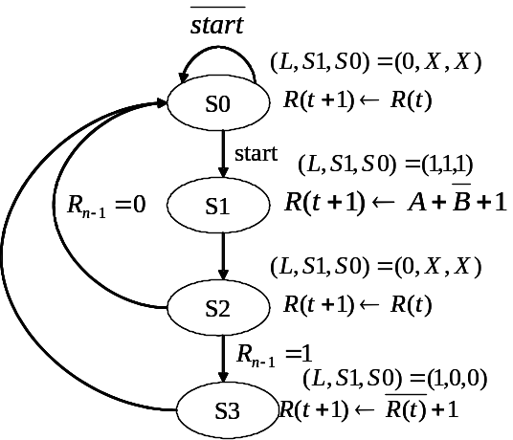
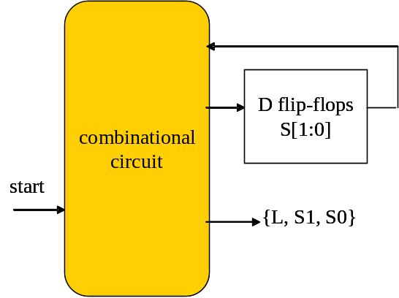
Timing of the control unit
control unit appears at the same cycle to the state
time
clock
state
S1
(L,S1,S0)
(1,1,1)
the same cycle
by combinational circuit

Slide 83
Timing of the control unit
state changes at the next cycle
time
clock
state
S1
S2
(L,S1,S0)
(1,1,1)

Slide 84
Timing of the data path
Computation at cycle t follows the control signals sent at cycle t
But the result appears on the register at cycle t+1
A
0
B
R
time
S1
MUX
MUX
S0
clock
NOT
state
S1
S2
(L,S1,S0)
(1,1,1)
adder
Cin
1
X
A+~B+1
X
load
L
register R
register R
x
A+~B+1

Slide 85
Timing of the data path
Computation at cycle t follows the control signals sent at cycle t
But the result appears on the register at cycle t+1
A
0
B
R
combinational circuit
time
S1
MUX
MUX
S0
clock
1
1
NOT
state
S1
S2
(L,S1,S0)
(1,1,1)
follows the
control signal
adder
Cin
1
X
A+~B+1
X
load
L
register R
register R
x
A+~B+1

Slide 86
Timing of the data path
Computation at cycle t follows the control signals sent at cycle t
But the result appears on the register at cycle t+1
A
0
B
R
time
S1
MUX
MUX
S0
clock
NOT
state
S1
S2
(L,S1,S0)
(1,1,1)
adder
Cin
1
A+~B+1
stored at the
next cycle
X
X
1
load
L
register R
register R
x
A+~B+1

Slide 87
Timing of the whole circuit
realize the hardware algorithm:
  do the required computation at each cycle
  and store the result at the next cycle
time
S0
clock
start
state
S1
S2
S1
(L,S1,S0)
(1,1,1)
S2
X
A+~B+1
register R
x
A+~B+1
S3

Slide 88
Timing of the whole circuit
realize the hardware algorithm:
  do the required computation at each cycle
  and store the result at the next cycle
time
S0
clock
start
state
S1
S2
S1
(L,S1,S0)
(1,1,1)
S2
X
A+~B+1
register R
x
A+~B+1
S3

Slide 89
Timing of the whole circuit
realize the hardware algorithm:
  do the required computation at each cycle
  and store the result at the next cycle
time
S0
clock
start
state
S1
S2
S1
(L,S1,S0)
(1,1,1)
S2
X
A+~B+1
register R
x
A+~B+1
S3

Slide 90
Timing of the whole circuit
state transition following the state diagram
time
S0
clock
start
state
S1
S2
S1
(L,S1,S0)
(1,1,1)
S2
X
A+~B+1
register R
x
A+~B+1
S3

Slide 91

Timing diagram of an working example
You just have to look at the hardware algorithm
A
3
B
8
start
1
0
state
S0
S1
S2
S3
S0
(L, S1, S0)
(0,X,X)
(1,1,1)
(0,X,X)
(1,0,0)
(0,X,X)
R[n-1]
x
x
1
1
0
R
x
x
-5
-5
5

