Slide 1
Digital Clock
Lab 04

Slide 2
Spec of the digital clock
refresh the time every one second
00:59 -> 01:00
EN
digital clock
4
display
8
minute
second
1 KHz clock

Slide 3
Schedule of this Lab
Part 1: (2016/10/28)
  Finish 4-bit binary counter with parallel load
  Demo the waveform for counting
Part 2: (2016/11/04)
  Turn-in the pre-lab report
  Finish the digital clock
  Demo on the FPGA board

Slide 4
Global architecture of the digital clock

Slide 5
Global architecture
digit
display
pulser
EN
BCD4
4
pout
count
m1
4
m0
4
s1
4
s0
4
display
8
m1
m0
s1
s0
(minute)
(second)

Slide 6
Global architecture
digit
display
pulser
EN
BCD4
4
pout
count
m1
4
m0
4
s1
4
s0
4
display
8
1 cycle
pout
1 second
m1
m0
s1
s0
(minute)
(second)

Slide 7
Global architecture
digit
display
pulser
EN
BCD4
4
pout
count
m1
4
m0
4
s1
4
s0
4
display
8
4 BCD counters to count the time m1m0: s1s0
(BCD: binary coded decimal)
m1
m0
s1
s0
(minute)
(second)

Slide 8
Pre-Lab Report
design components in the global architecture

Slide 9
Pre-Lab Report
Design a “pulser” to send one cycle pulse for every 1 second
Design a BCD (binary coded decimal) counter
Design counter (BCD-mod-6) counting from 0 to 5
Completes the digital clock with elements listed above

Slide 10
Spec of the pulser
1 cycle
pulser
pout
pout
1 second
1 KHz

Slide 11
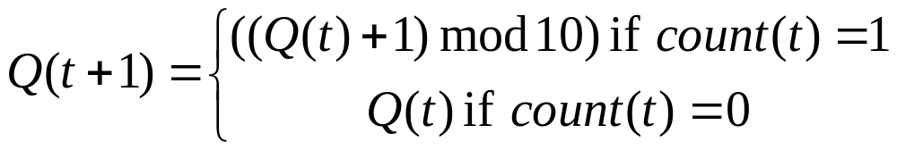
Spec of BCD counter
BCD: binary coded decimal
a 4-bit counter that counts from 0-9
BCD
counter
count
Q
4
time
clock
…
counter
0
1
2
…
9
0
1
2
count
1

Slide 12
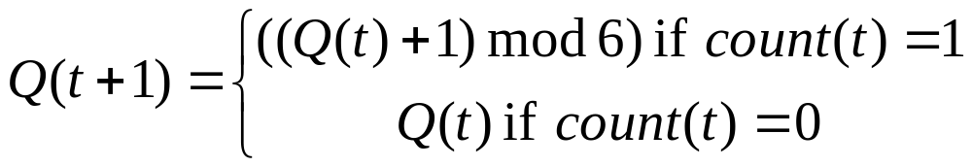
Spec of BCD-mod-6 counter
BCD counter but counts only 0-5
BCD-mod-6
counter
count
Q
4
time
clock
…
counter
0
1
2
…
5
0
1
2
count
1

Slide 13
Remark: on use of Verilog

Slide 14
Announce
part of your design are allowed to be written in Verilog
only for combinational circuit with the two coding style
  structural description with Boolean equations
  behavior description with truth table
learn by yourself!

Slide 15
Allowed coding styles
module my_circuit (A, B, C, D);
input A;
input B;
input C;
output D;
always @(*) begin
case ({A, B, C})
3’b000: D = 1’b0;
3’b001: D = 1’b1;
3’b010: D = 1’b0;
3’b011: D = 1’b0;
3’b100: D = 1’b1;
3’b101: D = 1’b0;
3’b110: D = 1’b1;
3’b111: D = 1’b1;
endcase
end
endmodule
module my_circuit (A, B, C, D);
input A;
input B;
input C;
output D;
assign D = (A & B) | C;
endmodule

