Slide 1
Counters
Lecture 04
Section 6-6 (Part 2)

Slide 2
Outline
counters:
  synchronous binary counter
  binary counter with parallel load
  down counter (your quiz)
application of counters
  digital clock
  frequency divider

Slide 3
Synchronous binary counter

Slide 4
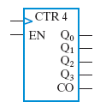
The spec
Function of the counter
clock
…
counter (Q)
0
1
2
3
…
14
15
EN
1

Slide 5
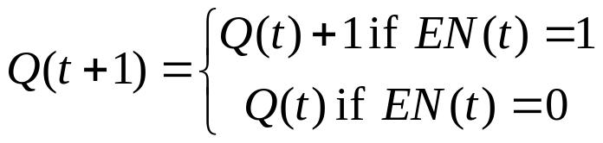
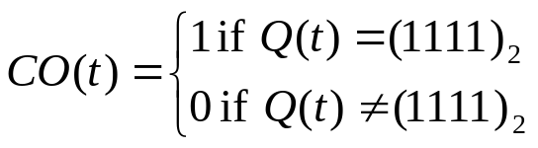
The Spec
time
clock
Q[3:0]
EN
CO

Slide 6
The Spec
count enable
time
clock
Q[3:0]
A
A+1
EN
1
CO

Slide 7
The Spec
count enable
time
clock
Q[3:0]
1010
1011
EN
1
CO

Slide 8
The Spec
count enable
time
clock
Q[3:0]
1111
0000
EN
1
CO

Slide 9
The Spec
count enable
time
clock
Q[3:0]
A
A
EN
0
CO

Slide 10
The Spec
count enable
time
clock
Q[3:0]
1010
1010
EN
0
CO

Slide 11
The Spec
carry out
time
clock
Q[3:0]
1010
EN
X
CO
0

Slide 12
The Spec
carry out
time
clock
Q[3:0]
1111
EN
X
CO
1

Slide 13
Function of the counter
clock
…
counter
0
1
…
15
0
1
2
EN
1
clock
…
counter (Q)
0
1
2
3
…
14
15
EN
1

Slide 14
How to design the counter
my steps

Slide 15
Steps
Observation: when Q_{i} will be inversed (the design strategy)
Redraw the circuit framework (to inverse Q_{i})
Derive Boolean equation to inverse Q_{i}
Circuit simplification

Slide 16
Steps
inverse Q₂ since Q₁=1 and Q₀=1
0010
Observation: when Q_{i} will be inversed (the design strategy)
Redraw the circuit framework (to inverse Q_{i})
Derive Boolean equation to inverse Q_{i}
Circuit simplification
0011
0100
0101
inverse Q₂ since Q₁=1 and Q₀=1
0110
0111
1000

Slide 17
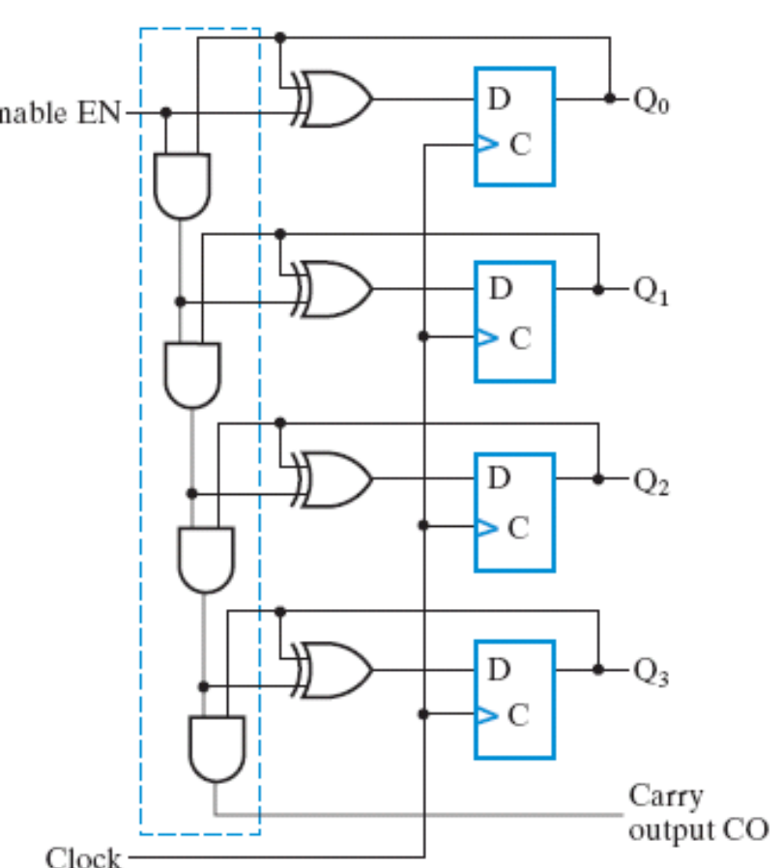












Steps
combinational
circuit
Observation: when Q_{i} will be inversed (the design strategy)
Redraw the circuit framework (to inverse Q_{i})
Derive Boolean equation to inverse Q_{i}
Circuit simplification
0 0 0
0 1 1
0 1
1 1 0

Slide 18

Steps
combinational
circuit
Observation: when Q_{i} will be inversed (the design strategy)
Redraw the circuit framework (to inverse Q_{i})
Derive Boolean equation to inverse Q_{i}
Circuit simplification

Slide 19
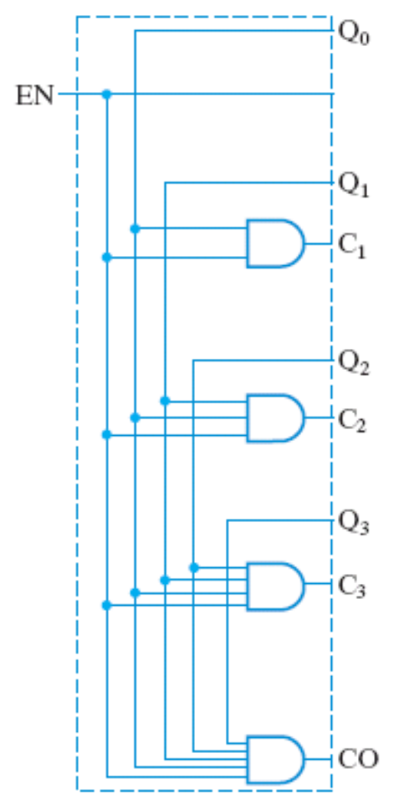
Steps
combinational
circuit
Observation: when Q_{i} will be inversed (the design strategy)
Redraw the circuit framework (to inverse Q_{i})
Derive Boolean equation to inverse Q_{i}
Circuit simplification

Slide 20




Steps
combinational
circuit
Observation: when Q_{i} will be inversed (the design strategy)
Redraw the circuit framework (to inverse Q_{i})
Derive Boolean equation to inverse Q_{i}
Circuit simplification

Slide 21
Steps
Observation: when Q_{i} will be inversed (the design strategy)
Redraw the circuit framework (to inverse Q_{i})
Derive Boolean equation to inverse Q_{i}
Circuit simplification

Slide 22
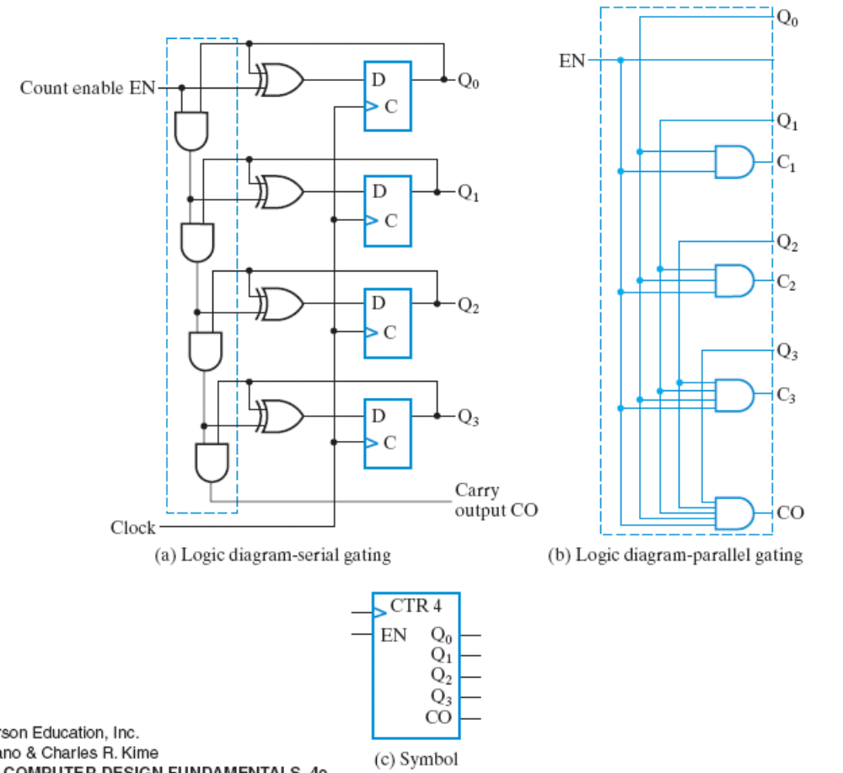
The resulted design
Figure 6-13

Slide 23
Binary counter with parallel load

Slide 24
The Spec
Load
counter
Count
D
Q
4
4
clock
Load: to load data input D into Q
Count: force counting Q=Q+1
time
Load(t)
Count(t)
Q(t+1)
clock
0
0
Q(t+1)=Q(t)
Q[3:0]
0
1
Q(t+1)=Q(t)+1
1
X
Q(t+1)=D(t)
D[3:0]
Load
Count

Slide 25
The Spec
Load
counter
Count
D
Q
4
4
clock
Load: to load data input D into Q
Count: force counting Q=Q+1
time
Load(t)
Count(t)
Q(t+1)
clock
0
0
Q(t+1)=Q(t)
Q[3:0]
A
A
0
1
Q(t+1)=Q(t)+1
1
X
Q(t+1)=D(t)
D[3:0]
B
Load
0
Count
0

Slide 26
The Spec
Load
counter
Count
D
Q
4
4
clock
Load: to load data input D into Q
Count: force counting Q=Q+1
time
Load(t)
Count(t)
Q(t+1)
clock
0
0
Q(t+1)=Q(t)
Q[3:0]
1100
1100
0
1
Q(t+1)=Q(t)+1
1
X
Q(t+1)=D(t)
D[3:0]
0101
Load
0
Count
0

Slide 27
The Spec
Load
counter
Count
D
Q
4
4
clock
Load: to load data input D into Q
Count: force counting Q=Q+1
time
Load(t)
Count(t)
Q(t+1)
clock
0
0
Q(t+1)=Q(t)
Q[3:0]
A
A+1
0
1
Q(t+1)=Q(t)+1
1
X
Q(t+1)=D(t)
D[3:0]
B
Load
0
Count
1

Slide 28
The Spec
Load
counter
Count
D
Q
4
4
clock
Load: to load data input D into Q
Count: force counting Q=Q+1
time
Load(t)
Count(t)
Q(t+1)
clock
0
0
Q(t+1)=Q(t)
Q[3:0]
1100
1101
0
1
Q(t+1)=Q(t)+1
1
X
Q(t+1)=D(t)
D[3:0]
0101
Load
0
Count
1

Slide 29
The Spec
Load
counter
Count
D
Q
4
4
clock
Load: to load data input D into Q
Count: force counting Q=Q+1
time
Load(t)
Count(t)
Q(t+1)
clock
0
0
Q(t+1)=Q(t)
Q[3:0]
A
B
0
1
Q(t+1)=Q(t)+1
1
X
Q(t+1)=D(t)
D[3:0]
B
Load
1
Count
X

Slide 30
The Spec
Load
counter
Count
D
Q
4
4
clock
Load: to load data input D into Q
Count: force counting Q=Q+1
time
Load(t)
Count(t)
Q(t+1)
clock
0
0
Q(t+1)=Q(t)
Q[3:0]
1100
0101
0
1
Q(t+1)=Q(t)+1
1
X
Q(t+1)=D(t)
D[3:0]
0101
Load
1
Count
X

Slide 31
How to design the counter with parallel load

Slide 32












My Steps
combinational
circuit
(A=Q+1)
Load
MUX
D
draw the circuit framework for multiple functions
complete the part for counting
the complete circuit
MUX
D
MUX
D
Count
MUX
D

Slide 33
My Steps
combinational
circuit
(A=Q+1)
Load=1
MUX
D
draw the circuit framework for multiple functions
complete the part for counting
the complete circuit
MUX
D
Load(t)
Count(t)
Q(t+1)
0
0
Q(t+1)=Q(t)
MUX
D
0
1
Q(t+1)=Q(t)+1
1
X
Q(t+1)=D(t)
Count
MUX
D

Slide 34
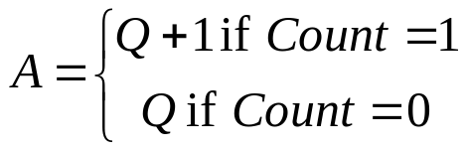
My Steps
combinational
circuit
(A=Q+1)
Load=0
MUX
D
draw the circuit framework for multiple functions
complete the part for counting
the complete circuit
MUX
D
Load(t)
Count(t)
Q(t+1)
0
0
Q(t+1)=Q(t)
MUX
D
0
1
Q(t+1)=Q(t)+1
1
X
Q(t+1)=D(t)
Count
MUX
D

Slide 35
My Steps
combinational
circuit
(A=Q+1)
Load
MUX
D
draw the circuit framework for multiple functions
complete the part for counting
the complete circuit
MUX
D
How to design?
MUX
D
Count
MUX
D

Slide 36
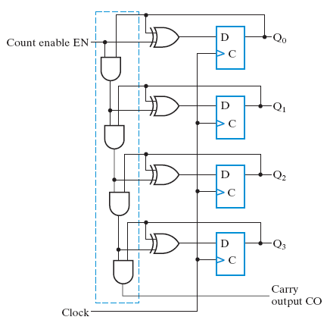

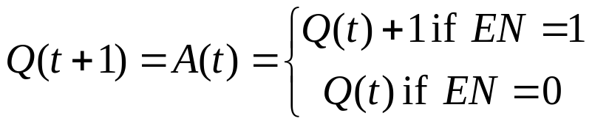



Recall: the counter design

Slide 37
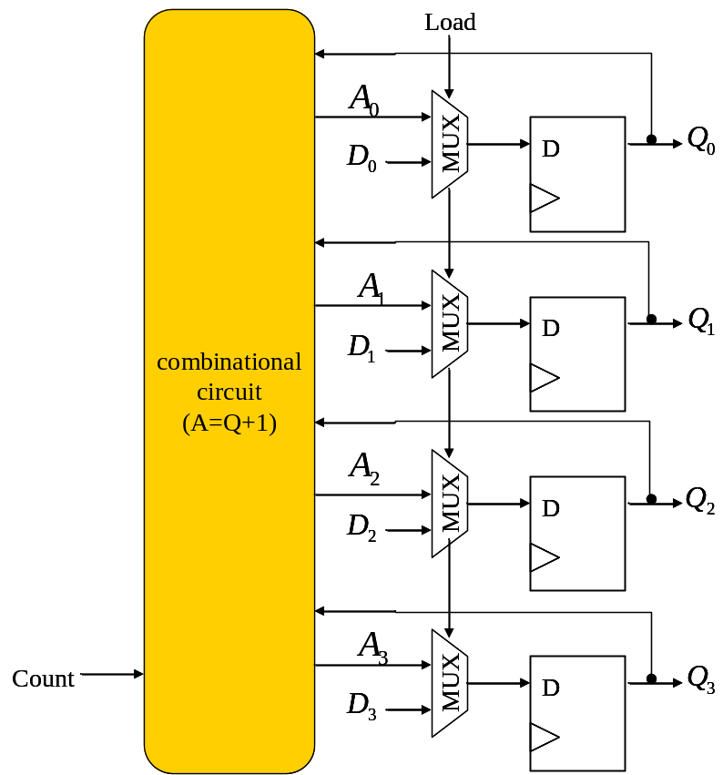
Recall: the counter design

Slide 38
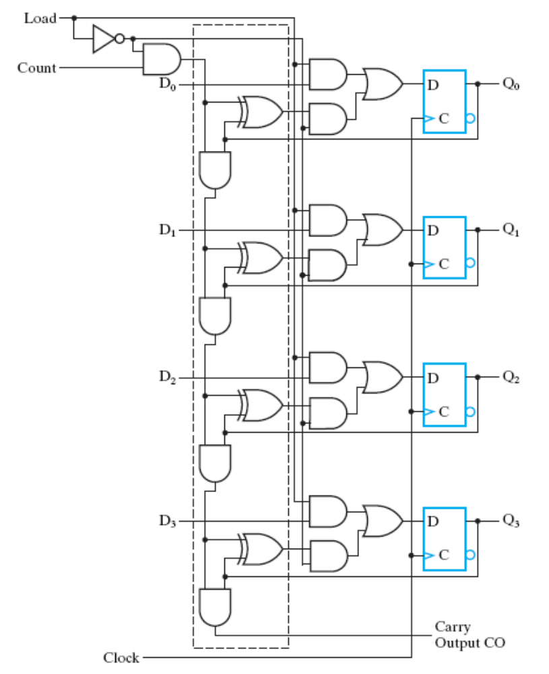
My Steps
the multiplexer
draw the circuit framework for multiple functions
complete the part for counting
the complete circuit
Figure 6-14

Slide 39
My Steps
draw the circuit framework for multiple functions
complete the part for counting
the complete circuit

Slide 40
Down Counter
Your Quiz

Slide 41
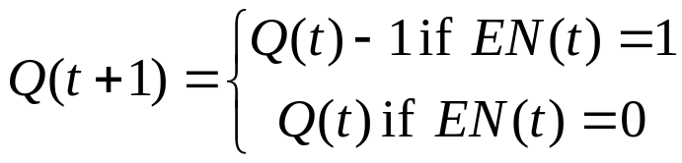
Spec of the down counter
clock
…
counter (Q)
15
14
13
12
…
1
0
EN
1

Slide 42
Spec of the down counter
time
clock
Q[3:0]
EN
CO

Slide 43
Spec of the down counter
count enable
time
clock
Q[3:0]
A
A-1
EN
1
CO

Slide 44
Spec of the down counter
count enable
time
clock
Q[3:0]
1010
1001
EN
1
CO

Slide 45
Spec of the down counter
count enable
time
clock
Q[3:0]
0000
1111
EN
1
CO

Slide 46
Spec of the down counter
count enable
time
clock
Q[3:0]
A
A
EN
0
CO

Slide 47
Spec of the down counter
count enable
time
clock
Q[3:0]
1010
1010
EN
0
CO

Slide 48
Function of the down counter
clock
…
counter
15
14
…
1
0
15
14
EN
1
clock
…
counter (Q)
15
14
13
12
…
1
0
EN
1

Slide 49
How to design the down counter
my steps

Slide 50
Steps
Observation: when Q_{i} will be inversed (the design strategy)
Redraw the circuit framework (to inverse Q_{i})
Derive Boolean equation to inverse Q_{i}
Circuit simplification

Slide 51
Steps
Observation: when Q_{i} will be inversed (the design strategy)
Redraw the circuit framework (to inverse Q_{i})
Derive Boolean equation to inverse Q_{i}
Circuit simplification
0110
0101
inverse Q₂ since Q₁=0 and Q₀=0
0100
0011
(when EN=1)
inverse Q₁ since Q₀=0
0010
0001

Slide 52
Steps
combinational
circuit
Observation: when Q_{i} will be inversed (the design strategy)
Redraw the circuit framework (to inverse Q_{i})
Derive Boolean equation to inverse Q_{i}
Circuit simplification
0 0 0
0 1 1
0 1
1 1 0

Slide 53
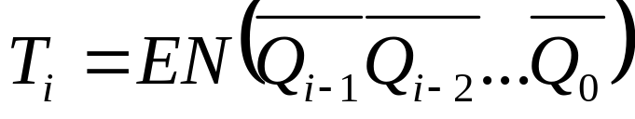

Steps
combinational
circuit
Observation: when Q_{i} will be inversed (the design strategy)
Redraw the circuit framework (to inverse Q_{i})
Derive Boolean equation to inverse Q_{i}
Circuit simplification

Slide 54
Down counter with parallel load

Slide 55
The Spec
Load
counter
Count
D
Q
4
4
clock
Load: to load data input D into Q
Count: force counting Q=Q-1
time
Load(t)
Count(t)
Q(t+1)
clock
0
0
Q(t+1)=Q(t)
Q[3:0]
0
1
Q(t+1)=Q(t)-1
1
X
Q(t+1)=D(t)
D[3:0]
Load
Count

Slide 56
The Spec
Load
counter
Count
D
Q
4
4
clock
Load: to load data input D into Q
Count: force counting Q=Q-1
time
Load(t)
Count(t)
Q(t+1)
clock
0
0
Q(t+1)=Q(t)
Q[3:0]
A
A
0
1
Q(t+1)=Q(t)-1
1
X
Q(t+1)=D(t)
D[3:0]
B
Load
0
Count
0

Slide 57
The Spec
Load
counter
Count
D
Q
4
4
clock
Load: to load data input D into Q
Count: force counting Q=Q-1
time
Load(t)
Count(t)
Q(t+1)
clock
0
0
Q(t+1)=Q(t)
Q[3:0]
1100
1100
0
1
Q(t+1)=Q(t)-1
1
X
Q(t+1)=D(t)
D[3:0]
0101
Load
0
Count
0

Slide 58
The Spec
Load
counter
Count
D
Q
4
4
clock
Load: to load data input D into Q
Count: force counting Q=Q-1
time
Load(t)
Count(t)
Q(t+1)
clock
0
0
Q(t+1)=Q(t)
Q[3:0]
A
A-1
0
1
Q(t+1)=Q(t)-1
1
X
Q(t+1)=D(t)
D[3:0]
B
Load
0
Count
1

Slide 59
The Spec
Load
counter
Count
D
Q
4
4
clock
Load: to load data input D into Q
Count: force counting Q=Q-1
time
Load(t)
Count(t)
Q(t+1)
clock
0
0
Q(t+1)=Q(t)
Q[3:0]
1100
1011
0
1
Q(t+1)=Q(t)-1
1
X
Q(t+1)=D(t)
D[3:0]
0101
Load
0
Count
1

Slide 60
The Spec
Load
counter
Count
D
Q
4
4
clock
Load: to load data input D into Q
Count: force counting Q=Q-1
time
Load(t)
Count(t)
Q(t+1)
clock
0
0
Q(t+1)=Q(t)
Q[3:0]
A
B
0
1
Q(t+1)=Q(t)-1
1
X
Q(t+1)=D(t)
D[3:0]
B
Load
1
Count
X

Slide 61
The Spec
Load
counter
Count
D
Q
4
4
clock
Load: to load data input D into Q
Count: force counting Q=Q-1
time
Load(t)
Count(t)
Q(t+1)
clock
0
0
Q(t+1)=Q(t)
Q[3:0]
1100
0101
0
1
Q(t+1)=Q(t)-1
1
X
Q(t+1)=D(t)
D[3:0]
0101
Load
1
Count
X

Slide 62
How to design the down-counter with parallel load

Slide 63
My Steps
combinational
circuit
(A=Q-1)
Load
MUX
D
draw the circuit framework for multiple functions
complete the part for counting
the complete circuit
MUX
D
MUX
D
Count
MUX
D

Slide 64
My Steps
combinational
circuit
(A=Q-1)
Load=1
MUX
D
draw the circuit framework for multiple functions
complete the part for counting
the complete circuit
MUX
D
Load(t)
Count(t)
Q(t+1)
0
0
Q(t+1)=Q(t)
MUX
D
0
1
Q(t+1)=Q(t)-1
1
X
Q(t+1)=D(t)
Count
MUX
D

Slide 65
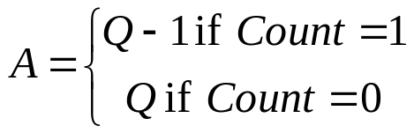
My Steps
combinational
circuit
(A=Q-1)
Load=0
MUX
D
draw the circuit framework for multiple functions
complete the part for counting
the complete circuit
MUX
D
Load(t)
Count(t)
Q(t+1)
0
0
Q(t+1)=Q(t)
MUX
D
0
1
Q(t+1)=Q(t)+1
1
X
Q(t+1)=D(t)
Count
MUX
D

Slide 66
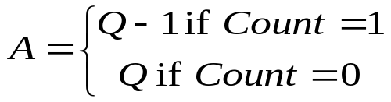
My Steps
combinational
circuit
(A=Q-1)
Load
MUX
D
draw the circuit framework for multiple functions
complete the part for counting
the complete circuit
MUX
D
How to design?
MUX
D
Count
MUX
D

Slide 67
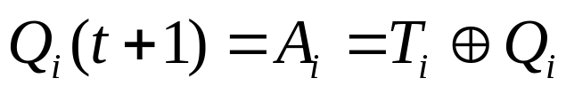
Recall: the down-counter design
combinational
circuit

Slide 68
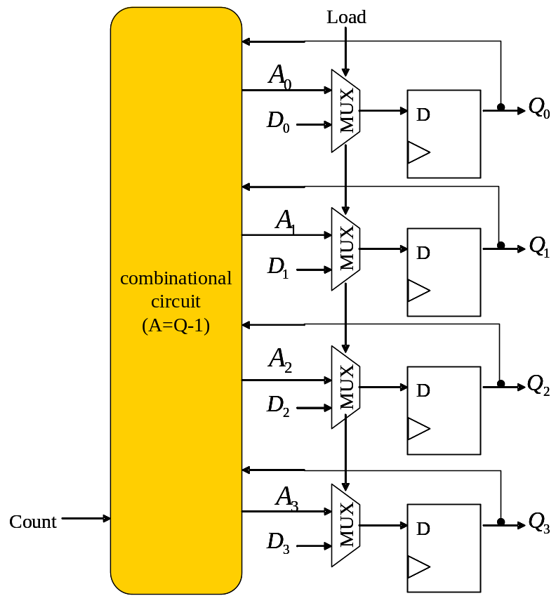
The complete design
combinational
circuit

Slide 69
Modulo-N Counter

Slide 70
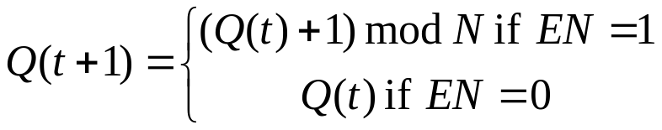
What is modulo-N counter
counter
CO
EN
Q
n
clock
time
clock
…
counter
0
1
…
N-1
0
1
2
EN
1
CO
0
1
0

Slide 71
Design of the modulo-N counter
use an (up) counter with parallel load (Figure 7-14)
load a zero when count-up to N-1
Load
up
counter
(Fig. 7-14)
Count
EN
Q
Q==N-1
EQ
D
AND
0
n
n
CO
EN
clock

Slide 72
General scheme to check A==B?
A[0]
X[0]
XOR
out=1 iff A==B
B[0]
equal
A[1]
X[1]
NOR
A
1
XOR
n
B[1]
…
out
out
B
…
n
A[n-1]
X[n-1]
XOR
B[n-1]

Slide 73
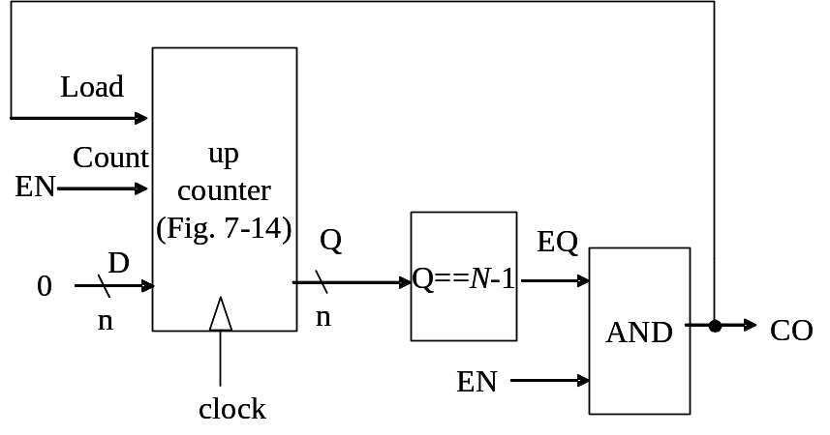
How the modulo-N counter works
time
clock
…
counter
0
1
…
N-2
N-1
0
1
CO
0
0
0
0
1
0
0
load
0
0
0
0
1
0
0
EN
1

Slide 74
Alternative and special cases of modulo-N counter

Slide 75
Modulo-N down counter
the pulser for 1 pulse every second is a modulo-1000 down counter
Load
down
counter
Count
1
Q
Q==0
D
pout
999
10
10
clock

Slide 76
BCD counter
BCD: binary coded decimal (十進位)
a modulo-10 counter
clock
…
counter
0
1
…
9
0
1
2
EN
1

Slide 77
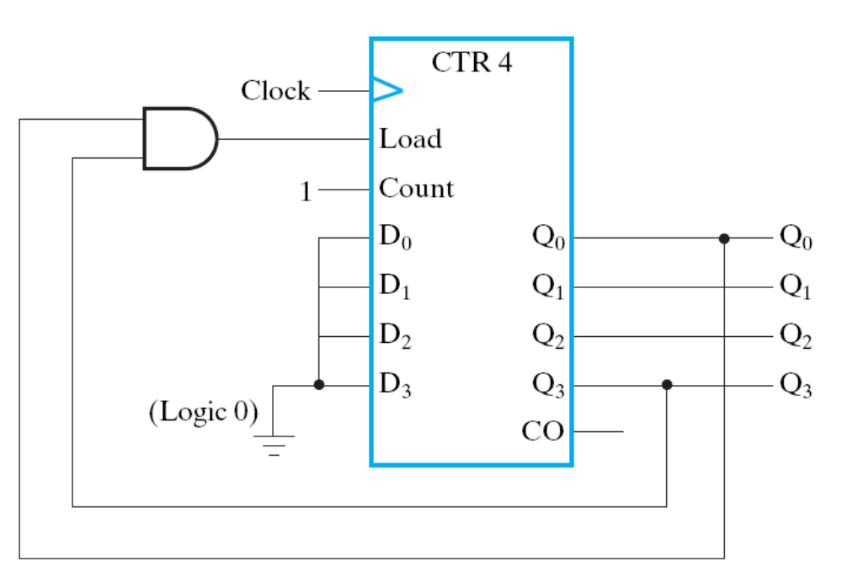
BCD counter
design with general modulo-N scheme
to check for Q=9=(1001)₂

Slide 78
Simplification of BCD counter

Slide 79
Goal: to design a modulo-10 counter (with circuit simplification)
counter
EN
Q
4
clock
clock
…
counter
0
1
…
9
0
1
2
EN
1

Slide 80
Steps to design a BCD counter
Draw the circuit framework
Observe when Q_{i} inversed
Derive the Boolean equation

Slide 81
Steps to design a BCD counter
combinational
circuit
Draw the circuit framework
Observe when Q_{i} inversed
Derive the Boolean equation

Slide 82
Steps to design a BCD counter
Q₁ not inverse for this transition
Draw the circuit framework
Observe when Q_{i} inversed
Derive the Boolean equation
0000
1001
Q₁ inverse when Q₀=1
0001
1000
0010
0111
(when EN=1)
0011
0110
(irregular due to the counting sequence
not going through 1111 -> 0000)
0100
0101

Slide 83


Steps to design a BCD counter
combinational
circuit
Draw the circuit framework
Observe when Q_{i} inversed
Derive the Boolean equation
(when EN=1)
(differ to general counter due to the counting
sequence not going through 1111 -> 0000)

Slide 84



Steps to design a BCD counter
combinational
circuit
Draw the circuit framework
Observe when Q_{i} inversed
Derive the Boolean equation
(differ to the text book (page 382) on EN signal)

Slide 85
Digital Clock
Application of counters

Slide 86
Spec of the digital clock
refresh the time every one second
00:59 -> 01:00
EN
digital clock
4
display
8
minute
second
1 KHz clock

Slide 87
Global architecture of the digital clock

Slide 88
Global architecture
digit
display
pulser
EN
BCD4
4
pout
count
m1
4
m0
4
s1
4
s0
4
display
8
m1
m0
s1
s0
(minute)
(second)

Slide 89
Global architecture
digit
display
pulser
EN
BCD4
4
pout
count
m1
4
m0
4
s1
4
s0
4
display
8
1 cycle
pout
1 second
m1
m0
s1
s0
(minute)
(second)

Slide 90
Global architecture
digit
display
pulser
EN
BCD4
4
pout
count
m1
4
m0
4
s1
4
s0
4
display
8
4 BCD counters to count the time m1m0: s1s0
(BCD: binary coded decimal)
m1
m0
s1
s0
(minute)
(second)

Slide 91
The Pulser

Slide 92
Spec of the pulser
1 cycle
pulser
pout
pout
1 second
1 KHz

Slide 93
Two schemes to design the pulser
use an up counter with parallel load
use a down counter with parallel load

Slide 94
Pulser design (1)
use an up counter with parallel load

Slide 95
Scheme to design the pulser
up-counter within the pulser
send out a pulse when counter==999
clock
…
counter
0
1
…
998
999
0
1
pout
0
0
0
0
1
0
0
1 second

Slide 96
Pulser design
Load
up
counter
Count
1
Q
Q==999
D
pout
0
10
10
clock

Slide 97
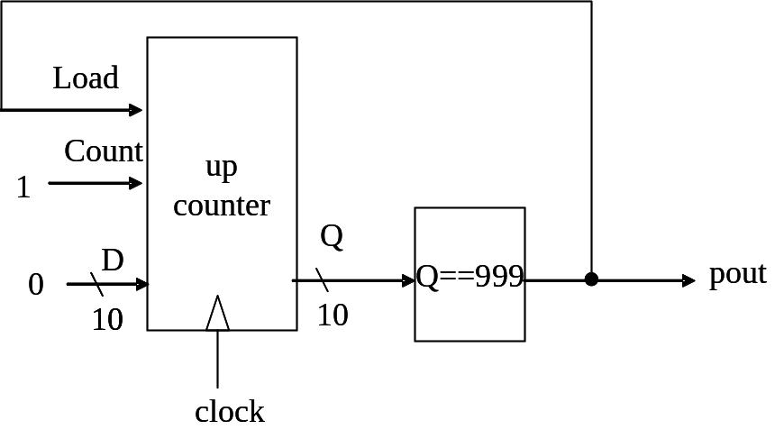
How the pulser works
time
clock
…
counter
0
1
…
998
999
0
1
pout
0
0
0
0
1
0
0
load
0
0
0
0
1
0
0
force the up counter
to load input 0

Slide 98
How to check equal?
pout=1 iff Q=999?
Q
Q==999
pout
10

Slide 99
General scheme to check A==B?
A[0]
X[0]
XOR
out=1 iff A==B
B[0]
equal
A[1]
X[1]
NOR
A
1
XOR
n
B[1]
…
out
out
B
…
n
A[n-1]
X[n-1]
XOR
B[n-1]

Slide 100

General scheme to check A==B?
Case 1: A=0100, B=0101
  X[i]=1 if
A[0]
X[0]
1
XOR
out=1 iff A==B
B[0]
equal
A[1]
X[1]
NOR
0
A
1
XOR
n
B[1]
…
out
out
B
…
n
A[n-1]
X[n-1]
XOR
B[n-1]

Slide 101
General scheme to check A==B?
Case 2: A=0101, B=0101
  X[i]=0 iff A[i]=B[i]
A[0]
X[0]
0
XOR
out=1 iff A==B
B[0]
equal
A[1]
X[1]
0
NOR
1
A
1
XOR
n
B[1]
…
out
out
B
…
n
A[n-1]
X[n-1]
0
XOR
B[n-1]

Slide 102


General scheme to check A==B?
General Rules:
A[0]
X[0]
0
XOR
out=1 iff A==B
B[0]
equal
A[1]
X[1]
0
NOR
1
A
1
XOR
n
B[1]
…
out
out
B
…
n
A[n-1]
X[n-1]
0
XOR
B[n-1]

Slide 103
Pulser design (2)
use a down counter with parallel load

Slide 104
Scheme to design the pulser
a down counter within the pulser
send out a pulse when counter==0
clock
…
counter
999
998
…
1
0
999
998
pout
0
0
0
0
1
0
0
1 second

Slide 105
Pulser design
Load
down
counter
Count
1
Q
Q==0
D
pout
999
10
10
clock

Slide 106
Check zero
pout=1 iff Q=0
Q[9]
Q
Q==0
Q[8]
pout
…
pout
10
Q[1]
Q[0]

Slide 107
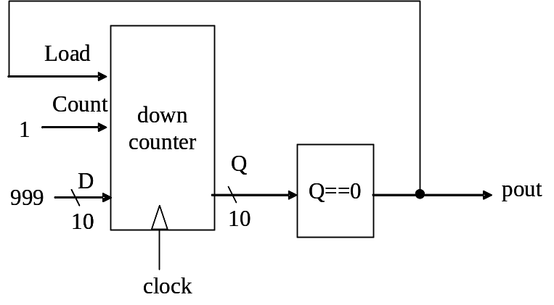
How the pulser works
time
clock
…
counter
999
998
…
1
0
999
998
pout
0
0
0
0
1
0
0
load
0
0
0
0
1
0
0
force the down counter
to load input 999

Slide 108
Core counters of the digital clock

Slide 109
The core counters for m1m0:s1s0
digit
display
pulser
EN
BCD4
4
pout
count
m1
4
m0
4
s1
4
s0
4
display
8
m1
m0
s1
s0
(minute)
(second)

Slide 110
Architecture of the core counter
minute
second
Mod-6
Counter
BCD
Counter
Mod-6
Counter
BCD
Counter
CO
EN
CO
EN
CO
EN
CO
EN
Q
Q
Q
Q
m1
m0
s1
s0
1
2
3
4
current time: 12:34

Slide 111
Architecture of the core counter
minute
second
Mod-6
Counter
BCD
Counter
Mod-6
Counter
BCD
Counter
CO
EN
CO
EN
CO
EN
CO
EN
Q
Q
Q
Q
m1
m0
s1
s0
0
1
2
3
4
counting
sequence
9
8
7
6
5

Slide 112
Architecture of the core counter
minute
second
Mod-6
Counter
BCD
Counter
Mod-6
Counter
BCD
Counter
CO
EN
CO
EN
CO
EN
CO
EN
Q
Q
Q
Q
m1
m0
s1
s0
0
1
2
counting
sequence
5
4
3

Slide 113
Architecture of the core counter
each counter receives an enable signal to make Q(t+1)=Q(t)+1
the counting is triggered by previous digit or pulser
minute
second
Mod-6
Counter
BCD
Counter
Mod-6
Counter
BCD
Counter
CO
EN
CO
EN
CO
EN
CO
EN
Q
Q
Q
Q
m1
m0
s1
s0

Slide 114
Architecture of the core counter
each counter receives an enable signal to make Q(t+1)=Q(t)+1
the counting is triggered by previous digit or pulser
minute
second
Mod-6
Counter
BCD
Counter
Mod-6
Counter
BCD
Counter
CO
EN
CO
EN
CO
EN
CO
EN
pout
Q
Q
Q
Q
s0++ triggered by the pulser one cycle per second
m1
m0
s1
s0

Slide 115
Timing diagram of carry-in
…
m1
1
1
1
1
m0
2
2
2
2
s1
3
3
3
3
s0
4
5
5
6
+1
+1
pout
(from pulser)
1
0
1
0
1 second

Slide 116
Architecture of the core counter
each counter receives an enable signal to make Q(t+1)=Q(t)+1
the counting is triggered by previous digit or pulser
minute
second
C
Mod-6
Counter
BCD
Counter
Mod-6
Counter
BCD
Counter
CO
EN
CO
EN
CO
EN
CO
EN
Q
Q
Q
Q
s1++ triggered when s0==9 and has to increment
m1
m0
s1
s0

Slide 117
Timing diagram of carry-in
…
m1
1
1
1
1
m0
2
2
2
2
s1
3
3
3
4
s0
8
9
9
0
+1
+1
pout
(from pulser)
1
0
1
0
CO=1 if Q==9 and EN=1
C
0
0
1
0

Slide 118
Architecture of the core counter
each counter receives an enable signal to make Q(t+1)=Q(t)+1
the counting is triggered by previous digit or pulser
minute
second
Mod-6
Counter
BCD
Counter
Mod-6
Counter
BCD
Counter
CO
EN
CO
EN
CO
EN
CO
EN
Q
Q
Q
Q
m0++ triggered when s1==5 and has to increment (:59)
m1
m0
s1
s0

Slide 119
7-Segment Digit Display

Slide 120
Global architecture
digit
display
pulser
EN
BCD4
4
pout
count
m1
4
m0
4
s1
4
s0
4
display
8
m1
m0
s1
s0
(minute)
(second)

Slide 121
7-segment LED display
1
A
G
B
0
B
F
1
C
A
1
D
0
E
C
E
1
F
G
D
H
1

Slide 122




Group of 7-seg digit display
sharing decoded display signal
digit
decode
8
display

Slide 123
Group of 7-seg digit display
sharing decoded display signal
1011011
digit
decode
8
display
2
1
0
0
0

Slide 124
Group of 7-seg digit display
sharing decoded display signal
1011011
digit
decode
8
display
2
0
1
0
0

Slide 125
Group of 7-seg digit display
sharing decoded display signal
1011011
digit
decode
8
display
2
0
0
1
0

Slide 126
Group of 7-seg digit display
sharing decoded display signal
1011011
digit
decode
8
display
2
0
0
0
1

Slide 127






Global Diagram of the Design
digit
decode
8
display
4
2
encoder
4
MUX
rotation register
4
4
4
4

Slide 128
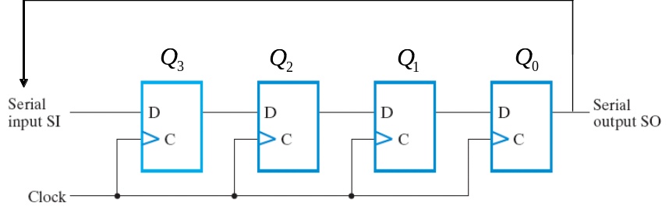
Rotation register to send SCN
digit
decode
8
display
4
2
encoder
4
MUX
rotation register
4
4
4
4

Slide 129
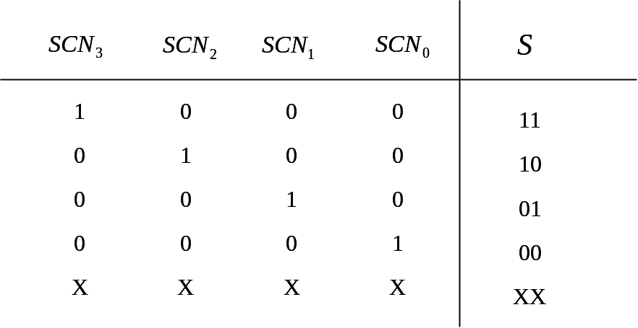
Cooperation of rotation register and MUX control
digit
decode
8
display
4
2
encoder
4
MUX
rotation register
4
4
4
4

Slide 130
Operation of the Digit Display Controller

Slide 131
Rotation register to send SCN
digit
decode
8
display
4
2
encoder
4
MUX
rotation register
4
4
4
4

Slide 132
Rotation register to send SCN
digit
decode
8
display
1
4
0
0
0
2
encoder
4
MUX
rotation register
4
4
4
4

Slide 133
Rotation register to send SCN
digit
decode
8
display
0
4
1
0
0
2
encoder
4
MUX
rotation register
4
4
4
4

Slide 134
Rotation register to send SCN
digit
decode
8
display
0
4
0
1
0
2
encoder
4
MUX
rotation register
4
4
4
4

Slide 135
Rotation register to send SCN
digit
decode
8
display
0
4
0
0
1
2
encoder
4
MUX
rotation register
4
4
4
4

Slide 136
Select display number by MUX
digit
decode
8
display
to select the number to be displayed
4
2
encoder
4
MUX
rotation register
4
4
4
4
1
2
3
4

Slide 137
Select display number by MUX
digit
decode
8
display
4
2
encoder
4
MUX
rotation register
4
4
4
4
1
2
3
4

Slide 138
Select display number by MUX
digit
decode
8
display
4
2
encoder
4
MUX
rotation register
4
4
4
4
1
2
3
4

Slide 139
Select display number by MUX
digit
decode
8
display
4
2
encoder
4
MUX
rotation register
4
4
4
4
1
2
3
4

Slide 140
Select display number by MUX
digit
decode
8
display
4
2
encoder
4
MUX
rotation register
4
4
4
4
1
2
3
4

Slide 141
Cooperation of rotation register and MUX control
digit
decode
8
display
4
2
encoder
4
MUX
rotation register
4
4
4
4

Slide 142
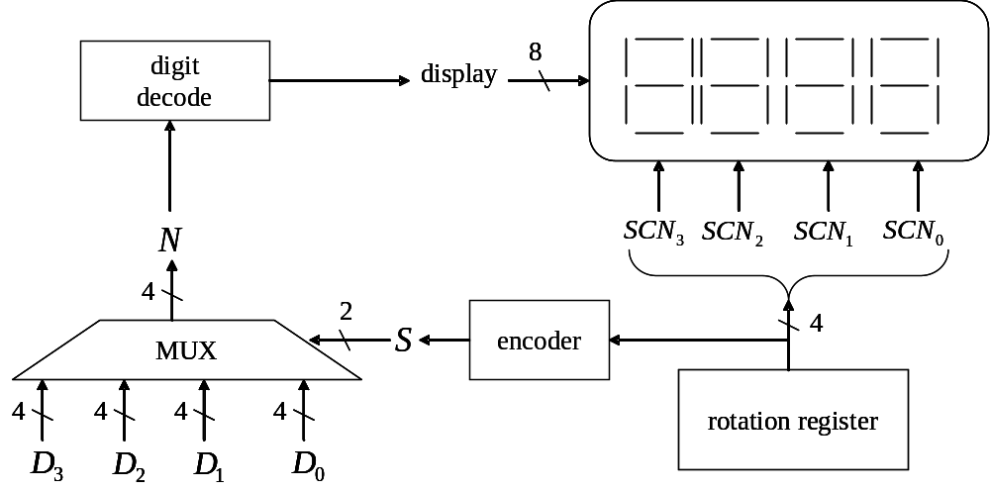
Timing
Diagram
1
2
3
4
time
clock
SCN
1000
0100
0010
0001
1000
0100
S
11
10
01
00
11
10
N
D₃
D₂
D₁
D₀
D₃
D₂

Slide 143
Timing
Diagram
1
2
3
4
time
clock
SCN
1000
0100
0010
0001
1000
0100
S
11
10
01
00
11
10
N
D₃
D₂
D₁
D₀
D₃
D₂

Slide 144
Timing
Diagram
1
2
3
4
time
clock
SCN
1000
0100
0010
0001
1000
0100
S
11
10
01
00
11
10
N
D₃
D₂
D₁
D₀
D₃
D₂

Slide 145
Summary and Review Questions
we finished Section 7-1 and 7-6
(registers and counters)

Slide 146
Question 1
Classification | Type | Pages in the textbook
register | register | pp. 354-357 (Sec. 7-1)
 | register with parallel load
shift registers | shift register | pp. 371-374 (Sec. 7-6)
 | shift register with parallel load
 | rotation register | additional material
counters | counter | pp. 377-381
 | counter with parallel load
 | down counter
 | down counter with parallel load
 | modulo-N counter | pp. 381-384
 | modulo-N down counter | additional material
 | BCD counter | pp. 381-384
How many kinds of registers and counters we talked about?

Slide 147
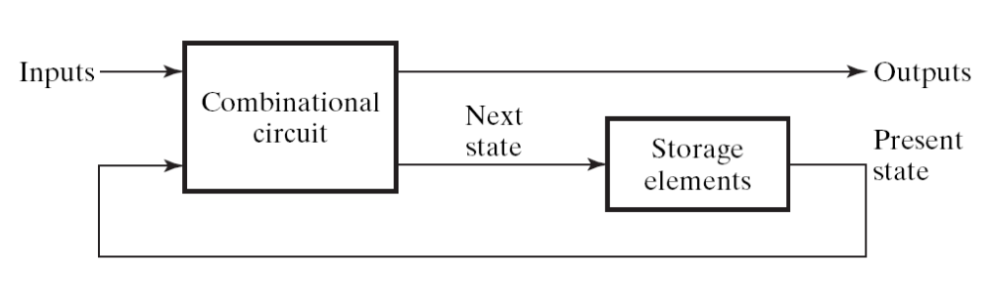
Question 2
Always starts from a general framework
Observe how to set Q_{i}
Derive the Boolean equation
Can you summarize a rule of thumb for registers/counters design?
clock
Figure 5-1

Slide 148
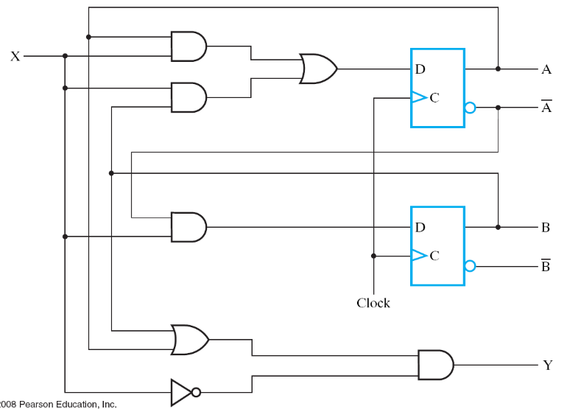
What’s the clock for?
Answer: to make the circuit doing step-by-step computation
  clock signal is fed to all flip flops of the circuit
  to let a sequential circuit performs its task in step-by-step manner
  forms a sequence of state change on flip flops
    imagine the flip flops as variables for programming
sequence of state change
time
clock
A
0
0
1
0
0
state
B
0
1
1
0
0
input
X
1
1
0
0
0

Slide 149
Question 3
How to verify that you fully understand the content in Section 7-1 and 7-6
  not by the teacher!
Design a digital clock!

Slide 150
Coming Up
“register transfer”

Slide 151
Coming Up
We will go into Chap. 7 (register and register transfer)
Lecture 03: registers design
  Section 7.1: register with parallel load
  Section 7.6: shift registers
Lecture 04: counters design and their applications
  Section 7.6
  with your digital clock lab
Lecture 05: RTL design
  RTL: register-transfer level design
  go through whole Chap. 7
  with dash-watch example

Slide 152
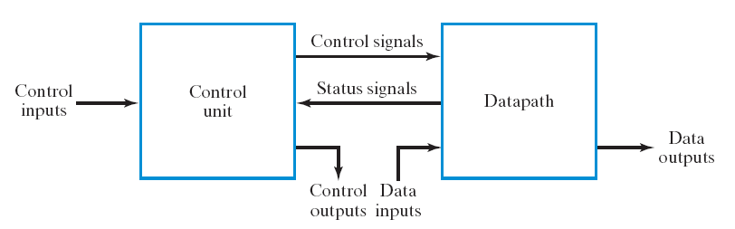
Materials for Lecture 05
Section 7-2: “Register Transfer”
  and guide you to design a stop-watch
Figure 7-3
“one-step” operation for hardware
  Section 7-3: “Register Transfer Operations”
  Section 7-4: “A note for the VHDL and Verilog users only”
  Section 7-5: “Micro-operations”

Slide 153
Materials for Lecture 05 (cont’d)
Design examples and exercises (Sec 7.8-7.10)
  C=A+B+C+D
  C=|A-B| (your lab)
  C=|A-B|+|C-D| (your lab)
  Dash watch (7.10)

Slide 154
Your work before the next meeting
Recall the following content from your “digital circuit” course
  adder design
  binary number systems
  2’s complement encoding for signed number
Chap. 1 & 4 of your “digital circuit” textbook

