Slide 1
Processor Data Path
Lab 09

Slide 2
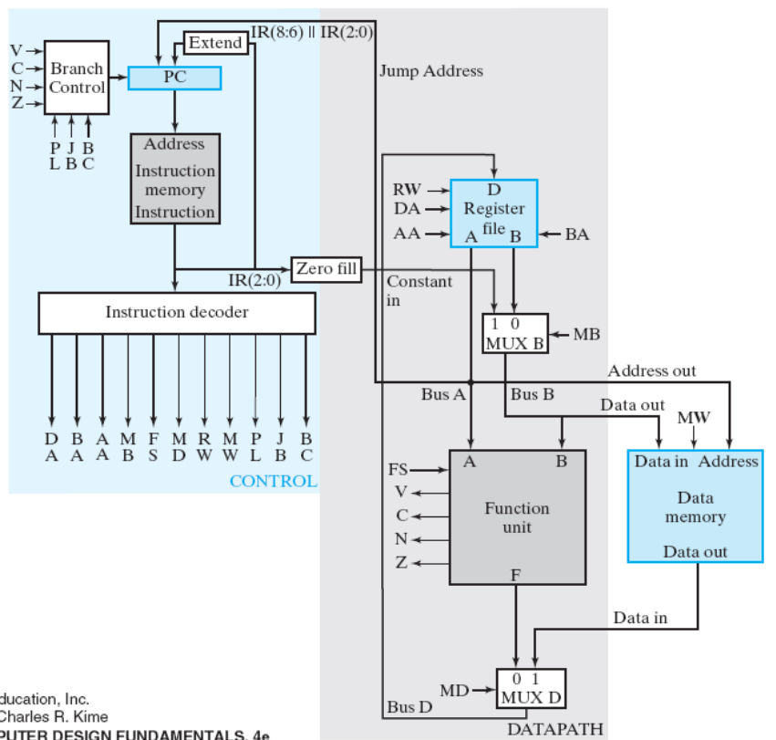
Your Task
realize the data path
testing: waveform of the computations:
  R4=maximum even number not exceeding (R1-R2)+R3
  R3=|R2-R1|
Figure 9-15: single-cycle CPU

Slide 3
Grading
Finish the processor data path (70%)
Bonus
  with control unit to do R4=max. even number not exceeding (R1-R2)+R3 (+10%)
  with control unit to do R3=|R1-R2| (+10%)
Report: 10%

Slide 4
The bonus
  with control unit to do R4=max. even number not exceeding (R1-R2)+R3 (+10%)
  with control unit to do R3=|R1-R2| (+10%)
processor data path
(right-hand side of
Figure 8-15)
control
unit

Slide 5
Pre-Lab Report
state-diagram and control signal values of each cycle to do the computation using the CPU data path
  R4=maximum even number not exceeding (R1-R2)+R3
  R3=|R2-R1|

Slide 6
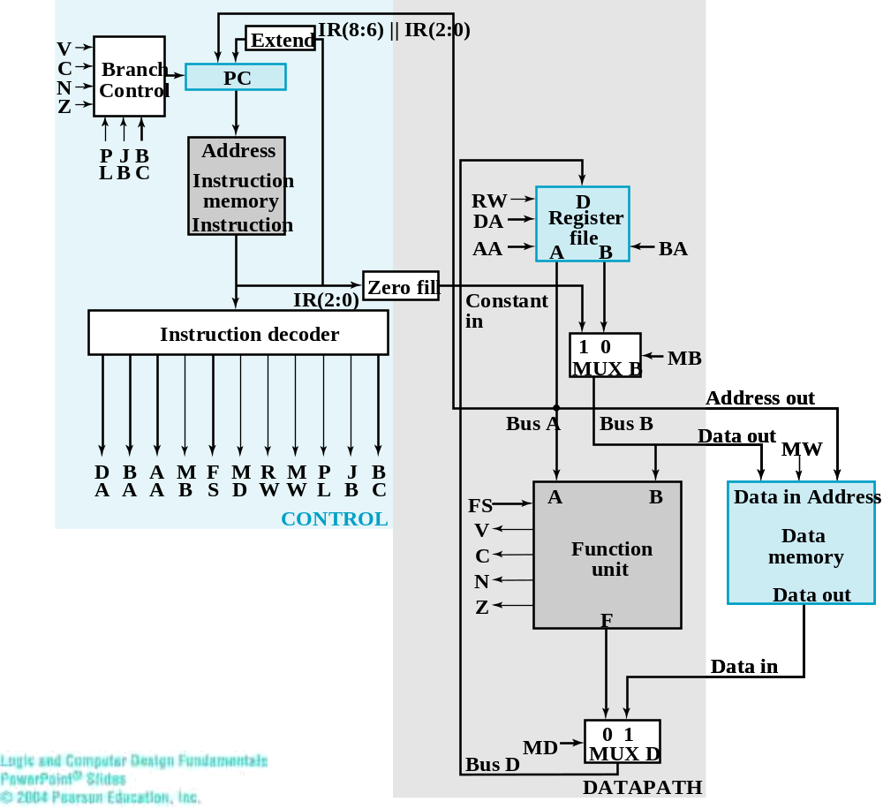

Control signal of the data path
control signals
(routed to the data path)
Figure 9-15: the CPU

Slide 7
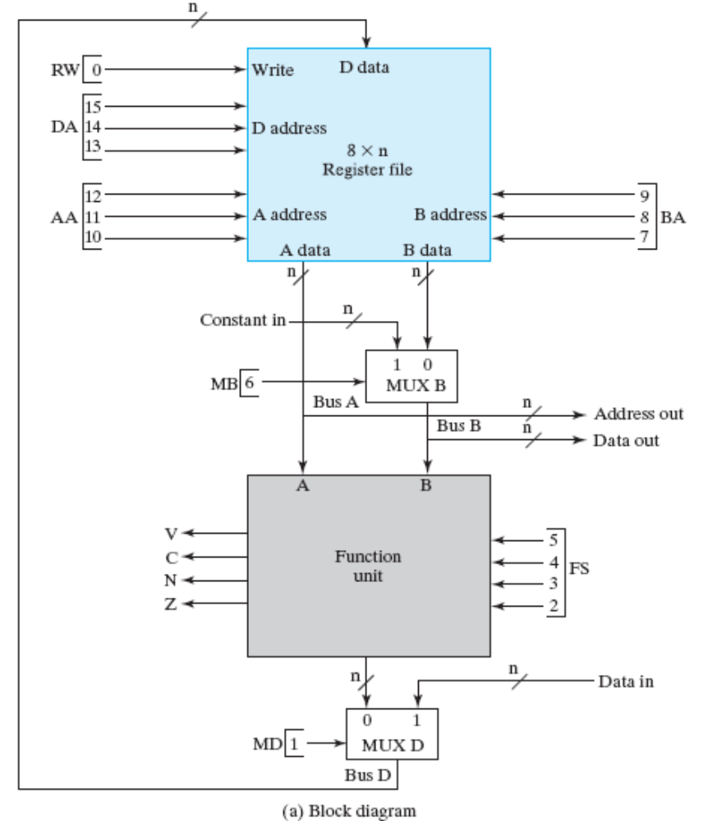





Control
Signals
enable
write R3
STOP
R2
R1
011
010
001
0
0101
0
1

Slide 8
Remark
leave the control signals and data buses as input/output ports
Figure 9-15: the CPU

Slide 9
Remark
you can set the value of a register through the highlighted path

Slide 10
Remark
you can read the value of a register through these paths

