Slide 1
Realizing Arithmetic Operations with RTL Design
Lab 05
Section 6.2 – 6.5

Slide 2
Your Task
Select one of these exercises:
Q=A+B+C+D with only one adder (60%)
Q=|A-B| with only one adder (75%)
Q=|A-B|+|C-D| with only one adder (90%)
Description:
A, B, C, D are 8-bit signed integers, encoded with 2’s complements
you can use only one 8-bit adder (given module)
input from dip-switch and output on 7-seg display
START
arithmetic
unit
(your design)
FINISH
A
B
C
Q
D

Slide 3
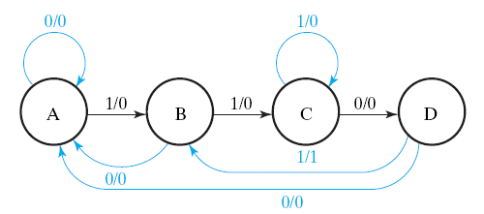
Purpose of this lab
to learn RTL design methodology at Chap. 6
K: A=B+C
(if (K==1) then A=B+C;)

Slide 4
Pre-Lab Report
Q1: Show how you realize your design following the RTL design steps
behavior specification of control unit and data path
Q2: Expected timing diagram for each sub-module of your design
K: A=B+C
(if (K==1) then A=B+C;)

