Slide 1
Usage of FPGA Experiment Board
Lab 01

Slide 2
Goals of this lab
Let you know how to work with our FPGA board
FPGA: Field Programmable Gate Array
a special hardware architecture to simulate digital circuit design
Establish your imagination on timing analysis

Slide 3
Grading of this lab
Basic: 75
Complete Task 1 and show the timing waveform
Complete Task 2 (rear-light controller) and demo on FPGA
Bonus: +25
Task 3: extension of the rear-light controller

Slide 4
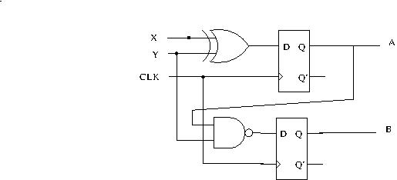
Task 1
Draw the circuit and demo the timing waveform of the simulation to TA

Slide 5
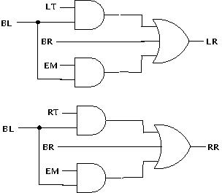
Task 2
Demo the rear-light controller on the FPGA board
Input:
LT: turn left
RT: turn right
BR: brake
EM: emergency
BL: 1 Hz blink (clock)
Output:
LR: left light ON
RR: right light ON
Assume: at most one of LT/RT/BR/EM is 1 at any time

Slide 6
Task 3 (Bonus)
Extend the design of rear-light controller (task 2)
But it is possible that 2+ input signal is one
Take control by the priority:
(LT, RT) > BR > EM
Design by Yourself!

