Slide 1
8051 Assembly Programming
Lab 01

Slide 2
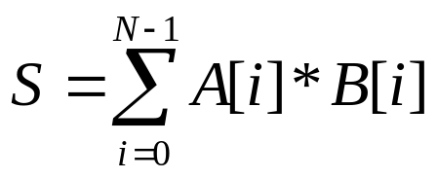
Today’s Goal
Guide you to write your first 8051 assembly program
  and perhaps your first assembly program
Your work: write a program to compute
  where A[i], B[i] are integer arrays (8-bit) in 8051’s internal memory

Slide 3
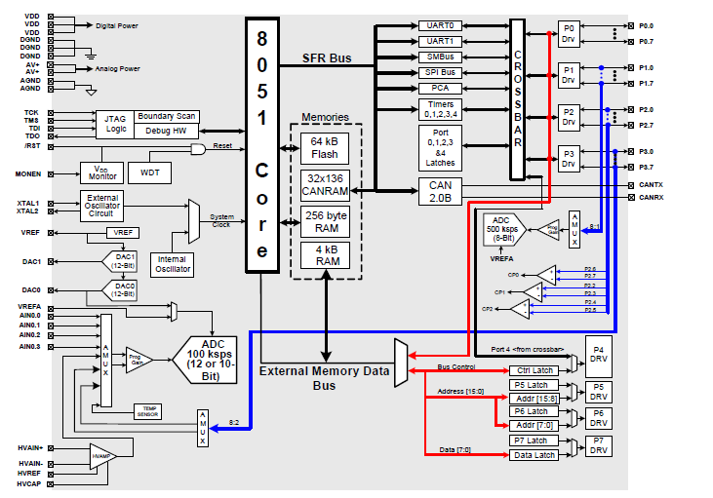
Overview: the C8051F040 SoC
a system-on-a-chip integrating the processor core, memory, peripheral devices, everything in a computer syste,

Slide 4
Fundamental: von Neumann model in assembly level

Slide 5
The Von Neumann Model
memory
D = A+B*C;
E = D+F;
A = A-1;
A
10
CPU
B
20
C
30
D
40
PC: program counter
E
50
F
60

Slide 6
The Von Neumann Model
memory
PC
D = A+B*C;
E = D+F;
A = A-1;
A
10
CPU
B
20
C
30
D
610
PC: program counter
E
50
F
60

Slide 7
The Von Neumann Model
memory
D = A+B*C;
E = D+F;
A = A-1;
PC
A
10
CPU
B
20
C
30
D
610
PC: program counter
E
670
F
60

Slide 8
The Von Neumann Model
memory
D = A+B*C;
E = D+F;
A = A-1;
A
9
PC
CPU
B
20
C
30
D
610
PC: program counter
E
670
F
60

Slide 9
How a CPU works?
follow the von Neumann model
  step by step
  one instruction per step
but decompose operations into primitive and regular ones
assembly program
load R1, A; //R1 = mem[A];
load R2, B; //R2 = mem[B];
load R3, C; //R3 = mem[C];
mult R4, R2, R3; //R4=R2*R3;
add R5, R1, R4; //R5=R1+R4;
store D, R5; //mem[D] = R5;
load R6, F; //R6 = mem[D];
add R7, R5, R6; //R7 = R5+R6;
store E, R7; //mem[E] = R7;
sub R1, R1, 1; //R1 = R1-1;
store A, R1; //mem[A] = R1;
D = A+B*C;
E = D+F;
A = A-1;

Slide 10
Question
Q: what’s the major difference between assembly programming and high-level language programming?
A: you have to imagine how hardware works!

Slide 11
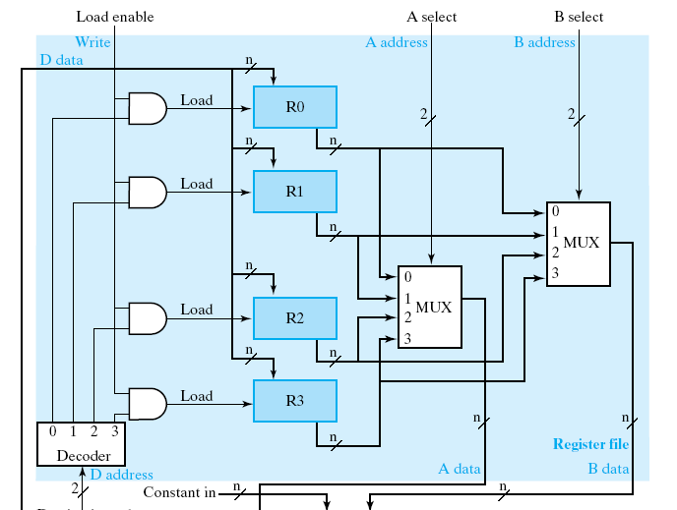
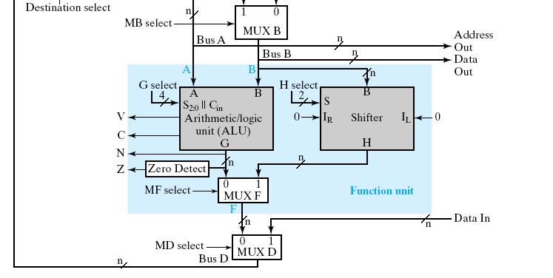
How a CPU works?
from hardware design perspective
the data path:

Slide 12
How a CPU works?
registers to store variables
registers

Slide 13
How a CPU works?
function units to perform computation
function units

Slide 14
How a CPU works?
still follows von Neumann model
A = B+C;
memory
A
B
load R1, B; //R1 = mem[B];
load R2, C; //R2 = mem[C];
add R3, R1, R2; //R3 = R1+R2;
store A, R3; //mem[A] = R3;
C

Slide 15
How a CPU works?
still follows von Neumann model
A = B+C;
memory
A
B
load R1, B; //R1 = mem[B];
load R2, C; //R2 = mem[C];
add R3, R1, R2; //R3 = R1+R2;
store A, R3; //mem[A] = R3;
C

Slide 16
How a CPU works?
still follows von Neumann model
A = B+C;
memory
A
B
load R1, B; //R1 = mem[B];
load R2, C; //R2 = mem[C];
add R3, R1, R2; //R3 = R1+R2;
store A, R3; //mem[A] = R3;
C

Slide 17
How a CPU works?
still follows von Neumann model
A = B+C;
memory
A
B
load R1, B; //R1 = mem[B];
load R2, C; //R2 = mem[C];
add R3, R1, R2; //R3 = R1+R2;
store A, R3; //mem[A] = R3;
C

Slide 18
How a CPU works?
still follows von Neumann model
A = B+C;
memory
A
B
load R1, B; //R1 = mem[B];
load R2, C; //R2 = mem[C];
add R3, R1, R2; //R3 = R1+R2;
store A, R3; //mem[A] = R3;
C

Slide 19
8051 Architecture Model

Slide 20
Imagination on 8051 architecture
Imagine how data flow in the architecture!
8051 CPU core
internal memory
general purpose
registers
special function
registers (SFR)
…
R0
A
R1
B
R2
P0
30h
31h
…
…
32h
R7
…
…
ALU
address

Slide 21
Imagination on 8051 architecture
flow of an arithmetic instruction
8051 CPU core
internal memory
general purpose
registers
special function
registers (SFR)
…
R0
A
R1
B
R2
P0
30h
31h
…
…
32h
R7
…
…
ALU
address

Slide 22
Imagination on 8051 architecture
data movement between memory and registers
the MOV instruction
8051 CPU core
internal memory
general purpose
registers
special function
registers (SFR)
…
R0
A
R1
B
R2
P0
30h
31h
…
…
32h
R7
…
…
ALU
address

Slide 23
Imagination on 8051 architecture
the MOV also for registers
8051 CPU core
internal memory
general purpose
registers
special function
registers (SFR)
…
R0
A
R1
B
R2
P0
30h
31h
…
…
32h
R7
…
…
ALU
address

Slide 24
Imagination on 8051 architecture
Feature: most of instructions have limited use on registers
Example:
  ADD uses ACC
  MUL (multiply) uses A and B
8051 CPU core
internal memory
general purpose
registers
special function
registers (SFR)
…
R0
A
R1
B
R2
P0
30h
31h
…
…
32h
R7
…
…
ALU
address

Slide 25
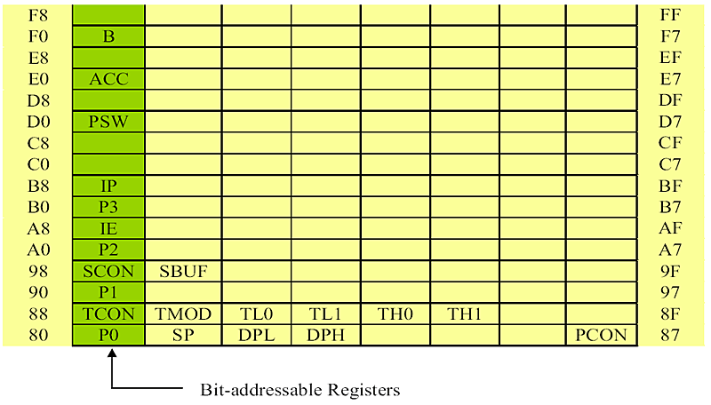
Special Function Registers (SFR)
for multiply/divide
accumulator
processor status word

Slide 26
A first look on 8051 assembly program

Slide 27
Features of 8051 CPU and assembly
8-bit data operation
two-operand assembly instruction
  Example: ADD A, R1 //A=A+R1

Slide 28
Classification of instructions
Arithmetic (ADD, SUBB, MUL, etc.)
  Notice: the use of register
  e.g. ADD A, R0
  e.g. MUL AB
Branch (AJMP, ACALL, RET)
  Notice: the jump range
Data Transfer (MOV)
  direct/indirect addressing mode
Logical
  bit-addressible instruction

Slide 29
8051 assembly language looks like
[label:] mnemonic [operands] [;comment]
ORG 0H ;start (origin) at location 0
MOV R5,#25H ;load 25H into R5
MOV R7,#34H ;load 34H into R7
MOV A,#0 ;load 0 into A
ADD A,R5 ;add contents of R5 to A
;now A = A + R5
ADD A,R7 ;add contents of R7 to A
;now A = A + R7
ADD A,#12H ;add to A value 12H
;now A = A + 12H
HERE: SJMP HERE ;stay in this loop
END ;end of asm source file

Slide 30
8051 assembly language looks like
general form
[label:] mnemonic [operands] [;comment]
ORG 0H ;start (origin) at location 0
MOV R5,#25H ;load 25H into R5
MOV R7,#34H ;load 34H into R7
MOV A,#0 ;load 0 into A
ADD A,R5 ;add contents of R5 to A
;now A = A + R5
ADD A,R7 ;add contents of R7 to A
;now A = A + R7
ADD A,#12H ;add to A value 12H
;now A = A + 12H
HERE: SJMP HERE ;stay in this loop
END ;end of asm source file

Slide 31
8051 assembly language looks like
[label:] mnemonic [operands] [;comment]
ORG 0H ;start (origin) at location 0
MOV R5,#25H ;load 25H into R5
MOV R7,#34H ;load 34H into R7
MOV A,#0 ;load 0 into A
ADD A,R5 ;add contents of R5 to A
;now A = A + R5
ADD A,R7 ;add contents of R7 to A
;now A = A + R7
ADD A,#12H ;add to A value 12H
;now A = A + 12H
HERE: SJMP HERE ;stay in this loop
END ;end of asm source file
R7=0x34

Slide 32
8051 assembly language looks like
[label:] mnemonic [operands] [;comment]
ORG 0H ;start (origin) at location 0
MOV R5,#25H ;load 25H into R5
MOV R7,#34H ;load 34H into R7
MOV A,#0 ;load 0 into A
ADD A,R5 ;add contents of R5 to A
;now A = A + R5
ADD A,R7 ;add contents of R7 to A
;now A = A + R7
ADD A,#12H ;add to A value 12H
;now A = A + 12H
HERE: SJMP HERE ;stay in this loop
END ;end of asm source file
ACC=ACC+R5

Slide 33
8051 assembly language looks like
[label:] mnemonic [operands] [;comment]
ORG 0H ;start (origin) at location 0
MOV R5,#25H ;load 25H into R5
MOV R7,#34H ;load 34H into R7
MOV A,#0 ;load 0 into A
ADD A,R5 ;add contents of R5 to A
;now A = A + R5
ADD A,R7 ;add contents of R7 to A
;now A = A + R7
ADD A,#12H ;add to A value 12H
;now A = A + 12H
HERE: SJMP HERE ;stay in this loop
END ;end of asm source file
goto HERE

Slide 34
Example 1: d=a*b+c

Slide 35
In-Class Exercise
write the program d=a*b+c
  where a, b, c are originally in the memory
8051 instructions you need:
  add
  mul (multiplication)
  inc (increment)
  mov (move)
Check the instruction reference manual for restrictions on using register operands!

Slide 36
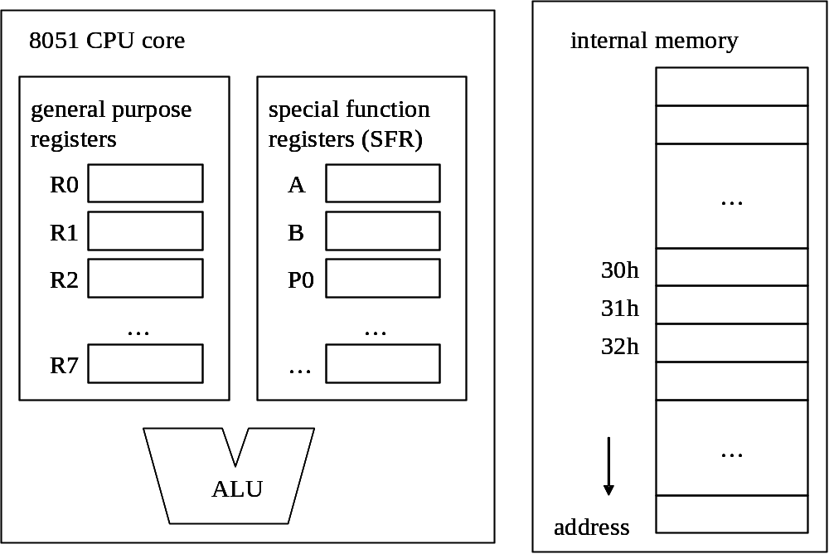
Example: d=a*b+c
mov R1, #30h ; R1=30
mov A, @R1 ; A=mem[R1]
inc R1 ; R1++
mov B, @R1 ; B=mem[R1]
inc R1 ; R1++
mov R0, @R1 ; R0=mem[R1]=C
mul AB ;{A,B} = A*B
add A, R0 ; A=A+R0
wait:
sjmp wait
a
1
b
2
c
3

Slide 37
Example: d=a*b+c
mov R1, #30h ; R1=30
mov A, @R1 ; A=mem[R1]
inc R1 ; R1++
mov B, @R1 ; B=mem[R1]
inc R1 ; R1++
mov R0, @R1 ; R0=mem[R1]=C
mul AB ;{A,B} = A*B
add A, R0 ; A=A+R0
wait:
sjmp wait
30h
a
1
b
2
c
3

Slide 38
Example: d=a*b+c
mov R1, #30h ; R1=30
mov A, @R1 ; A=mem[R1]
inc R1 ; R1++
mov B, @R1 ; B=mem[R1]
inc R1 ; R1++
mov R0, @R1 ; R0=mem[R1]=C
mul AB ;{A,B} = A*B
add A, R0 ; A=A+R0
wait:
sjmp wait
30h
a
1
b
2
c
3

Slide 39
Example: d=a*b+c
mov R1, #30h ; R1=30
mov A, @R1 ; A=mem[R1]
inc R1 ; R1++
mov B, @R1 ; B=mem[R1]
inc R1 ; R1++
mov R0, @R1 ; R0=mem[R1]=C
mul AB ;{A,B} = A*B
add A, R0 ; A=A+R0
wait:
sjmp wait
1
30h
a
1
b
2
c
3

Slide 40
Example: d=a*b+c
mov R1, #30h ; R1=30
mov A, @R1 ; A=mem[R1]
inc R1 ; R1++
mov B, @R1 ; B=mem[R1]
inc R1 ; R1++
mov R0, @R1 ; R0=mem[R1]=C
mul AB ;{A,B} = A*B
add A, R0 ; A=A+R0
wait:
sjmp wait
1
30h
a
1
b
2
c
3

Slide 41
Example: d=a*b+c
mov R1, #30h ; R1=30
mov A, @R1 ; A=mem[R1]
inc R1 ; R1++
mov B, @R1 ; B=mem[R1]
inc R1 ; R1++
mov R0, @R1 ; R0=mem[R1]=C
mul AB ;{A,B} = A*B
add A, R0 ; A=A+R0
wait:
sjmp wait
1
31h
a
1
b
2
c
3

Slide 42
Example: d=a*b+c
mov R1, #30h ; R1=30
mov A, @R1 ; A=mem[R1]
inc R1 ; R1++
mov B, @R1 ; B=mem[R1]
inc R1 ; R1++
mov R0, @R1 ; R0=mem[R1]=C
mul AB ;{A,B} = A*B
add A, R0 ; A=A+R0
wait:
sjmp wait
1
31h
2
a
1
b
2
c
3

Slide 43
Example: d=a*b+c
mov R1, #30h ; R1=30
mov A, @R1 ; A=mem[R1]
inc R1 ; R1++
mov B, @R1 ; B=mem[R1]
inc R1 ; R1++
mov R0, @R1 ; R0=mem[R1]=C
mul AB ;{A,B} = A*B
add A, R0 ; A=A+R0
wait:
sjmp wait
1
32h
2
a
1
b
2
c
3

Slide 44
Example: d=a*b+c
mov R1, #30h ; R1=30
mov A, @R1 ; A=mem[R1]
inc R1 ; R1++
mov B, @R1 ; B=mem[R1]
inc R1 ; R1++
mov R0, @R1 ; R0=mem[R1]=C
mul AB ;{A,B} = A*B
add A, R0 ; A=A+R0
wait:
sjmp wait
3
1
32h
2
a
1
b
2
c
3

Slide 45
Example: d=a*b+c
mov R1, #30h ; R1=30
mov A, @R1 ; A=mem[R1]
inc R1 ; R1++
mov B, @R1 ; B=mem[R1]
inc R1 ; R1++
mov R0, @R1 ; R0=mem[R1]=C
mul AB ;{A,B} = A*B
add A, R0 ; A=A+R0
wait:
sjmp wait
3
1
32h
2
a
1
b
2
c
3

Slide 46
Example: d=a*b+c
mov R1, #30h ; R1=30
mov A, @R1 ; A=mem[R1]
inc R1 ; R1++
mov B, @R1 ; B=mem[R1]
inc R1 ; R1++
mov R0, @R1 ; R0=mem[R1]=C
mul AB ;{A,B} = A*B
add A, R0 ; A=A+R0
wait:
sjmp wait
3
2
32h
0
a
1
b
2
c
3

Slide 47
Example: d=a*b+c
mov R1, #30h ; R1=30
mov A, @R1 ; A=mem[R1]
inc R1 ; R1++
mov B, @R1 ; B=mem[R1]
inc R1 ; R1++
mov R0, @R1 ; R0=mem[R1]=C
mul AB ;{A,B} = A*B
add A, R0 ; A=A+R0
wait:
sjmp wait
3
2
32h
0
a
1
b
2
c
3

Slide 48
Example: d=a*b+c
mov R1, #30h ; R1=30
mov A, @R1 ; A=mem[R1]
inc R1 ; R1++
mov B, @R1 ; B=mem[R1]
inc R1 ; R1++
mov R0, @R1 ; R0=mem[R1]=C
mul AB ;{A,B} = A*B
add A, R0 ; A=A+R0
wait:
sjmp wait
3
5
32h
0
a
1
b
2
c
3

Slide 49
Branch (Jump) Instruction

Slide 50
What is a branch/jump instruction
the “goto” to control program execution path
the mul instruction won’t be executed
add A, R1
sjmp label_1 ; goto label_1
mul AB
…
label_1:
add A, R2

Slide 51
Frequently used branch instructions of 8051
LJMP addr16 | Long jump | 3 | 4
SJMP rel | Short jump (from –128 to +127 locations relative to the following instruction) | 2 | 3
JC rel | Jump if carry flag is set. Short jump. | 2 | 3
JNC rel | Jump if carry flag is not set. Short jump. | 2 | 3
JB bit,rel | Jump if direct bit is set. Short jump. | 3 | 4
JBC bit,rel | Jump if direct bit is set and clears bit. Short jump. | 3 | 4
JMP @A+DPTR | Jump indirect relative to the DPTR | 1 | 2
JZ rel | Jump if the accumulator is zero. Short jump. | 2 | 3
JNZ rel | Jump if the accumulator is not zero. Short jump. | 2 | 3
for more, check http://www.mikroe.com/en/books/8051book/ch3/

Slide 52
Conditional Branch Instructions
JC: Jump if Carry=1
JNC: Jump if Carry=0
JZ: Jump if A=0
JNZ: Jump if A!=0
DJNZ Rn, location
  Rn = Rn-1
  jump if Rn!=0

Slide 53
How conditional branch works in 8051?
an arithmetic instruction sets bits in PSW
the conditional branch checks bits in PSW to determine whether to jump or not

Slide 54
How conditional branch works in 8051?
an arithmetic instruction sets bits in PSW
the conditional branch checks bits in PSW to determine whether to jump or not
a register in SFR

Slide 55

How conditional branch works in 8051?
an arithmetic instruction sets bits in PSW
the conditional branch checks bits in PSW to determine whether to jump or not
carry flag set by ALU
D1
D0
11011010
+)
11101011
carry
ALU
1
11000101
carry
out

Slide 56
Example of conditional branch instruction
JC label
  if (C==1) goto label
JNC label
  if (C==0) goto label

Slide 57
In-Class Exercise
write the program:
if (R0+R1>0xff)
A = 0xff;
else
A = R0+R1

Slide 58
Example: using JNC
if (R0+R1>0xff)
A = 0xff;
else
A = R0+R1
A = R0;
A = A+R1; //implicitly set C
if (C==0) goto exit;
A = 0xff;
exit:
…
mov A, R0
add A, R1
JNC exit
mov A, #ffh
exit:
…

Slide 59
Example: a simple for loop

Slide 60
A useful instruction
DJNZ Rn, location
  Rn = Rn-1
  jump if Rn!=0

Slide 61
Loop example
sum = 0;
for (i=10;i>0;i--)
sum = sum+i;
A = 0; //A is sum
R0 = 10; //R0 is i
loop_start:
A = A+R0;
if (--R0) goto loop_start;
mov A, #0
mov R0, #10
loop_start:
add A, R0
djnz R0, loop_start

Slide 62
Now you should be able to do your work
write a program to compute
  where A[i], B[i] are integer array (8-bit) in 8051’s internal memory
instructions you may use:
  ADD (addition)
  MUL (multiply)
  MOV (move data)
  DJNZ (decrement and jump if not zero)
Check the instruction reference manual!

Slide 63
How to build an executable program
Recap on the system programming before the practical guide

Slide 64
The Next Lab: LED lights

