Slide 1
Timer and Interrupt Mechanism
Lab 03

Slide 2
Your work today
program 8051 to show some LED pattern like last week
but control using timer and interrupt mechanism

Slide 3
Overview: program control using timer and interrupt

Slide 4
Why use timer + interrupt
a program to do precisely timed control
Example: make LED switches precisely every 1 second
LED
LED
LED
LED
time
1 second

Slide 5
Will you like to do it in this way?
LED
LED
LED
LED
time
1 second
while (1) {
  A = RR(A); //rotate right
  P0 = A;
  delay (N);
}
delay (int N)
{
int i;
for (i=0;i<N;i++);
}
How to set N?
  you need precise cycle count for each assembly instruction

Slide 6
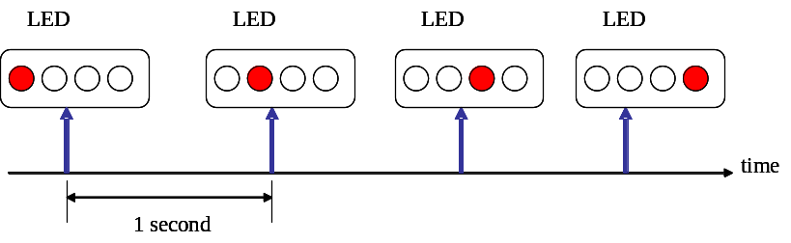
A better way to do timed control
use timer + interrupt
Example:
wake me up one second later
CPU
timer
counter
Hey! Time-up!
count for 1 second

Slide 7
Basic concepts of interrupt mechanism

Slide 8
What is an interrupt?
to “interrupt” the normal execution of a CPU
  turn to do something exceptional and then back to normal execution
  usually to serve external I/O devices

Slide 9

Interrupt normal execution and then return
process ID. 1234
main()
{
while (…) {
…
//normal execution
…
}
}
keyboard_intr_handler ()
{
printf (“A”);
}
$> press something
interrupt service routine (ISR)
send interrupt
PC

Slide 10
Timer + Interrupt for timed control
the conceptual idea

Slide 11
A better way to do timed control
use timer + interrupt
Example:
LED
LED
LED
LED
time
1 second

Slide 12
A better way: uses timer+interrupt
main () {
set_counter (100);
timer_go ();
…
//my own work
…
}
timer_intr_service ()
{
switch_LED ();
}
CPU
timer
counter

Slide 13
A better way: uses timer+interrupt
wake me up 100 units of time later
main () {
set_counter (100);
timer_go ();
…
//my own work
…
}
timer_intr_service ()
{
switch_LED ();
}
CPU
timer
counter
Setup the timer and interrupt

Slide 14
A better way: uses timer+interrupt
CPU does its own work and the timer go counting
main () {
set_counter (100);
timer_go ();
…
//my own work
…
}
timer_intr_service ()
{
switch_LED ();
}
CPU
timer
counter
time
100
99
98
…
1
0

Slide 15
A better way: uses timer+interrupt
the timer sends an interrupt to CPU when time-up
wake up! (interrupt)
main () {
set_counter (100);
timer_go ();
…
//my own work
…
}
timer_intr_service ()
{
switch_LED ();
}
CPU
timer
counter
time
100
99
98
…
1
0

Slide 16
A better way: uses timer+interrupt
CPU turn to the interrupt service routine
wake up!
main () {
set_counter (100);
timer_go ();
…
//my own work
…
}
timer_intr_service ()
{
switch_LED ();
}
CPU
timer
counter
time
100
99
98
…
1
0

Slide 17
A better way: uses timer+interrupt
then back to its normal execution
main () {
set_counter (100);
timer_go ();
…
//my own work
…
}
timer_intr_service ()
{
switch_LED ();
}
CPU
timer
counter
time
100
99
98
…
1
0

Slide 18
Summary
Interrupt mechanism:
  a hardware signal to inform CPU some event has happened
  makes CPU change its execution path
    turn to “Interrupt Service Routine” (ISR)
    then return to its normal execution path and status
Timer:
  an external counter to count up for specified time
  usually inform CPU with interrupt

Slide 19
The 8051 part

Slide 20
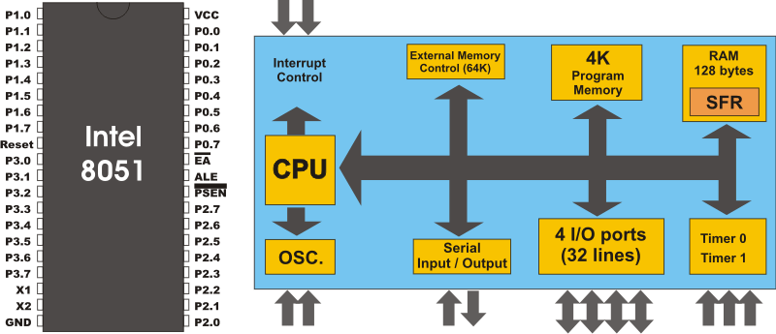
The 8051 architecture
You are playing this part today

Slide 21
Imagination on 8051 architecture
Imagine how data flow in the architecture!
8051 CPU core
internal memory
general purpose
registers
special function
registers (SFR)
…
R0
A
R1
B
R2
P0
30h
31h
…
…
32h
R7
…
…
ALU
address

Slide 22
Imagination on 8051 architecture
flow of an arithmetic instruction
8051 CPU core
internal memory
general purpose
registers
special function
registers (SFR)
…
R0
A
R1
B
R2
P0
30h
31h
…
…
32h
R7
…
…
ALU
address

Slide 23
Imagination on 8051 architecture
data movement between memory and registers
the MOV instruction
8051 CPU core
internal memory
general purpose
registers
special function
registers (SFR)
…
R0
A
R1
B
R2
P0
30h
31h
…
…
32h
R7
…
…
ALU
address

Slide 24
Imagination on 8051 architecture
the MOV also for registers
8051 CPU core
internal memory
general purpose
registers
special function
registers (SFR)
…
R0
A
R1
B
R2
P0
30h
31h
…
…
32h
R7
…
…
ALU
address

Slide 25
Imagination on 8051 architecture
Imagine how data flow in the architecture!
8051 CPU core
internal memory
general purpose
registers
special function
registers (SFR)
…
R0
A
R1
B
R2
P0
30h
31h
…
…
32h
R7
…
…
ALU
address

Slide 26
How to program the timer and interrupt mechanism on 8051

Slide 27
Your program will look like this
main ()
{
TMOD = ???
TCON = ???
TH0 = ???
TL0 = ???
IE = ???
while (1); //infinite loop and do nothing
}
Timer_ISR ()
{
//change LED pattern
}

Slide 28
Your program will look like this
main ()
{
TMOD = ???
TCON = ???
TH0 = ???
TL0 = ???
IE = ???
while (1); //infinite loop and do nothing
}
Timer_ISR ()
{
//change LED pattern
}
Fill in SFR registers to setup the timer and the interrupt

Slide 29
Your program will look like this
main ()
{
TMOD = ???
TCON = ???
TH0 = ???
TL0 = ???
IE = ???
while (1); //infinite loop and do nothing
}
Timer_ISR ()
{
//change LED pattern
}
You don’t need to branch to control the LED pattern

Slide 30
Your program will look like this
main ()
{
TMOD = ???
TCON = ???
TH0 = ???
TL0 = ???
IE = ???
while (1); //infinite loop and do nothing
}
Timer_ISR ()
{
//change LED pattern
}
The timer interrupt will be executed regularly once setup finished

Slide 31
Things you need to know
main ()
{
TMOD = ???
TCON = ???
TH0 = ???
TL0 = ???
IE = ???
while (1); //infinite loop and do nothing
}
Timer_ISR ()
{
//change LED pattern
}
How to setup SFR registers for the timer and the interrupt?
Where to place the timer ISR?

Slide 32
How to program 8051’s interrupt mechanism

Slide 33
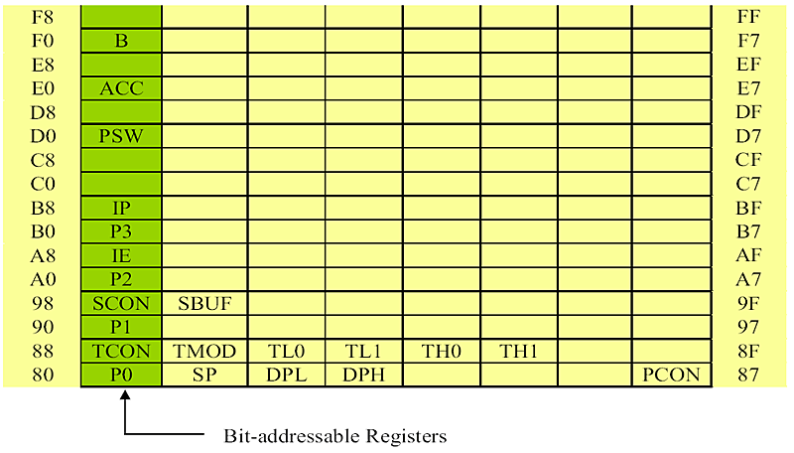
Things you need to know
How to set SFR registers
Where to place interrupt service routine (ISR)?
interrupt enable
registers to control the timer

Slide 34
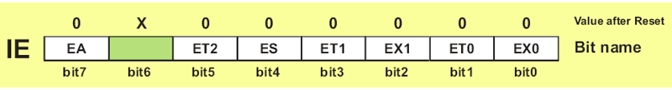
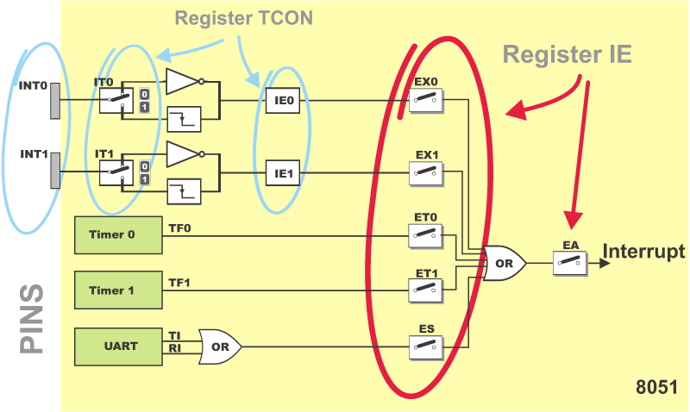
The IE register
1
1
1
1
imagine a path in the figure
set switches in the figure to enable the path

Slide 35
Where’s the interrupt service routing?
IE0: 0x3 (external interrupt)
TF0: 0xb (timer 0 overflow)
TF1: 0x1b (timer 1 overflow)
RI, TI: 0x23 (for UART)

Slide 36
So your program will looks like
assembler directive: place my code from address 0x0b
org 0H
AJMP MAIN
org 0Bh
AJMP show_LED
…
MAIN:
…//your main program
show_LED: //the tmer interrupt service routine
MOV R0, #LED_pattern
MOV P0, R0
…

Slide 37
So your program will looks like
org 0H
AJMP MAIN
org 0Bh
AJMP show_LED
…
MAIN:
…//your main program
show_LED: //the tmer interrupt service routine
MOV R0, #LED_pattern
MOV P0, R0
…
timer 0 ISR starts from here

Slide 38
How to program 8051 timer

Slide 39
Overview of 8051 timer
two timers:
  timer 0: {TH0, TL0}
  timer 1: {TH1, TL1}
four modes (set by TMOD register)
  0: 13-bit mode
  1: 16-bit mode
  2: auto reload mode
  3: split mode

Slide 40
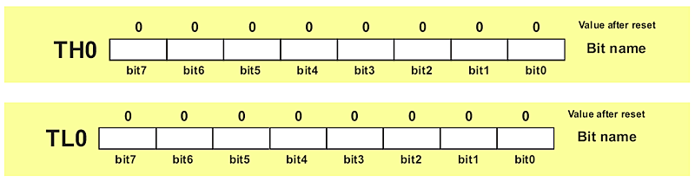
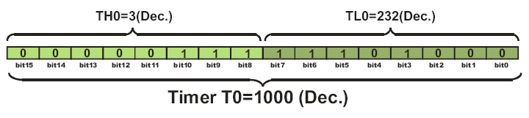
The SFRs for counting

Slide 41


Registers to control the timer mode
timer mode
timer mode

Slide 42
How 8051 timer works
Step 1: set {TH, TL}=N
Step 2: enable counting by setup TMOD, TCON
Step 3: wait for timer overflow (check TCON)
TF=1 to indicate timer overflow
(0xffff reached)
time
1000
1001
1002
…
0xffff
0

Slide 43
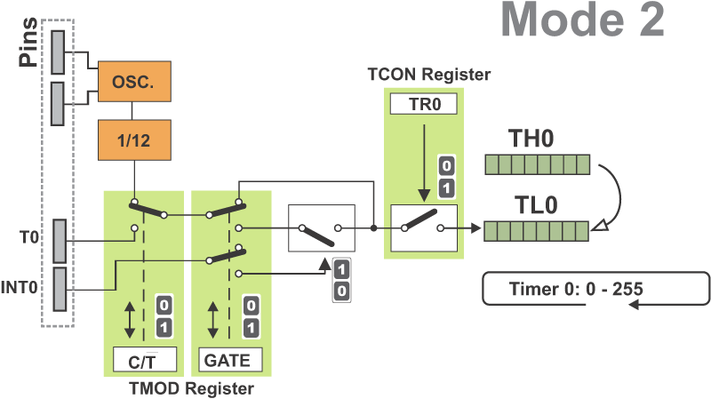
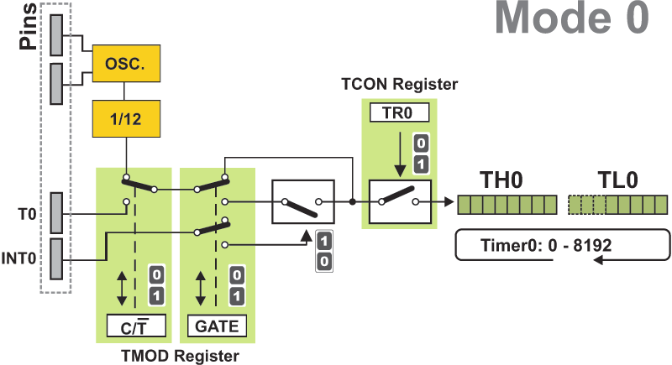
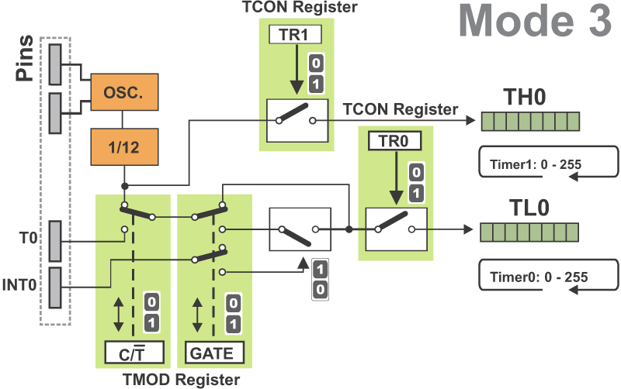
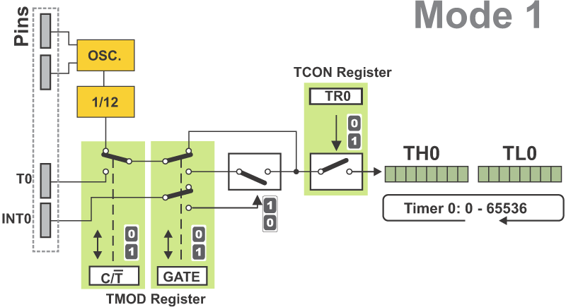
How to set lots of bits in TMOD, TCON, and IE
check these figures for the four timer modes

Slide 44
Timer Mode 0

Slide 45
Timer Mode 1

Slide 46
Timer Mode 2

Slide 47
Timer Mode 3

Slide 48
Exercise: setup timer control registers

Slide 49
In-Class Exercise
Suppose:
  one cycle period of the timer counter is 0.1ms
Q: How to program 8051 to send an interrupt every 1 second?

Slide 50
The SFR setup
setup the counter
  count once every 0.1 ms
  count 10000 times for 1 second
  {TH0, TL0}=65536 – 10000 = 55536 = (1101100011110000)₂
1
1
0
1
1
0
0
0
1
1
1
1
0
0
0
0

Slide 51
The SFR setup
use timer 0 with mode 01
  mode 01: 16-bit timer
0
0
0
1
0
0

Slide 52
The SFR setup
1
1
1
1
1
1

Slide 53
Demo: make LED run using the timer interrupt

Slide 54
Function of the demo
switches LED every 30 timer interrupts
LED
LED
switches LED every 30 timer interrupts
time
…
a timer interrput

Slide 55
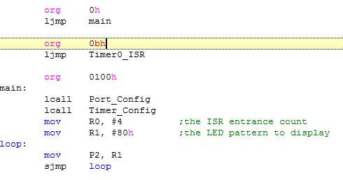
The demo program
org to force program address
and jump to actual ISR immediately

Slide 56
The demo program
Infinite loop to send control signals to LEDs

Slide 57
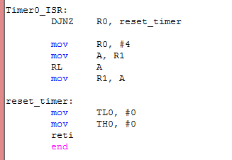
The demo program
The timer ISR
Change LED pattern every 4 times the ISR is executed

Slide 58
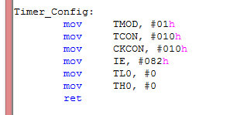
The demo program
Setup the timer interrupt
Q: what is CKCON?

Slide 59
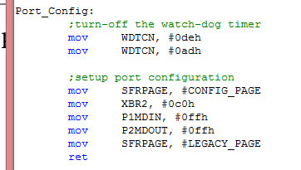
The demo program
Setup port configuration

Slide 60
Next Lab: Buttons

Slide 61
Lab 04
Turning the LED pattern by buttons
A
8051
LED

Slide 62
Lab04: the pre-lab report
(1) explain how to filter-out unstable signals when a button pressed
time
key_pressed
you pressed just once
but generate lots of pulses

Slide 63
Lab 04: the Pre-Lab Report
(2) How to access a control register in memory-mapped I/O system with standard C programming?
  With address mapping of the I/O device given
  You have only standard C compiler and no special support for the underlying hardware

