Slide 1
LCD Display
Lab 05

Slide 2
Your Task
Display characters according to the button pressed
A
B
ABC_
C
…

Slide 3
Grading
Basic: (60%)
Display the character pressed at the cursor position
Bonus 1: (+10%)
Implement the `new-line’ key
Change to the next line if new-line pressed at Line 1
Scroll the screen if new-line pressed at Line 2
Bonus 2: (+20%)
Implement the arrow keys (up, down, left, right)
Move the cursor by the arrow key
Insert character at the cursor position

Slide 4
Control the LCD Display
From the hardware perspective

Slide 5
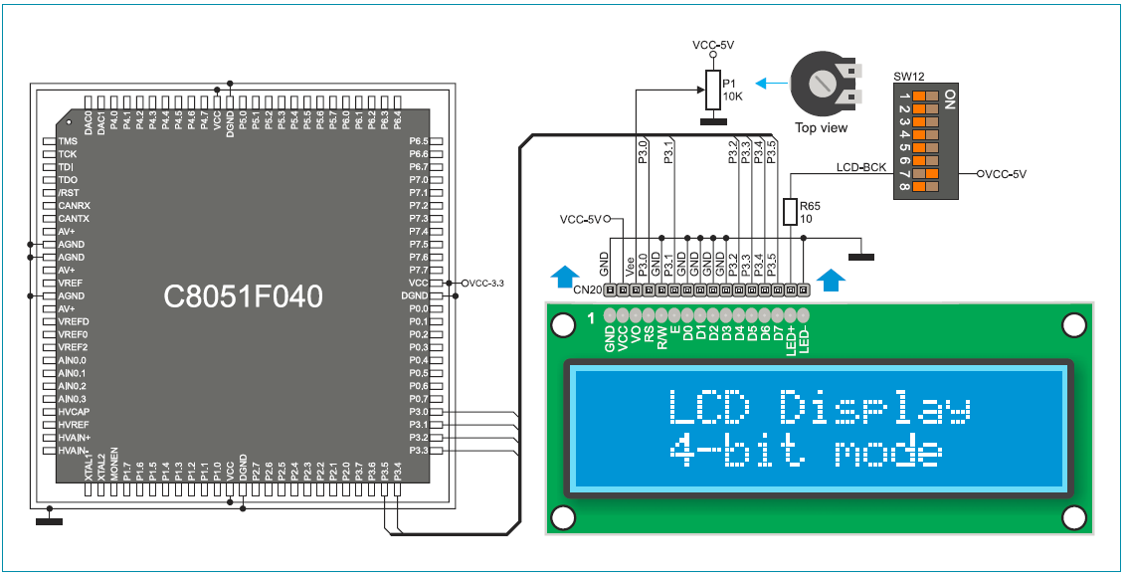
Signal Interface to the LCD
The application processor sends commands and data through port P3
A command:
Moving cursor
Clear screen
…etc
Data: the ASCII code of the character to display

Slide 6
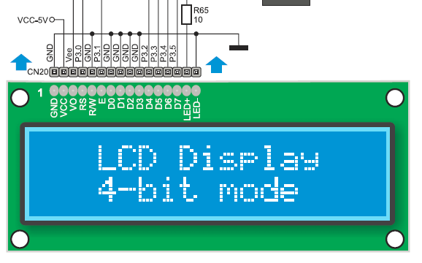
Signal interface to the LCD
RS: register select
0: command
1: data
E: latch enable
the LCD latches the command/data at negative edge (1→0)
D [7:0]
the 8-bit data/command
configured 4-bit mode
send higher portion first

Slide 7
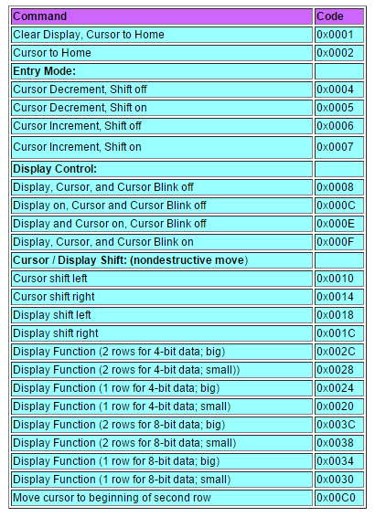
List of commands
http://www.eeherald.com/section/design-guide/sample_lcd_c_programs.html

Slide 8
Timing diagram to send command/data
Example: to send data ‘A’=0x41
The LCD prints ‘A’ at the cursor position
latch data
time
latch data
E
RS
1
1
D[3:0]
4
1
Higher-half of
the data
Lower-half of
the data

Slide 9
Timing diagram to send command/data
Example: to send command 0x01
clear screen, cursor home
latch command
time
latch command
E
RS
0
0
D[3:0]
0
1
Higher-half of
the command
Lower-half of
the command

Slide 10
How to program the LCD
Demo: LCD_Hello

Slide 11
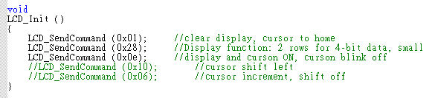
Initialize the LCD

Slide 12
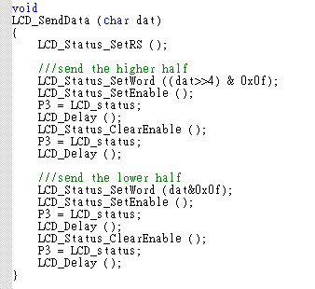
Program to send command/data
Example: to send data ‘A’=0x41
The LCD prints ‘A’ at the cursor position
latch data
time
latch data
E
Prepare the status word
RS
1
1
D[3:0]
4
1
Higher-half of
the data
Lower-half of
the data

Slide 13
Program to send command/data
Example: to send data ‘A’=0x41
The LCD prints ‘A’ at the cursor position
latch data
time
latch data
E
Send out from port P3
RS
1
1
D[3:0]
4
1
Higher-half of
the data
Lower-half of
the data

Slide 14
Your Mid-Term Project

Slide 15
Project: Count-Down Bomb
setup count-down timer by buttons
display residual time on the LCD
input password from buttons to stop count-down
explode the bomb when (1) time up (2) press the wrong password
A
B
C
D

Slide 16
Grading
Basic: count-down timer (60%)
display time mm:ss and refresh every second
count-down from 59:59
Additional function at setup stage:
setup the timer by buttons (5%)
blink the cursor on the digit to be set when you are setting up the time: 10%
Additional function at count-down stage:
speed-up counting when someone is trying to input the password (10%)
refresh every 0.1 second
make all digits blink when time-up/wrong password: 10%
Still bonus for additional functions you defined
your report: 10%

Slide 17
Mid-Term Project Proposal
The algorithm framework of your alarm/stop-watch
Key Issue: your time-sharing scheme for multiple events and hardware devices
LCD display
button input
timer events

