Slide 1
Sound Control
Lab 07

Slide 2
Your Task
Play a song you like
  multiple tones
  frequency of sound changes regularly

Slide 3
Pre-Lab Report
Q1: Briefly describe the clock system of C8051F040
  Check the data sheet
Q2: How to generate a clock signal with 100Hz in C8051F040
  Specify the setup of OSICN, CLKSEL, TMOD, TCON, THx, TLx, etc.

Slide 4
Grading Policy
Basic (70%): play each tone by request
  Do, Re, Mi, Fa, So, La, Si, Do
Play a song (+10%)
  歌譜 stored in an array and can be changed without modifying the program
Show the time-counting on LCD/GLCD while the song is playing (+10%)
  three jobs controlled by timers
  using 3 timers?
Your Report: 10%

Slide 5
Things you will learn today
Control everything by timer interrupts

Slide 6
Outline
How to control the buzzer (蜂鳴器) to play required sound?
How to generate a signal with required frequency?
  play a sound with fixed frequency
How to play a song?
  the frequency changes with time
C
C
A
B
C
A
A
C
C
C
periodic tasks
B
B
B
C
C
time

Slide 7
How to control the buzzer

Slide 8
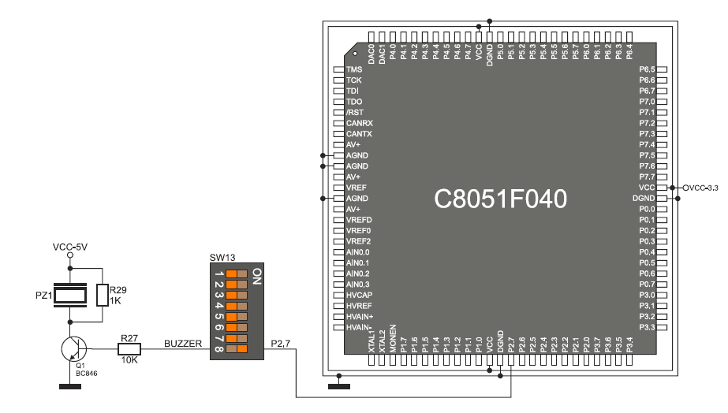
How to control the buzzer
control the sound by the frequency f of the input signal to the buzzer
time
1 sec
…
f = number of pulses in one second

Slide 9
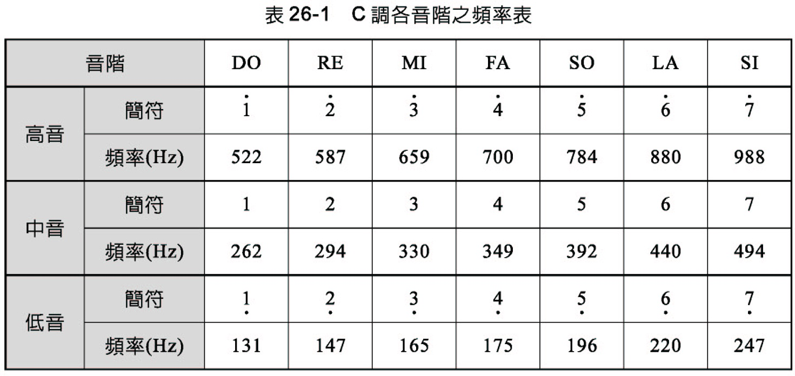
Appendix: frequency of tones

Slide 10
Generating a signal with given frequency

Slide 11
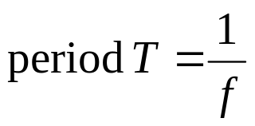
How to send out regular pulses with given frequency
time
main () {
while (1) {
status = ~status;
P2.7 = status;
delay (N);
}
}
1 sec
…
T
It’s difficult to fine-tune delay count N to match T/2 (if you use a for-loop)
This method is not recommended!

Slide 12
The Problem
Frequency generation using timer interrupt
  Suppose: the period for timer interrupt is 100us
  Question: How to generate a signal with half-period n*100us ?
n*100 us
P1.0
time
100 us

Slide 13
The method
int n;
int count=0;
char status;
Timer_ISR ()
{
count = (count+1)%n;
status=~status;
if (count==0) P2.7 = ~status;
}
just reverse the signal every n times the timer ISR is called
n*100 us
P1.0
n times
time
100 us

Slide 14
How to play a song?
the frequency changes with time

Slide 15
The method
Store the 歌譜 as an array of half-period
  Song_Table[i] = the half-period of the i-th tone
Use two timer interrupts
  Timer0_ISR: to control the signal frequency by half-period n
  Timer1_ISR: change the half-period (n) periodically
    n = Song_Table[i++]

Slide 16
The method
int Song_Table[3];
main ()
{
//setup timer interrupts
//initialize
Song_Table [0] = Half_Period (Do);
Song_Table [1] = Half_Period (Re);
Song_Table [2] = Half_Period (Mi);
…
while (1) P2.7=status;
}
int n;
int count;
char status;
Timer0_ISR () //to control signal frequency
{
count = (count+1)%n;
if (count==0) status=~status;
}
int i;
Timer1_ISR () //to change the tone
{
//counting for 1 second…
n = Song_Table [i];
i = (i+1)%3;
}

Slide 17
The method
int Song_Table[3];
main ()
{
//setup timer interrupts
//initialize
Song_Table [0] = Half_Period (Do);
Song_Table [1] = Half_Period (Re);
Song_Table [2] = Half_Period (Mi);
…
while (1) P2.7=status;
}
int n;
int count;
char status;
Timer0_ISR () //to control signal frequency
{
count = (count+1)%n;
if (count==0) status=~status;
}
int i;
Timer1_ISR () //to change the tone
{
//counting for 1 second…
n = Song_Table [i];
i = (i+1)%3;
}
Half period of each tone is stored in an array

Slide 18
The method
Frequency generator according to half-period n
int Song_Table[3];
main ()
{
//setup timer interrupts
//initialize
Song_Table [0] = Half_Period (Do);
Song_Table [1] = Half_Period (Re);
Song_Table [2] = Half_Period (Mi);
…
while (1) P2.7=status;
}
int n;
int count;
char status;
Timer0_ISR () //to control signal frequency
{
count = (count+1)%n;
if (count==0) status=~status;
}
int i;
Timer1_ISR () //to change the tone
{
//counting for 1 second…
n = Song_Table [i];
i = (i+1)%3;
}

Slide 19
The method
Frequency generator according to half-period n
int Song_Table[3];
main ()
{
//setup timer interrupts
//initialize
Song_Table [0] = Half_Period (Do);
Song_Table [1] = Half_Period (Re);
Song_Table [2] = Half_Period (Mi);
…
while (1) P2.7=status;
}
int n;
int count;
char status;
Timer0_ISR () //to control signal frequency
{
count = (count+1)%n;
if (count==0) status=~status;
}
int i;
Timer1_ISR () //to change the tone
{
//counting for 1 second…
n = Song_Table [i];
i = (i+1)%3;
}
changes half-period n of the generated signal every second

Slide 20
Term Project
From music box to video game

Slide 21
Grading of the term project
Basic (60%): music box
  Play a song when a button pressed
Optional: (in the context of the music box)
  Build as a keyboard to play music (+10%)
  Display a running text on LCD (+5%)
  Animation on the GLCD while the song is playing (+10%)
Optional: (build as a video game)
  Control the pattern movement on the GLCD by buttons while the song is playing (+10%)
  Fire the missile (+20%) (at least two moving objects on GLCD)
  Make the target move (+15%) (at least three moving objects on GLCD)
  Play specific tones when the missile hits the target (+10%)
Report: 10%

