Slide 1
Micro-Processor Lab
Lab 00
the course overview

Slide 2
What’s this course for
to learn programming to control I/O devices
CPU
display
bus & I/O
control
memory
network
interface
USB
keyboard

Slide 3
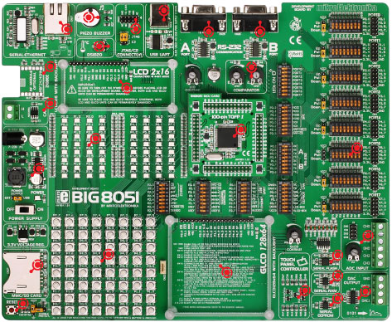
Experiment Platform
The BIG8051 experiment board

Slide 4
Reference
Milan Verle, “Architecture and Programming of 8051 Microcontrollers”
free on-line book
http://www.mikroe.com/en/books/8051book/
Silicon Lab C8051F04x data-sheet
https://www.silabs.com/documents/public/data-sheets/C8051F04x.pdf
Big8051 schematic
https://download.mikroe.com/documents/full-featured-boards/easy/big8051-v6/big8051-manual-v100.pdf

Slide 5
Grading
Pre-Lab report: 20%
Lab reports and demo: 40%
Mid-term project: 20%
Final term project: 20%

Slide 6
Where to get course materials
https://github.com/CGUSystemCourses/Micro_Lab-2017

Slide 7
Pre-Lab Report for Lab00
Assumptions (the Situation):
You graduated from CGU and becomes an engineer at Foxcon
You are given two terrible data-sheets of the experiment equipment's
http://www.silabs.com/products/mcu/mixed-signalmcu/Pages/C8051F04x.aspx
http://www.mikroe.com/downloads/get/1461/big8051_schematic_v100.pdf
You have only 24 hours left to write an LED-blinking demo program on the experiment board
No any assistant data available from Google
No one will teach you how to program the experiment board
Question: how will you read the terrible data-sheets to complete your project in 24 hours?

