Slide 1
General Purpose Digital I/O (GPIO)
Lab 02

Slide 2
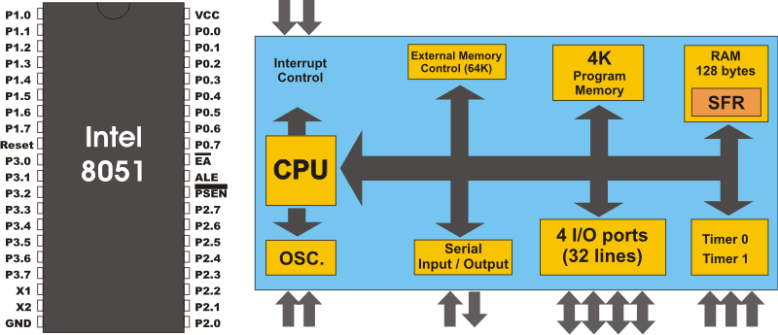
Objectives of this lab
to build up your imagination on how a program affects hardware signals
to learn how to send/receive signals from an application processor to external devices through I/O pads
I/O pins
to I/O devices
(e.g. LED)
from I/O devices
(e.g. keyboard)

Slide 3
Your work today
design a LED box
initial: all LED off
the LED runs some pattern after some button pressed
you can design your own pattern

Slide 4
Outline
Basic concepts of I/O control
I/O model of legacy 8051 processor
SiliconLab C8051F040 I/O control
Simplified programming model

Slide 5
Preparations before the Lab
Read the data sheet of SiliconLab C8051F040 SoC
Chap. 17
Read the schematics of the Big8051 experiment board
On LEDs

Slide 6
Pre-Lab Report
Q1: Explain what is watch-dog timer
Somewhere in your OS textbook
Q2: Explain what is memory-mapped I/O
Check the textbooks of Computer Organization, Computer Architecture, or OS

Slide 7
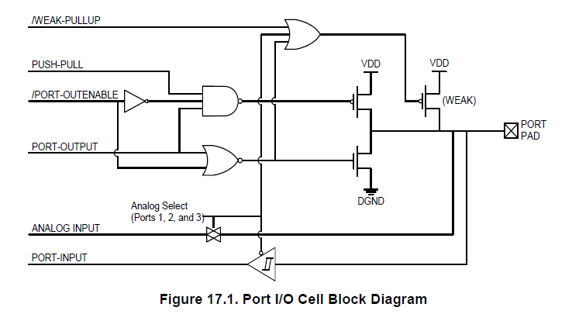
Pre-Lab Report (cont’d)
Q3:
Read Figure 17.1 of C8051F040 spec and the schematics of Big8051
List all control signal values to turn-on an LED at P0.0
Value of these
Control signals

Slide 8
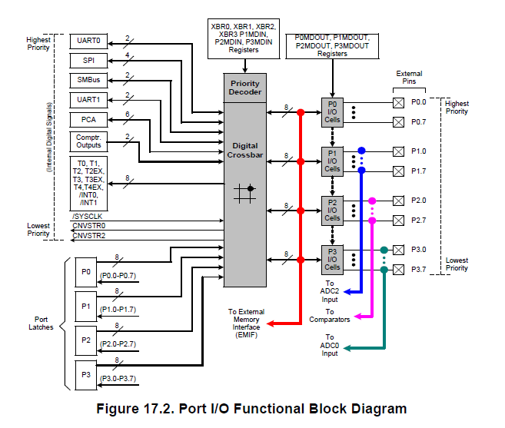
Pre-Lab Report (cont’d)
Q4:
Read Figure 17.2 of C8051F040 spec
List the values of all control registers to configure port P0 as a digital output port

Slide 9
General I/O Control Model

Slide 10
How a processor commands an I/O peripheral
Through access control registers
memory
CPU
System interconnect
Control register
…
peripheral
disk
USB controller
GPIO

Slide 11
How a processor commands an I/O peripheral
Through access control registers
memory
CPU
Status
System interconnect
Command
…
disk
USB controller
GPIO

Slide 12
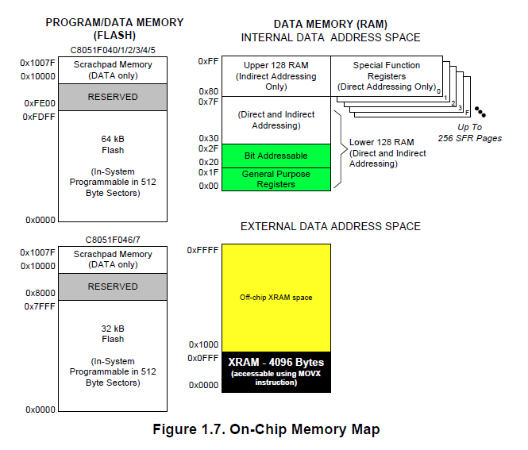
How to access control registers: the memory-mapped I/O
Part of the addressing space is assigned to control registers
Each control register is mapped to some memory address

Slide 13
How a processor commands an I/O peripheral
Through access control registers
memory
CPU
mov 0xd0, #0101B
mov R1, 0xe0
Status
System interconnect
Command
0xd0
0xe0
…
disk
USB controller
GPIO

Slide 14
General Purpose Digital I/O
the processor assigns/examines the logical status of some I/O pins directly
P0
CPU
core
0100101
0100101
I/O pins
8051 chip

Slide 15
I/O Model of Legacy 8051 Processor

Slide 16
Features of 8051 I/O
four 8-bit I/O ports P0-P3
each pin is bidirectional
sometimes input and sometimes output

Slide 17
Features of 8051 I/O
four 8-bit I/O ports P0-P3
each pin is bidirectional
sometimes input and sometimes output

Slide 18
Features of 8051 I/O
four 8-bit I/O ports P0-P3
each pin is bidirectional
sometimes input and sometimes output

Slide 19
Features of 8051 I/O
four 8-bit I/O ports P0-P3
each pin is bidirectional
sometimes input and sometimes output
I/O device
(e.g. keyboard)

Slide 20
Features of 8051 I/O
four 8-bit I/O ports P0-P3
each pin is bidirectional
sometimes input and sometimes output
I/O device
(e.g. LED)

Slide 21
Imagination on 8051 architecture
Imagine how data flow in the architecture!
8051 CPU core
internal memory
general purpose
registers
special function
registers (SFR)
…
R0
A
R1
B
R2
P0
30h
31h
…
…
32h
R7
…
…
ALU
address

Slide 22
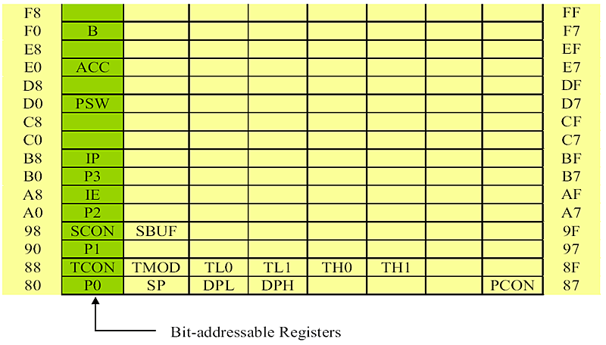
How to program I/O ports?
through SFRs P0-P3

Slide 23
How 8051 send out dedicated control signals
P0
MOV R0, #01001101B
MOV P0, R0
CPU
core
0100101
0100101
I/O pins
8051 chip

Slide 24
The case of input (receive)
initial: set a bit (pin) with value 1
receive (input): wait for the bit to be toggled to be 0
P0.3 = 1
//wait unit P0.3 been set to 0
while (P0.3==1);
//action for the I/O event
8051 MCU
P0
CPU
core
I/O device
…

Slide 25
The case of input (receive)
initial: set a bit (pin) with value 1
receive (input): wait for the bit to be toggled to be 0
prepare to receive input from an I/O device
P0.3 = 1
//wait unit P0.3 been set to 0
while (P0.3==1);
//action for the I/O event
8051 MCU
P0
CPU
core
I/O device
1
…

Slide 26
The case of input (receive)
initial: set a bit (pin) with value 1
receive (input): wait for the bit to be toggled to be 0
P0.3 = 1
//wait unit P0.3 been set to 0
while (P0.3==1);
//action for the I/O event
8051 MCU
set to zero to inform an event
P0
CPU
core
I/O device
1
0
…

Slide 27
The GPIO of C8051F040 SoC

Slide 28
Overview of SFR
Extension from legacy 8051
Divided into 3 pages
Page 145-149 of the C8051F040 data sheet

Slide 29
The port configuration
Set XBR2, PxMDIN and PxMDOUT to set port Px as general purpose I/O

Slide 30
The I/O pad
To send output 1
1
0
1
1

Slide 31
The I/O pad
To send output 0
1
0
0
0

Slide 32
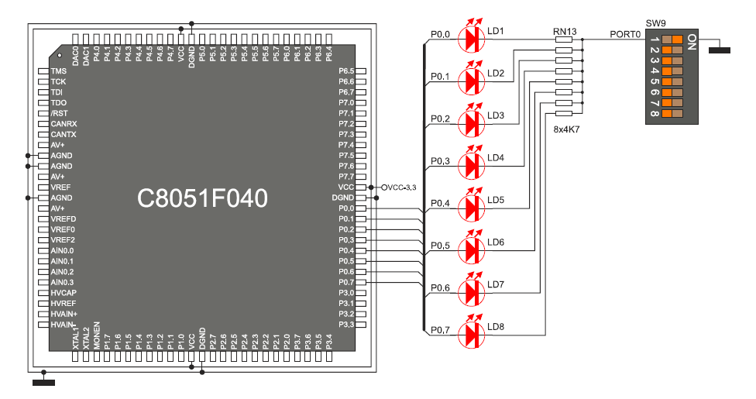
Schematics of the LED
mov P0, #10000000h to turn on LD8

Slide 33
Example 1
Detect button press and display on LED

Slide 34
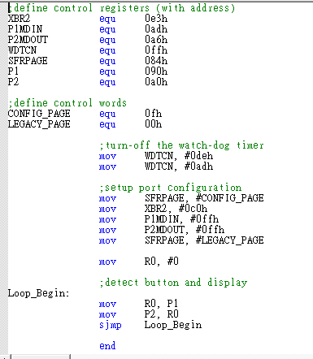
Example Code

Slide 35
Example 2: wait for a button pressed

Slide 36
Demo: wait for a button pressed
wait:
A = P1;
if (A==0) goto wait;
exit:
//something after button pressed
prepare to receive input from an I/O device
8051 MCU
P1
wait:
mov A, P1
JZ wait
exit:
//something after button pressed
CPU
core
I/O device
0
…

Slide 37
Demo: wait for a button pressed
wait:
A = P1;
if (A==0) goto wait;
exit:
//something after button pressed
Receive signal from the button
8051 MCU
P1
wait:
mov A, P1
JZ wait
exit:
//something after button pressed
CPU
core
I/O device
1
…

Slide 38
Example 3: make LED run
show how to output signal

Slide 39
Demo: rotate the LED light
MAIN:
MOV A, #11111110B
MOV PSW, #00H
Loop:
MOV P0, A
LCALL Delay
RR A
LJMP Loop
MOV R0, #50
Delay: MOV R1, #40
Delay1: MOV R2, #249
Delay2: DJNZ R2, Delay2
DJNZ R1, Delay1
DJNZ R0, Delay
RET

Slide 40
Demo: rotate the LED light
MAIN:
MOV A, #00000001B
MOV PSW, #00H
Loop:
MOV P0, A
LCALL Delay
RR A
LJMP Loop
MOV R0, #50
Delay: MOV R1, #40
Delay1: MOV R2, #249
Delay2: DJNZ R2, Delay2
DJNZ R1, Delay1
DJNZ R0, Delay
RET
control the LED through content of A

Slide 41
Demo: rotate the LED light
MAIN:
MOV A, #11111110B
MOV PSW, #00H
Loop:
MOV P0, A
LCALL Delay
RR A
LJMP Loop
MOV R0, #50
Delay: MOV R1, #40
Delay1: MOV R2, #249
Delay2: DJNZ R2, Delay2
DJNZ R1, Delay1
DJNZ R0, Delay
RET
rotate right (RR) A
00000001
00000010
00000100

Slide 42
Demo: rotate the LED light
MAIN:
MOV A, #11111110B
MOV PSW, #00H
Loop:
MOV P0, A
LCALL Delay
RR A
LJMP Loop
MOV R0, #50
Delay: MOV R1, #40
Delay1: MOV R2, #249
Delay2: DJNZ R2, Delay2
DJNZ R1, Delay1
DJNZ R0, Delay
RET
call a function at label “Delay”
a nested loop to delay some time

Slide 43
The Next Lab: Timer and Interrupt

Slide 44
Your Work at Lab 03
make LED run but using the timer interrupt to trigger pattern change

Slide 45
Pre-Lab Report
Q1: what is interrupt?
check Mano: logic and computer design fundamentals, Section 10-9
Q2: how to setup an ISR on 8051
ISR: interrupt service routine

