Slide 1
General Purpose Digital I/O (GPIO)
Lab 02

Slide 2
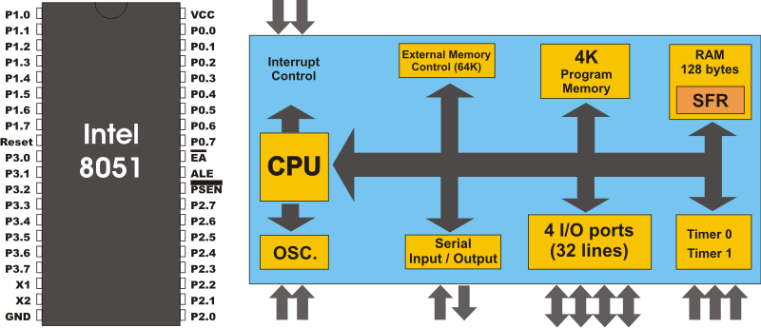
Objectives of this lab
to build up your imagination on how a program affects hardware signals
to learn how to send/receive signals from an application processor to external devices through I/O pads
I/O pins
to I/O devices
(e.g. LED)
from I/O devices
(e.g. keyboard)

Slide 3
Your Task
design a LED box
initial: all LED off
the LED runs some pattern after some button pressed
you can design your own pattern

Slide 4
Preparations before the Lab
Read the data sheet of SiliconLab C8051F040 SoC
Chap. 17
Read the schematics of the Big8051 experiment board
On LEDs

Slide 5
Pre-Lab Report
Q1: Explain what is watch-dog timer
Somewhere in your OS textbook
Q2: Explain what is memory-mapped I/O
Check the textbooks of Computer Organization, Computer Architecture, or OS

Slide 6
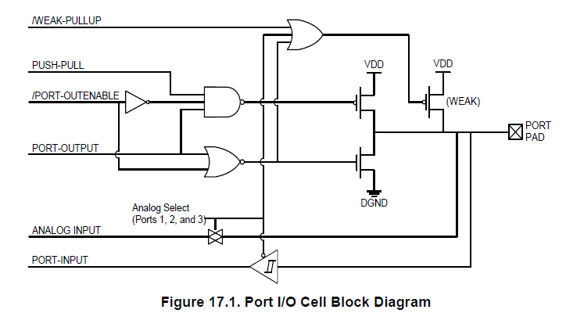
Pre-Lab Report (cont’d)
Q3:
Read Figure 17.1 of C8051F040 spec and the schematics of Big8051
List all control signal values to turn-on an LED at P0.0
Value of these
Control signals

Slide 7
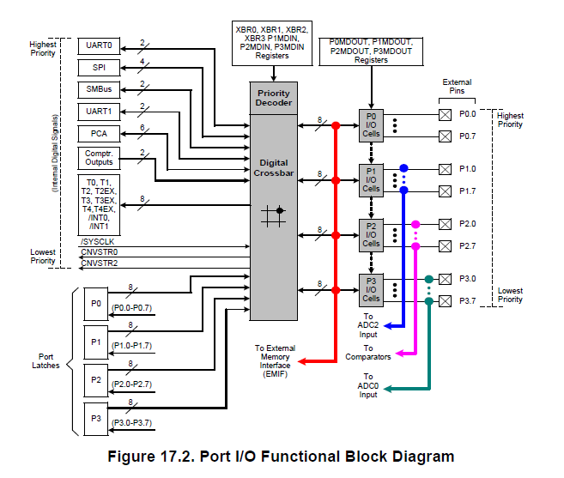
Pre-Lab Report (cont’d)
Q4:
Read Figure 17.2 of C8051F040 spec
List the values of all control registers to configure port P0 as a digital output port

