Slide 1
LCD Display
Lab 05

Slide 2
Your Task
Display characters according to the button pressed
A
B
ABC_
C
…

Slide 3
Pre-Lab Question
Explain how to send a command/character to the LCD
Show the timing waveform covering the following signals
RS, RW, E, D [7:4]
Reference:
http://www.8052.com/tutlcd.phtml
http://www.eeherald.com/section/design-guide/sample_lcd_c_programs.html
Explain in your own words!

Slide 4
Grading
Basic: (60%)
Display the character pressed at the cursor position
Bonus 1: (+10%)
Implement the `new-line’ key
Change to the next line if new-line pressed at Line 1
Scroll the screen if new-line pressed at Line 2
Bonus 2: (+20%)
Implement the arrow keys (up, down, left, right)
Move the cursor by the arrow key
Insert character at the cursor position
Bonus 3: (+20%)
Catch the signal waveform of sending a command/data using LA

Slide 5
General Concepts: Controlling I/O Devices
On-chip vs. off-chip

Slide 6
Control on-chip peripherals
access control registers with memory-mapped I/O
memory
CPU
Status
System interconnect
Command
…
disk
USB controller
GPIO

Slide 7
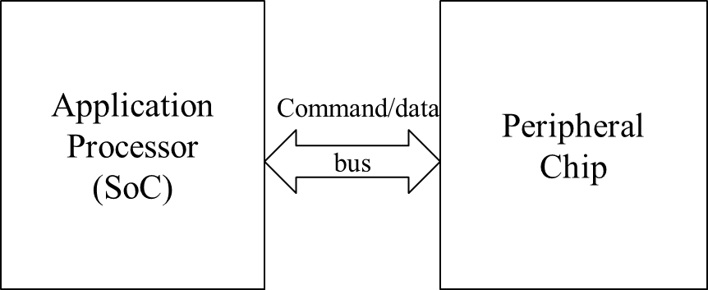
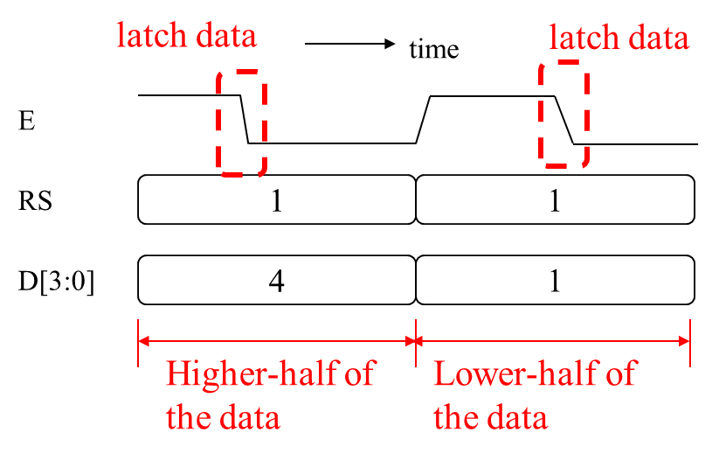
Control off-chip peripherals
Transfer command/data through off-chip buses
Following some protocol (waveform)

Slide 8
Control the LCD Display
From the hardware perspective

Slide 9
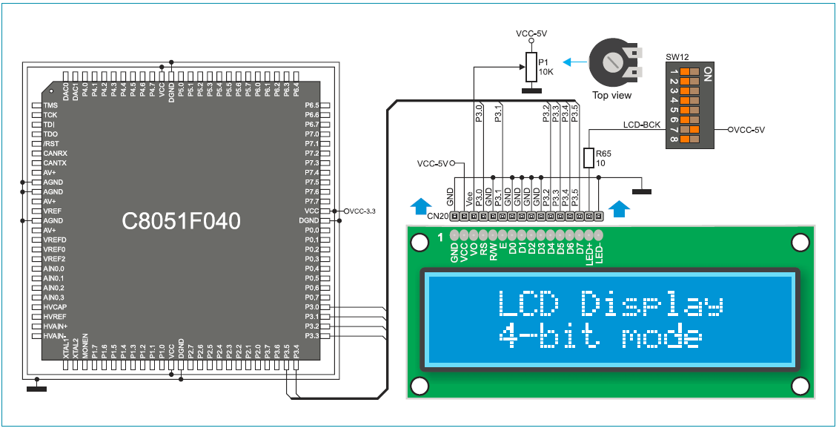
Signal Interface to the LCD
The application processor sends commands and data through port P3
A command:
Moving cursor
Clear screen
…etc
Data: the ASCII code of the character to display

Slide 10
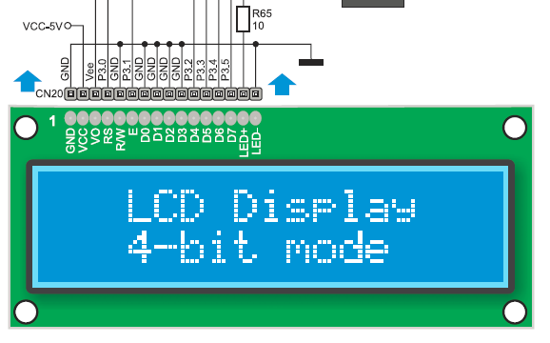
Signal interface to the LCD
RS: register select
0: command
1: data
E: latch enable
the LCD latches the command/data at negative edge (1→0)
D [7:0]
the 8-bit data/command
configured 4-bit mode
send higher portion first

Slide 11
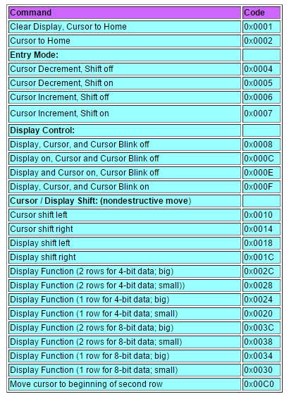
List of commands
http://www.eeherald.com/section/design-guide/sample_lcd_c_programs.html

Slide 12
Timing diagram to send command/data
Example: to send command 0x01
clear screen, cursor home
latch command
time
latch command
E
RS
0
0
D[3:0]
0
1
Higher-half of
the command
Lower-half of
the command

Slide 13
Timing diagram to send command/data
Example: to send data ‘A’=0x41
The LCD prints ‘A’ at the cursor position
latch data
time
latch data
E
RS
1
1
D[3:0]
4
1
Higher-half of
the data
Lower-half of
the data

Slide 14
How to program the LCD
Demo: LCD_Hello

Slide 15
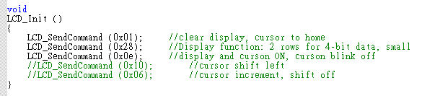
Initialize the LCD

Slide 16
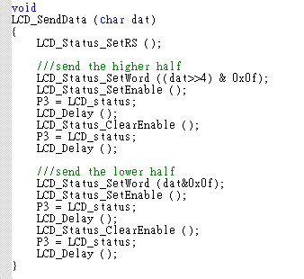
Program to send command/data
Example: to send data ‘A’=0x41
The LCD prints ‘A’ at the cursor position
Prepare the data
time
E
Prepare the status word
RS
1
1
D[3:0]
4
1
Higher-half of
the data
Lower-half of
the data

Slide 17
Program to send command/data
Example: to send data ‘A’=0x41
The LCD prints ‘A’ at the cursor position
Send out the data
time
E
RS
1
1
Send out the status word
D[3:0]
4
1
Higher-half of
the data
Lower-half of
the data

Slide 18
Program to send command/data
Example: to send data ‘A’=0x41
The LCD prints ‘A’ at the cursor position
Prepare the data
time
E
Prepare the status word
RS
1
1
D[3:0]
4
1
Higher-half of
the data
Lower-half of
the data

Slide 19
Program to send command/data
Example: to send data ‘A’=0x41
The LCD prints ‘A’ at the cursor position
Send out the data
time
E
Send out the status word
RS
1
1
D[3:0]
4
1
Higher-half of
the data
Lower-half of
the data

Slide 20
Program to send command/data
Example: to send data ‘A’=0x41
The LCD prints ‘A’ at the cursor position
time
Send out the data
E
RS
1
1
Send signal for lower-half
D[3:0]
4
1
Higher-half of
the data
Lower-half of
the data

