Slide 1
Graphics-LCD Display
Lab 06

Slide 2
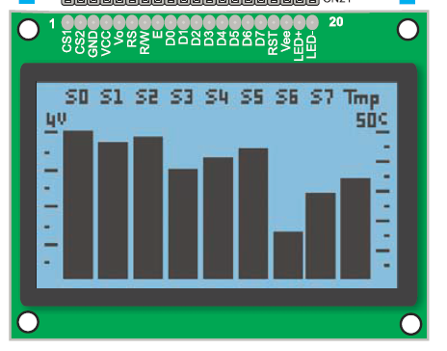
Your Task
Draw a still image on the graphics LCD
Bonus: show some animation

Slide 3
Grading
Basic: (70%)
“Draw” some still image
Optional: (animation)
Move the pattern horizontally (+10%)
Move the pattern vertically (+20%)
Report: (10%)
But this time you have to start from scratch
No demo code for you to modify

Slide 4
General Scheme to Control Graphics LCD
Fill the image bitmap into the display memory

Slide 5
The control scheme
Fill-in the bitmap into the display memory
MCU
(8051)
(address, data)
Display Memory
(128x64 bitmap)
Screen
(128x64 pixels)
Graphics LCD
Driver

Slide 6
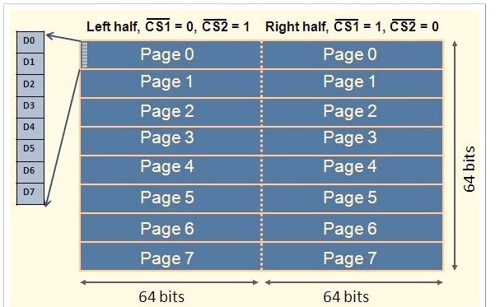
Detailed look of the control scheme
Fill the 0-1 bitmap into two-dimensional array
But each time we fill 8-bit for 8 pixels on the x-axis
x
y

Slide 7
Signal Interface to Fill the Image Memory
And the timing

Slide 8
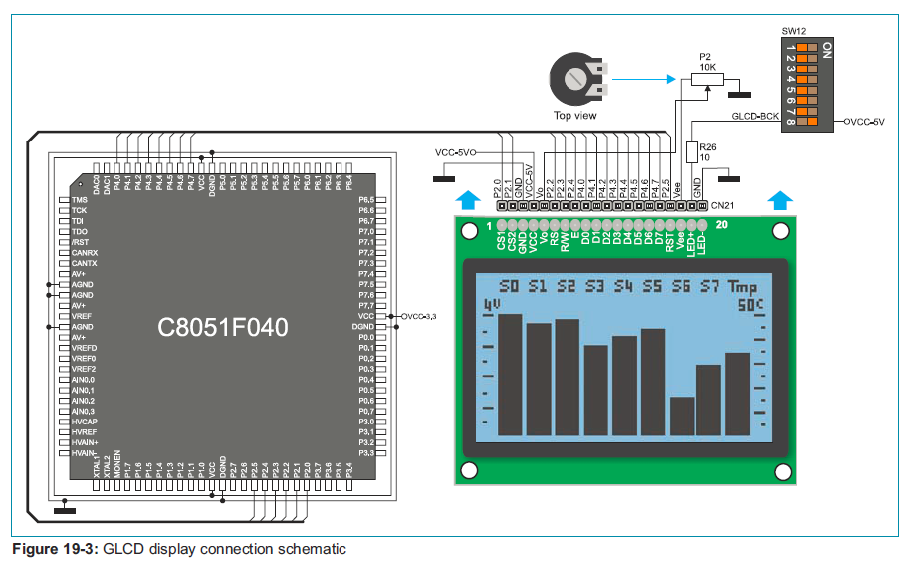
Signal Interface on Experiment Board
Through P2 and P4

Slide 9

Signal interface to the LCD
RS: register select
0: command
1: data
RW: read/write select
0: write
1: read
E: latch enable
DB [7:0]
the 8-bit data/command
CS1, CS2: select left/right half

Slide 10
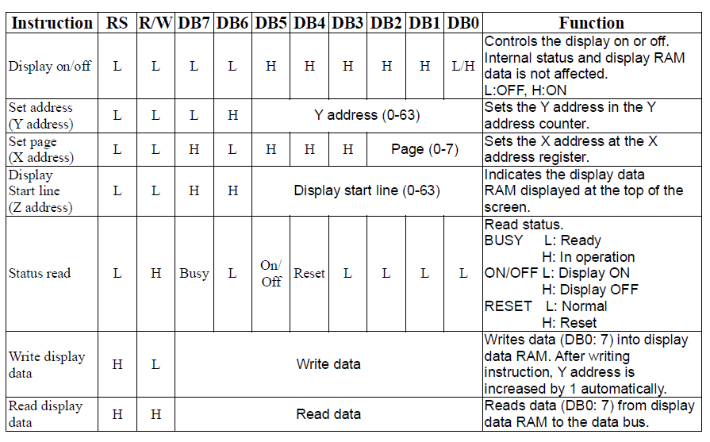
List of commands

Slide 11
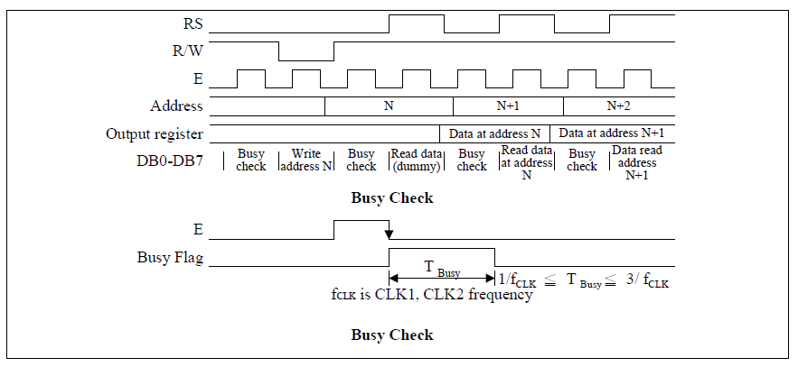
Timing diagram to send command/data
Notice the latch trigger on E
Has to check for busy

Slide 12
Pseudo Code of the General Control Sequence
Convert each part to a sequence of accesses to ports P2 and P4
do {
read status;
} while (status==busy);
Set address x;
Set address y;
Write bitmap A;

Slide 13
In-Class Exercise
Write a sequence of P2 and P4 value to reset and turn-on the graphics LCD

Slide 14
In-Class Exercise
Write a sequence of P2 and P4 value to test whether the GLCD is busy or not

Slide 15
In-Class Exercise
Write the series of P2 and P4 value to set a bitmap 0xAF on address x=3, y=25

Slide 16
Pre-Lab Report

Slide 17
Pre-Lab Questions
Q1: how to enable port P4 for input and output?
Q2: write a C function to set 8-bit bitmap on address (x, y)
Draw (char x, char y, char bitmap)
Q3: find a tool to generate the bitmap of your image
Please google!

Slide 18
Demo before you leave today
Use the SiliconLab IDE to manually draw some still image on the GLCD screen
Key-in the value of P2 and P4 manually
You have only sample code for basic setup

