Slide 1
Mid-Term Project
Traffic Signal / LED display

Slide 2
Overview
Do one of the following projects
Project 1: Traffic Light Controller
Project 2: Running LED Patterns

Slide 3
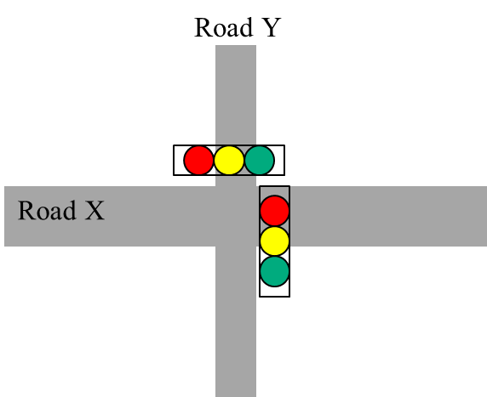
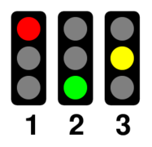
Project 1 : Traffic Light Controller
Basic : (80%)
Design the traffic light controller on a cross-road
Running periodic patterns
Road X
20s
5s
2s
20s
Road Y
40s
5s
2s

Slide 4
Project 1 : Traffic Light Controller
Bonus 1 : (+15%)
Blinking (閃爍) the green light 5 seconds before turning yellow light
Blinking
15s
5s
5s
2s

Slide 5
Project 1 : Traffic Light Controller
Bonus 2 : (+10%)
Pedestrian (行人) Button
Road X
20s
5s
2s
Road Y
2s
40s
5s
Pedestrian
15s
Press the Button

Slide 6
Project 2 : Running LED Pattern
Basic : (60%)
Simple round-robin pattern in the same direction

Slide 7
Project 2 : Running LED Pattern
Bonus 1 : (+10%)
Reverse direction when meeting the bottom

Slide 8
Project 2 : Running LED Pattern
Bonus 2 : (+10%)
Assign “four” button as the password
The running LED pattern stops if correct password is entered
Bonus 3 : (+10%)
Speedup the running pattern if no button is hit after 1 minute
Bonus 4 : (+10%)
Speedup the running pattern if wrong password is given

