Slide 1
Button control and De-Bounce Filter
Lab 04

Slide 2
Your Task
Control the LED display by pressing a button
A
8051
LED

Slide 3
Grading
Basic: each hit of the button moves up/down the LED (75%)
Bonus 1: (+15%)
the LED runs automatically
Hitting the button will change the pattern
Hint: use timer interrupt to make two I/O devices work simultaneously

Slide 4
Things you need to know for your task
How to program 8051 to receive an input signal from the button?
How to filter-out unstable signal when a button pressed?
the de-bounce filter

Slide 5
How to receive a button input

Slide 6
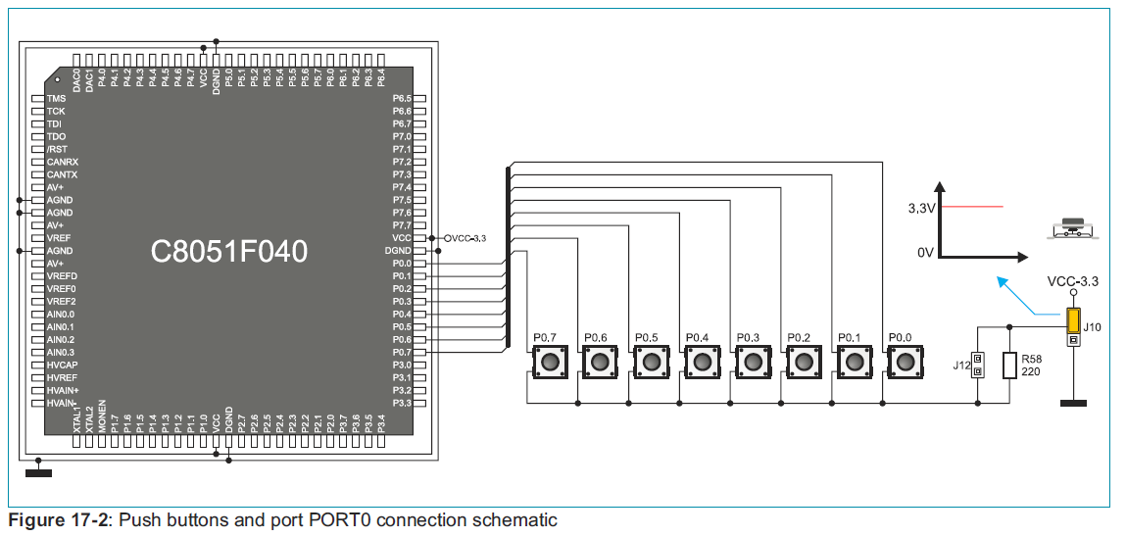
How to detect the push button
A hit generates a logic 1 to an GPIO pin

Slide 7
How to count number of hits to a button?
deal with unstable signal

Slide 8
Things you need to know for your task
How to program 8051 to receive an input signal from the button?
How to filter-out unstable signal when a button pressed?
the de-bounce filter
How to make 7-seg display and button controller work together?
time-sharing scheme

Slide 9
You may write such a program
8051 MCU
prepare to receive input from an I/O device
count = 0;
while (1) {
while (P1.3==0);
//goto here if P1.3==1
count++;
}
P1
CPU
core
I/O device
0
…

Slide 10
You may write such a program
count = 0;
while (1) {
while (P1.3==0);
//goto here if P1.3==1
count++;
}
8051 MCU
P1
Button pressed
CPU
core
I/O device
1
…

Slide 11
You may write such a program
What’s wrong with this program?
count = 0;
while (1) {
while (P1.3==0);
//goto here if P1.3==1
count++;
}
You think you just hit the button once but the CPU sense it for hundreds of times
time
clock
…
button_hit
hit button once

Slide 12
You may write such a program
What’s wrong with this program?
count = 0;
while (1) {
while (P1.3==0);
//goto here if P1.3==1
count++;
}
(2) Unstable signal when you pressed a button
time
key_pressed
you pressed just once
but generate lots of pulses

Slide 13
De-bounce filter
the design concepts

Slide 14
Things you need to know for your task
How to program 8051 to receive an input signal from the button?
How to filter-out unstable signal when a button pressed?
the de-bounce filter
How to make 7-seg display and button controller work together?
time-sharing scheme

Slide 15
How to filter-out multiple pulses from a press
time
clock
key_pressed
you pressed just once
but generate lots of pulses

Slide 16
How to filter-out multiple pulses from a press
use a counter to count the time to stable
time
key_pressed
counter
0
unstable
N
unstable
N
N-1
N-2
…
1
0
0
key_input

Slide 17
How to filter-out multiple pulses from a press
use a counter to count the time to stable
time
keep counter=N when key_pressed = 1
key_pressed
counter
0
unstable
N
unstable
N
N-1
N-2
…
1
0
0
key_input

Slide 18
How to filter-out multiple pulses from a press
use a counter to count the time to stable
count-down to 0 when key released
time
key_pressed
counter
0
unstable
N
unstable
N
N-1
N-2
…
1
0
0
key_input

Slide 19
How to filter-out multiple pulses from a press
use a counter to count the time to stable
time
a one-cycle pulse for each key press
key_pressed
counter
0
unstable
N
unstable
N
N-1
N-2
…
1
0
0
key_input

Slide 20
De-Bounce Filter
How to program

Slide 21
How to filter-out multiple pulses from a press
write a program for the hardware concept
time
key_pressed
counter
0
unstable
N
unstable
N
N-1
N-2
…
1
0
0
key_input

Slide 22
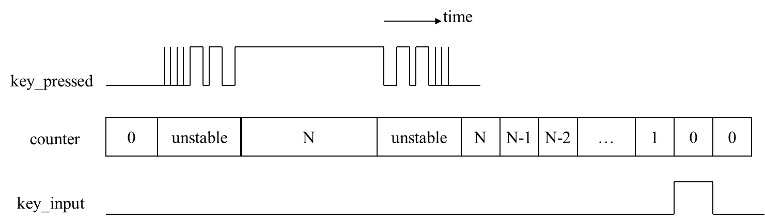
De-Bounce filter programming
while (1) {
//Stage 1: wait for a button pressed
do {
key_hold = P0;
} while (!key_hold);
//Stage 2: wait for key released
key_release = 0;
count = N;
while (!key_release) {
key_hold = P0;
if (key_hold) {
count = N;
}
else {
count--;
if (count==0) key_release = 1;
}
}//Stage 2: wait for key released
//Stage 3:move LED pattern
LED_pattern = (LED_pattern << 1)+1;
if (LED_pattern=0xff) LED_pattern = 0xfe;
P1 = LED_pattern;
}//while (1)

Slide 23
De-Bounce filter programming
while (1) {
//Stage 1: wait for a button pressed
do {
key_hold = P0;
} while (!key_hold);
//Stage 2: wait for key released
key_release = 0;
count = N;
while (!key_release) {
key_hold = P0;
if (key_hold) {
count = N;
}
else {
count--;
if (count==0) key_release = 1;
}
}//Stage 2: wait for key released
//Stage 3:move LED pattern
LED_pattern = (LED_pattern << 1)+1;
if (LED_pattern=0xff) LED_pattern = 0xfe;
P1 = LED_pattern;
}//while (1)
wait for key pressed

Slide 24
De-Bounce filter programming
while (1) {
//Stage 1: wait for a button pressed
do {
key_hold = P0;
} while (!key_hold);
//Stage 2: wait for key released
key_release = 0;
count = N;
while (!key_release) {
key_hold = P0;
if (key_hold) {
count = N;
}
else {
count--;
if (count==0) key_release = 1;
}
}//Stage 2: wait for key released
//Stage 3:move LED pattern
LED_pattern = (LED_pattern << 1)+1;
if (LED_pattern=0xff) LED_pattern = 0xfe;
P1 = LED_pattern;
}//while (1)
keep counter=N when key hold
start count-down when key_hold=0
trying to figure out when a key is totally released

Slide 25
De-Bounce filter programming
while (1) {
//Stage 1: wait for a button pressed
do {
key_hold = P0;
} while (!key_hold);
//Stage 2: wait for key released
key_release = 0;
count = N;
while (!key_release) {
key_hold = P0;
if (key_hold) {
count = N;
}
else {
count--;
if (count==0) key_release = 1;
}
}//Stage 2: wait for key released
//Stage 3:move LED pattern
LED_pattern = (LED_pattern << 1)+1;
if (LED_pattern=0xff) LED_pattern = 0xfe;
P1 = LED_pattern;
}//while (1)
keep counter=N when key hold
start count-down when key_hold=0
unstable counter value

Slide 26
De-Bounce filter programming
while (1) {
//Stage 1: wait for a button pressed
do {
key_hold = P0;
} while (!key_hold);
//Stage 2: wait for key released
key_release = 0;
count = N;
while (!key_release) {
key_hold = P0;
if (key_hold) {
count = N;
}
else {
count--;
if (count==0) key_release = 1;
}
}//Stage 2: wait for key released
//Stage 3:move LED pattern
LED_pattern = (LED_pattern << 1)+1;
if (LED_pattern=0xff) LED_pattern = 0xfe;
P1 = LED_pattern;
}//while (1)
keep counter=N when key hold
start count-down when key_hold=0
count-down to 0 when a key is totally released

Slide 27
How to make two I/O devices work simultaneously
About the bonus

Slide 28
You may write such a program
while (1) {
wait_button_pressed ();
btn_count++;
LED_display ();
}

Slide 29
You may write such a program
do {
key_hold = P0;
} while (!key_hold);
//Stage 2: wait for key released
key_release = 0;
count = N;
while (!key_release) {
key_hold = P0;
if (key_hold) {
count = N;
}
else {
count--;
if (count==0) key_release = 1;
}
}//Stage 2: wait for key released
while (1) {
wait_button_pressed ();
btn_count++;
LED_display ();
}

Slide 30
You may write such a program
while (1) {
wait_button_pressed ();
btn_count++;
LED_display ();
}
//scan for each digit
for (i=0;i<3;i++) {
P0 = pattern (digit[i]);
}

Slide 31
You may write such a program
What’s wrong with this program?
do {
key_hold = ~P0;
} while (!key_hold);
//Stage 2: wait for key released
key_release = 0;
count = N;
while (!key_release) {
key_hold = ~P0;
if (key_hold) {
count = N;
}
else {
count--;
if (count==0) key_release = 1;
}
}//Stage 2: wait for key released
while (1) {
wait_button_pressed ();
btn_count++;
LED_display ();
}
//scan for each digit
for (i=0;i<3;i++) {
P0 = pattern (digit[i]);
}

Slide 32
You may write such a program
What’s wrong with this program?
You will never see button control and digit display work together
while (1) {
wait_button_pressed ();
btn_count++;
LED_display ();
}
for seconds
for seconds
button
control
LED display
button
control
LED display
time

Slide 33
Time-sharing to control multiple I/O devices

Slide 34
The correct scheme
time-sharing to control all the I/O devices
time
switches in mini-seconds!
LED
display
button
control
LED
display
button
control
LED
display
button
control
LED
display
button
control
1 ms
0.1 ms

Slide 35
A scheme for time sharing control
main program: for button control
timer ISR: to scan for digit display
time
switches in mini-seconds!
LED
display
button
control
LED
display
button
control
LED
display
button
control
LED
display
button
control
1 ms
0.1 ms
infinite loop in the main program
triggered by timer interrupt

Slide 36
A scheme for time sharing control
main () {
….
while (1) {
//Stage 1: wait for a button pressed
do {
key_hold = P0;
} while (!key_hold);
//Stage 2: wait for key released
key_release = 0;
count = N;
while (!key_release) {
key_hold = P0;
if (key_hold) {
count = N;
}
else {
count--;
if (count==0) key_release = 1;
}
}//Stage 2: wait for key released
//Stage 3: increment button counter
button_count++;
}//while (1)
}
Timer_ISR () {
switch LED pattern;
}
infinite loop in the main program
triggered by timer interrupt
LED
Display
button
control
LED
Display
button
control
LED
Display
button
control
LED
Display
button
control
1 ms

Slide 37
Appendix: Programming 8051 in C Language

Slide 38
How to access a control register?
In memory-mapped I/O
Just access through a pointor
char *p;
p = (char*) 0x80;
*p = 0xaa;

Slide 39
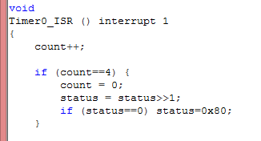
How to setup an interrupt service routine
use “interrupt” directive
The ISR table of Keil-C compiler: http://www.keil.com/support/man/docs/c51/c51_le_interruptfuncs.htm
Check demo LED_shift

Slide 40
Coming up
Midterm project (TBA)
Lab 05: LCD Programming

Slide 41
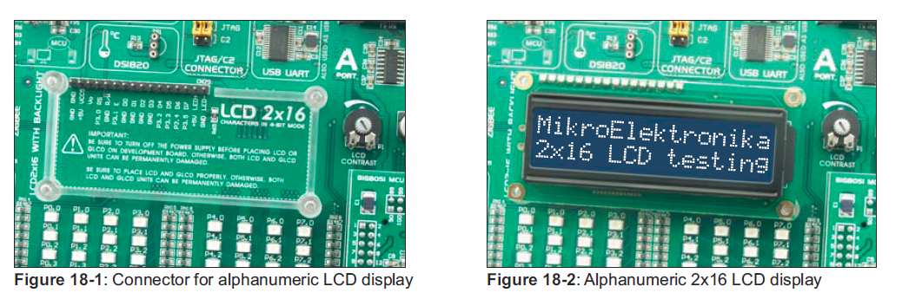
Lab 05: LCD Programming
Display “Hello World!” on the LCD

Slide 42
Pre-Lab Question
Explain how to send a command/character to the LCD
Show the timing waveform covering the following signals
RS, RW, E, D [7:4]
Reference:
http://www.8052.com/tutlcd.phtml
http://www.eeherald.com/section/design-guide/sample_lcd_c_programs.html

