Slide 1
Graphics-LCD Display
Lab 06

Slide 2
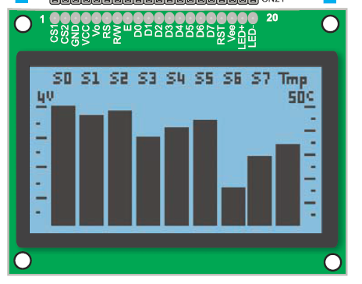
Your Task
Draw a still image on the graphics LCD
Bonus: show some animation

Slide 3
Grading
Basic: (70%)
“Draw” some still image
Optional: (animation)
Move the pattern horizontally (+10%)
Move the pattern vertically (+20%)
Report: (10%)
But this time you have to start from scratch
No demo code for you to modify

Slide 4
General Scheme to Control Graphics LCD
Fill the image bitmap into the display memory

Slide 5
The control scheme
Fill-in the bitmap into the display memory
MCU
(8051)
(address, data)
Display Memory
(128x64 bitmap)
Screen
(128x64 pixels)
Graphics LCD
Driver

Slide 6
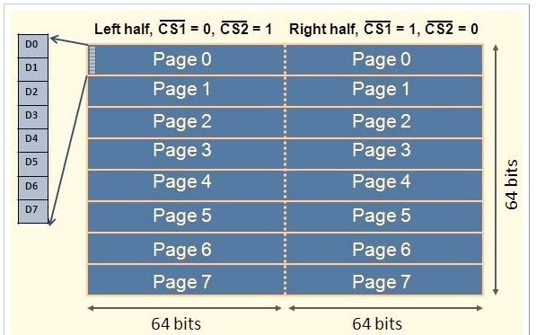
Detailed look of the control scheme
Fill the 0-1 bitmap into two-dimensional array
But each time we fill 8-bit for 8 pixels on the x-axis
x
y

Slide 7
Signal Interface to Fill the Image Memory
And the timing

Slide 8
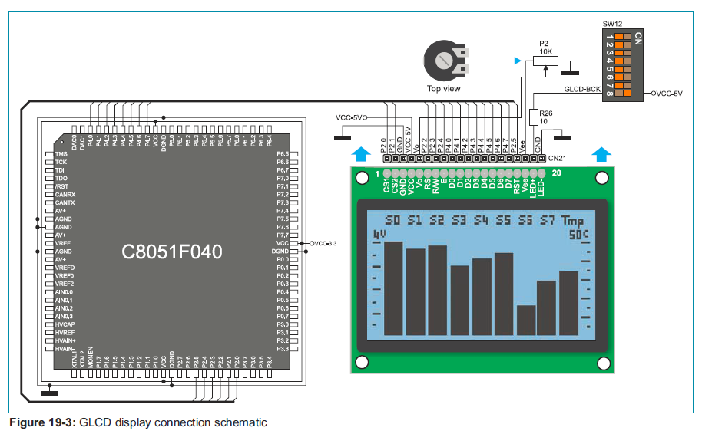
Signal Interface on Experiment Board
Through P2 and P4

Slide 9

Signal interface to the LCD
RS: register select
0: command
1: data
RW: read/write select
0: write
1: read
E: latch enable
DB [7:0]
the 8-bit data/command
CS1, CS2: select left/right half

Slide 10
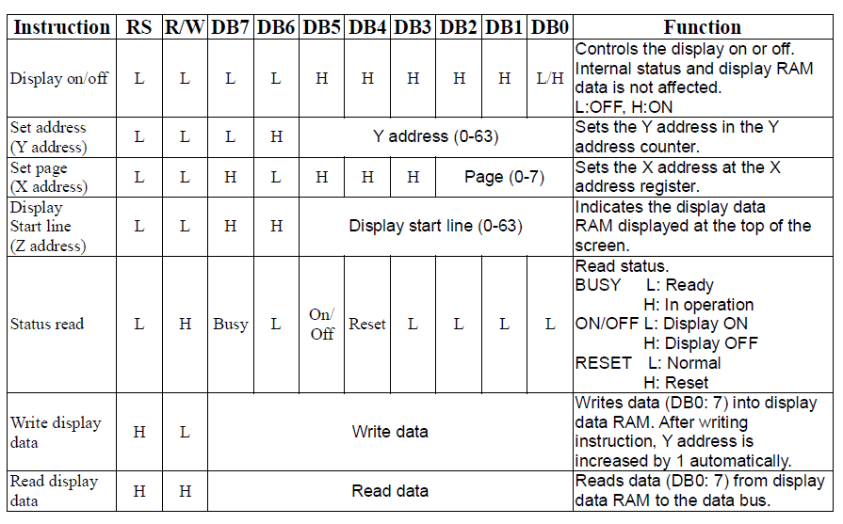
List of commands

Slide 11
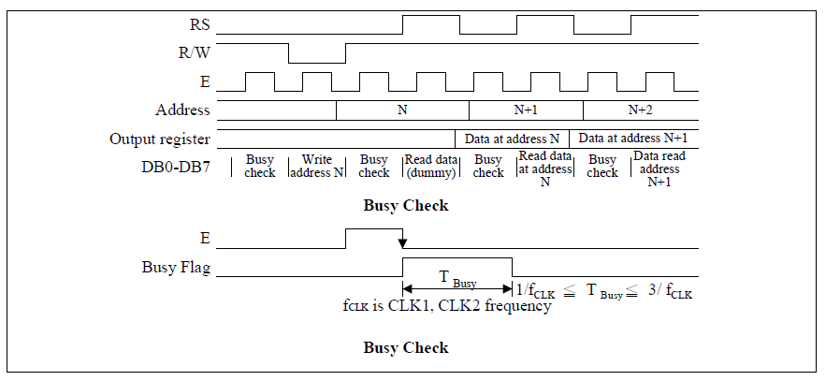
Timing diagram to send command/data
Notice the latch trigger on E
Has to check for busy

Slide 12
Pseudo Code of the General Control Sequence
Convert each part to a sequence of accesses to ports P2 and P4
do {
read status;
} while (status==busy);
Set address x;
Set address y;
Write bitmap A;

Slide 13
In-Class Exercise
Write a sequence of P2 and P4 value to reset and turn-on the graphics LCD

Slide 14
In-Class Exercise
Write a sequence of P2 and P4 value to test whether the GLCD is busy or not

Slide 15
In-Class Exercise
Write the series of P2 and P4 value to set a bitmap 0xAF on address x=3, y=25

Slide 16
Pre-Lab Report

Slide 17
Pre-Lab Questions
Q1: how to enable port P4 for input and output?
Q2: write a C function to set 8-bit bitmap on address (x, y)
Draw (char x, char y, char bitmap)
Q3: find a tool to generate the bitmap of your image
Please google!

Slide 18
Suggestion: do this before you leave today
Use the SiliconLab IDE to manually draw some still image on the GLCD screen
Key-in the value of P2 and P4 manually
You have only sample code for basic setup

