Slide 1
Multi-Threading on UNIX
Lecture 10 (B)

Slide 2
Basic concepts of multi-threading
Part 1
from your OS textbook Chap. 4

Slide 3
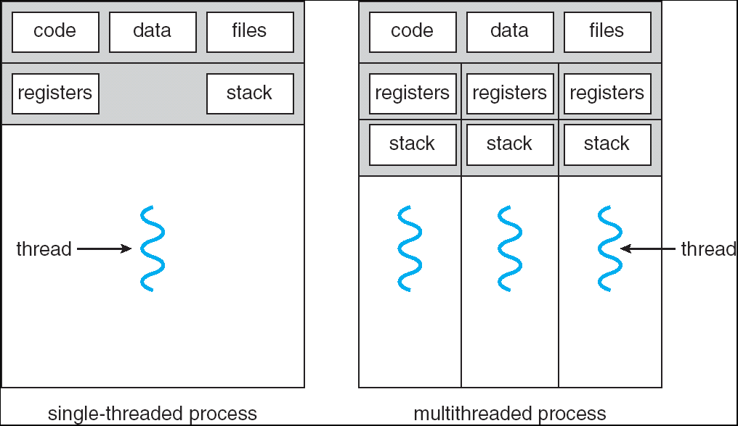
What is a thread?
an instruction execution sequence in a process

Slide 4
What is a thread?
Demo: thread_demo
main ()
Thread 01
Thread 02
pthread_create ()
mile-stone 1
mile-stone 1
time
mile-stone 2
mile-stone 2
mile-stone 3
mile-stone 3
pthread_join ()

Slide 5
What is a thread?
a thread has its own “context”
register file content
stack

Slide 6
What is a thread?
separate context for a thread
a thread has its own “context”
register file content
stack

Slide 7
What is a thread?
all threads share the same memory content
shared by all threads

Slide 8
What is a thread
DEMO: pthread_basic
global variables value and flag shared by all threads
thread. 1
thread. 2
/* initial: flag = 0 */
value = 100;
flag = 1;
while (flag==0);
print value;

Slide 9
What is a thread?
Summary
a thread is an instruction execution sequence in a process
each thread has its own context
register file content
stack
all threads in a process share the same memory space

Slide 10
Why multi-threading

Slide 11
Why multi-threading?
Responsiveness Resource sharing Economy Utilization of multiprocessor architecture
Responsiveness Resource sharing Economy Utilization of multiprocessor architecture
Responsiveness Resource sharing Economy Utilization of multiprocessor architecture
Responsiveness Resource sharing Economy Utilization of multiprocessor architecture

Slide 12
Why multi-threading?
Responsiveness
Example: Web-browser do the following simultaneously
receiving a image/video from Internet and decompressing
waiting for your input from a dialog box

Slide 13
Why multi-threading?
Responsiveness
Resource sharing
Economy
Utilization of multiprocessor architecture
time
Demo: pthread_run
CPU 1
thread 1
CPU 2
thread 2

Slide 14
Why multi-threading?
Recall: fork() duplicates the whole memory space of a process
Resource sharing
Economy
shared by all threads

Slide 15
How to create a new process?
fork and generate a process with identical content
Parent Process
Child Process
pid = fork ();
if (pid==0) {//child process
execlp (filename, filename, (void*)0);
printf (“Error if you see this line\n”);
}
else { //parent process
printf (“This is in parent process\n”);
}
pid = fork ();
if (pid==0) {//child process
execlp (filename, filename, (void*)0);
printf (“Error if you see this line\n”);
}
else { //parent process
printf (“This is in parent process\n”);
}
fork
identical copy to the parent process

Slide 16
Multi-threaded programming on UNIX
Part 2
the pthread system call families

Slide 17
UNIX support for multi-threading
create and terminate a thread
pthread_create
pthread_exit
pthread_join
thread synchronization
pthread_mutex_init
pthread_mutex_destroy
pthread_mutex_lock
pthread_mutex_trylock
pthread_mutex_unlock

Slide 18
Thread creation and termination
pthread_create, pthread_exit, and pthread_join

Slide 19
Creating a thread
pthread_create (*thread_id, *attribute, start_addr, *argument)
thread_id: location to store the ID of a thread after creation
start_addr: starting address of executing the thread
argument: memory location for arguments to start executing the thread

Slide 20
Terminating a thread
just return from the starting subroutine
return a pointor to the execution result
call pthread_exit (*result)

Slide 21
Wait for a thread to terminate
pthread_join (thread_id, **result)

Slide 22
Demo: pthread_basic
thread. 1
thread. 2
/* initial: flag = 0 */
value = 100;
flag = 1;
while (flag==0);
print value;

Slide 23
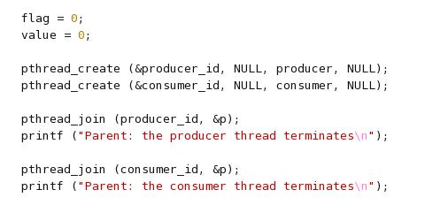
Demo: pthread_basic

Slide 24
Demo: pthread_basic
create a thread to start execution from function producer ()

Slide 25
Demo: pthread_basic
wait for a thread to terminate

Slide 26
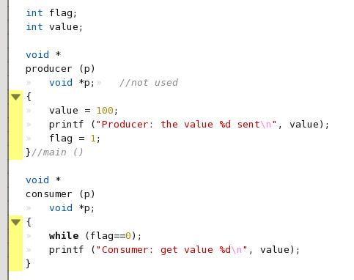
Demo: pthread_basic
thread. 1
thread. 2
/* initial: flag = 0 */
value = 100;
flag = 1;
while (flag==0);
print value;

Slide 27
Mutual exclusive and critical section for multi-threading

Slide 28
Recap: A program with bug
doing dot-product with two processors
Proc. 1
Proc. 2
mysum = 0;
for (i=0;i<10000;i++)
mysum += a[i]*b[i];
acc += mysum;
mysum = 0;
for (i=10000;i<20000;i++)
mysum += a[i]*b[i];
acc += mysum;
acc
shared memory

Slide 29
Recap: A program with bug (cont’d)
Detailed view: the trace of two processors
P0
P1
...
...
/* mysum == 5 */
/* mysum == 10 */
acc = acc + mysum;
acc = acc + mysum;

Slide 30
Recap: A program with bug (cont’d)
Detailed view: the trace of two processes
P0
P1
...
...
/* mysum == 5 */
/* mysum == 10 */
acc = acc + mysum;
acc = acc + mysum;
/* R0 == mysum == 5 */
R1 = mem [Acc] //load
R2 = R1 + R0
mem[Acc] = R2 //store

Slide 31
A program with bug (cont’d)
Detailed view with assembly
P0
P1
/* R0 == mysum == 5 */
/* R0 == mysum == 10 */
R1 = mem [acc];
R1 = mem [acc];
R2 = R1 + R1;
R2 = R1 + R1;
trace
mem[acc] = R2;
mem[acc] = R2;

Slide 32
A program with bug (cont’d)
With timing
P0
P1
/* R0 == mysum == 5 */
/* R0 == mysum == 10 */
R1 = mem [acc];
R2 = R1 + R1;
time
mem[acc] = R2;
correct answer
acc=15
obtained
R1 = mem [acc];
R2 = R1 + R1;
mem[acc] = R2;

Slide 33
A program with bug (cont’d)
With timing
P0
P1
/* R0 == mysum == 5 */
/* R0 == mysum == 10 */
R1 = mem [acc];
time
R1 = mem [acc];
R2 = R1 + R1;
R2 = R1 + R1;
incorrect answer
acc=10
obtained
mem[acc] = R2;
mem[acc] = R2;

Slide 34
A program with bug (cont’d)
With timing
P0
P1
/* R0 == mysum == 5 */
/* R0 == mysum == 10 */
R1 = mem [acc];
time
R1 = mem [acc];
R2 = R1 + R1;
R2 = R1 + R1;
incorrect answer
acc=5
obtained
mem[acc] = R2;
mem[acc] = R2;

Slide 35
The correct program
Proc. 1
Proc. 2
mysum = 0;
for (i=0;i<10000;i++)
mysum += a[i]*b[i];
lock (L);
acc += mysum;
unlock (L);
mysum = 0;
for (i=10000;i<20000;i++)
mysum += a[i]*b[i];
lock (L);
acc += mysum;
unlock (L);
acc
shared memory

Slide 36
System calls for mutual-exclusive synchronization for multi-threading
thread synchronization
pthread_mutex_init
pthread_mutex_destroy
pthread_mutex_lock
pthread_mutex_trylock
pthread_mutex_unlock

Slide 37
Demo: pthread_acc
Thread 1
Thread 2
Thread 3
Thread 4
acc = acc + …;
acc = acc + …;
acc = acc + …;
acc = acc + …;
acc
shared memory

Slide 38
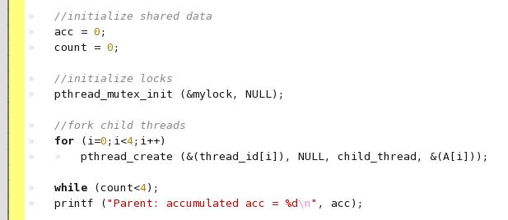

Demo: pthread_acc
initialize a lock

Slide 39
Demo: pthread_acc
initialize a lock
the lock variable

Slide 40
Demo: pthread_acc
initialize a lock
initializing the lock

Slide 41
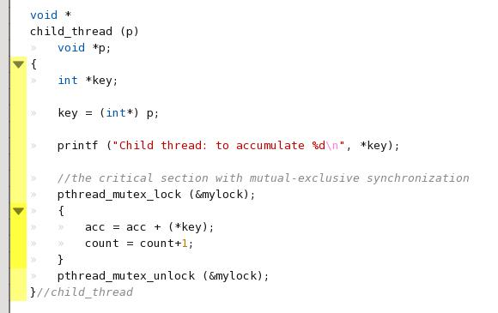
Demo: pthread_acc
the critical section

Slide 42
Demo: pthread_acc
the critical section
the critical section

Slide 43
Demo: pthread_acc
create threads and pass parameters
create threads

Slide 44
Lab 05
write a dot-product with pthread
you may modify from pthread_acc
Estimate the execution time and compare to sequential execution

