Slide 1
Network Programming
Lecture 11
the socket API of UNIX

Slide 2
Today’s Objective
help you prepare background to do
  network programming
  Internet service programming
the goal:
  learn how to use UNIX socket API

Slide 3
Introduction to network computing

Slide 4

What is network computing
do a parallel job with a network of computers
matrix multiplication
interconnection network (ethernet, etc.)

Slide 5
What is network computing
cluster computing
  a network of workstations with a single system image
grid computing
  a cluster where computing nodes are
    spread in wide area
    un-trust each other
cloud computing?

Slide 6
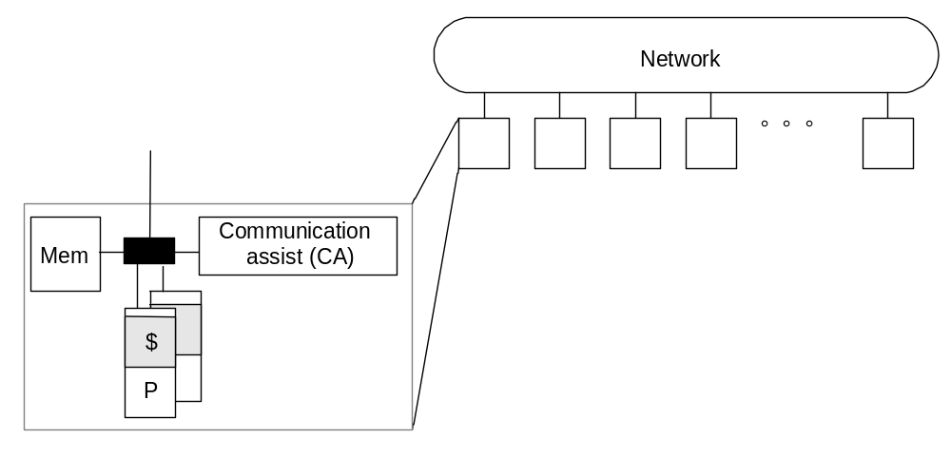
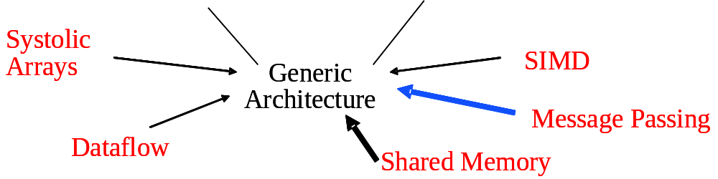
Why network computing
history of parallel architecture evolution
fast memory access & reduce bandwidth requirement
low-cost and easily available
modular scale-up

Slide 7
Representative clusters
Google
Berkeley NOW project (http://now.cs.berkeley.edu/)
IBM SP/2 and Deep-blue,
IBM BlueGene
Virginia Tech SystemX (http://www.arc.vt.edu/arc/SystemX/index.php)
NFS service on Linux

Slide 8
How the UNIX realizes network computing and services
an overview on system hierarchy

Slide 9
OSI protocol stack
application
presentation
session
application
transport
transport
network
network
data link
data link
physical

Slide 10
Protocol stack for UNIX network services
user-mode process
(e.g. telnet, httpd)
user-mode process
TCP
(Transmission Control Protocol)
UDP
(User Datagram Protocol)
transport layer
IP
(Internet Protocol)
network layer
hardware
interface
data-link layer
Kernel

Slide 11
System hierarchy to realize network computing
user-mode process
user-mode process
application program
application program
OpenMP
PVM
MPI
OpenMP
PVM
MPI
Workstation 1
Workstation 2
socket
socket
TCP/IP
protocol
TCP/IP
protocol
Kernel
Kernel
network
driver
network
driver
network

Slide 12
Overview on socket API

Slide 13
What is a socket?
“natural or artificial hollow into which something fits or in which something turns”, from Oxford dictionary
application on
workstation 1
network & protocols
application on
workstation 1
socket
socket
the kernel deals with it for you

Slide 14
Protocol stack view of a socket
user-mode process
user-mode process
application program
application program
OpenMP
PVM
MPI
OpenMP
PVM
MPI
Workstation 1
Workstation 2
socket
socket
TCP/IP
protocol
TCP/IP
protocol
Kernel
Kernel
network
driver
network
driver
network

Slide 15
How an application sends/receives data thru network
The same to file access!
int fd;
…
//socket setup
…
write (fd, “hello!”,…);
int fd;
…
//socket setup
…
read (fd, buf,…);
network & protocols
(TCP/IP)
socket
socket

Slide 16
Socket programming example
a client/server program through TCP/IP

Slide 17
Demo: net_server
client
server
int fd;
…
//socket setup
…
write (fd, “hello!”,…);
int fd;
…
//socket setup
…
read (fd, buf,…);
network & protocols
(TCP/IP)
socket
socket

Slide 18
Flow to establish client/server connection
socket ()
socket ()
bind ()
listen ()
Server
connect ()
Client
accept ()
write ()
read ()
process request
write ()
read ()

Slide 19
What you need to know
create a socket
setting up address
the server side setup: bind (), listen (), connect ()
the client side operation: connect ()

Slide 20
Creating a socket

Slide 21
Socket system call
int socket (domain, type, protocol)
determines which protocol
behind the socket
application on
workstation 1
network & protocols
application on
workstation 1
socket
socket

Slide 22
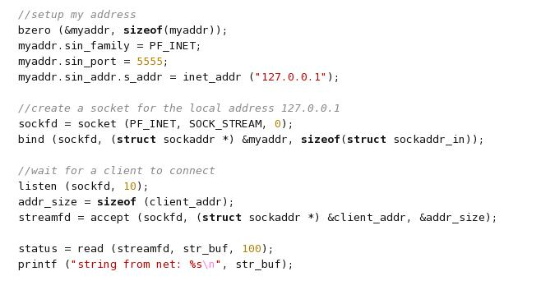
Socket system call
application on
workstation 1
TCP/IP
socket

Slide 23
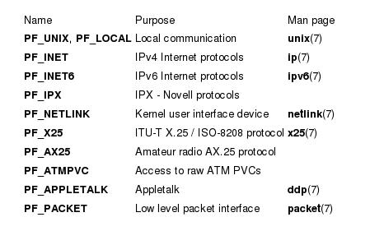
Socket domains

Slide 24
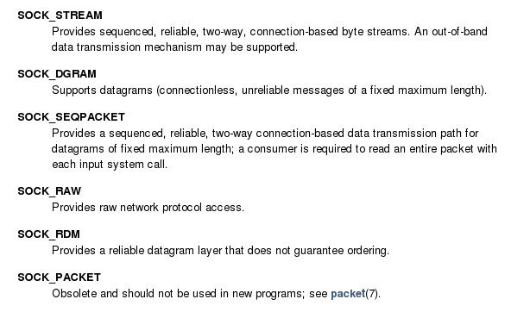
Socket types

Slide 25
Internet address format

Slide 26

General address format for a socket
address
sa_family
address (protocol dependent)
4-byte integer to indicate protocol family

Slide 27
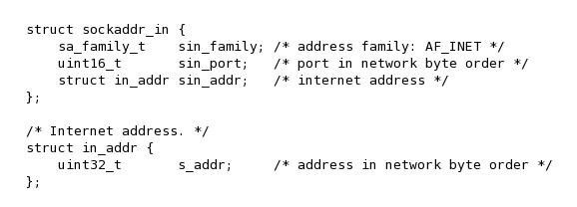
Address format for IPv4
address
sa_family
port#
address (e.g. 163.25.101.86)
4-byte integer to indicate the port number
4-byte integer to indicate protocol family
(special code to indicate TCP/IP)

Slide 28
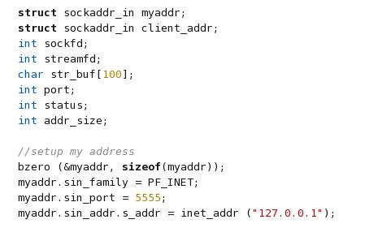
Address setup for Internet domain

Slide 29
bind system call and IP-address setup
setup address

Slide 30
Transform address
“man inet_addr” for more functions

Slide 31
The server side

Slide 32
Flow to establish client/server connection
socket ()
socket ()
bind ()
listen ()
Server
connect ()
Client
accept ()
write ()
read ()
process request
write ()
read ()

Slide 33
Bind system call
to “bind” a socket to “listen” to some port of some address
  e.g. 163.25.101.86, port 5555
Usage:
  bind (socket_id, *ip_address, address_size)

Slide 34
bind system call and IP-address setup
setup address
bind the server port and address

Slide 35
Listen and accept a connection
Note: use different file-descriptor to read/write

Slide 36
Listen and accept a connection
system call listen:
  listen (socket_id, buffer_size)
accept a connection:
  file_descriptor = accept (socket_id, *addr, addr_size)
  access through the returned file_descriptor like accessing a file!

Slide 37
The client side

Slide 38
Flow to establish client/server connection
socket ()
socket ()
bind ()
listen ()
Server
connect ()
Client
accept ()
write ()
read ()
process request
write ()
read ()

Slide 39
System call connect
Usage:
  connect (socket_fd, *address, address_size)
the file descriptor socket_fd on client side can be used by read()/write() like accessing a file

Slide 40
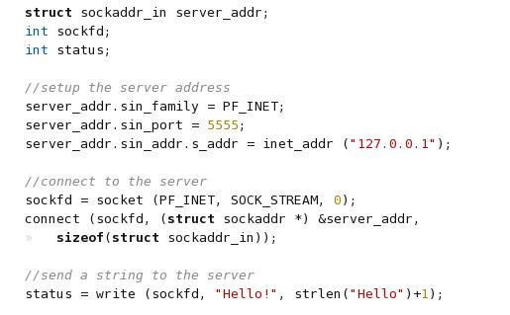
Connect to the server

Slide 41
In-Class Exercise
Modify the net_server program to send strings between 2+ computers

Slide 42
The End

