Slide 1
Introduction to Parallel Programming
Lecture 10

Slide 2
What’s today’s talk for
An introduction to
  Chap. 11: “Threads”
  Chap. 12: “Thread Control”
  Chap. 15: “Inter-process Communication”
  Chap. 16: “Network IPC: Sockets”
  Chap. 6 of OS textbook: “Synchronization”

Slide 3

What is parallel computing
do a job with 2+ processors
single processor
multi-processors

Slide 4
What is a Parallel System?
A parallel computer is a collection of processing elements that cooperate to solve large problems fast
Examples
  IBM Deep Blue
  Google
  Sony Play Station 3
  Cell Phone

Slide 5
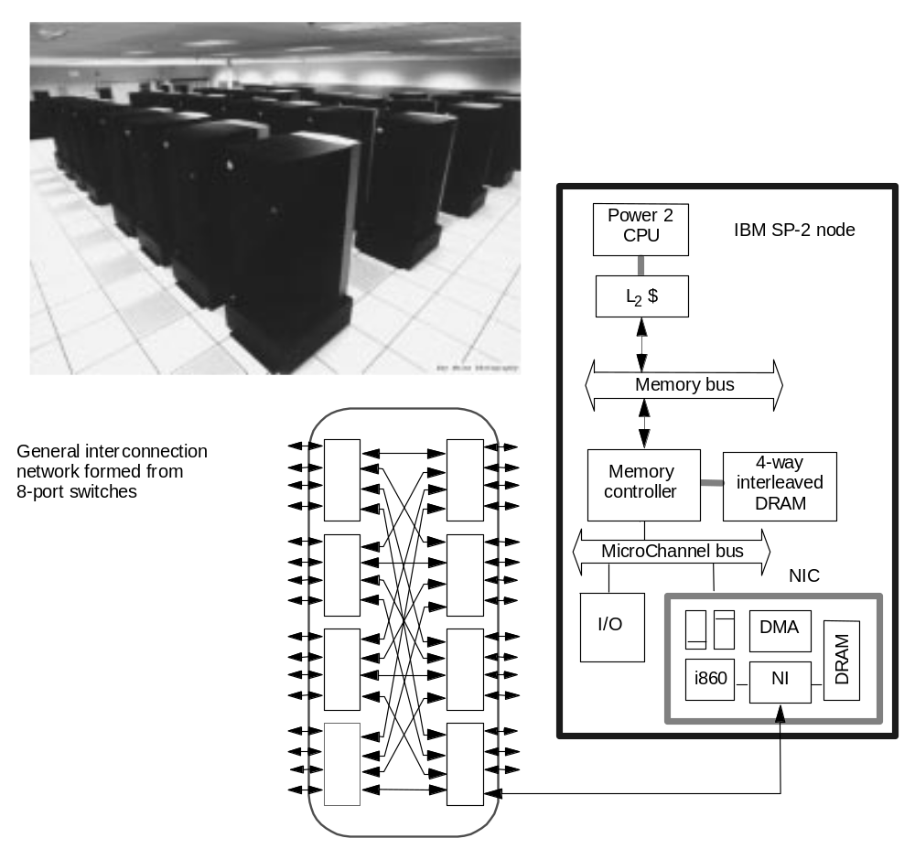
Paradigm: IBM SP-2 Cluster
Made out of essentially complete RS6000 workstations
Network interface integrated in I/O bus
The Chess Play Machine

Slide 6
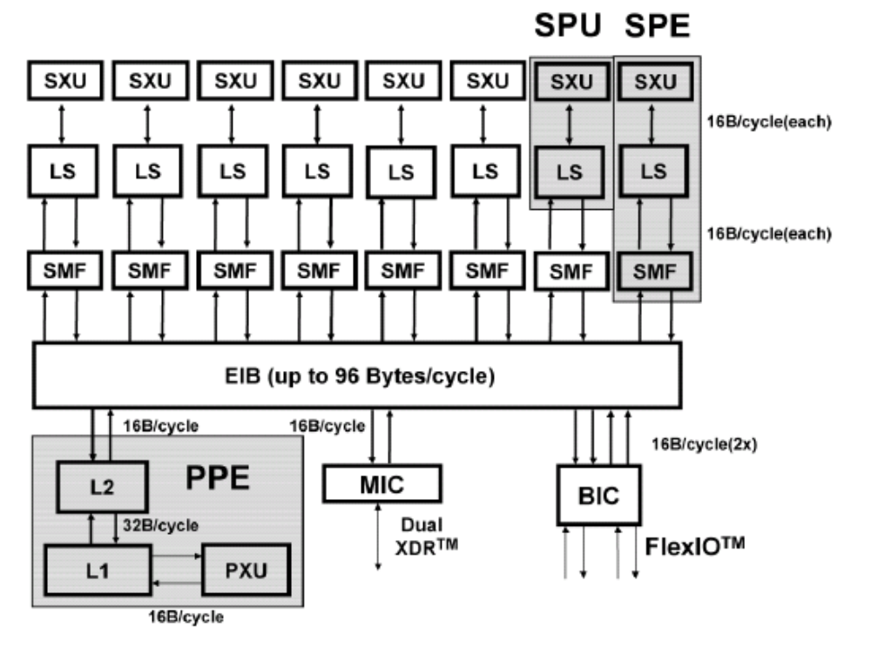
IBM Cell Processor for SONY PlayStation/3

Slide 7
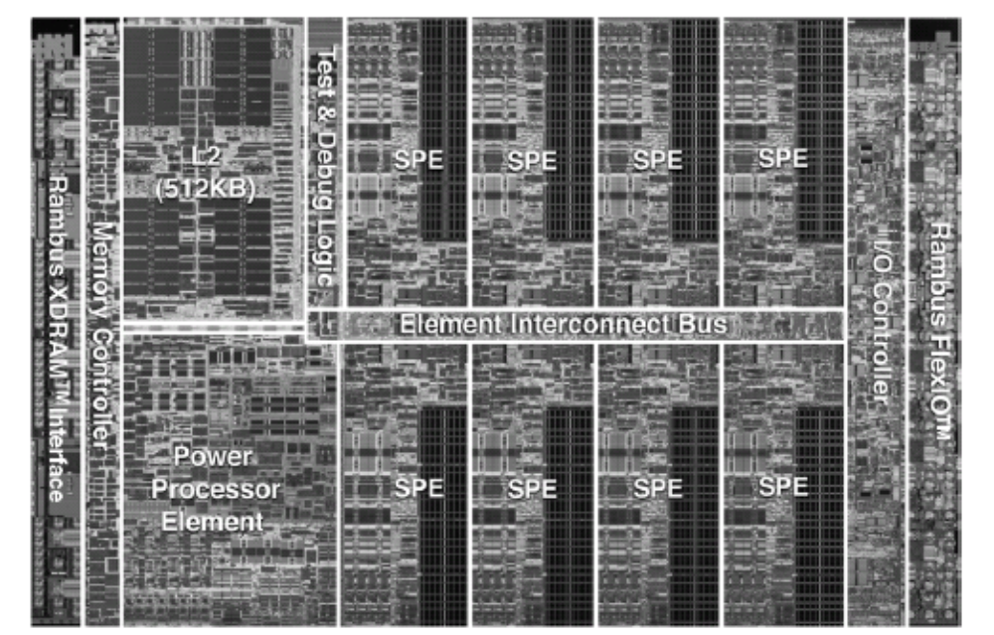
IBM Cell Processor

Slide 8
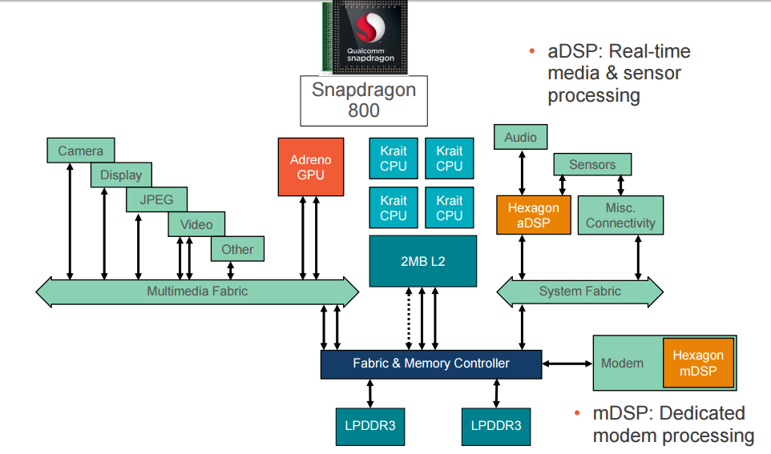
Qualcomm Snapdragon SoC for Mobile Phone

Slide 9
Style of parallel programming
shared memory vs. message passing

Slide 10
Shared Memory Programming Model
CPU 1
CPU 2
…
CPU n
memory

Slide 11
Shared Memory Programming Model
from the tradition of multi-programming
Virtual address spaces for a
collection of processes communicating
via shared addresses
Machine physical address space
P
n
p
r
i
v
a
t
e
L
o
a
d
P
n
Common physical
addresses
P
P
2
P
1
0
S
t
o
r
e
P
p
r
i
v
a
t
e
Shared portion
of address space
2
Private portion
of address space
P
1
p
r
i
v
a
t
e
P
0
p
r
i
v
a
t
e

Slide 12
Message Passing Model
CPU 1
CPU 2
…
CPU n
Network

Slide 13
Message Passing Programming Model
Match
Receive
Y
,
P
,
t
Send
X, Q, t
Addr
ess
Y
Addr
ess
X
Local pr
ocess
Local pr
ocess
addr
ess space
addr
ess space
Pr
ocess
P
Pr
ocess
Q

Slide 14
Difficulty of writing a parallel program
communication and synchronization

Slide 15
What is parallel computing
Q: Do you believe that parallel computing always doing job faster?
single processor
multi-processors

Slide 16
Recap: what the OS has taught you
Chap. 6 of your OS text book
  titled “Synchronization”
parallel process synchronization
critical section for mutual exclusive
semaphore

Slide 17
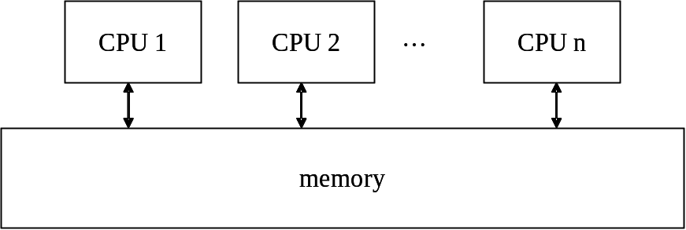
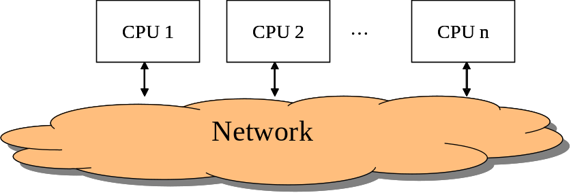
Difficulty on parallel computing
processors get blocked when exchanging data

Slide 18
Synchronization
the major difficulty to parallel programming

Slide 19
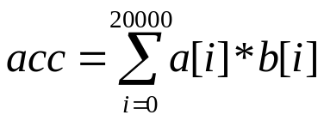
A program with bug
doing dot-product with two processes
Proc. 1
Proc. 2
mysum = 0;
for (i=0;i<10000;i++)
mysum += a[i]*b[i];
acc += mysum;
mysum = 0;
for (i=10000;i<20000;i++)
mysum += a[i]*b[i];
acc += mysum;
acc
shared memory

Slide 20
A program with bug (cont’d)
Detailed view: the trace of two processes
P0
P1
...
...
/* mysum == 5 */
/* mysum == 10 */
acc = acc + mysum;
acc = acc + mysum;

Slide 21
A program with bug (cont’d)
Detailed view: the trace of two processes
P0
P1
...
...
/* mysum == 5 */
/* mysum == 10 */
acc = acc + mysum;
acc = acc + mysum;
/* R0 == mysum == 5 */
R1 = mem [Acc] //load
R2 = R1 + R0
mem[Acc] = R2 //store

Slide 22
A program with bug (cont’d)
Detailed view with assembly
P0
P1
/* R0 == mysum == 5 */
/* R0 == mysum == 10 */
R1 = mem [acc];
R1 = mem [acc];
R2 = R1 + R0;
R2 = R1 + R0;
trace
mem[acc] = R2;
mem[acc] = R2;

Slide 23
A program with bug (cont’d)
With timing
P0
P1
/* R0 == mysum == 5 */
/* R0 == mysum == 10 */
R1 = mem [acc];
R2 = R1 + R0;
time
mem[acc] = R2;
correct answer
acc=15
obtained
R1 = mem [acc];
R2 = R1 + R0;
mem[acc] = R2;

Slide 24
A program with bug (cont’d)
With timing
P0
P1
/* R0 == mysum == 5 */
/* R0 == mysum == 10 */
R1 = mem [acc];
time
R1 = mem [acc];
R2 = R1 + R0;
R2 = R1 + R0;
incorrect answer
acc=10
obtained
mem[acc] = R2;
mem[acc] = R2;

Slide 25
A program with bug (cont’d)
With timing
P0
P1
/* R0 == mysum == 5 */
/* R0 == mysum == 10 */
R1 = mem [acc];
time
R1 = mem [acc];
R2 = R1 + R0;
R2 = R1 + R0;
incorrect answer
acc=5
obtained
mem[acc] = R2;
mem[acc] = R2;

Slide 26
The correct program
Proc. 1
Proc. 2
mysum = 0;
for (i=0;i<10000;i++)
mysum += a[i]*b[i];
lock (L);
acc += mysum;
unlock (L);
mysum = 0;
for (i=10000;i<20000;i++)
mysum += a[i]*b[i];
lock (L);
acc += mysum;
unlock (L);
acc
shared memory

Slide 27
The correct program
Proc. 1
Proc. 2
mysum = 0;
for (i=0;i<10000;i++)
mysum += a[i]*b[i];
lock (L);
acc += mysum;
unlock (L);
mysum = 0;
for (i=10000;i<20000;i++)
mysum += a[i]*b[i];
lock (L);
acc += mysum;
unlock (L);
critical
section
acc
shared memory

Slide 28
The correct program
Proc. 1
Proc. 2
mysum = 0;
for (i=0;i<10000;i++)
mysum += a[i]*b[i];
lock (L);
acc += mysum;
unlock (L);
mysum = 0;
for (i=10000;i<20000;i++)
mysum += a[i]*b[i];
lock (L);
acc += mysum;
unlock (L);
blocked here until
proc.1 unlock
executing
acc
shared memory

Slide 29
The timing
time
…
//local compute
…
LOCK (L);
acc += mysum;
UNLOCK (L);
p0
local compute
+acc
p1
local compute
+acc
p2
local compute
+acc
p3
local compute
+acc
synchronization
wait time of p3

Slide 30
UNIX support for parallel programming
IPC with shared memory (Chap.15)
semaphore for mutual exclusive (Chap. 15)
message queue (Chap. 15)
multi-thread library (pthread) (Chap. 11, 12)

