Slide 1
UNIX Architecture
Lecture 03
What services the OS provides to the programmer

Slide 2
Today’s Goal
UNIX architecture and service overview
  a global image for you to write a program through out this semaster

Slide 3
Today’s material comes from
Chap. 1 of [Stevens]
Chap. 3 & 4 of your OS textbook [Silberschatz]
  Chap. 3: operating system structure
  Chap. 4: processes

Slide 4
What an OS provides?

Slide 5
What services UNIX provides
(the textbook version)
program execution
user protection
  user ID, group ID, file permissions
file management
I/O device control
process/thread management and parallel programming support
networking
Why these services?

Slide 6
What an OS should provides?
for general users: ease to run application programs
for programmers: ease of programming over all hardware resources
security and users protection

Slide 7
What an OS should provides?
for general users: ease to use application programs
  program execution support (shell, command interpreter)
  GUI (Graphics User Interface)
    X-windows (on UNIX)
    M$-Windows
for programmers: ease of programming over all hardware resources
security and users protection

Slide 8
What an OS should provides?
for general users: ease to use application programs
for programmers: ease of programming over all hardware resources
  manage CPUs and processes/threads scheduling
  memory and storage devices management (e.g. virtual memory, file system, etc.)
  API (application programmer interfaces) to I/O devices
security and users protection

Slide 9
What an OS should provides?
for general users: ease to use application programs
for programmers: ease of programming over all hardware resources
security and users protection
  access permission for files, I/O devices for multi-users
  network security

Slide 10
In-Class Exercise
(1) create another account, say user2
(2) trying to read a file in /home/user2
  should be not able to read
(3) do the following: (login as user2)
  chmod 777 /home/user2
  cd /home/user2
  chmod 666 /home/user2/test.c (the file to read)
(4) login as user1 and read /home/user2/test.c

Slide 11
How the OS provides its services
the UNIX architecture overview

Slide 12
UNIX Architecture
Hardware support: user mode and privilege mode
run in user mode
application processes
library
shell
X-window
run in
privilege mode
system call
software
Operating System (Kernel)
CPU
memory
hard disk
optical
disk
USB port
terminal
I/O
hardware

Slide 13
Execution modes supported by CPU
CPU hardware has to support two execution modes
  Privileged (kernel) mode: to execute the OS
    everything the hardware can do
  User mode: to execute application program
    no I/O operation and low-level hardware control

Slide 14
UNIX Architecture
You cannot access the disk using assembly with direct I/O control
run in user mode
application processes
library
shell
X-window
system call
software
Operating System (Kernel)
CPU
memory
hard disk
optical
disk
USB port
terminal
I/O
hardware

Slide 15
UNIX Architecture
How should I access the disk?
call the OS to do it for you
through system call (e.g. write ())
run in user mode
application processes
The OS executes low-level I/O operation to do the disk access for you
library
shell
X-window
privileged mode
system call
software
Operating System (Kernel)
CPU
memory
hard disk
optical
disk
USB port
terminal
I/O
hardware

Slide 16
UNIX Architecture: from the view point of a single program
application code:
main() {
…
p = malloc (sizeof(struct tt));
}
memory allocation
(malloc)
library function
system call
OS kernel
sbrk

Slide 17
Basic concepts of a process

Slide 18
What an OS should provides?
for general users: ease to use application programs
for programmers: ease of programming over all hardware resources
  manage CPUs and processes/threads scheduling
  memory and storage devices management (e.g. virtual memory, file system, etc.)
  API (application programmer interfaces) to I/O devices
security and users protection

Slide 19
What services UNIX provides
application processes
process/thread control and scheduling
communication and synchronization
fork, wait, signal, pthread_mutex_lock, pthread_mutex_unlock
library
shell
X-window
system call
Operating System (Kernel)
CPU
memory
network
hard disk
optical
disk
USB port
terminal
I/O

Slide 20
What is a process
an instance of program been executed
  process ID
  it’s own virtual memory space
  files opened, I/O devices accessed, etc.
  …and a lot…
there may be 2 or more processes corresponding to the same program
Example:
  run an infinite-loop program
  find out what a process is in “top”

Slide 21
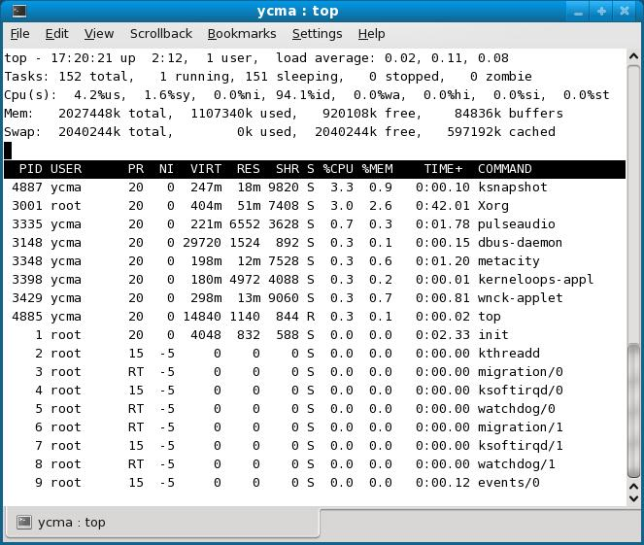
Attributes of a process

Slide 22
Attributes of a process
PID: the process ID

Slide 23
Attributes of a process
USER: owner of this process

Slide 24
Attributes of a process
parameters about process scheduling
PR: priority
NI: nice value

Slide 25
Attributes of a process
virtual memory size of this process

Slide 26
Attributes of a process
size of physical memory used by this process

Slide 27
Attributes of a process
shared memory size
(an IPC mechanism)

Slide 28
Attributes of a process
state of the process

Slide 29
Process scheduling and management of CPUs (1)
what the OS textbook tells you

Slide 30
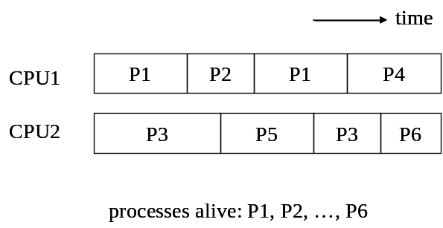
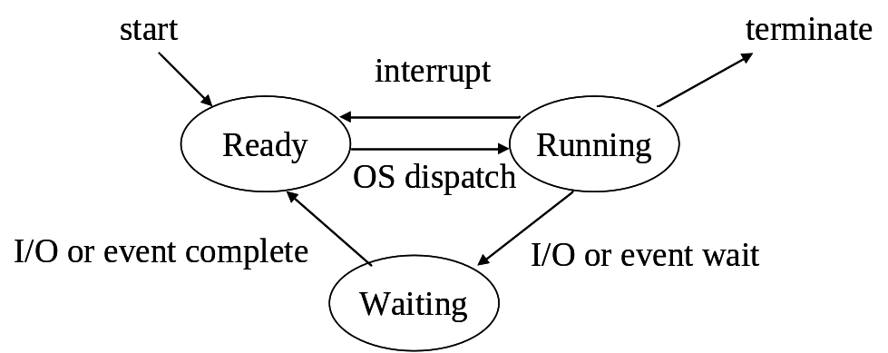
What the OS does to manage your CPUs and processes
executing processes with time-sharing scheme
a process may be in one of these states

Slide 31
Time sharing
the OS schedules a set of processes to run on CPUs
at any time, only one process is running on an CPU
time
CPU1
P1
P2
P1
P4
CPU2
P3
P5
P3
P6
processes alive: P1, P2, …, P6

Slide 32
States of a process
start
terminate
interrupt
Ready
Running
OS dispatch
I/O or event complete
I/O or event wait
Waiting

Slide 33


Process scheduling with states
Consider process P1

Slide 34
Process scheduling with states
P1 in running state and occupies a CPU

Slide 35
Process scheduling with states
P1 enters Waiting/Ready state due to
  OS schedules, or
  waiting for an I/O

Slide 36
Process scheduling with states
P1 enters Waiting/Ready state due to
  OS schedules, or
  waiting for an I/O
Preemptive

Slide 37
Process scheduling with states
P1 re-gains the CPU due to
  OS schedules, or
  waiting for an I/O

Slide 38
Process scheduling and management of CPUs (2)
Let’s see a concrete example on Linux

Slide 39
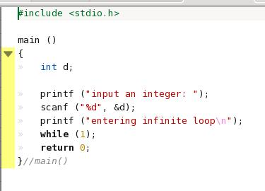
Example program
Let’s trace how the process state transfers with this program

Slide 40
Example program
(1) At initial, the process is running

Slide 41
Example program
(2) Transfer to waiting state while waiting the user input from the keyboard

Slide 42
Example program
(3) Transfer to Ready state after the user inputs something from the keyboard

Slide 43
Example program
(4) Regain the CPU after the OS picks it up

Slide 44
Example program
Let’s have a trial on Linux
  demo/infinite_loop/demo2.c

Slide 45
More on the process
inter-process communication
process creation
Let’s explain other services of OS first

Slide 46
How the OS manages memory and storage devices

Slide 47
What an OS should provides?
for general users: ease to use application programs
for programmers: ease of programming over all hardware resources
  manage CPUs and processes/threads scheduling
  memory and storage devices management (e.g. virtual memory, file system, etc.)
  API (application programmer interfaces) to I/O devices
security and users protection

Slide 48
What services UNIX provides
application processes
library
shell
X-window
virtual memory
sbrk
system call
Operating System (Kernel)
CPU
memory
network
hard disk
optical
disk
USB port
terminal
I/O

Slide 49
What is virtual memory
a mechanism provided by OS+CPU
Purpose:
  let a program has individual memory space, not interfere with others
  let you write a program larger than the size of physical memory
Program
(2GB)
physical
memory
(1GB)

Slide 50
The magic of virtual memory
use RAM + hard disk to run your program
  RAM + hard disk > program size
swap in currently required part
swap out currently not required part
physical memory
(RAM)
CPU
swap in
your program
swap out

Slide 51
Check the virtual memory setup of your Linux
try command “top”
you can setup the size of swap space at install (setup disk partition)

Slide 52
Check the virtual memory setup of your Linux
size of the physical memory

Slide 53
Check the virtual memory setup of your Linux
size of the swap space

Slide 54
Attributes of a process
virtual memory size of this process

Slide 55
Attributes of a process
size of physical memory used by this process

Slide 56
Example program for virtual memory
demo/infinite_loop/vmem.c
  a program accessing an arry of 2GB size
  to execute on my laptop with only 1GB RAM
Remark: create the swap space if your system does not have
  dd if=/dev/zero of=swap_space.swap bs=1024 count=10240234
  mkswap swap_space.swap
  swapon swap_space.swap

Slide 57
How UNIX manages networking and I/O devices

Slide 58
What services UNIX provides
application processes
library
shell
X-window
socket, connect, bind,…
system call
Operating System (Kernel)
CPU
memory
network
hard disk
optical
disk
USB port
terminal
I/O

Slide 59
What services UNIX provides
I/O devices are accessed like files
application processes
open, read, write, fcntl, …
library
shell
X-window
system call
Operating System (Kernel)
CPU
memory
network
hard disk
optical
disk
USB port
terminal
I/O
I/O devices

Slide 60
How the OS provides security and protection

Slide 61
What an OS should provides?
for general users: ease to use application programs
for programmers: ease of programming over all hardware resources
security and users protection
  access permission for files, I/O devices for multi-users
  network security

Slide 62
Example of security and protection
trying to access other ones file
  check the file permission

Slide 63
UNIX provides protection through system call
system call: a special function call provided by OS
all hardware resources can only be accessed through system calls
the system call checks for access permission
application processes
library
shell
X-window
system call
software
Operating System (Kernel)
CPU
memory
hard disk
optical
disk
USB port
terminal
I/O
hardware

Slide 64
More on process
How to create a new process and execute a program
The IPC (inter-process communication)

Slide 65
Processes may also communicate like accessing files
main ()
{
…
fd = open (“sample.fifo”, …);
write (fd,…);
…
}
main ()
{
…
fd = open (“sample.fifo”, …);
read (fd, …);
…
}
FIFO
(pipe)
Process 1
Process 2

Slide 66

A simple exercise on using FIFO
Step 1: execute command
  mkfifo test.fifo
Step 2: open a terminal and execute command
  cat test.fifo
Step 3: open another terminal and execute command
  cat text_file.txt > test.fifo
cat text_file.txt
cat test.fifo

Slide 67
How to create a new process?
fork and generate a process with identical content
Parent Process
Child Process
pid = fork ();
if (pid==0) {//child process
execlp (filename, filename, (void*)0);
printf (“Error if you see this line\n”);
}
else { //parent process
printf (“This is in parent process\n”);
}
pid = fork ();
if (pid==0) {//child process
execlp (filename, filename, (void*)0);
printf (“Error if you see this line\n”);
}
else { //parent process
printf (“This is in parent process\n”);
}
fork
identical copy to the parent process

Slide 68
How to create a new process? (cont’d)
But different PID results in different execution path
Parent Process
Child Process
pid = fork ();
if (pid==0) {//child process
execlp (filename, filename, (void*)0);
printf (“Error if you see this line\n”);
}
else { //parent process
printf (“This is in parent process\n”);
}
pid = fork ();
if (pid==0) {//child process
execlp (filename, filename, (void*)0);
printf (“Error if you see this line\n”);
}
else { //parent process
printf (“This is in parent process\n”);
}
Program Counter

Slide 69
How to create a new process? (cont’d)
The child process executes an exec() system call to refill its content
Child Process
pid = fork ();
if (pid==0) {//child process
execlp (filename, filename, (void*)0);
printf (“Error if you see this line\n”);
}
else { //parent process
printf (“This is in parent process\n”);
}
main(){
printf (“I am the new program\n”);
return 0;
}
exec

Slide 70
A simple exercise
What will happen?
  while (1) {
    fork ();
  }

Slide 71
Next Lecture
Basic file operations
  Chap. 3 of [Stevens]
Remark: History of UNIX skipped (Chap. 2)
  various versions of UNIX and compatibility issues
  in simple words: see man before you use a function/command/system call

Slide 72
Open Problem
Does an embedded device (e.g. cell phone) need a protected-mode OS?
Trend on embedded OS (RTOS) research
  embedded Linux
  uCOS
  TinyOS (UC-Berkeley)

