Slide 1
Signals and the Timer
Lecture 07

Slide 2
Signals and Timer
the driving example: alarm

Slide 3
Driving application: the Alarm
$> myalarm 11:50 &
It is 11:40 now and I will wake you up at 11:50
$>
Wakeup! It is 11:50 now
$>
display at 11:50
Not consuming CPU time during waiting

Slide 4
What you need to know
How a UNIX program receives hardware (the timer) interrupt?
concept of “signal”
How a UNIX program knows what time it is?
How the UNIX represents time?

Slide 5
Basic concepts of “signal”
an inter-process communication mechanism in UNIX

Slide 6
What is a signal?
to interrupt the normal execution of a process
terminate the process, or
turn to do something exceptional and return to normal execution

Slide 7
Terminate the execution of a process
process ID 1234
$> kill -9 1234
main ()
{
…
while (1);
}
send signal No. 9
to process 1234
PC

Slide 8
Interrupt normal execution and then return
process ID. 1234
main()
{
while (…) {
…
//normal execution
…
}
}
sig10_handler ()
{
printf (“I got signal 10\n”);
}
$> kill -10 1234
send signal No. 10
to process 1234
PC

Slide 9
List of signal numbers
please “man 7 signal”

Slide 10
How to send a signal to a process
command
kill –signo proc_id
system call
kill (signo, proc_id);

Slide 11
How to setup a signal handler
a simple example

Slide 12
How to intercept an incoming signal
system call
signal (signo, handler);

Slide 13
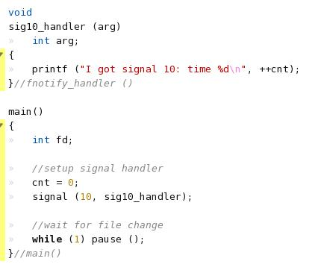
Demo: sig10

Slide 14
Demo: sig10
the signal handler function
register the signal handler

Slide 15
Demo: sig10
ready
run
wait
system call to cause a process sleep

Slide 16
In-Class Exercise
Write a program that CTRL-C cannot kill
Hint: modify the sig10 demo
Hint: check “man 7 signal”

Slide 17
How a user-level program receives hardware interrupt
timer as an example

Slide 18
Let user process receiving timer interrupt
main () {
alarm (10);
}
sigalarm_handler (){
printf (“It is time now”);
}
User process
signal
alarm()
Kernel
timer
control
interrupt
handler
Hardware
CPU
counter
interrupt

Slide 19
Let user process receiving timer interrupt
wake me up 10 sec. latter
main () {
alarm (10);
}
sigalarm_handler (){
printf (“It is time now”);
}
User process
signal
alarm()
Kernel
timer
control
interrupt
handler
program the timer to send intterupt
Hardware
CPU
counter
interrupt

Slide 20
Let user process receiving timer interrupt
main () {
alarm (10);
}
sigalarm_handler (){
printf (“It is time now”);
}
User process
signal
alarm()
Kernel
timer
control
interrupt
handler
time up!
Hardware
CPU
counter
interrupt

Slide 21
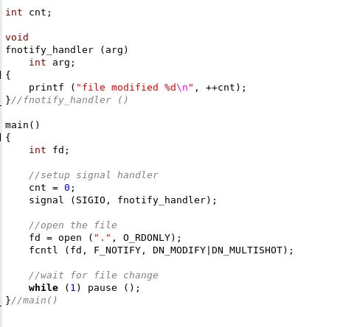
Review: register a signal handler
the signal handler function
register the signal handler

Slide 22
How to know what time it is

Slide 23
UNIX standard functions to get the time
convert to user friendly format
main () {
time_t sec;
struct tm *tm_rec;
time (&sec);
tm_rec = localtime (&sec);
}
User process
ctime ()
localtime ()
get #sec. since Epoch (1970-01-01)
time ()
Kernel
RTC
driver
Real Time Clock
RTC
Hardware

Slide 24
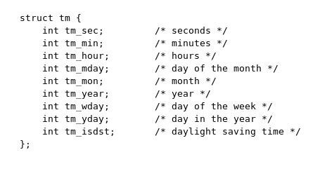
Struct tm

Slide 25
Appendix: How to access RTC hardware in Linux

Slide 26
Control the RTC hardware
main () {
struct rtc_time *tm;
…
fd = open (“/dev/rtc”, …);
ioctl (fd, RTC_RD_TIME, tm );
ioctl (fd, RTC_SET_TIME, tm);
…
}
User process
man rtc
/dev/rtc
Kernel
RTC
driver
RTC
Hardware

Slide 27
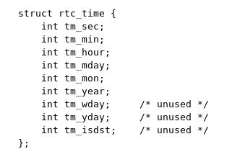
Struct rtc_time

Slide 28
How to watch a file with signal

Slide 29
Demo: f_notify
to get informed if some file in current directory has been modified

Slide 30
Demo: f_notify
Issues
register a signal handler
get informed when some file in a directory been modified
make a process sleep without consuming CPU time

Slide 31
Register a signal handler
the signal handler function
register the signal handler

Slide 32
Watch directory modification
use fcntl to get signal when some file in a directory modified

Slide 33
Question
How to get informed when a friend login?
not consuming CPU time
you cannot repeatedly check /var/run/utmp
Answer:
modify the f_notify demo to watch for the directory /var/run
check for new entries in /var/run/utmp

