Slide 1
Advanced File System Operations
Lecture 05
[Stevens] Chap. 4
[Silberschatz] Chap. 10

Slide 2
Goals
learn how to set/get all attributes of an entry in the file system
you need the knowledge of internal implementation of UNIX file system
HW03:
Count the number of lines for each file in a directory tree

Slide 3
Content Outline
file system services provided by OS
things that M$-WinXP users not familiar
multiple path to the same file
mount
I/O devices as files
internal structure of UNIX file system
the i-node

Slide 4
File system services provided by OS
Review of your OS textbook

Slide 5
File Attributes
Name – only information kept in human-readable form.
Type – needed for systems that support different types.
Location – pointer to file location on device.
Size – current file size.
Protection – controls who can do reading, writing, executing.
Time, date, and user identification – data for protection, security, and usage monitoring.
Information about files are kept in the directory structure, which is maintained on the disk.
everything you see with “ls –l”

Slide 6
File Operations
Create (create, open)
Write (write)
Read (read)
Reposition within file – file seek (lseek)
Delete (unlink)
Truncate (open with mode setting)
Open(F_{i}) – search the directory structure on disk for entry F_{i}, and move the content of entry to memory.
Close (F_{i}) – move the content of entry F_{i} in memory to directory structure on disk.

Slide 7
Directory structures
review of your OS textbook

Slide 8
Directory Structure
A collection of nodes containing information about all files.
Directory
Files
F 1
F 2
F 3
F 4
F n
Both the directory structure and the files reside on disk.
Backups of these two structures are kept on tapes.

Slide 9
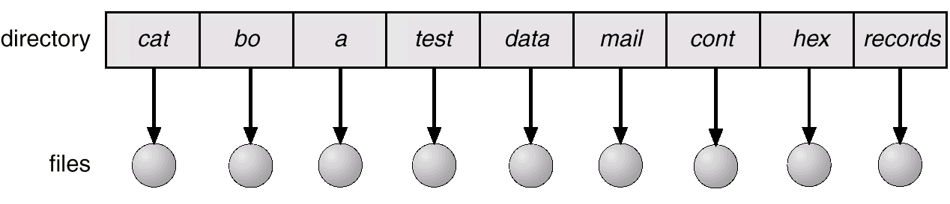
Single-Level Directory
A single directory for all users.
Naming problem
Grouping problem

Slide 10
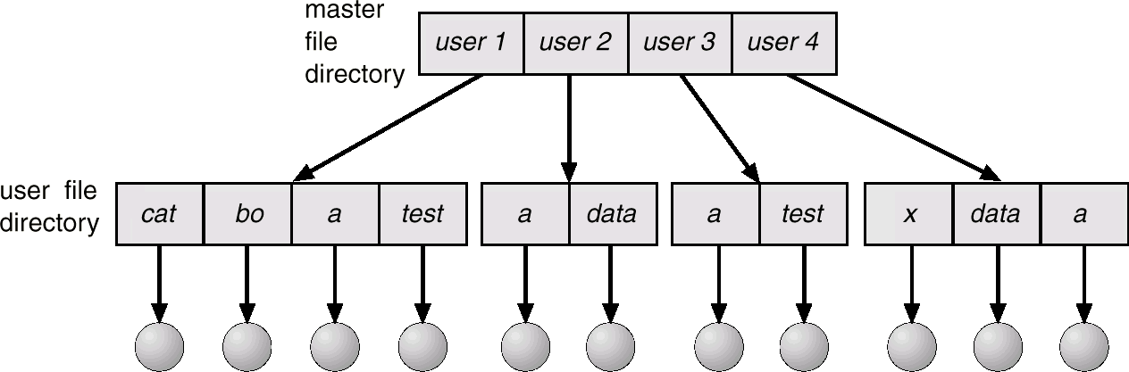
Two-Level Directory
Separate directory for each user.
Path name
Can have the same file name for different user
Efficient searching
No grouping capability

Slide 11
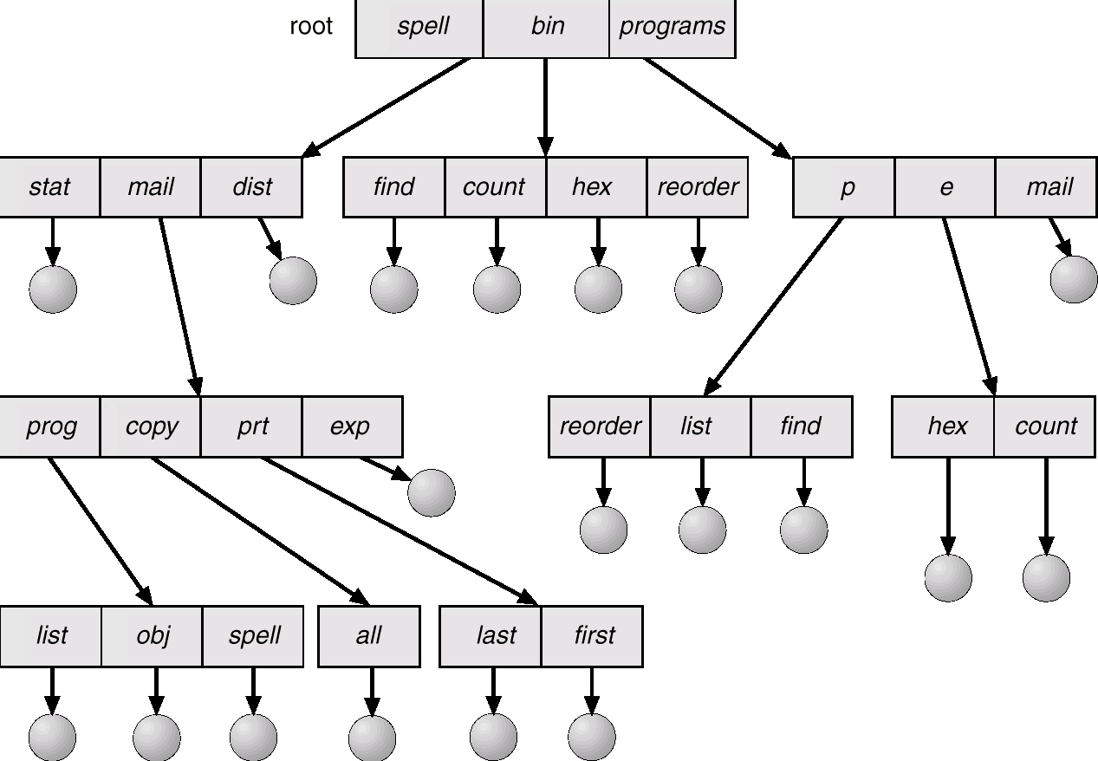
Tree-Structured Directories

Slide 12
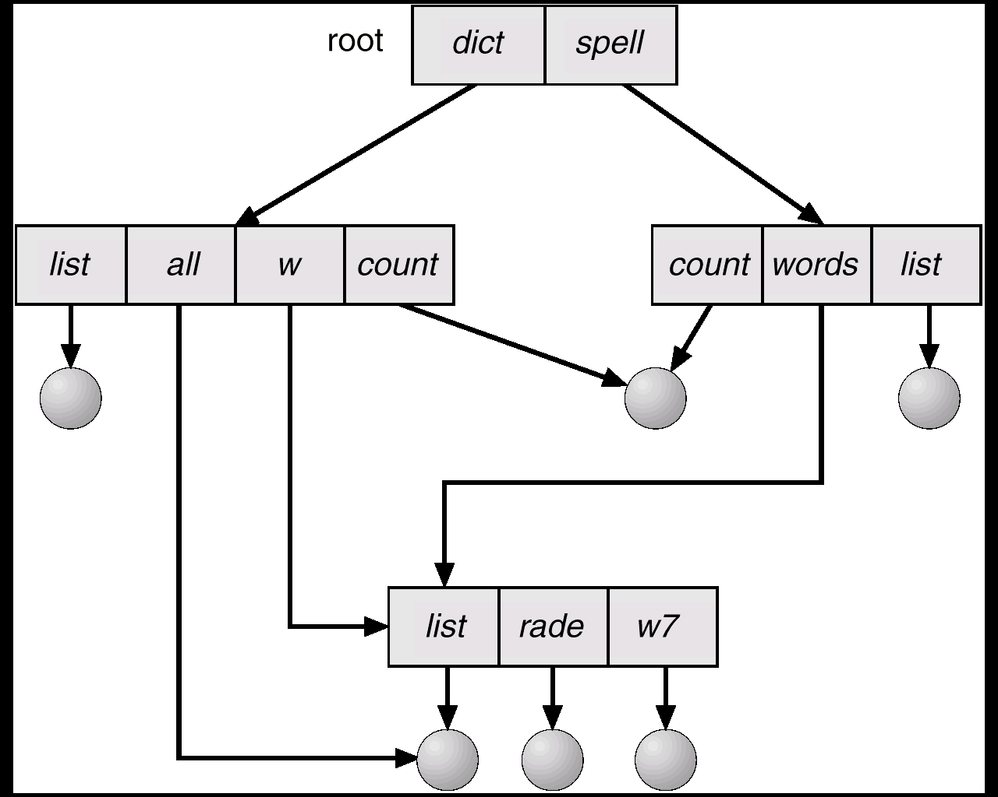
Acyclic-Graph Directories
Have shared subdirectories and files.

Slide 13
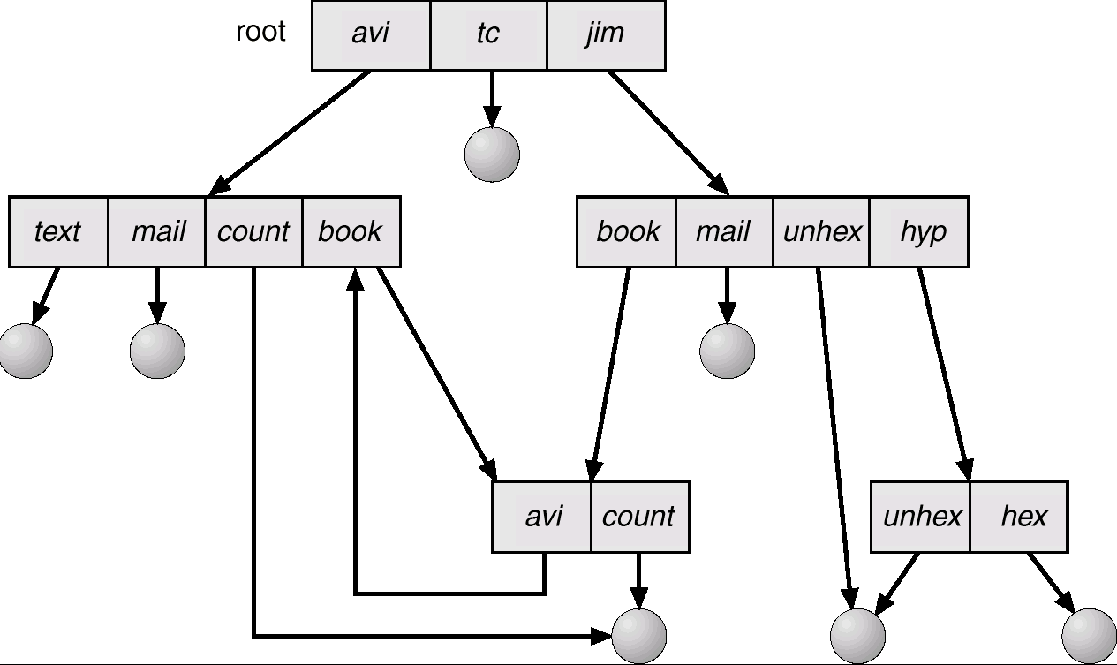
General Graph Directory

Slide 14
Question:
Which type of directory structure that UNIX use?
single-level?
tree?
acyclic graph?
general graph?

Slide 15
Features that WinXP users not familiar
mounting a file system
Multiple pathname to refer to the same file
link, unlink, and symbolic link
I/O devices as a file
/dev/hda0, /dev/tty1, etc.

Slide 16
Mount

Slide 17
File System Mounting
A file system must be mounted before it can be accessed.
A unmounted file system (i.e. Fig. 11-11(b)) is mounted at a mount point.

Slide 18
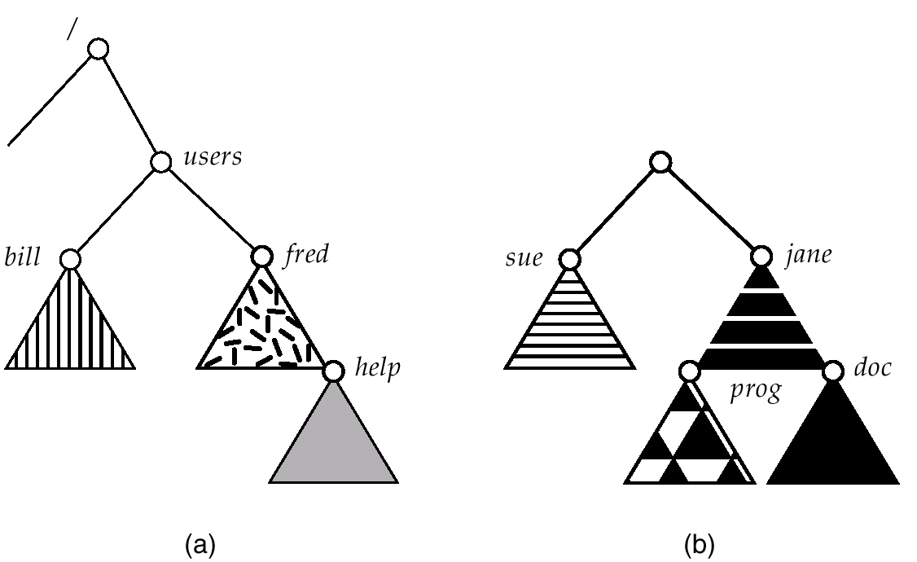
(a) Existing. (b) Unmounted Partition

Slide 19
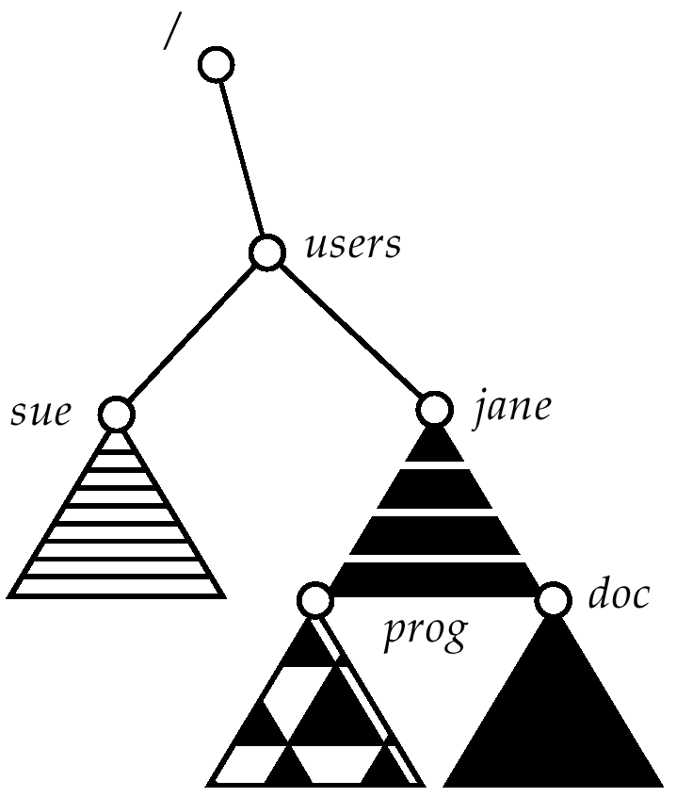
Mount Point

Slide 20
In-Class Exercise
plug-in your USB flash disk
do this as root:
create an empty directory /media/usb_flash
command “mount /dev/sda2 /media/usb_flash”
you may need to name another device rather than /dev/sda2
check the content in the directory /media/usb_flash
command “df” to see what happened
command “umount /media/usb_flash”

Slide 21
Multiple path referring to the same file

Slide 22
Features that WinXP users not familiar
mounting a file system
Multiple pathname to refer to the same file
link, unlink, and symbolic link
I/O devices as a file
/dev/hda0, /dev/tty1, etc.

Slide 23
Multiple pathname to refer to the same file
refer to the same file
/home/username/dir1/test.txt
…
…
…
/home/username/dir2/clone.txt
try to edit clone.txt and then display the content of test.txt

Slide 24
In-Class Exercise
create a file /home/username/dir1/test1.txt
in another directory /home/username/dir2
ln /home/username/testdir1/test1.txt clone.txt
modify one and read from another
trying to remove one and check if another exists

Slide 25
Symbolic link
in directory /home/username/dir2
ln –s /home/username/dir1/test.txt clone.txt
see what happened by “ls –l”
see what happened if you remove /home/username/dir1/test.txt
refer to the same file
/home/username/dir1/test.txt
…
…
…
/home/username/dir2/clone.txt

Slide 26
Question:
Which type of directory structure that UNIX use?
single-level?
tree?
acyclic graph?
general graph?
Answer: general graph!

Slide 27
In-Class Exercise
do this as “root”:
mkdir dir1
cd dir1
mkdir dir2
cd dir2
ln –s ../../dir1 .
you just created a directory structure with a cycle!
dir1
dir2

Slide 28
Special files representing I/O devices

Slide 29
Features that WinXP users not familiar
mounting a file system
Multiple pathname to refer to the same file
link, unlink, and symbolic link
I/O devices as a file
/dev/hda0, /dev/tty1, etc.

Slide 30
Special files referring to I/O device
“ls –l” in directory “/dev”
your hard disk:
/dev/sda1, /dev/sda2, …
your terminals
/dev/tty1, /dev/tty2
command “w” to see which terminals you occupy
“ls –l /dev/tty*” which one you are the owner?

Slide 31
Some I/O devices
/dev/audio
/dev/ttyS0 (serial port, modem)
/dev/floppy
/dev/cdrom
/dev/parport0
/dev/pts/1 (terminal in X-window)

Slide 32
How a UNIX program controls I/O device?
main ()
{
…
fd = open (“/dev/tty1”,…);
write (fd, …);
…
}
access like a file
file system
…
/dev/tty1
/dev/hda1
…
driver of
/dev/tty1
driver of
/dev/hda1
intercept to do I/O
UNIX kernel

Slide 33
Demo: peek_tty
open additional terminal window
see which terminal devices you have by “w” or “ls –l /dev”
modify the C source code: open the device you have
you will see “Hello!” in another terminal

Slide 34
Inside UNIX File System

Slide 35
UNIX file system overview
/dev/hda1
/dev/hda2
partition
partition
partition
…
cylinder group 0
cylinder group 1
…
cylinder group n
boot block(s)
super block
i-node
map
block
bitmap
i-nodes
data blocks
basic information of a file
super-block copy
cg info
i-node
i-node
…
i-node

Slide 36
What is i-node
i-node
array
…
data
block
…
data
block
…
directory
block
…
data
block
i-node
i-node
…
i-node
…
…
i-node
no.
filename
file type
access permissions
last modify times
(everything you see in “ls –l”)
…

Slide 37
Types of a “file” (an i-node entry)
regular file
directory
block I/O device (e.g. hard-disk /dev/hda0)
character I/O device (e.g. terminal /dev/tty1)
FIFO (created by mkfifo)
socket (for networking)
symbolic link

Slide 38
How to access a directory/file through i-nodes

Slide 39
A directory is a data block (like a file) with special format in it
i-node
array
…
data
block
…
data
block
…
directory
block
…
data
block
…
directory
block
i-node
…
i-node
1267
…
i-node
2549
…
i-node
3027
testdir
…
2549
.
1267
..
parent of testdir
3027
testfile.txt
…
…
2549
testdir
…

Slide 40
An entry in the directory
i-node
array
…
data
block
…
data
block
…
directory
block
…
data
block
…
directory
block
i-node
…
i-node
1267
…
i-node
2549
…
i-node
3027
testdir
…
2549
.
1267
..
parent of testdir
3027
testfile.txt
…
…
2549
testdir
…

Slide 41
To find data of a file
from a path such as “testdir/testfile.txt”

Slide 42
Step 1: find the inode of the sub-directory
i-node
array
…
data
block
…
data
block
…
directory
block
…
data
block
…
directory
block
i-node
…
i-node
1267
…
i-node
2549
…
i-node
3027
testdir
…
2549
.
1267
..
parent of testdir
3027
testfile.txt
…
…
2549
testdir
Step (1)
…

Slide 43
Step 2: find the data block of the sub-directory
i-node
array
…
data
block
…
data
block
…
directory
block
…
data
block
…
directory
block
Step (2)
i-node
…
i-node
1267
…
i-node
2549
…
i-node
3027
testdir
…
2549
.
1267
..
parent of testdir
i-node has a pointor to data block
3027
testfile.txt
…
…
2549
testdir
…

Slide 44
Step 3: find the inode of the file
i-node
array
…
data
block
…
data
block
…
directory
block
…
data
block
…
directory
block
i-node
…
i-node
1267
…
i-node
2549
…
i-node
3027
testdir
…
2549
.
1267
..
parent of testdir
3027
testfile.txt
…
…
2549
testdir
…

Slide 45
Step 4: find the data blocks of the file
i-node
array
…
data
block
…
data
block
…
directory
block
…
data
block
…
directory
block
i-node
…
i-node
1267
…
i-node
2549
…
i-node
3027
testdir
…
2549
.
1267
..
parent of testdir
3027
testfile.txt
…
…
2549
testdir
…

Slide 46
Special entries in a directory

Slide 47
Link to current directory
i-node
array
…
data
block
…
data
block
…
directory
block
…
data
block
…
directory
block
i-node
…
i-node
1267
…
i-node
2549
…
i-node
3027
testdir
…
2549
.
1267
..
parent of testdir
3027
testfile.txt
…
…
2549
testdir
…

Slide 48
Link to parent directory
i-node
array
…
data
block
…
data
block
…
directory
block
…
data
block
…
directory
block
i-node
…
i-node
1267
…
i-node
2549
…
i-node
3027
testdir
…
2549
.
1267
..
parent of testdir
3027
testfile.txt
…
…
2549
testdir
…

Slide 49
How multiple path refer to the same file/directory
i-node
array
…
data
block
…
data
block
…
directory
block
…
data
block
…
directory
block
i-node
…
i-node
1267
…
i-node
2549
…
i-node
3027
testdir
…
2549
.
1267
..
parent of testdir
3027
testfile.txt
…
…
2549
testdir
…

Slide 50
Multiple links to a file
i-node
array
…
data
block
…
data
block
…
directory
block
…
data
block
…
directory
block
i-node
i-node
…
i-node
…
…
i-node
no.
filename
…
Associated with count number
…
i-node
no.
filename
…

Slide 51
How to get/set attributes of an inode (file)

Slide 52
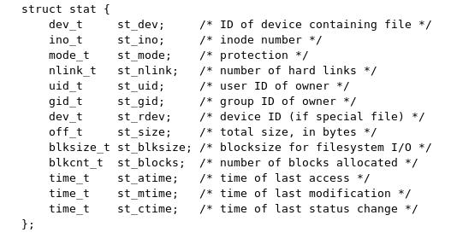
Structure stat
int stat (char *pathname, struct stat *buf)
int fstat (int fd, struct stat *buf)
int lstat (char *pathname, struct stat *buf)

Slide 53
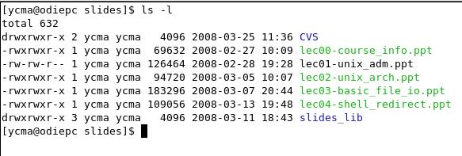
Everything you see from “ls –l” is from struct stat

Slide 54
Examine file type and permission
st_mode is a bitmap to encode
file type, and
access permission
…
…
…
user has execute permission
user has read permission
user has write permission
is regular file
is block device

Slide 55
Macros to set file access permission
Macro
Meaning
S_IRUSR
user read
S_IWUSR
user write
S_IXUSR
user executable
S_IRGRP
group read
S_IWGRP
group write
S_IXGRP
group executable
S_IROTH
others read
S_IWOTH
others write
S_IXOTH
others executable

Slide 56
Filter file permission setting—umask (command and system call)
user read
user write
user executable
mode parameter
for open
…
1
1
0
…
umask
…
0
1
0
…
actual file permission
…
1
0
0
…
umask prevents this bit
been turned ON

Slide 57
Examine file type
Macro
Type
…
struct stat buf;
int mode;
…
stat (filename, &buf);
mode = buf.st_mode;
if (S_ISDIR(mode)) {
printf (“This is a directory\n”);
}
S_ISREG()
regular file
S_ISDIR()
directory
S_ISCHR()
character device
S_ISBLK()
block device
S_ISFIFO()
FIFO
S_ISLINK()
symbolic link
S_ISSOCK()
socket

Slide 58
Setting up multiple path to the same file
/home/username/dir1/test.txt
…
…
…
/home/username/dir2/clone.txt
new link
link (“/home/username/dir1/test.txt”, “/home/username/dir2/clone.txt”)
other related system calls:
unlink: to remove an exist link
actually removes a file when stat.nlink_t=0
symlink: to setup symbolic link
readlink: read file content through symbolic link

Slide 59
Other system calls to setup inode information
chmod | change access mode
fchmod
chown | change the owner/group of a file
fchown
lchown | change the owner/group of a file (for symbolic link)
truncate | force the file size as specified (cut-off tail)
ftruncate
utime | set file access time
remove | remove a file (the same to unlink)
rename | change the name of the file
“man” please

Slide 60
Accessing a directory

Slide 61
Directory is just like a file with special format
i-node
array
…
data
block
…
data
block
…
directory
block
…
data
block
…
directory
block
i-node
…
i-node
1267
…
i-node
2549
…
i-node
3027
testdir
…
2549
.
1267
..
parent of testdir
3027
testfile.txt
…
…
2549
testdir
…

Slide 62
Reading a directory
testdir
#include <dirent.h>
main ()
{
DIR *dp;
struct dirent *buf;
dp = opendir (“testdir”);
while ((buf=readdir(dp))!=NULL) {
…//examine each file …
}
}
inode#
file name
1234
test.txt
2358
temp
3019
hello.c
…
…

Slide 63
Reading a directory
open the directory and
allocate internal management data structure
testdir
#include <dirent.h>
main ()
{
DIR *dp;
struct dirent *buf;
dp = opendir (“testdir”);
while ((buf=readdir(dp))!=NULL) {
…//examine each file …
}
}
inode#
file name
1234
test.txt
2358
temp
3019
hello.c
…
…

Slide 64
Reading a directory
testdir
#include <dirent.h>
main ()
{
DIR *dp;
struct dirent *buf;
dp = opendir (“testdir”);
while ((buf=readdir(dp))!=NULL) {
…//examine each file …
}
}
inode#
file name
1234
test.txt
2358
temp
3019
hello.c
…
…
sequentially access each entry by
readdir()

Slide 65
Reading a directory
struct dirent {
ino_t d_ino; //inode number
char d_name[NAME_MAX+1];
};
testdir
#include <dirent.h>
main ()
{
DIR *dp;
struct dirent *buf;
dp = opendir (“testdir”);
while ((buf=readdir(dp))!=NULL) {
…//examine each file …
}
}
inode#
file name
1234
test.txt
2358
temp
3019
hello.c
…
…
buf
3019
hello.c

Slide 66
System calls to access a directory
system call | description
opendir | open a directory to start to access
readdir | read a directory entry
rewinddir | move access position back to the head
closedir | close (internal data structure) to access a directory
telldir | check if a pathname is a directory
seekdir | move access position of accessing directory entries
mkdir | create a new directory
rmdir | remove a directory
chdir | change current working directory (of a process)
fchdir
getcwd | get current working directory

Slide 67
In-Class Exercise
play demo “dir”, “dir_name”
check how to get user name from user ID
check /etc/passwd file
useful library function to read /etc/passwd
modify the program to get last modify time of a file
check man for how to operate with various time formats
modify the program to get file type
run in /dev
check macros for st_mode
(4) create a link (ln) and check i-node numbers of these files

Slide 68
HW03
program to
Recursion into a directory tree and visit each file
Print out file name and the number of lines in each file
Assume each file is a text file
top/
dir1/
hello.c (150)
Makefile (30)
dir2/
test.c (200)
Makefile (30)
README.txt (100)

