Slide 1
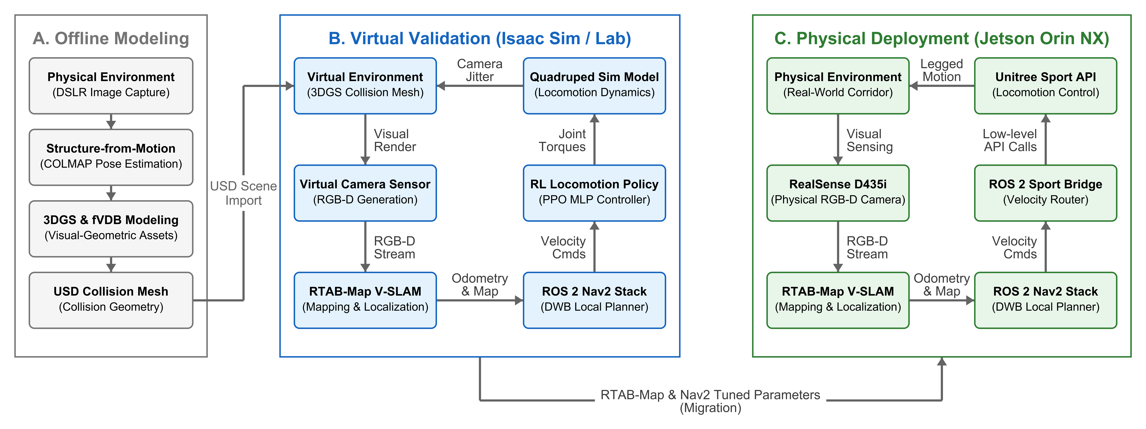
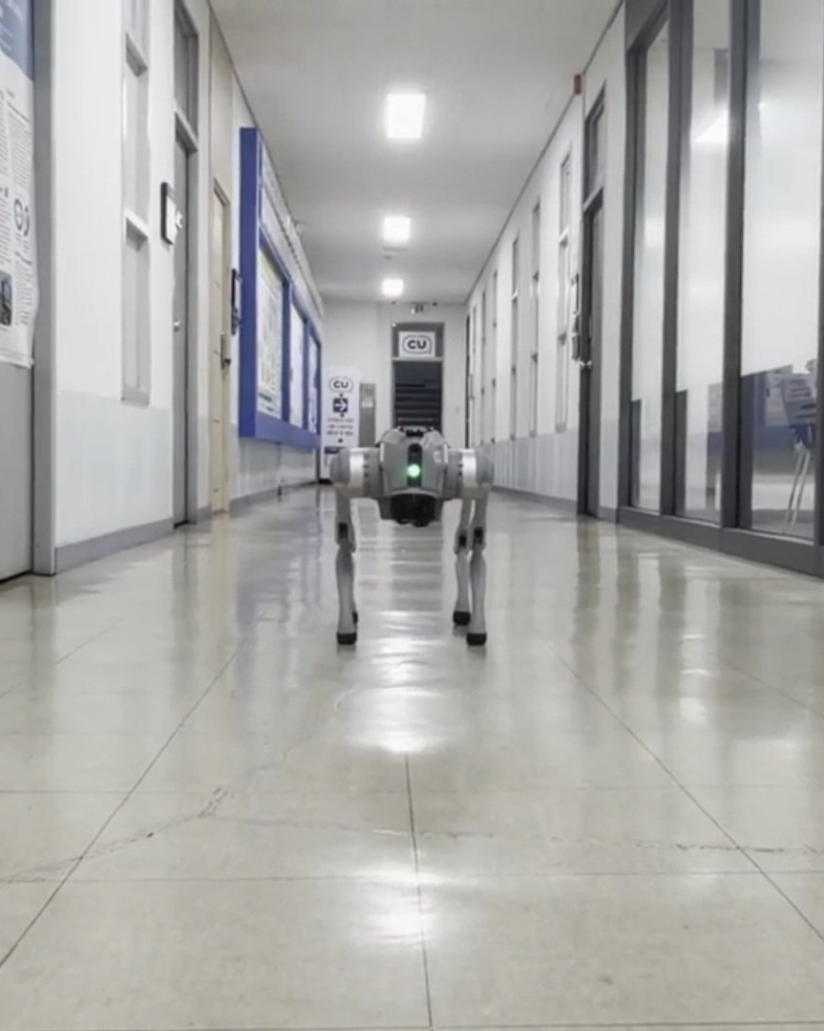
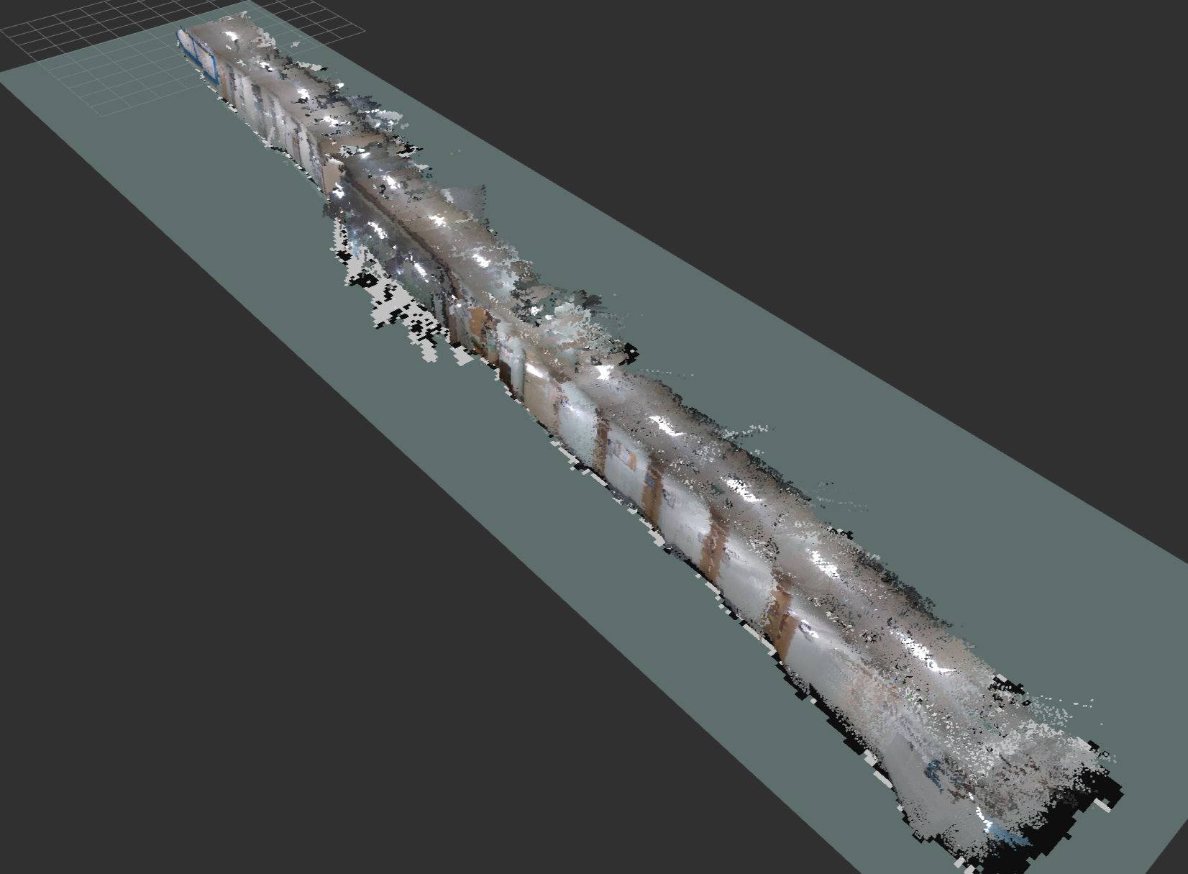
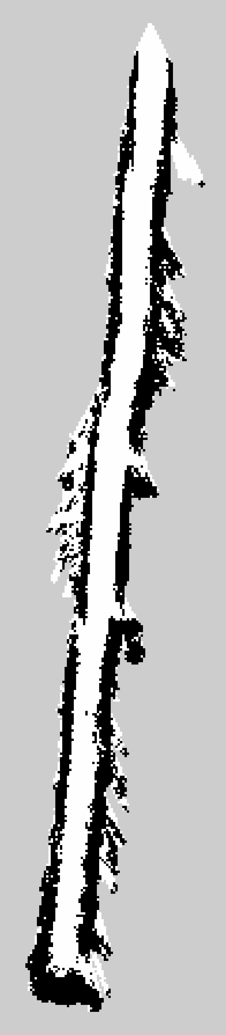
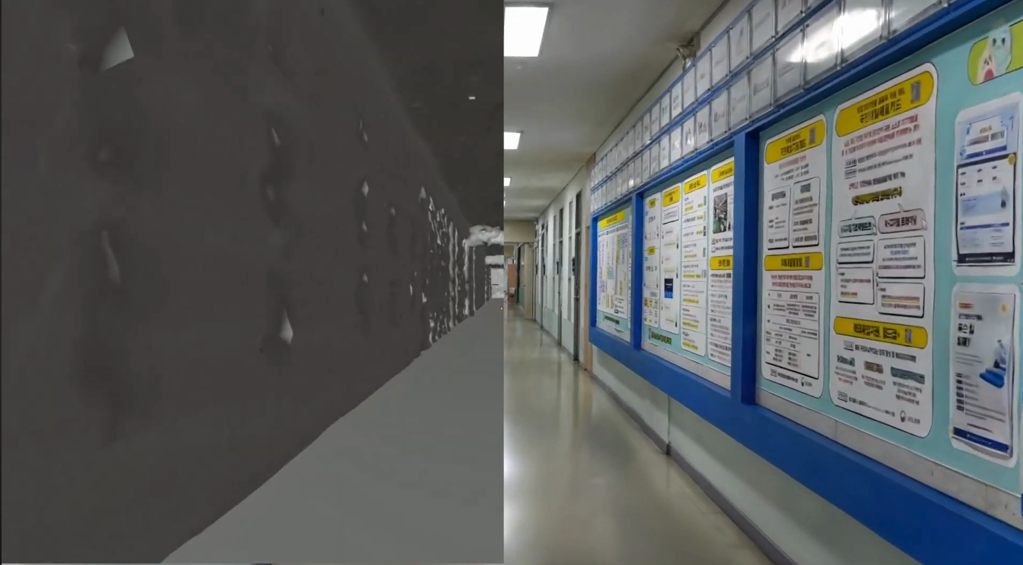
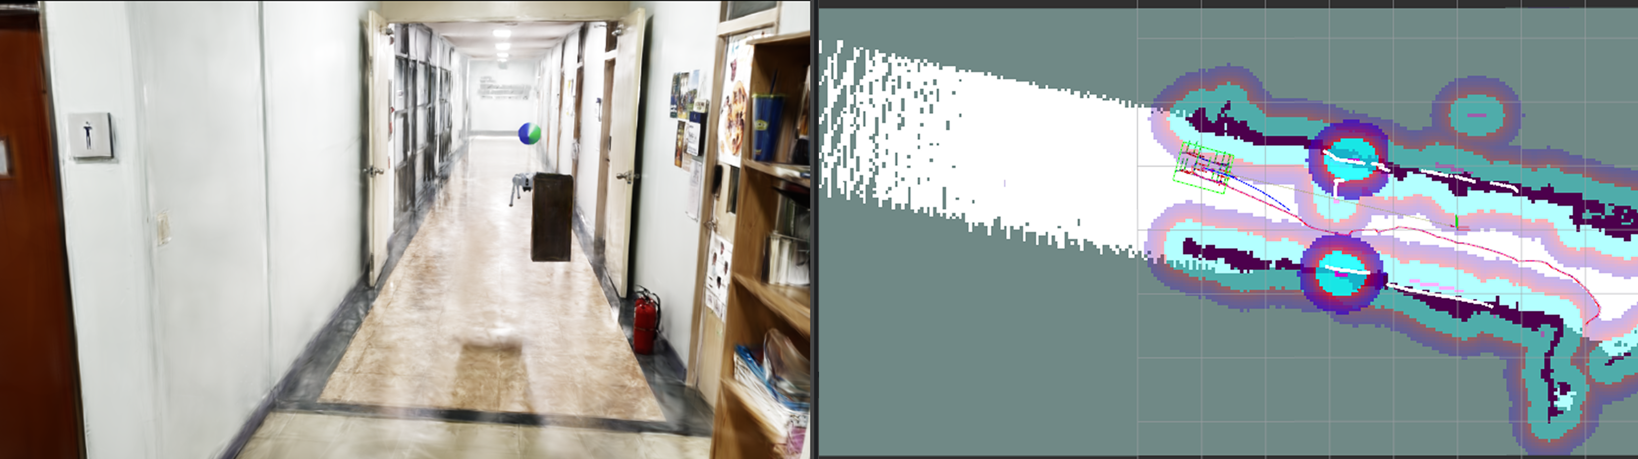

ICCAS 2026 Poster [ Session Code [TuP...] ]
Computer Graphics & Virtual Reality Lab (CGV) · Handong Global University
Bridging the Sim-to-Real Gap in Quadrupedal Visual Navigation via 3D Gaussian Splatting
Minseok Lee¹, Seongyu Han¹, Heejae Moon¹, and Sung Soo Hwang^{1*}
¹School of Artificial Intelligence, Computer and Electrical Engineering, Handong Global University, Pohang 37554, Korea · *sshwang@handong.edu
Sim-to-Real Quadrupedal Visual Navigation Architecture
Core Sim-to-Real Methodology: Virtual parameters optimized under simulated 3DGS photorealism & RL gait bobbing noise (Phase B) transfer directly to the physical Unitree Go2 (Phase C). Hardware control routes commands to the built-in Sport API via a ROS 2 bridge, bypassing heavy RL computation on the Jetson Orin NX.
1. Motivation & Sim-to-Real Gap
4. Physical Deployment (Unitree Go2)
LiDAR-Free Quadruped Autonomy: Single RGB-D camera replaces heavy, power-hungry LiDAR on legged robots.
Perceptual Sim-to-Real Gap: Simulators lack photorealistic textures, causing V-SLAM feature tracking to fail in real environments.
Dynamic Gait Bobbing Noise: Locomotion induces periodic camera jitter (pitch/roll/vertical), generating severe motion blur and false phantom obstacles.
Hardware Safety Bottleneck: Physical trial-and-error tuning carries high collision risks and severe battery runtime limits.
Go2 + Orin NX
RTAB-Map 3D
2D
Fully Onboard Edge Computing: Intel RealSense D435i connected via USB 3.0 to an NVIDIA Jetson Orin NX, executing RTAB-Map and Nav2 autonomously in real time.
Decoupled Locomotion Control: To conserve edge compute for SLAM, the heavy RL policy is bypassed on physical hardware; Nav2 velocity commands route directly to the built-in Sport API via a lightweight ROS 2 bridge.
2. 3DGS Digital Twin & Collision Mesh
fVDB Collision Mesh
3DGS Photorealistic Render
5. Experimental Results & Verification
80 m
3DGS Corridor Digital Twin
0.4 m/s
Walking Speed w/ Loop Closure
Offline Digital Twin Modeling: Reconstructed from DSLR images via COLMAP Structure-from-Motion (SfM) and 3D Gaussian Splatting (3DGS) exported to USDZ format.
NVIDIA fVDB Sparse Volumetric Mesh: Integrated into Isaac Sim 5.1.0 to compute accurate contact geometry and collision boundaries for quadruped foot placement.
Sensor Profile Alignment: Virtual camera FOV, resolution (640x480), and optical center strictly match the physical Intel RealSense D435i sensor to eliminate hardware discrepancies.
1 RGB-D
Single D435i Camera (Zero LiDAR)
0 Recalib
Zero-Code Sim-to-Real Transfer
Direct Parameter Migration: Parameters optimized under simulated camera bobbing transferred seamlessly across ROS distributions (Jazzy on sim → Foxy on robot) without physical retuning.
Robust Visual Mapping: RTAB-Map successfully extracted features and detected global loop closures throughout the 80 m corridor, eliminating phantom obstacles.
3. Virtual Validation & Replanning
Isaac Sim Quadruped Model
RViz Nav2 Costmap & Global Path
6. Conclusion & Future Outlook
Practical Virtual Sandbox: Demonstrates that pairing a photorealistic 3DGS digital twin with RL-generated gait dynamics provides an effective, risk-free testbed for visual quadruped navigation.
Decoupled Edge Efficiency: Separating simulation-based parameter discovery from onboard execution enables lightweight real-world deployment on resource-constrained Jetson platforms.
Future Research: Expanding from static corridors to dynamic obstacle avoidance benchmarks, multi-floor terrain transitions, and direct neural policy deployment.
Gait Oscillation Emulation: RL policy (PPO in Isaac Lab 2.3.2) trained with domain randomization (mass ±3kg, friction 0.6–0.8) reproduces realistic camera bobbing dynamics.
RTAB-Map V-SLAM Optimization: Point cloud registration and loop closure thresholds tuned to withstand simulated locomotion pitch/roll oscillations without tracking loss.
Nav2 Local Replanning: DWB local planner dynamically computes collision-free trajectories around inserted obstacles in the 80 m × 2.5 m digital corridor.
References: [1] B. Kerbl et al., “3D Gaussian splatting for real-time radiance field rendering,” ACM TOG, 2023. [2] M. Labbé & F. Michaud, “RTAB-Map as an open-source lidar and visual SLAM library,” arXiv:2403.06341, 2024. [3] S. Macenski et al., “Robot Operating System 2: Design and architecture,” Science Robotics, 2022. [4] S. Zhu et al., “VR-Robo: Real-to-sim-to-real for visual robot navigation,” IEEE RA-L, 2025.
Acknowledgement: This research was supported by the National Research Foundation of Korea (NRF) grant funded by the Korean government (MSIT) (No. RS-2025-24683458).
GitHub Repo & Code

