Slide 1
Lighting Image/Video Style Transfer Methods by Iterative Channel Pruning
Author：
Kexin Wu , Jilin University
Fan Tang*, ICT-CAS
Ning Liu, Midea Group
Oliver Deussen, University of Konstanz
Thi-ngoc-hanh Le, National Cheng Kung University
Weiming Dong, CASIA
Tong-yee Lee, National Cheng Kung University
Notes:
Good morning everyone.
It's my honor to speak here, and I’m very glad to share our work with you.
Our paper’s title is Lighting Image/Video Style Transfer Methods by Iterative Channel Pruning.

Slide 2
Contents
1
Introduction
2
Methods
3
Experiments
4
Conclusion
Notes:
I will divide into the following parts to introduce.

Slide 3

Introduction
——Motivation
——Contribution
1
Notes:
The first part is Introduction.

Slide 4
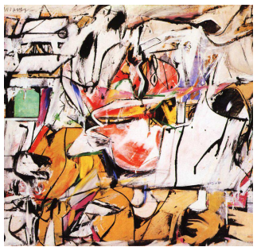
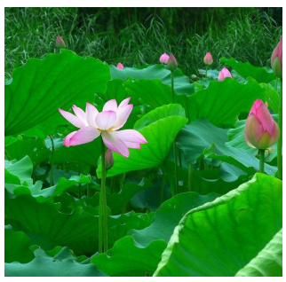
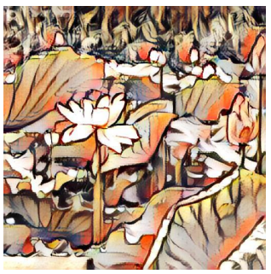
Introduction
Visual Style Transfer(VST)
+
=
Style image
Content image
Content remains, style changes
Input: a content image and a style image
Output: an image with the corresponding content and style
Notes:
Firstly I will briefly introduce the visual style transfer task.
As shown in Figures, input a content image and a style image, the VST model can output an image with the corresponding content and style.

Slide 5
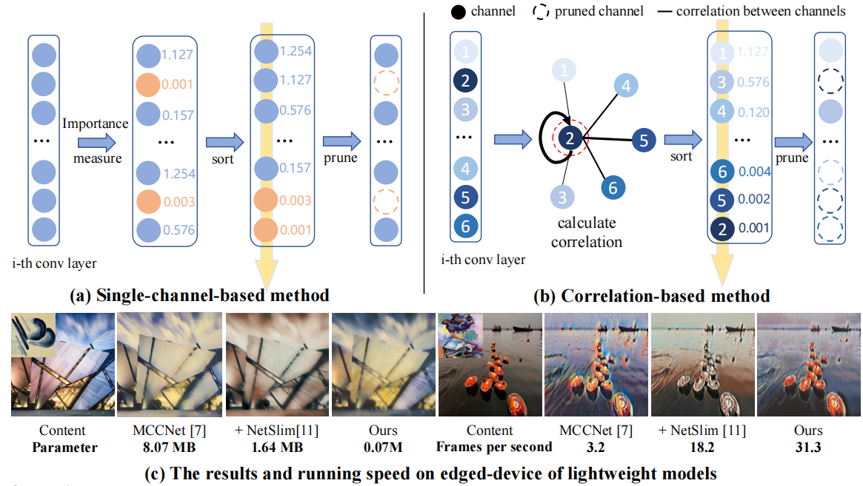
Introduction
Motivation
The visual style transfer(VST) model has high memory usage and latency
Most pruning methods are not suitable for VST tasks:
VST methods usually employ an encoder-decoder based backbone
Pruning based on single-channel method could potentially compromise the preservation of valuable style information.
Fig. 1. The difference between single-channel based methods and our correlation-based method.
Notes:
However, the high memory usage and latency prevent VST methods from being widely used on resource constrained mobile devices.
Although there are many lightweight methods, most of them are designed for classification and object detection, which are not suitable for VST tasks.
As shown in Fig. 1(c), when pruning 80%(eighty percent) parameters of MCCNet by NetSlim, the outputs fail to maintain style consistency with the input style reference (as shown on the top left of the content image).
The reasons are twofold:
The first one, VST methods usually employ an encoder decoder-based backbone, which is more complex than plain CNN networks;
The second one, VST tasks rely on the distribution of features across different channels to measure style information.
Pruning based on single-channel method could potentially compromise the preservation of valuable style information.
Therefore, we propose our method.

Slide 6
Introduction
Contribution
We propose a correlation-based channel regularization when training, which considering the correlation between channels.
We introduce an iterative layer-wise pruning strategy to prune VST model and keep the whole style transfer performance
Experiments on image and video stylization tasks prove the efficiency and generalization ability of the proposed method
Notes:
In this study, we present a novel approach to generate lightweight VST models that are suitable for mobile devices.
Specifically，…

Slide 7
Methods
——Problem Definition
——Correlation-based Channel Regularization
—— Iterative Layer-wise Pruning Strategy
2
Notes:
The second part we will introduce our methods.

Slide 8



Methods
Problem Definition
Model M
$$I_{C}$$
Encoder E
Transform T
Decoder D
$$I_{CS}$$
$$I_{S}$$
Fig.2. The common structure of VST method.
Our target:
To generate a lightweight model M′ (with E′ -T′ -D′ ) that allows us to generate similar visual effects to M, but reduces the needed resources when computed on mobile devices.
Notes:
Firstly, I will introduce the Problem Definition.
As shown in Fig.2, giving a content reference Ic and a style reference Is, the style transfer is to generate a re-stylized image Ics.
Our target is to generate a lightweight model M′(with E′-T′-D′) that allows us to generate similar visual effects to M, but reduces the needed resources when computed on mobile devices.
M′(M prime), E′(E prime), T′(T prime), D′(D prime)

Slide 9
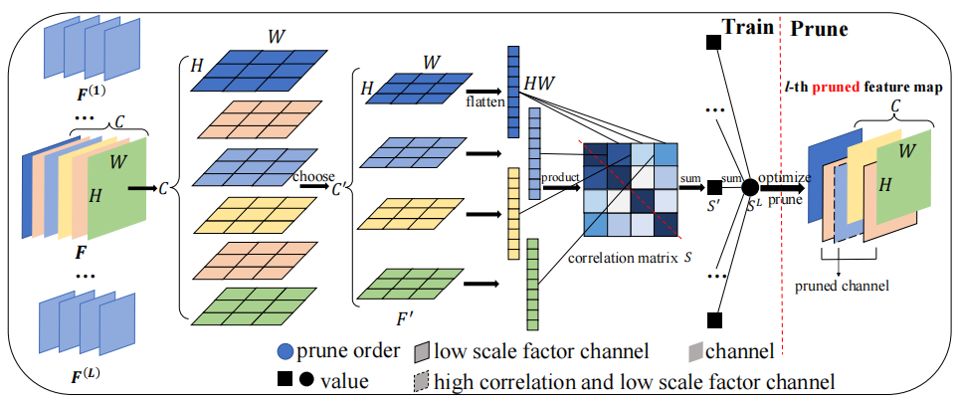








Methods
Correlation-based Channel Regularization
We have a convolutional layer l with output feature map
$$F∈ℝ^{B×C×H×W}$$
Then we obtain a channel index subset that satisfies the following conditions:
$$R=\left\{i | γ_{i}≥t\right\},\left|R\right|=C′$$
So we have new feature map:
$$F^{′}=F_{:,R,:,:},F^{′}∈ℝ^{B×C^{′}×H×W}$$
Convert the dimension of and get its transpose:
$$F^{′}$$
$$F^{′}∈ℝ^{B×C^{′}×HW}$$
$${\left(F^{′}\right)}^{T}∈^{B×HW×C^{′}}$$
Calculate the similarities among the
channels:
$$C^{′}$$
Fig.3. Correlation-based channel regularization
$$S=F^{′}{\left(F^{′}\right)}^{T},S∈ℝ^{B×C^{′}×C^{′}}$$
Notes:
We propose Correlation-based Channel Regularization as loss when training.
Specifically, as shown in Fig.3 …
(The second function), where γi is the scale factor of batch normalization layer corresponding to the i-th channel of current convolutional layer, t is threshold, whose value depends on the prune ratio r
F’(F prime) C(C prime)

Slide 10

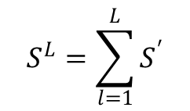


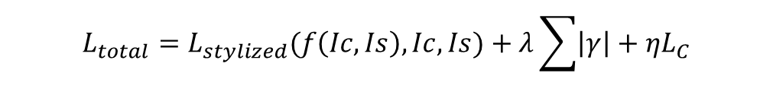


Methods
Correlation-based Channel Regularization
Calculate the similarities among the
channels:
$$C^{′}$$
$$S=F^{′}{\left(F^{′}\right)}^{T},S∈ℝ^{B×C^{′}×C^{′}}$$
Add the values of all dimensions of S to get a value
$$S^{′}∈ℝ$$
Add all layers’ similarity values, we get:
$$S^{L}=\sum_{l=1}^{L}{S^{′}}$$
Add an L1 regularization on to get correlation based regularization term:
$$S^{L}$$
$$L_{C}=\left|S^{L}\right|$$
Fig.3. Correlation-based channel regularization
$$L_{total}=L_{stylized}(f\left(Ic,Is\right),Ic,Is)+λ\sum{\left|γ\right|}+ηL_{C}$$
The whole optimization object for image-stylized approaches is
Notes:
S’(S prime)
(The last function),where Lstylized is the style transfer loss, γ(gamma) is the scale factor of Batch normalization layer, | | (double vertical bar) denotes L1 regularization, λ(lamda) and η（eta） are weight factors

Slide 11
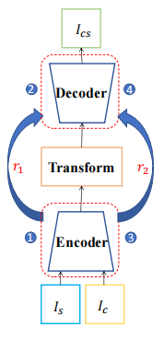
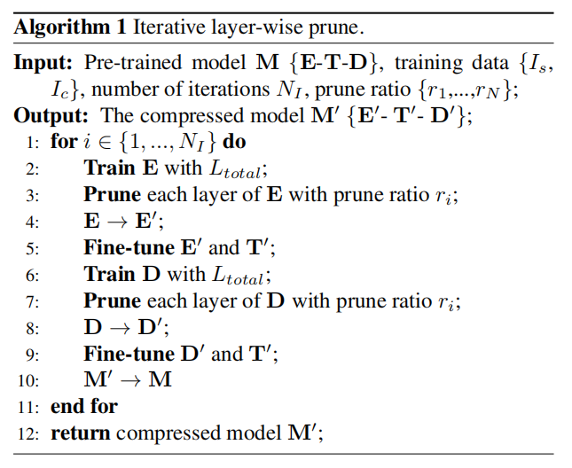


Methods
Iterative Layer-wise Pruning Strategy
We prune E and D alternatively and increases the prune ratio gradually until it reaches the desired value
We prune each layer separately to avoid affecting the correlation among channels of each layer.
We set the number of iterations equal to 2
$$N_{I}$$
$$r_{i}$$
is the prune ratio of different iterations
Each time E or D is processed, the training, pruning, fine-tuning process is included
Notes:
Then we propose Iterative Layer-wise Pruning Strategy.
Specifically, we prune E and D alternatively and increases the prune ratio gradually until it reaches the desired value.
We prune each layer separately to avoid affecting the correlation among channels of each layer.
As shown in left figure and Algorithm 1, we set the number of iterations N_I equal to 2, ri is the prune ratio of different iterations.
Each time E or D is processed, the training, pruning, fine-tuning process is included.

Slide 12
Experiments
——Visual Quality Assessment
——Efficiency Analysis
3
Notes:
In the third part, we introduce the experiments, which mainly include visual quality assessment and efficiency analysis, proving the effectiveness of our method from a qualitative and quantitative perspective, respectively.

Slide 13
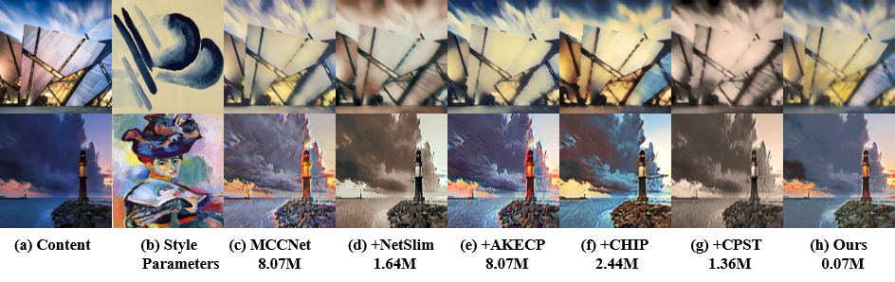
Experiments
Visual Quality Assessment
MCCNet^{[1]} is a basic visual stylization approach
NetSlim^{[2]}, AKECP^{[3]}, CHIP^{[4]} and CPST^{[5]} are pruning methods to prune MCCNet
Fig. 4. Visual comparisons for different pruning methods
CPST is a channel pruning method specially designed for style transfer
NetSlim and CPST fail to generate stylized results for layer collapsing during pruning
AKECP does not reduce the parameters
CHIP produces unexpected color shifts compared with the results of MCCNet
Notes:
MCCNet is a basic visual stylization approach
NetSlim, AKECP, CHIP and CPST are contrast pruning methods to prune MCCNet
The Visual comparisons for different pruning methods are as shown in Fig.4.
It should be noted that CPST is a channel pruning method specially designed for style transfer.
NetSlim and CPST fail to generate stylized results for layer collapsing during pruning.
AKECP does not reduce the parameters.
CHIP produces unexpected color shifts compared with the results of MCCNet.
Our ICCP can generate visually appealing results compared with other pruning methods.

Slide 14
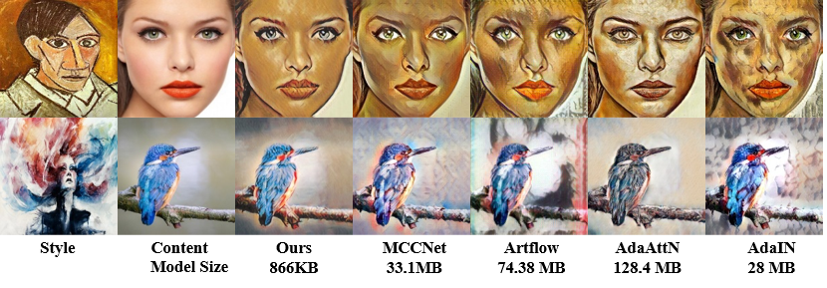
Experiments
Visual Quality Assessment
MCCNet^{[1]} , AdaIN^{[6]}, Artflow^{[7]}, AdaAttn^{[8]} are image stylization methods
Fig. 5. Image style transfer results by different style transfer
In the 1st row, our ICCP can generate a more realistic, closer-to-reference style (vs. AdaAttN) without noise (vs. AdaIN and Artflow) on the girl’s face
In the 2nd row, the generated image of MCCNet has a highlight around the bird’s body, but not in our approach
Notes:
Furthermore, we compare the image style transfer result of our pruned model with several SOTA image stylization methods.
As shown in Fig.5, our ICCP yields competitive and comparable results to the aforementioned SOTA methods.
Specifically, our ICCP effectively transfers the given styles for all the shown cases while accurately preserving the input content structure/patterns.
In certain instances, our ICCP performs even better.
For example, as exemplified in the first row, our ICCP can generate a more realistic, closer-to-reference style (vs. AdaAttN) and without noise (vs. AdaIN and Artflow) on the girl’s face.
In the second row, the generated image of MCCNet has a highlight around the bird’s body, but not in our approach.

Slide 15

Experiments
Efficiency Analysis
Table 1. Quantitative results for different pruning methods.
 |  |  | Parameters
Method | FLOPs | Temporal Loss | Encoder | Transform Module | Decoder
MCCNet | 209.32G | 7.30 × 10⁻⁸ | 3.51M | 1.05M | 3.51M
+NetSlim | 9.09G | 6.70 × 10⁻⁸ | 0.48M | 1.05M | 0.11M
+AKECP | 209.32G | 7.16 × 10⁻⁸ | 3.51M | 1.05M | 3.51M
+CHIP | 12.14G | 6.49 × 10⁻⁸ | 0.14M | 1.05M | 1.25M
+CPST | 7.30G | 6.50 × 10⁻⁸ | 0.21M | 1.05M | 0.10M
+Ours | 2.11G | 6.44 × 10⁻⁸ | 0.03M | 0.01M | 0.03M
The encoder, decoder, and transform module parameters have been reduced by 99.15%, 99.15%, and 99.05%, respectively
FLOPs have been reduced by 98.99%
AKECP achieves compression by setting some parameters to zero, exhibiting similar parameters and FLOPs to MCCNet
CHIP and CPST remove the channels directly but reserve higher parameters and FLOPs than our ICCP
Temporal loss:
$$L_{temporal}=average\left(\left\|O∘\left(W_{I_{c}^{t−1}→I_{c}^{t}}\left(I_{cs}^{t−1}\right)−I_{cs}^{t}\right)\right\|\right)$$
$$O=\left|W_{I_{c}^{t−1}→I_{c}^{t}}\left(I_{cs}^{t−1}\right)−I_{cs}^{t}\right|>10$$
where O is an occlusion mask and any position that doesn’t satisfy the condition will be set to zero
Notes:
The next is efficiency analysis.
We compare the parameters and FLOPs of MCCNet before pruning and after using pruning methods.
The comprehensive result is shown in Table 1.
In total, ICCP achieves the lowest FLOPs and parameters.
The encoder, decoder, and transform module parameters have been reduced by 99.15%(Ninety-nine point one five percent), 99.15%(Ninety-nine point one five percent) and 99.05%(Ninety-nine point zero five percent), respectively.
Likewise, FLOPs have been reduced by 98.99%(Ninety-eight point nine nine percent) when using our ICCP.
AKECP achieves compression by setting some parameters to zero, exhibiting similar parameters and FLOPs to MCCNet.
CHIP and CPST remove the channels directly but reserve higher parameters and FLOPs than our ICCP.
To measure the coherence of the videos generated from different pruning methods, we calculate temporal loss, the calculation method is as shown in the formula, where O is an occlusion mask and any position that doesn’t satisfy the condition will be set to zero:
We observe a small difference between these values, demonstrating that our method can generate relatively stable videos even if the number of parameters and memory requirement is reduced significantly.

Slide 16
Experiments
Efficiency Analysis
Table 2. Average run time (seconds) for our method and other methods with three input sizes on Samsung Galaxy S10.
Input size | MCCNet | +NetSlim | +AKECP | +CHIP | +CPST | +ICCP
128×128 | 0.310 | 0.055 | 0.298 | 0.057 | 0.061 | 0.032
255×255 | 0.770 | 0.134 | 0.758 | 0.141 | 0.131 | 0.072
512×512 | 2.757 | 0.478 | 2.829 | 0.516 | 0.546 | 0.199
Our ICCP achieves the fastest inference time (0.032s, 0.072s, and 0.199s) with all three input image sizes.
For an input size of 512 × 512, our inference speed is improved by 92.78% compared to the original MCCNet
Notes:
Then we compare the inference time with three input sizes on mobile device Samsung Galaxy S10, as shown in Table.2.
Our ICCP achieves the fastest inference time (0.032s, 0.072s, and 0.199s)( Zero point zero three two seconds, Zero point zero seven two seconds and Zero point one nine nine seconds).
For an input size of 512 × 512(five hundred twelve multiplied by five hundred twelve), our inference speed is improved by 92.78%(ninety-two point seven eight percent) compared to the original MCCNet.
All of the above experiments demonstrate the validity of our method.

Slide 17
Conclusion
4
Notes:
Finally, we summarized our work.

Slide 18
Conclusion
Conclusion
We proposes an iterative correlation-based channel pruning (ICCP) methods, which can be deployed on resource-constrained devices with fewer parameters and faster inference speed.
The proposed ICCP introduces a channel regularization as loss when training that adds restraints on channel correlation and uses an iterative layer-wise pruning strategy when pruning
Quantitative and qualitative measurements adequately prove the validity of our method.

Slide 19
References
[1] Yingying Deng, Fan Tang, Weiming Dong, Haibin Huang, Chongyang Ma, and Changsheng Xu, “Arbitrary video style transfer
via multi-channel correlation,” in Proceedings of the AAAI Conference on Artificial Intelligence (AAAI), 2021, pp. 1210–1217.
[2] Zhuang Liu, Jianguo Li, Zhiqiang Shen, Gao Huang, Shoumeng Yan, and Changshui Zhang, “Learning efficient convolutional
networks through network slimming,” in Proceedings of the IEEE International Conference on Computer Vision (ICCV), 2017,
pp. 2736–2744.
[3] Haonan Zhang, Longjun Liu, Hengyi Zhou, Wenxuan Hou, Hongbin Sun, and Nanning Zheng, “Akecp: Adaptive knowledge
extraction from feature maps for fast and efficient channel pruning,” in Proceedings of the ACM International Conference on
Multimedia, 2021, pp. 648–657.
[4] Yang Sui, Miao Yin, Yi Xie, Huy Phan, Saman Aliari Zonouz, and Bo Yuan, “Chip: Channel independence-based pruning for
compact neural networks,” 2021, vol. 34, pp. 24604–24616.
[5] Minseong Kim and Hyun-Chul Choi, “Compact image style transfer: Channel pruning on the single training of a network,”
Sensors, vol. 22, no. 21, pp. 8427, 2022.
[6] Xun Huang and Serge Belongie, “Arbitrary style transfer in real-time with adaptive instance normalization,” in Proceedings of
the IEEE International Conference on Computer Vision (ICCV), 2017, pp. 1501–1510.
[7] Jie An, Siyu Huang, Yibing Song, Dejing Dou, Wei Liu, and Jiebo Luo, “Artflow: Unbiased image style transfer via reversible
neural flows,” in Proceedings of the IEEE Conference on Computer Vision and Pattern Recognition (CVPR), 2021, pp. 862–871.
[8] Songhua Liu, Tianwei Lin, Dongliang He, Fu Li, Meiling Wang, Xin Li, Zhengxing Sun, Qian Li, and Errui Ding, “Adaattn:
Revisit attention mechanism in arbitrary neural style transfer,” in Proceedings of the IEEE International Conference on
Computer Vision (ICCV), 2021, pp. 6649–6658.
Notes:
These are the references.

Slide 20
Thank you
Notes:
That’s all, thank you.

