Slide 1
Automate XL

Slide 2
Automation Process
Input Excel Workbook (.xlsx file)
Program does tasks you alternatively would have done in Excel
Output Processed Excel Workbook (.xlsx file)

Slide 3
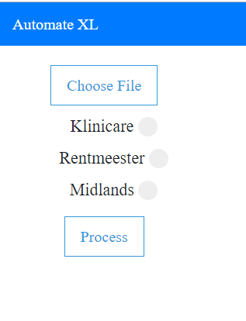
Graphical User Interface

Slide 4
Programming Languages and Libraries
Python is an interpreted, high-level, general-purpose programming language.
openpyxl is a Python library to read/write Excel xlsx/xlsm/xltx/xltm files.
Flask is a micro web framework written in Python.
HTML and CSS - Web development
Jinja is a modern day templating language for Python developers and is used to create HTML, XML or other markup formats that are returned to the user via an HTTP request

Slide 5
Functions
insert_cols()
delete_rows()
get_month(month) – Function that returns the month, example: JANUARY
load_workbook – Loads the workbook
Save() – Saves the workbook

Slide 6
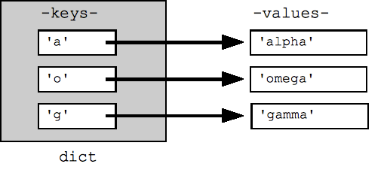
Data Structures
List L = ["apple", "banana", "cherry"] – A dynamic array that shrinks and grows
Print(L[2])
#Output: cherry
Dictionary

Slide 7
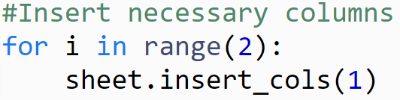
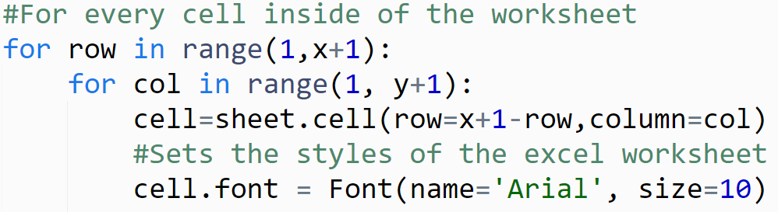
Algorithms

Slide 8
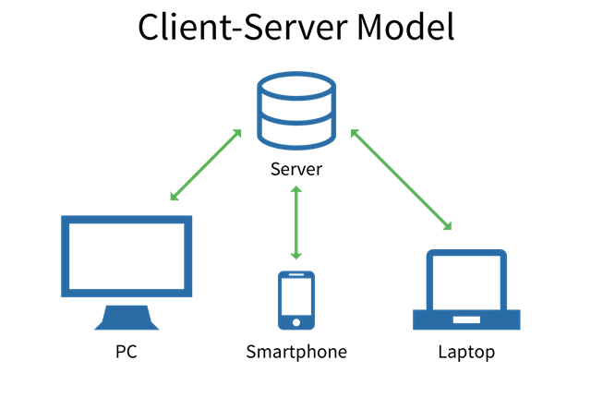
Web Application

Slide 9
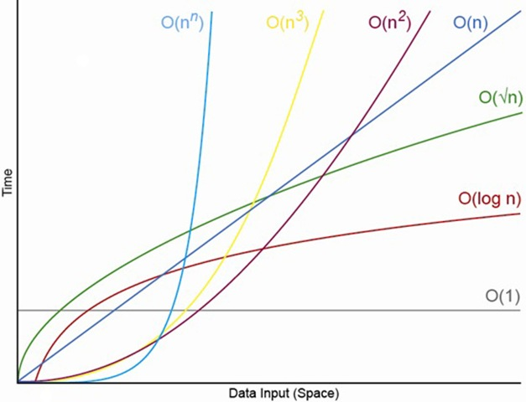
Processing Time
In some instances, the program will have constant time algorithms O(1), like when using a dictionary data structure
In other instances the longest the program will take to interpret the excel workbook will be O(n)

Slide 10
Hardware Requirements Recommended
CPU - Dual Core 2.0 GHz
Memory - 4Gb RAM
HDD Space - 40Gb
Minimal Requirements
CPU - Single Core 1.0 Ghz
Memory - 1Gb RAM
HDD Space - 40Gb

Slide 11
Software Requirements (For installation)
Windows 7 or Windows Server 2008
Python 3.7.2 or newer
Python Libraries:
CS50
VirtualEnv
VirtualEnvWrapper-win
Flask
Openpyxl
Python Flask Windows Development Environment Setup (Guide)

Slide 12
Requirements (For Usage)
Connection to the server (Wired LAN or Wi-Fi)
Any Device
Browser

