Slide 1

CST-105 Milestone 1 Storyboard
﻿(This is my own work Chad Galloway)

Slide 2
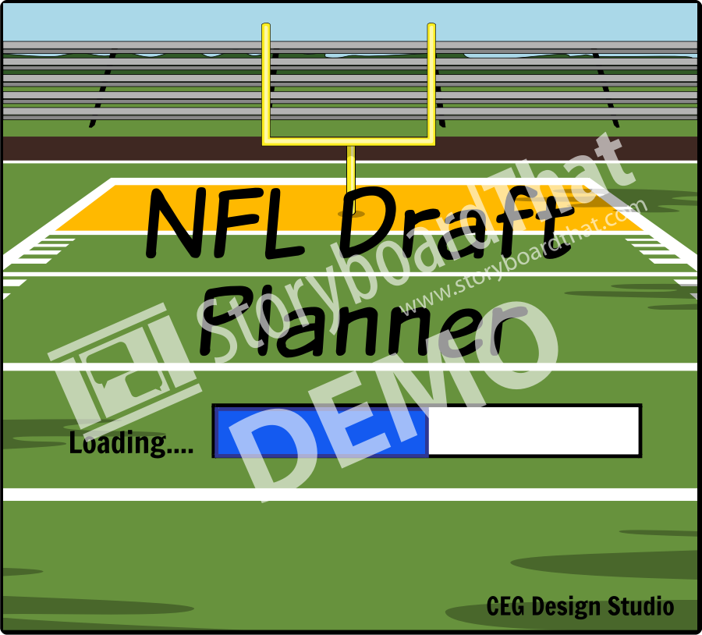
Splash Screen
Splash screen containing Company logo, software name, and loading bar
Falls through to the next screen.

Slide 3
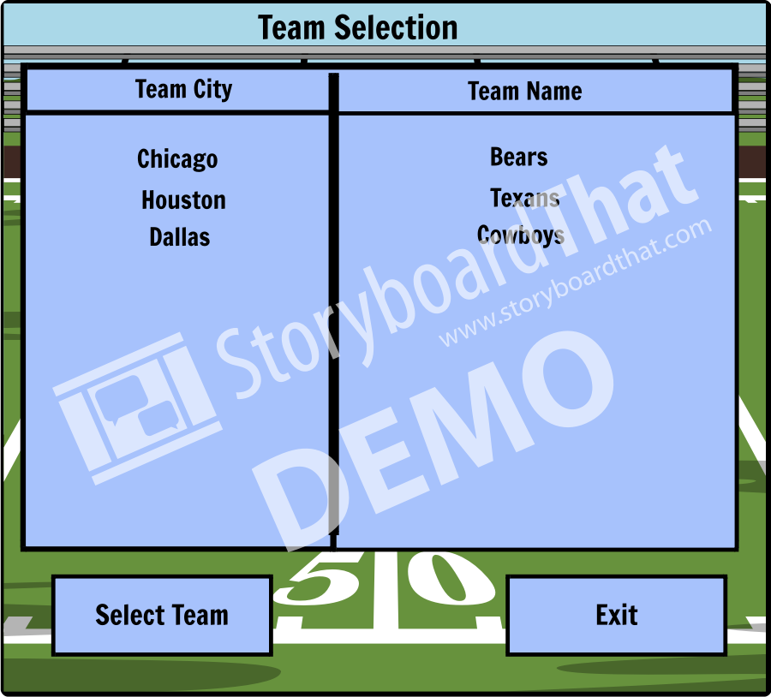
Introduction Screen
Screen for selecting which team the Draft Planner is running for.
Allow user to select team or exit program.
Falls through to the next screen after team sleection.

Slide 4
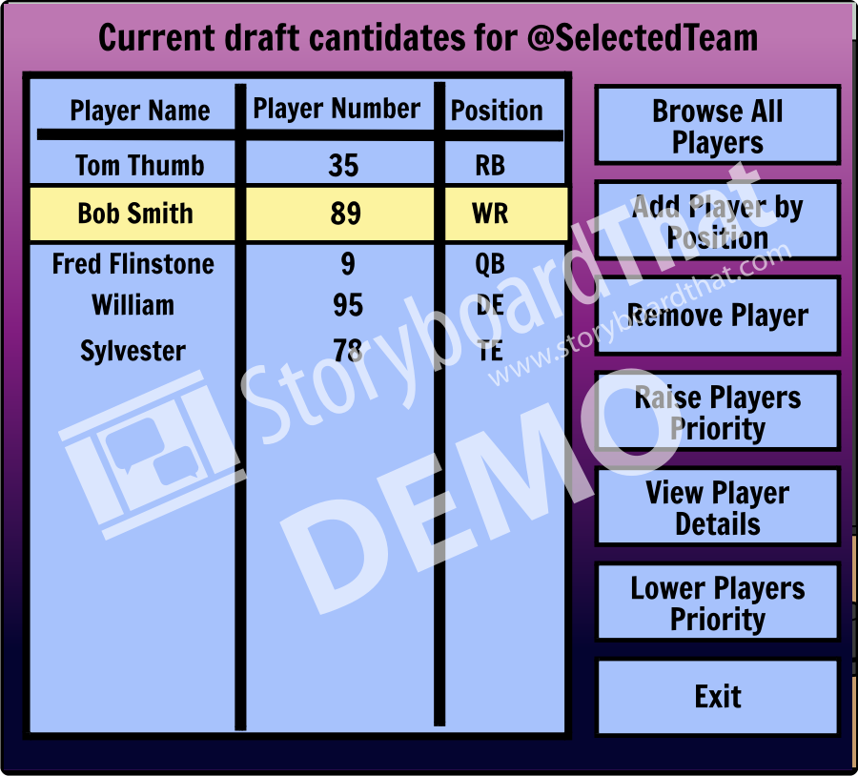
Main Screen
Screen with the current list of players selected for drafting and buttons for common tasks.
Players can be removed directly from this screen or moved up and down the list.
User can browse players to add or add a player by position.
User can view a popup window of selected player details.

Slide 5
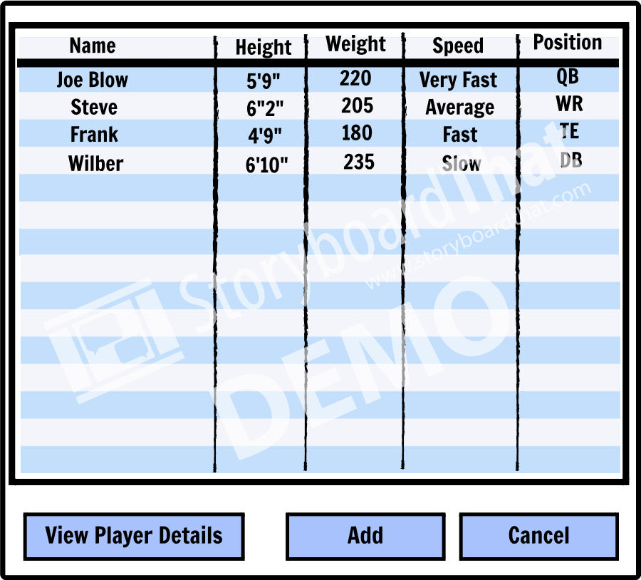
﻿Add Player Screen﻿
﻿Screen with a list of all the available players if the user selected browse or a list of players for the selected position. ﻿List will be sortable for each category.
Selecting add takes the user to the confirmation screen.
User can view a popup window of selected player details.

Slide 6
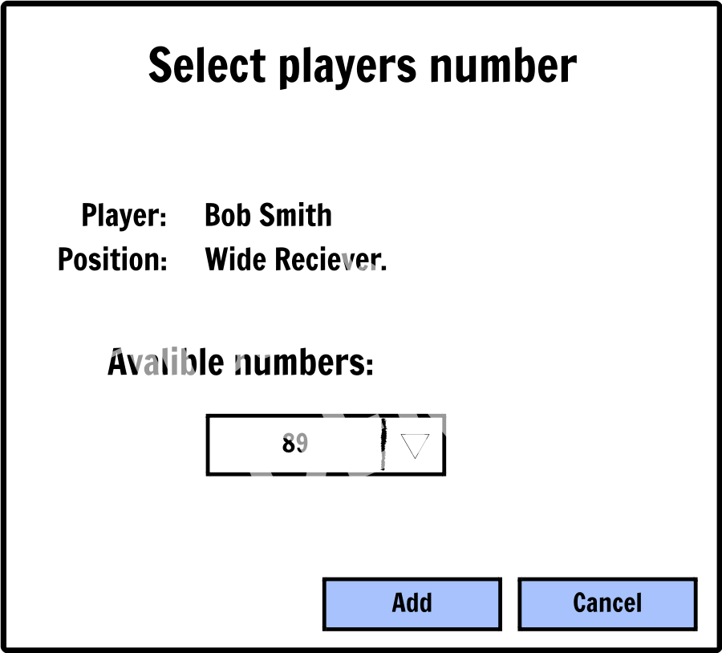
﻿Add Player Confirmation Screen﻿
﻿Screen To confirm the player is to be added to the roster and select their number on the team.

Slide 7
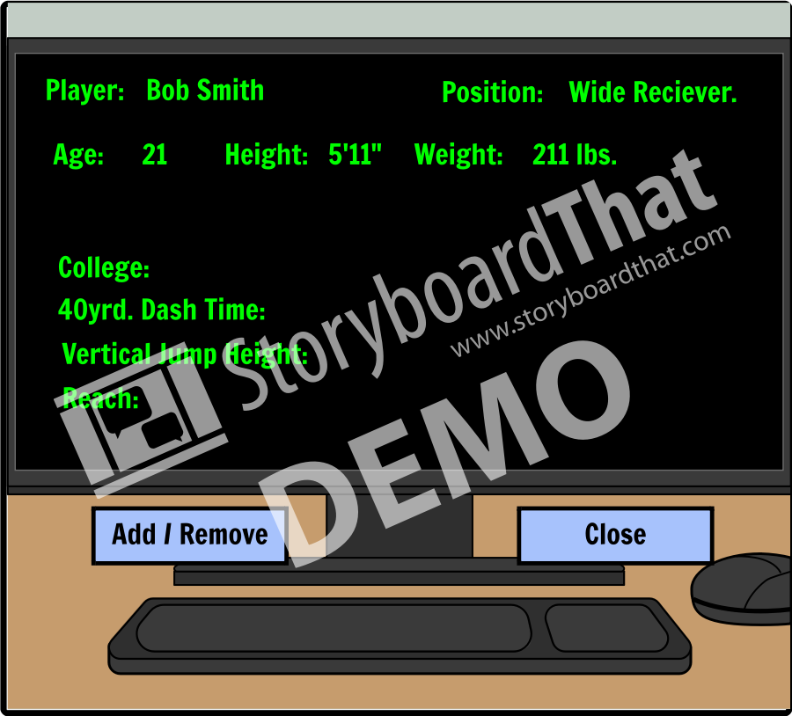
View Player Details Screen
﻿Screen containing a very detailed account of the selected player's statistics.﻿ Visible when the user selects “View Player Details".
(Either the Add or Remove option will be available on details page depending on whether or not the player is already on the roster.)

