Slide 1
Intro to Machine Learning with Spark and Java

Slide 2
Outline
Intro to Big Data
Machine Learning
Regression Analysis
Bayes and Sentiment Analysis
Recommendation Systems
Clustering
Graph analytics
Real-time analysis
Deep Learning

Slide 3
Intro to Big Data
Map Reduce -> Apache Spark
Data cleaning and munging

Slide 4
Machine Learning
Supervised Learning
Unsupervised Learning
Semi supervised Learning
Classification
Regression

Slide 5
Regression Analysis
Linear regression
Logistic regression

Slide 6

Naïve Bayes analysis
$P\left(A | B\right)= \frac{P(A|B)P(A)}{P(B)}$
Probability Value | Description
P(A|B) | Conditional probabliility of event A given that event B has occurred
P(B|A) | Conditional probability of event B given that event A has occurred
P(A) | Individual probability of event A without regard to event B
P(B) | Individual probability of event B without regard to event A
** assumes that the features in the dataset are completely independent

Slide 7
Sentimental analysis
Load data
Clean and Munge
Extract Tokens
Remove Stop words
Find TF-IRF of the words
Train a Classifier model
Predict Sentiment using model on new Data

Slide 8
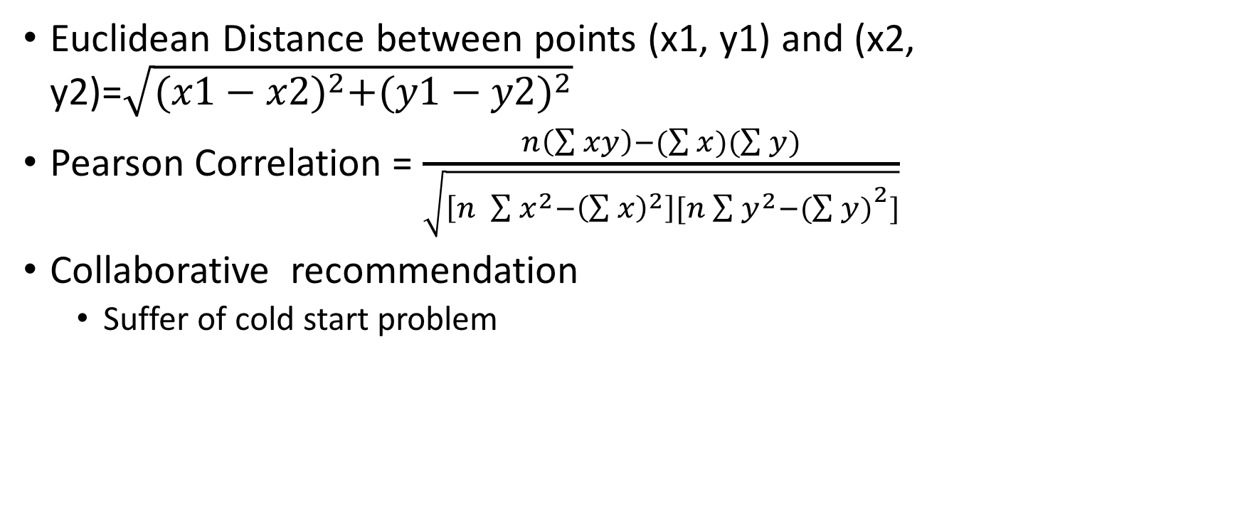
Recommendation System
Euclidean Distance between points (x1, y1) and (x2, y2)=$\sqrt{{(x1−x2)}^{2}+{(y1−y2)}^{2}}$
Pearson Correlation = $\frac{n\left(\sum{xy}\right)−(\sum{x})(\sum{y)}}{\sqrt{\left[n \sum{x^{2}−{\left(\sum{x}\right)}^{2}}\right][n\sum{y^{2}−{(\sum{y)}}^{2}}]}}$
Collaborative recommendation
Suffer of cold start problem

Slide 9

Alternating Least Squared
(m,n) matrix
(n,k) matrix
(m,k) matrix
=
$$X$$
K
M
N
N
M
K

Slide 10
Clustering
Hierarchical clustering
K-means clustering
Bisecting k-means clustering

Slide 11
Hierarchical clustering

Slide 12
K-means clustering

Slide 13
Bisecting K-means clustering

Slide 14
Graph Analytics
A
D
Adjacency Matrix
B
 | A | B | C | D
A | 0 | 1 | 0 | 0
B | 0 | 0 | 1 | 1
C | 0 | 0 | 0 | 1
D | 0 | 0 | 0 | 0
C
Adjacency Matrix
A->B
B->C->D
C->D

Slide 15
Graphs on Big Data
Path analytics
Connectivity analytics
Community analytics
Centrality analytics

Slide 16
Real-time analysis
Mobile
Kafka Topic
Website
Third Party Systems
Spark Streaming
To various sources like HDFS, Databases, etc
Iot Sensors
…

Slide 17
Deep learning: artificial neuron
Input
Input
Output
X
Input

Slide 18
Deep learning: artificial network
Inputs
Outputs

Slide 19
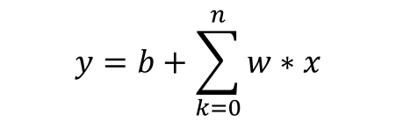

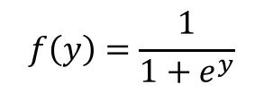
Sigmoid neuron
x1
Perceptron
$$y=b+\sum_{k=0}^{n}{w∗x}$$
x2
Output
y
$$f(y)$$
Activation function
$$f\left(y\right)=\frac{1}{1+e^{y}}$$
b

